Slide 1
Low Dropout Voltage Regulator
ECE531 Mixed-Signal VLSI Design

Slide 2
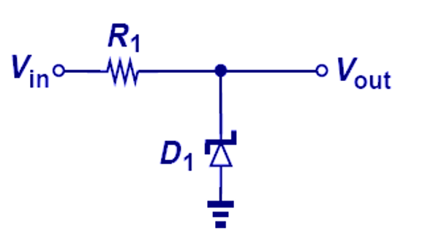
Types of Voltage Regulator
Zener diode voltage regulation
Simple, low cost
Switching regulator
High efficiency, but noisy and bulky
Buck DC-DC converter
Boost converter
Inverting converter
Flyback converter
Linear regulator
Less noisy, relatively simply circuit structure, wide bandwidth, but less efficient
Low Dropout regulator

Slide 3
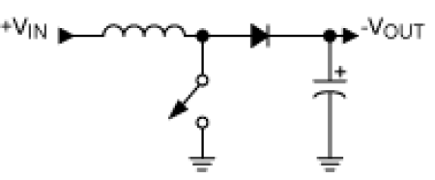
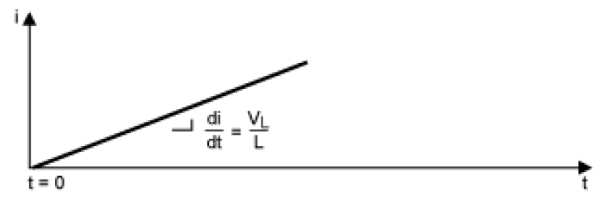

Boost converter
Basic circuit structure
When Vout<Vin, diode conducts to charge Vout to Vin level. Hence, the following discussion assume Vout>Vin
When switch is close (on),
the diode is reverse biased and hence off
The voltage across the inductor is Vin and the rate of the change of the inductor current $\frac{di}{dt}=\frac{V_{in}}{L}$
Maxim Application note AN2031 DC_DC converter Tutorial
Maxim Application note AN2031 DC_DC converter Tutorial

Slide 4
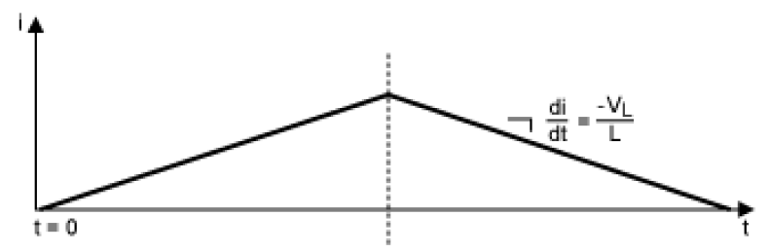

Boost converter
When the switch is open (off)
The inductor current continuously flows, forcing the diode forward biasing and charging output capacitor. The inductor voltage is: $V_{L}=V_{out}+V_{Don}−V_{in}$
Where $V_{Don}$ is the diode voltage when it is forward basing
The inductor current gradually decreases with the slope of $\frac{di}{dt}=−\frac{V_{L}}{L}$
Switch close
Switch open
Charging cycle duration t_{on}
Discharging cycle duration t_{off} t_{on}

Slide 5
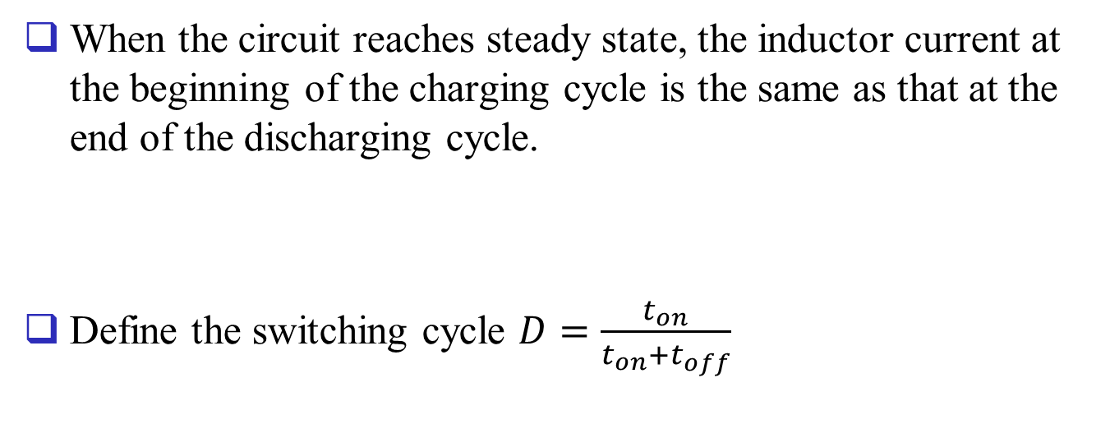

Boost converter
Switch close
Switch open
Charging cycle duration t_{on}
Discharging cycle duration t_{off} t_{on}
When the circuit reaches steady state, the inductor current at the beginning of the charging cycle is the same as that at the end of the discharging cycle.
Define the switching cycle $D=\frac{t_{on}}{t_{on}+t_{off}}$
$$t_{on}⋅\frac{V_{in}}{L}=t_{off}⋅\frac{V_{out}+V_{Don}−V_{in}}{L}$$

Slide 6
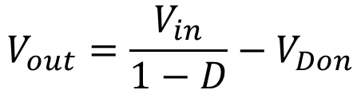
Boost converter
We can solve Vout as
Since D<1, Vout>Vin.
Vout value can be varied by changing switch duty cycle, which is controlled a clock signal
The regulator output will contain large noise energy at the clock frequency. Filters can be used to attenuate it.
The above analysis relies on many simplifications, such as
It assumes the voltage at the right side terminal of the inductor jumps from 0 to Vout+V_{Don} immediately after opening the switch
$$V_{out}=\frac{V_{in}}{1−D}−V_{Don}$$

Slide 7
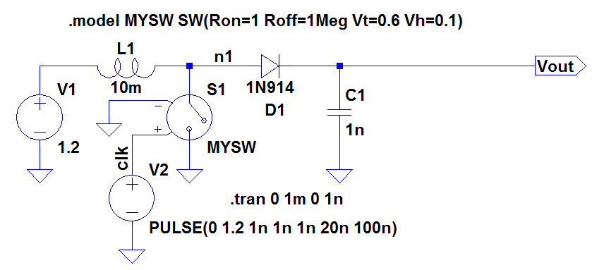
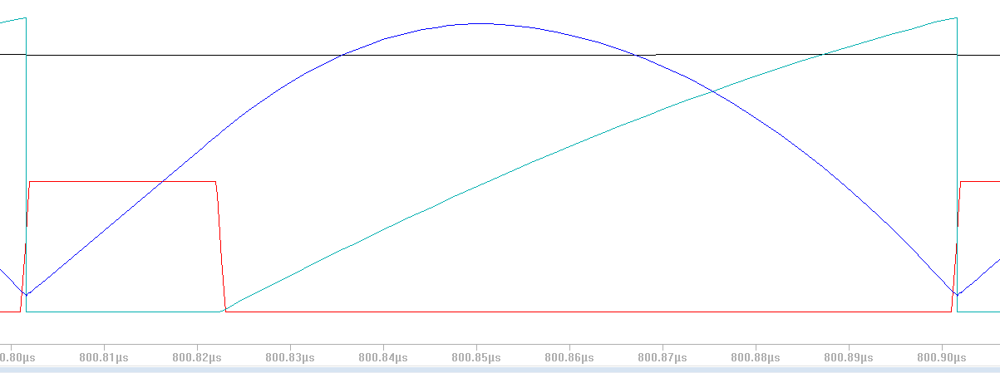
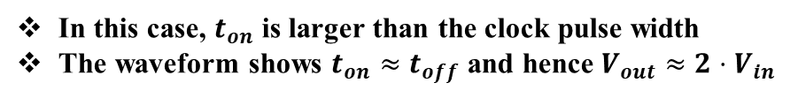
Boost converter
In this case, $t_{on}$ is larger than the clock pulse width
The waveform shows $t_{on}≈t_{off}$ and hence $V_{out}≈2⋅V_{in}$
After opening switch, inductor current continues to increases because Vn1<Vin
V(n1)
Vout
2.4V
clk
1.2V
I_{indctor}

Slide 8
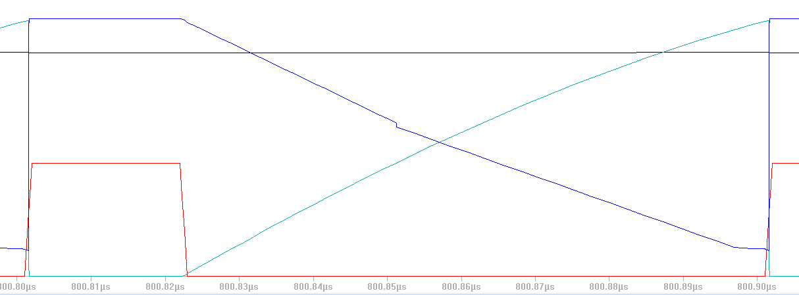


Boost Converter
Example
Constant Inductor voltage
$$\frac{dI_{ind}}{dt}=120A/S$$
V(n1)
Vout
clk
$$\frac{dI_{inductor}}{dt}$$
Constant Inductor voltage

Slide 9
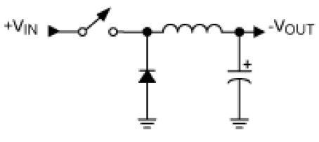
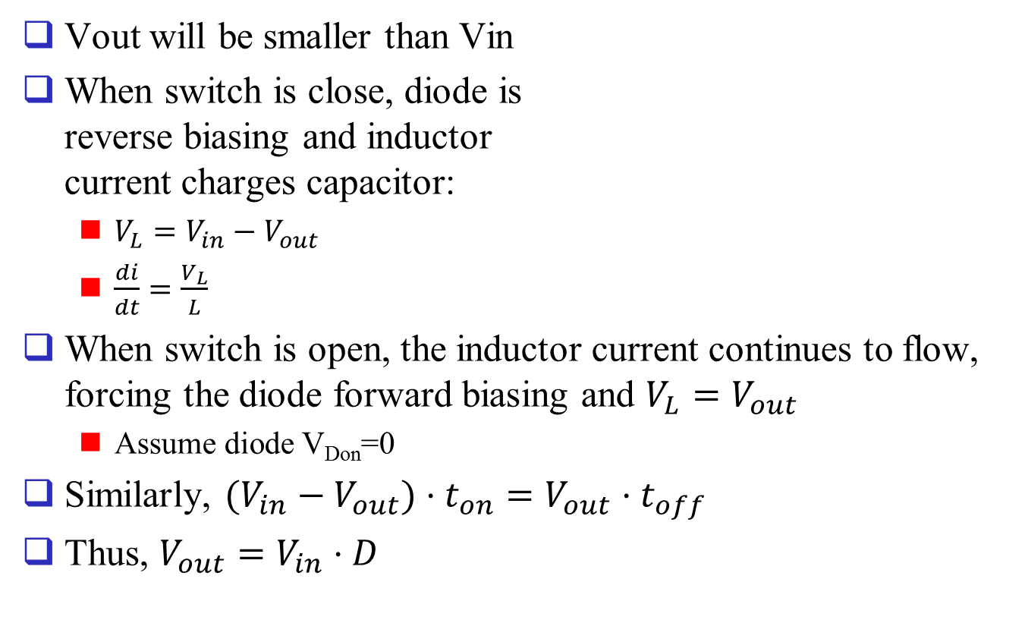
Buck Converter
Vout will be smaller than Vin
When switch is close, diode is reverse biasing and inductor current charges capacitor:
$V_{L}=V_{in}−V_{out}$
$\frac{di}{dt}=\frac{V_{L}}{L}$
When switch is open, the inductor current continues to flow, forcing the diode forward biasing and $V_{L}=V_{out}$
Assume diode V_{Don}=0
Similarly, $(V_{in}−V_{out})⋅t_{on}=V_{out}⋅t_{off}$
Thus, $V_{out}=V_{in}⋅D$

Slide 10
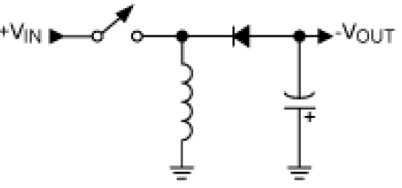
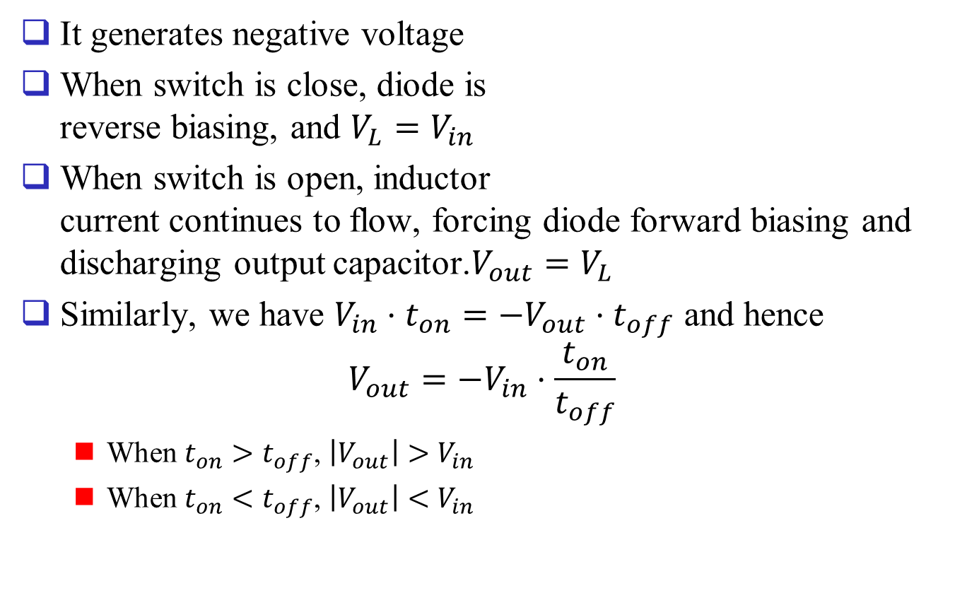
Inverting Converter
It generates negative voltage
When switch is close, diode is reverse biasing, and $V_{L}=V_{in}$
When switch is open, inductor current continues to flow, forcing diode forward biasing and discharging output capacitor.$V_{out}=V_{L}$
Similarly, we have $V_{in}⋅t_{on}=−V_{out}⋅t_{off}$ and hence $V_{out}=−V_{in}⋅\frac{t_{on}}{t_{off}}$
When $t_{on}>t_{off}$, $\left|V_{out}\right|>V_{in}$
When $t_{on}<t_{off}$, $\left|V_{out}\right|<V_{in}$

Slide 11
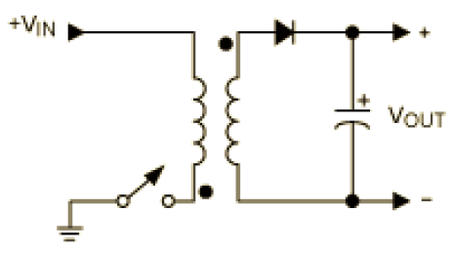
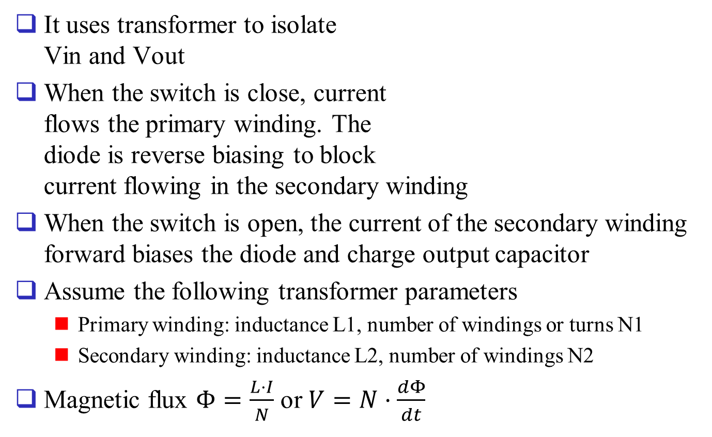
Flyback Converter
It uses transformer to isolate Vin and Vout
When the switch is close, current flows the primary winding. The diode is reverse biasing to block current flowing in the secondary winding
When the switch is open, the current of the secondary winding forward biases the diode and charge output capacitor
Assume the following transformer parameters
Primary winding: inductance L1, number of windings or turns N1
Secondary winding: inductance L2, number of windings N2
Magnetic flux $Φ=\frac{L⋅I}{N}$ or $V=N⋅\frac{dΦ}{dt}$

Slide 12
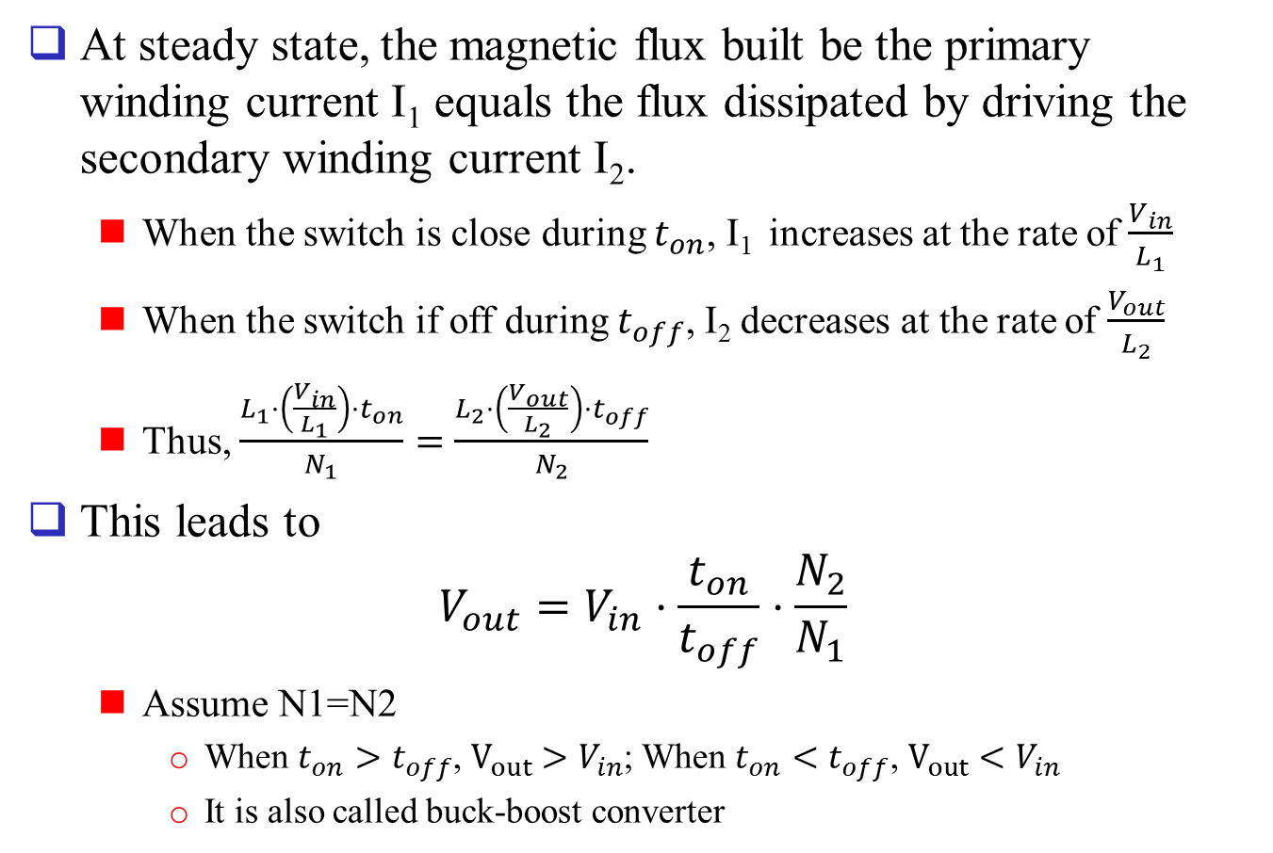
Flyback Converter
At steady state, the magnetic flux built be the primary winding current I₁ equals the flux dissipated by driving the secondary winding current I₂.
When the switch is close during $t_{on}$, I₁ increases at the rate of $\frac{V_{in}}{L_{1}}$
When the switch if off during $t_{off}$, I₂ decreases at the rate of $\frac{V_{out}}{L_{2}}$
Thus, $\frac{L_{1}⋅\left(\frac{V_{in}}{L_{1}}\right)⋅t_{on}}{N_{1}}=\frac{L_{2}⋅\left(\frac{V_{out}}{L_{2}}\right)⋅t_{off}}{N_{2}}$
This leads to $V_{out}=V_{in}⋅\frac{t_{on}}{t_{off}}⋅\frac{N_{2}}{N_{1}}$
Assume N1=N2
When $t_{on}>t_{off}$, $V_{out}>V_{in}$; When $t_{on}<t_{off}$, $V_{out}<V_{in}$
It is also called buck-boost converter

Slide 13
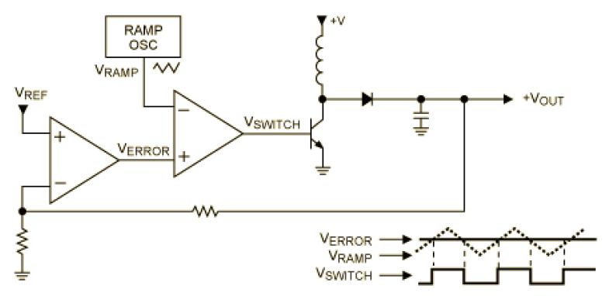

Control signals for switching converters
Pulse width modulation technique is typically used to control the duty cycle of the switches
comparator
Error Amplifier
$$V_{switch}$$
Maxim Application note AN2031 DC_DC converter Tutorial

Slide 14

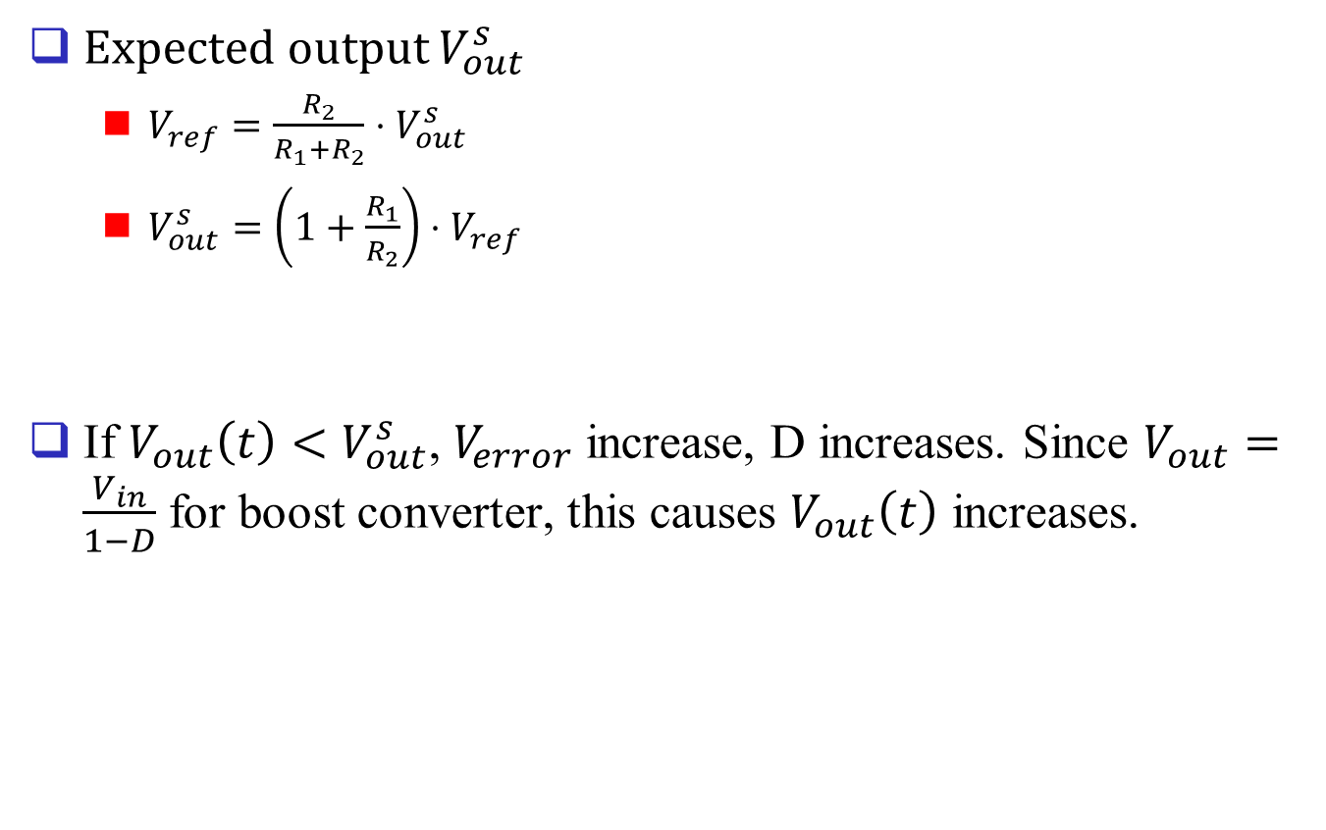



Control signals for switching converters
Expected output $V_{out}^{s}$
$V_{ref}=\frac{R_{2}}{R_{1}+R_{2}}⋅V_{out}^{s}$
$V_{out}^{s}=\left(1+\frac{R_{1}}{R_{2}}\right)⋅V_{ref}$
If $V_{out}\left(t\right)<V_{out}^{s}$, $V_{error}$ increase, D increases. Since $V_{out}=\frac{V_{in}}{1−D}$ for boost converter, this causes $V_{out}\left(t\right)$ increases.
$$R_{2}$$
$$R_{1}$$
$$V_{ramp}$$
$$V_{error}$$

Slide 15
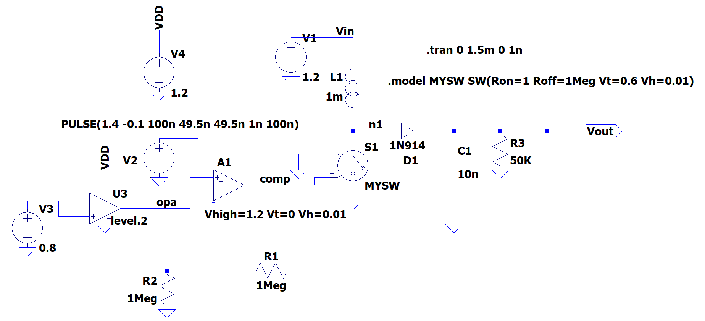
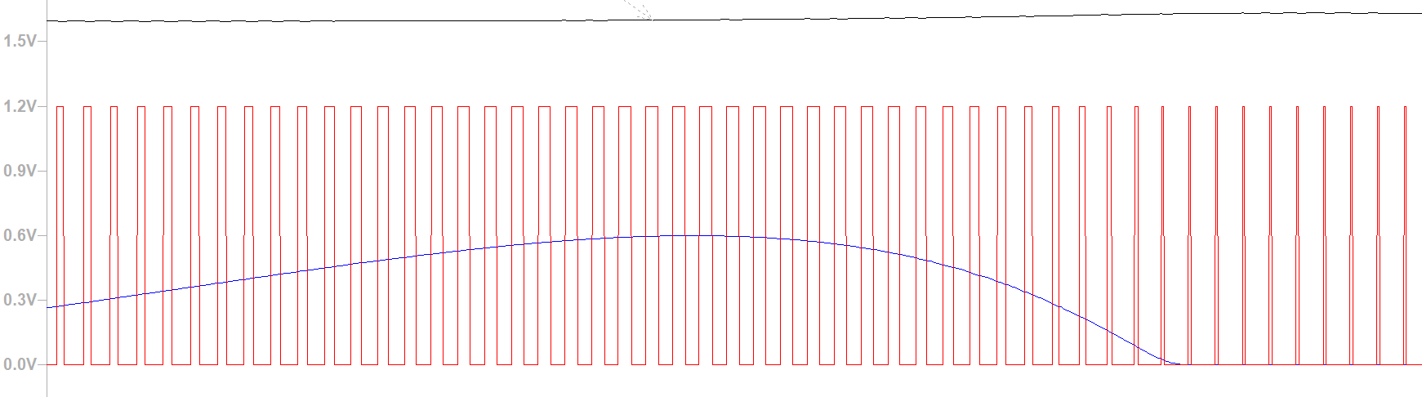



Control signals for switching converters
Simulation
1.598V
1.631V
$$V_{out}$$
$$V_{comp}$$
$$V_{opa}$$

Slide 16
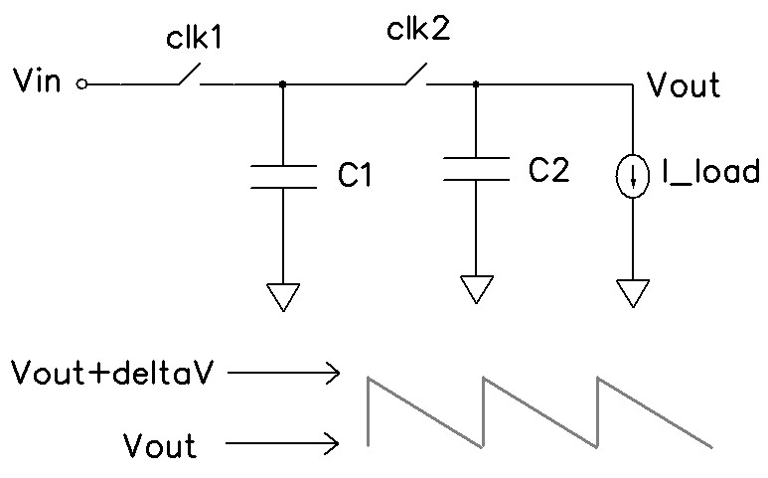
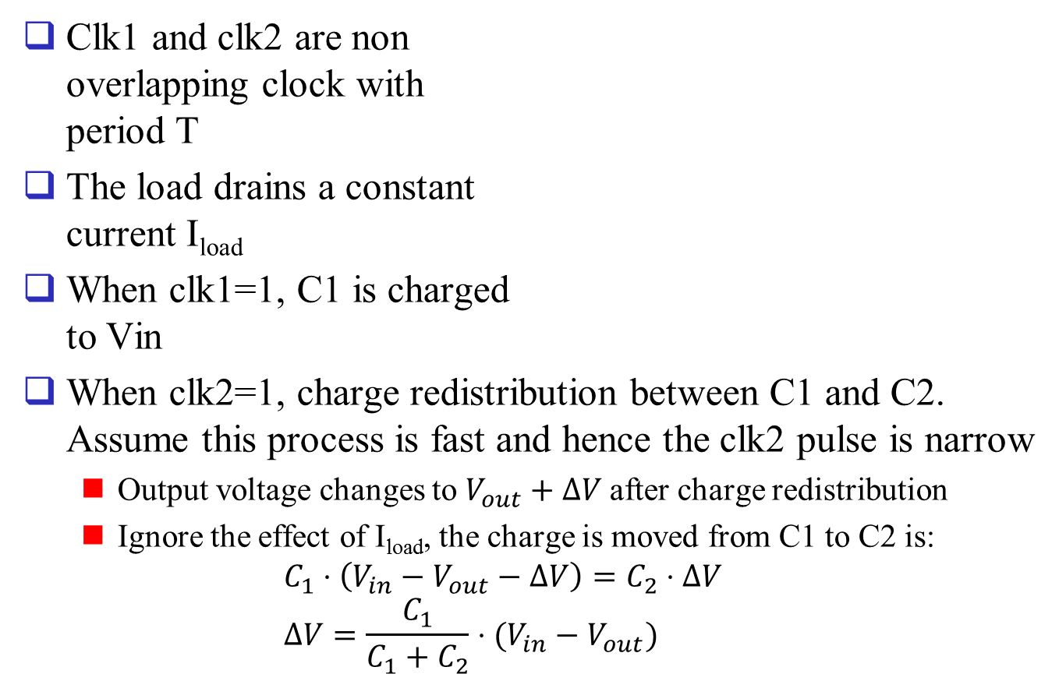
Capacitor-only voltage down converter
Clk1 and clk2 are non overlapping clock with period T
The load drains a constant current I_{load}
When clk1=1, C1 is charged to Vin
When clk2=1, charge redistribution between C1 and C2. Assume this process is fast and hence the clk2 pulse is narrow
Output voltage changes to $V_{out}+ΔV$after charge redistribution
Ignore the effect of I_{load}, the charge is moved from C1 to C2 is: $C_{1}⋅\left(V_{in}−V_{out}−ΔV\right)=C_{2}⋅ΔV$ $ΔV=\frac{C_{1}}{C_{1}+C_{2}}⋅(V_{in}−V_{out})$

Slide 17
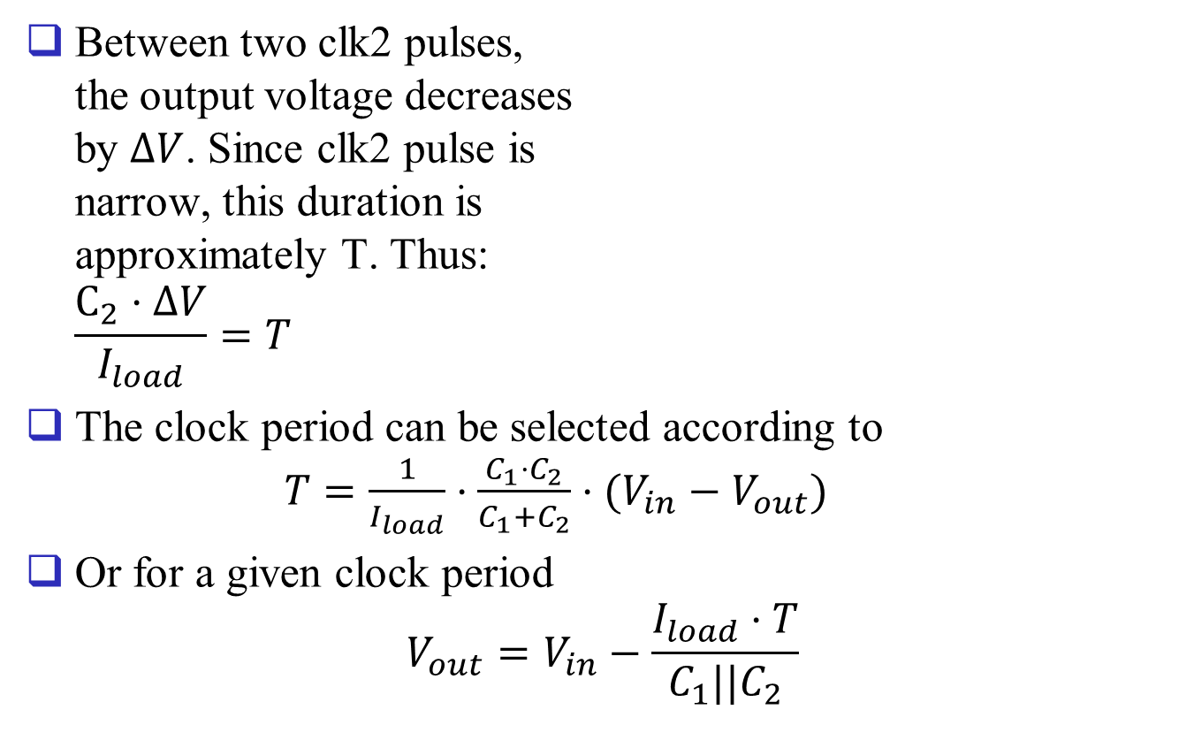
Capacitor-only voltage down converter
Between two clk2 pulses, the output voltage decreases by $ΔV$. Since clk2 pulse is narrow, this duration is approximately T. Thus: $\frac{C_{2}⋅ΔV}{I_{load}}=T$
The clock period can be selected according to $T=\frac{1}{I_{load}}⋅\frac{C_{1}⋅C_{2}}{C_{1}+C_{2}}⋅(V_{in}−V_{out})$
Or for a given clock period $V_{out}=V_{in}−\frac{I_{load}⋅T}{C_{1}||C_{2}}$

Slide 18
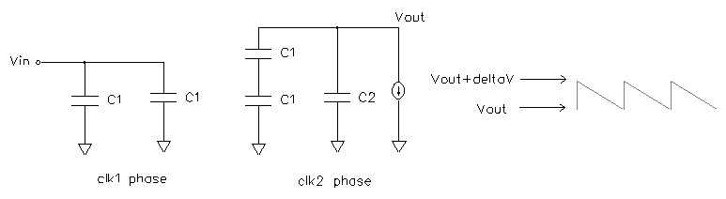
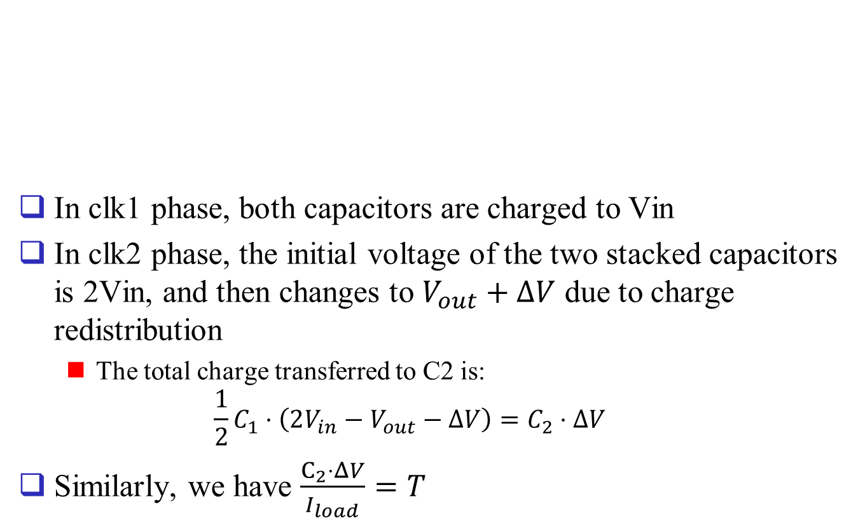
Capacitor-only voltage up converter
In clk1 phase, both capacitors are charged to Vin
In clk2 phase, the initial voltage of the two stacked capacitors is 2Vin, and then changes to $V_{out}+ΔV$ due to charge redistribution
The total charge transferred to C2 is: $\frac{1}{2}C_{1}⋅\left(2V_{in}−V_{out}−ΔV\right)=C_{2}⋅ΔV$
Similarly, we have $\frac{C_{2}⋅ΔV}{I_{load}}=T$

Slide 19
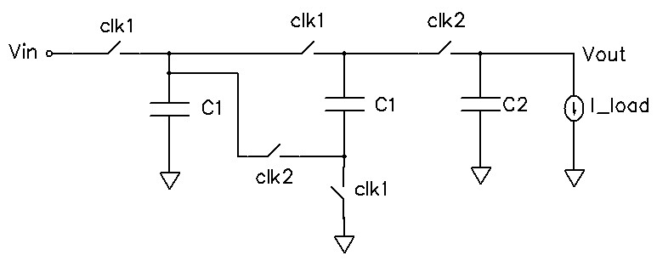

Capacitor-only voltage up converter
We have: $V_{out}=2V_{in}−I_{load}⋅T⋅(\frac{1}{C_{2}}+\frac{2}{C_{1}})$
If $V_{in}>I_{load}⋅T⋅(\frac{1}{C_{2}}+\frac{2}{C_{1}})$, we have $V_{out}>V_{in}$
Circuit implementation

Slide 20
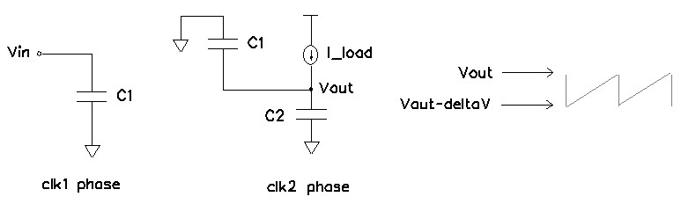

Capacitor-only negative voltage converter
In clk1 phase, C1 is charged to Vin
In clk2 phase, the potential at the bottom plate of C1 is initially –Vin. After the charge redistribution, it becomes $V_{out}−ΔV$.
The charge moved from C1 to C2 is: $C_{1}⋅\left(−V_{in}−V_{out}+ΔV\right)=−C_{2}⋅ΔV$

Slide 21
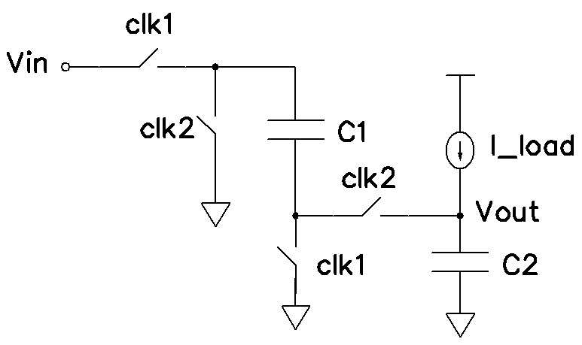

Capacitor-only negative voltage converter
Also, we have $\frac{C_{2}⋅ΔV}{I_{load}}=T$
Thus $V_{out}=−V_{in}+\frac{C_{1}+C_{2}}{C_{1}⋅C_{2}}⋅I_{load}⋅T$
If $V_{in}>\frac{C_{1}+C_{2}}{C_{1}⋅C_{2}}⋅I_{load}⋅T$, Vout is negative
Circuit implementation

Slide 22
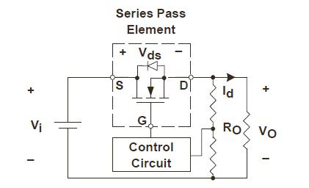
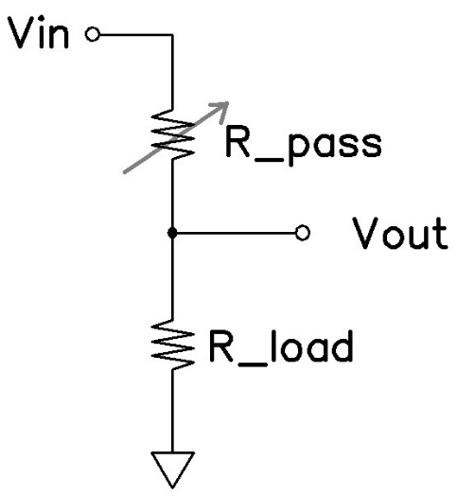

Low dropout regulator (LDO)
LDO behaviors like a voltage divider.
The load impedance is the bottom resistor
The series pass element is the top resistor, whose impedance is controlled by the control circuit
$$V_{out}=\frac{R_{load}}{R_{load}+R_{pass}}⋅V_{in}$$
S. Lee, Technical Review of Low Dropout Voltage Regulator Operation and Performance, TI Application Note, SLVA072

Slide 23
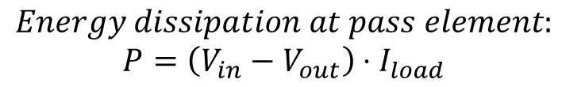
Low dropout regulator (LDO)
Pro
LDO output is less noisy compared to switching regulator
It has high power ripple rejection ratio
Simple circuit structure
Cons
Pass element consumes energy. Hence low efficiency and potential thermal management issue
The voltage drop along the pass element is preferred to be small (However, too small will fail the LDO operation)
$$Energy dissipation at pass element:$$
$$P=\left(V_{in}−V_{out}\right)⋅I_{load}$$

Slide 24
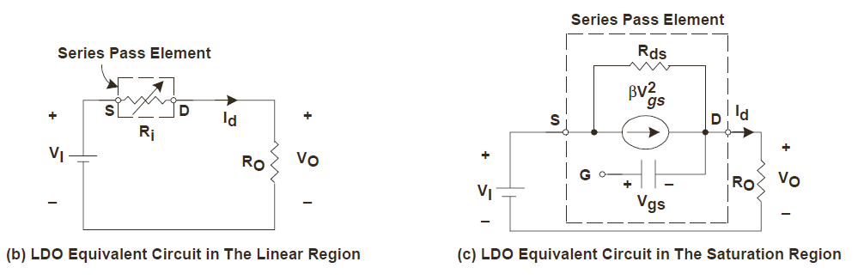

Low dropout regulator (LDO)
Assume the pass element is an NMOS transistor (Though PMOS is more widely used)
The transistor may operate in linear region but often is required to operate in saturation region. Their equivalent circuits are:
Note that $V_{DS}=V_{I}−V_{O}$
S. Lee, Technical Review of Low Dropout Voltage Regulator Operation and Performance, TI Application Note, SLVA072

Slide 25
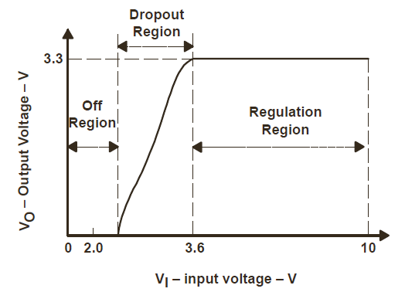
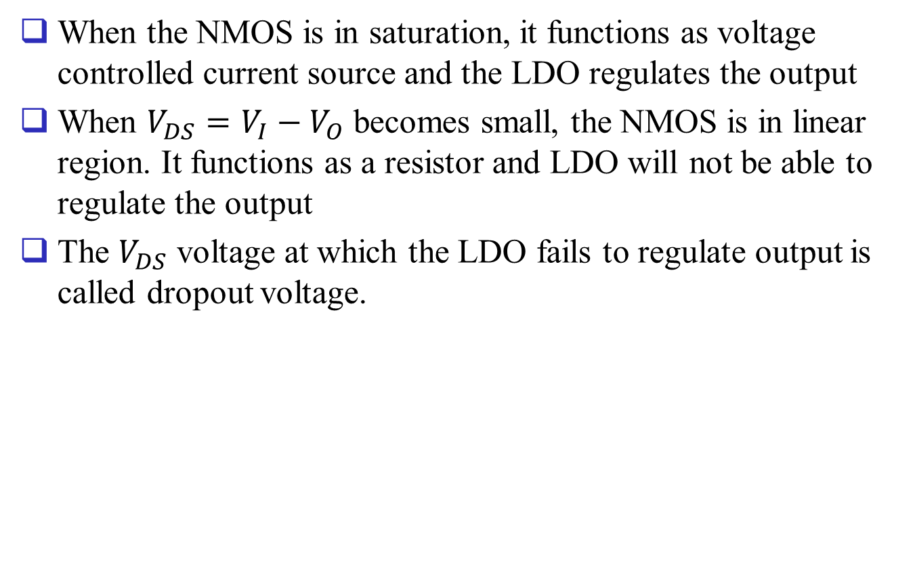
Low dropout regulator (LDO)
When the NMOS is in saturation, it functions as voltage controlled current source and the LDO regulates the output
When $V_{DS}=V_{I}−V_{O}$ becomes small, the NMOS is in linear region. It functions as a resistor and LDO will not be able to regulate the output
The $V_{DS}$ voltage at which the LDO fails to regulate output is called dropout voltage.

Slide 26
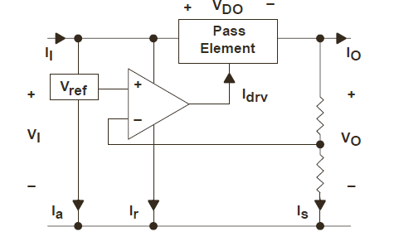

LDO Topology
Pass element can be bipolar or MOS transistors. In CMOS circuit, PMOS is often used
Vref can be provided by Bandgap or externally
The voltage divider enables V_{ref}<Vout
$V_{S}=\frac{R_{2}}{R_{1}+R_{2}}⋅V_{o}=V_{ref}=⇒V_{o}=\left(1+\frac{R_{1}}{R_{2}}\right)⋅V_{ref}$
R1
V_{S}
R2

Slide 27

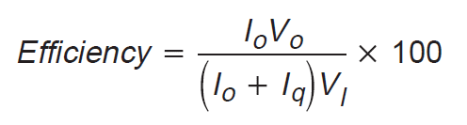
LDO ground current
Quiescent current, or ground current, is the difference between input and output currents.
Ground current is caused by the voltage reference, error amplifier, etc.
Efficiency:

Slide 28
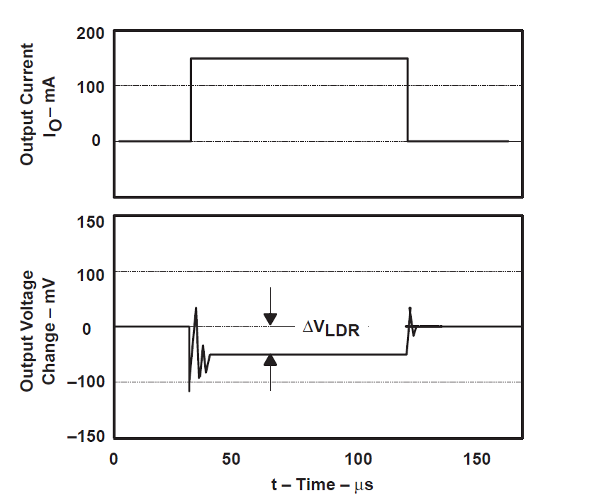


LDO performance metrics
Load regulation is a measure of the circuit’s ability to maintain the specified output voltage under varying load conditions.
$$ΔI_{load}$$
$$Load Regulation : \\ \frac{ΔV_{LDR}}{ΔI_{load}}$$
S. Lee, Technical Review of Low Dropout Voltage Regulator Operation and Performance, TI Application Note, SLVA072

Slide 29
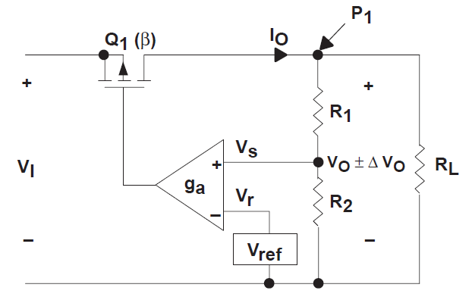

Load Regulation
g_{m} is the trans-conductance of the power device
A is the gain of the error amplifier
Assume there is a load current change $ΔI_{o}$ and the voltage change is $ΔV_{o}$
increasing error amplifier gain A and power transistor transconductance improves load regulation
A
$$ΔI_{o}=g_{m}⋅ΔV_{gs}=g_{m}⋅A⋅\frac{R_{2}}{R_{1}+R_{2}}⋅ΔV_{O} =⇒ \frac{ΔV_{O}}{ΔI_{O}}=\frac{1}{g_{m}⋅A}⋅\frac{R_{1}+R_{2}}{R_{2}}$$

Slide 30
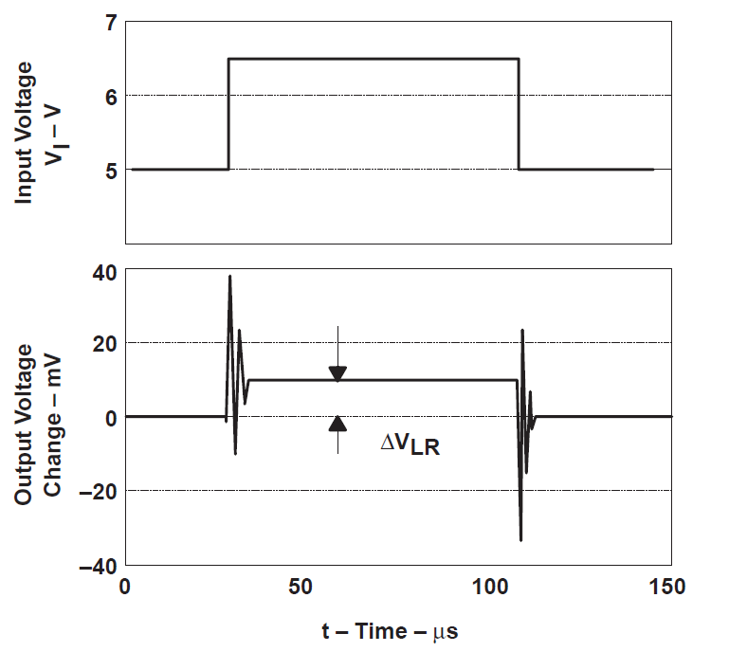

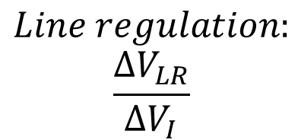
Line regulation
Line regulation is a measure of the circuit’s ability to maintain the specified output voltage with varying input voltage
$$ΔV_{I}$$
$$Line regulation:$$
$$\frac{ΔV_{LR}}{ΔV_{I}}$$
S. Lee, Technical Review of Low Dropout Voltage Regulator Operation and Performance, TI Application Note, SLVA072

Slide 31




Line regulation
A
$$V_{gs}=\frac{R_{2}}{R_{1}+R_{2}}⋅V_{o}⋅A−V_{I}=D⋅A⋅V_{o}−V_{I}$$
$$\frac{V_{I}−V_{O}}{r_{ds}}−g_{m}⋅V_{gs}=\frac{V_{O}}{R_{L}}$$
$$\frac{V_{O}}{V_{I}}=\frac{\frac{1}{r_{ds}}+g_{m}}{\frac{1}{r_{ds}}+\frac{1}{R_{L}}+g_{m}⋅A⋅D}≈\frac{1}{A⋅D}$$

Slide 32

LDO transient response
Transient response refers to how LDO output voltage settle after a step change of output current or input voltage
If no capacitor is present at the LDO output, a load current change can dramatically drive the output voltage away from its desirable value before the control loop take effects
The response time of the control loop is related to the bandwidth of the control loop

Slide 33

LDO transient response
A large capacitor can be added at the LDO output node which serves as a charge tank to stabilize the output voltage before the control loop to take effect
This results in two poles in the system frequency response: one is the output node pole P_{o} and the second is the opamp dominant pole P_{a}
This typically leads to an unstable system

Slide 34



LDO transient response
To make system stable, a zero can be created by adding a resistor in series with the output capacitor
However, the ESR also causes voltage drop when a large current is drained from the output capacitor. To address this, a bypass capacitor can be added

Slide 35



Frequency response
Error amplifier contribute a pole
Impedance of output node
Reference
S. Lee, Technical Review of Low Dropout Voltage Regulator Operation and Performance, TI Application Note, SLVA072

Slide 36



Frequency response
C_{O}>>C_{b}
Reference
S. Lee, Technical Review of Low Dropout Voltage Regulator Operation and Performance, TI Application Note, SLVA072

Slide 37




Frequency response
Pole Pb smaller than unit gain frequency (large ESR) leading to unstable system
Pole and zero placement to keep LDO stable
Zero is higher than unit gain frequency (small ESR) leading to unstable system

Slide 38

Improving LDO transient responses with double control loop
Two control loops can be used to improve LDO transient responses
One is slow loop with high gain amplifier for accuracy
The other one is fast loop that has simple structure to improve transient response
Reference
Kosta Luria, Joseph Shor, Michael Zelikson, Alex Lyakhov, Dual-Use Low-Drop-Out Regulator / Power Gate with Linear and On-Off Conduction Modes for Microprocessor On-Die Supply Voltages in 14nm, 2015 IEEE International Solid-State Circuits Conference

Slide 39

Double Loop LDO
Slow loop
V_{CCG}↑➔V_{SET}↓➔V_{n1}↑ (M2 is a CS amplifier)➔ V_{n3}↑ (M5 is a CG amplifier)➔I_{DS1}↓➔ V_{CCG}↓
V_{CCG} follows the relation $V_{ref}=\frac{R_{1}}{R_{1}+R_{2}}⋅V_{CCG}$
$V_{set}=V_{CCG}−|V_{GS2}|$
Reference

Slide 40
Double Loop LDO
Fast loop
V_{CCG}↑➔V_{n1}↑ (M2 is a CG amplifier)➔ V_{n3}↑ (M5 is a CG amplifier)➔I_{DS1}↓➔ V_{CCG}↓
It can show that the output resistance of the fast loop circuit alone (supper source follower, or flipped source follower) has small output resistance. Output current change does not cause large voltage variation.
Reference

Slide 41


Double Loop LDO
Reference
Peter Hazucha, Tanay Karnik, Area-Efficient Linear Regulator With Ultra-Fast Load Regulation, IEEE JOURNAL OF SOLID-STATE CIRCUITS, VOL. 40, NO. 4, APRIL 2005

Slide 42





Double Loop LDO
Output impedance estimation
A
$$\frac{1}{g_{m}}$$
$$\frac{1}{{A⋅g}_{m}}$$
$$A≈g_{m2}⋅r_{o4}$$
Reference
$$r_{out}≈\frac{1}{{g_{m1}⋅g}_{m2}⋅r_{o4}}$$

Slide 43
Frequency compensation
Along the slow loop, nodes 1, 2, 3, 4 introduce poles
Nodes 2 and 4 have low resistance. Thus, their poles are at high frequency
Nodes 1 and 3 has high resistance, their poles are at low frequency
To make one pole the dominant pole, Rc and Cc are added
3
4
1
2
Cut the loop open here and perform AC analysis to find frequency response of the open loop gain
Reference

Slide 44




Frequency compensation
Capacitor multiplier
Vout
Iout
$$V_{1}=\frac{R_{c}}{R_{c}+\frac{1}{sC_{c}}}⋅V_{out} I_{out}=\frac{V_{out}}{R_{c}+\frac{1}{{sC}_{C}}}+g_{m4}⋅V_{1}$$
$$Z_{out}=\frac{V_{out}}{I_{out}}≈\frac{1}{g_{m4}}+\frac{1}{s⋅\left(g_{m4}⋅R_{C}\right)⋅C_{C}}=r_{1}+\frac{1}{sC_{1}}$$
Reference

Slide 45


Frequency compensation
It introduces a pole and zero
Reference
$$Z=\frac{r_{o4}⋅(r_{1}+\frac{1}{sC_{1}}) }{r_{o4}+r_{1}+\frac{1}{sC_{1}}}=\frac{r_{o4}⋅\left(1+sr_{1}C_{1}\right)}{1+sC_{1}(r_{o4}+r_{1})}$$

Slide 46

Digital LDO circuits
With low supply voltage, it is difficult to design power efficient high-gain wide bandwidth amplifier that required in analog LDO circuits
Digital LDO circuits
Error amplifier is replaced by a comparator
The single pass element (PMOS device) is replaced by an array of small pass devices
Yasuyuki Okuma, Koichi Ishida, et al. 0.5-V Input Digital LDO with 98.7% Current Efficiency and 2.7-μA Quiescent Current in 65nm CMOS

Slide 47


Digital LDO circuits
The controller controls how many PMOS transistors are conducting
When Vout<Vref, (comparator output is 0), more transistors need to be conducting
When Vout>Vref (comparator output is 1), less transistors need to be conducting
A specially designed shift register can be used as the control circuit.

Slide 48


Digital LDO circuit
Shift register implementation
Digital LDO output

Slide 49
Digital LDO circuit
In the previous design, only one transistor can be turned on or off during one clock cycle. Also, the update rate is controlled by the clock frequency
Such limitations lead to slow transient responses. Various techniques are developed to improve transient responses
Shift multiple bits if there is large voltage variation
Asynchronous shifting operation that leads to fast update when there is a large voltage variation

Slide 50

Digital LDO circuits
Low voltage MOS devices can be used as the pass devices to reduce area and improve transient response (less number of power transistors).
In conventional digital design, the gate of conducting PMOS device is tied to ground and hence |V_{GS}|=Vin.
Low voltage PMOS require smaller |V_{GS}| and hence the gate of conducting PMOS has to be tied to a level V_{S}
Masafumi Onouchi, Kazuo Otsuga, et al. A 1.39-V Input Fast-Transient-Response Digital LDO Composed of Low-Voltage MOS Transistors in 40-nm CMOS Process

Slide 51


Digital LDO circuit
V_{SSV} generation circuit
Other potential advantage of not tying power device to ground when it is conducting
Vin
Vin
0
Vssv
Vout
Vout
Transistor in linear region small ro
Transistor may be saturation region large ro

Slide 52

Other digital LDO
Instead of using comparator to detect voltage difference, other techniques can be used to monitor the output voltage
Voltage controlled delay line or voltage controlled oscillator
Circuit performance monitoring
Koji Hirairi, et. al. 13% Power Reduction in 16b Integer Unit in 40nm CMOS by Adaptive Power Supply Voltage Control with Parity-Based Error Prediction and Detection (PEPD) and Fully Integrated Digital LDO

Slide 53

Model of digital LDO
Digital LDO consists of both discrete-time and continuous time systems
Comparator is one-bit ADC
Digital gain can be adjusted by changing how many bit is shifted within one clock cycle
Reference
Saad Bin Nasir, Youngtak Lee, Arijit Raychowdhury, Modeling and Analysis of System Stability in a Distributed Power Delivery Network with Embedded Digital Linear Regulators

Slide 54



Model of digital LDO
Open loop transfer function
K_{D} digital gain; T clock period; K_{A} analog gain; $ω_{o}$ pole at output node
$α=1$
S-domain to Z-domain $\frac{1}{s⋅\left(s+a\right)}=>\frac{z⋅(1−e^{−a⋅T})}{a⋅\left(z−1\right)⋅\left(z−e^{−a⋅T}\right)}$
Let $K=k_{D}⋅K_{A}$
G$=K_{D}⋅\frac{Z}{Z−1}⋅\frac{1−e^{−T⋅s}}{s}⋅\frac{K_{A}}{1+\frac{s}{ω_{o}}}$
G$\left(Z\right)=K_{D}⋅K_{A}⋅Z⋅\frac{(1−e^{−ω_{o}⋅T})}{\left(z−1\right)⋅\left(z−e^{−ω_{o}⋅T}\right)}$
Reference

Slide 55



Stability of digital LDO
Closed loop transfer function
Reference
$$Vout\left(z\right)=ΔV\left(z\right)+\left(Vin\left(z\right)−Vout\left(z\right)\right)⋅G\left(z\right)$$
$$Vout\left(z\right)=\frac{G\left(z\right)}{1+G\left(z\right)}Vin\left(z\right)+\frac{1}{1+G\left(z\right)}ΔV(z)$$
$$H_{1}\left(z\right)=\frac{V_{out}\left(z\right)}{V_{in}\left(z\right)}=\frac{G\left(z\right)}{1+G\left(z\right)}$$
$$H_{2}\left(z\right)=\frac{V_{out}\left(z\right)}{ΔV\left(z\right)}=\frac{1}{1+G\left(z\right)}$$

