Slide 1

Kubernetes Security and Access Management
Privacy & Security
Chris Felix
Hitesh Garg
Serjik Dikaleh
IBM
IBM
IBM

Slide 2
Agenda
Image and pod security
Role Based Access Control (RBAC)
Resource management
Network policies
Secret management
Service mesh overview

Slide 3
Security Requirements
Org 1
Organization 1 and 2 will share the same cluster
Service A and B must be separated from service C
Service A and C are external facing REST API
Operations needs to mitigate potential denial of service attacks
Communication needs to be encrypted end to end
Services need to store secrets for communication with other backends
…
Service A
Service B
Org 2
Service C
Web

Slide 4
Image and Pod Security
Statements we have heard from Org A and B developers:
Why worry? My app lives in a container.
I need to ssh into my container - think of it as a “mini VM”
Just use the public Docker hub image of xyz:latest
If you need to store some files, just mount to a local host path
Just exec into the container to edit that file
Example

Slide 5
Adding service Accounts
Organization 1
Organization 2
Service A
Service B
Service C
org-1-service-account
org-2-service-account
Kubeconfig
Web
Kubeconfig

Slide 6
Open for business?
Containers and pods are secure in namespaces now right?
What if developers are allowed deploy to their namespace. They could modify pod spec!
Pod Security Policies to the rescue
Example

Slide 7
Cluster Resource Management
Protect against denial of service due to “noisy neighbours”
Set quotas for CPU and memory
You can also set quotas on certain k8s objects
Example

Slide 8
Network Policies
Namespaces do not offer network isolation out of the box
Network Policies can be used to achieve isolation
Network Policies allow you to define ingress and egress flows between services in your namespace as well as between namespaces.
Example

Slide 9
Adding Network Policy
Organization 1
Organization 2
Service A
Service B
Service C
org-1-service-account
org-2-service-account
Kubeconfig
Web
Kubeconfig

Slide 10
Secrets
Secrets are encoded and not encrypted
Hence the RBAC rule you saw that restricts viewing and editing
IBM Cloud does provide Key protect to also encrypts secrets
Open source HashiCorp Vault has k8s integration as well too manage secrets.

Slide 11
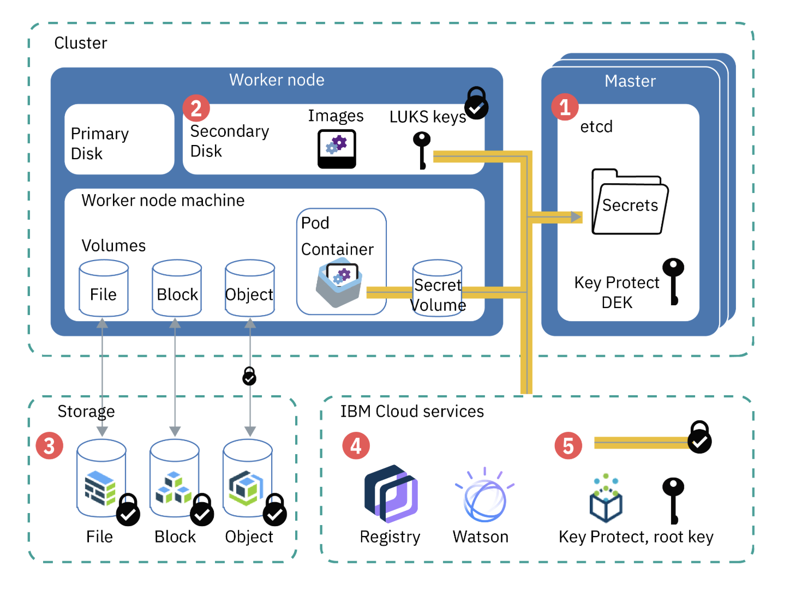

Slide 12
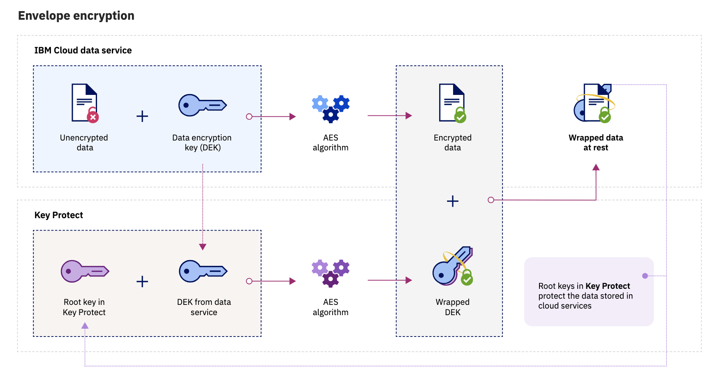

Slide 13
Service Mesh
Istio provides a service mesh control plane
Mutual TLS between all services using sidecar envoy container in pods
Advanced routing rules between services (e.g. service version based routing)
Istio ingress to have end to end encryption to services in cluster as well as mTLS between Istio clusters in federated mode

Slide 14
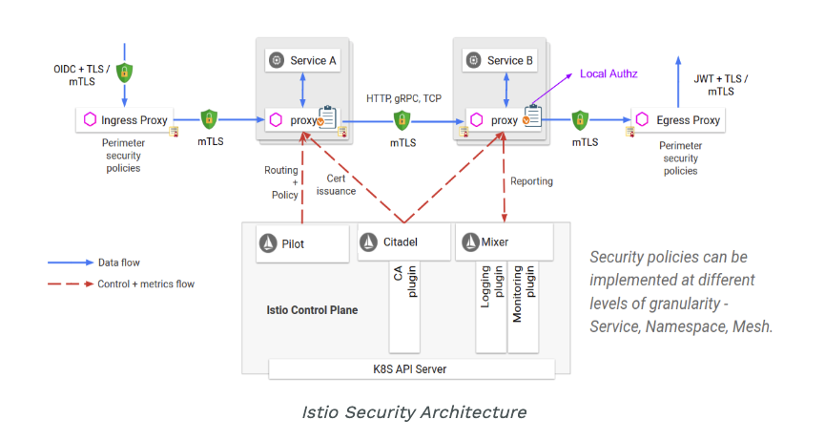

Slide 15
IBM Kubernetes Service
Manages security of master and worker nodes by providing host OS patches
Ingress provides mTLS as well as end to end TLS via annotations
Istio ingress integration also provided
Ingress can also integrate with IBM App ID to provide security at the edge
Application load balancers can be configured with Cloud Flare to provide global load balancing and DDoS mitigation
IBM Container Registry vulnerability scanning and ability to block vulnerable images from running

Slide 16
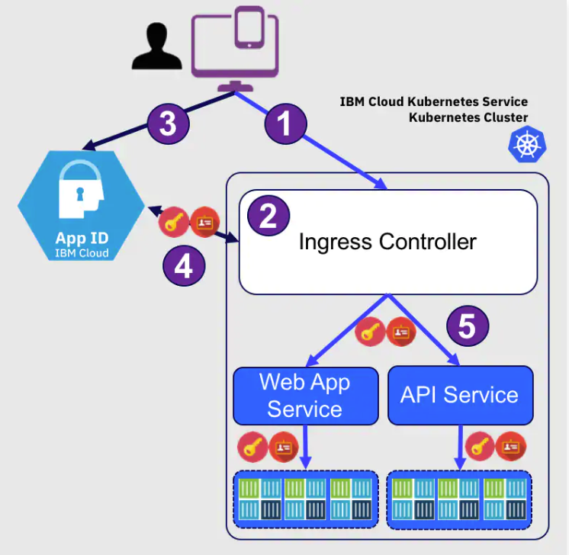

Slide 17
Thank You!

