Slide 1
Azure Web Apps Deployment and Scaling Techniques Ventsy Popov vepopov@Microsoft.com
Notes:
[EDITOR] Gaiyasi:
Thursday, October 03, 2013 Does PVM stand for Parallel Virtual Machine?
[EDITOR] Biju
08 October 2013 Kindly validate the edits.

Slide 2
What we shall talk about
The Basics of Web Apps
Publishing & Deployment
Hosting and Scaling Options
WebJobs
Q&A

Slide 3
The Basics
Notes:
[EDITOR] Gaiyasi:
Thursday, October 03, 2013 Does PVM stand for Parallel Virtual Machine?
[EDITOR] Biju
08 October 2013 Kindly validate the edits.

Slide 4



Microsoft Azure
Your Datacenter
Virtual Machines (IaaS)
Cloud Services
App Service –Web Apps
Applications
Applications
Applications
Applications
Data
Data
Data
Data
Firewall
Firewall Rules
Firewall Rules
Virtual Networks
Network
Virtual Networks
Virtual Networks
O/S
O/S
Virtualization
Hardware
Focus on the Application
Notes:
Slide Objectives:
Explain the differences between traditional self-hosting and the three options of Microsoft Azure hosting. Notice that unlike most slides that we have where the picture on the far right is SaaS, we have replace the SaaS with Websites.
Notes:
In a traditional environment you must manage the full stack. With Microsoft Azure you can choose a variety of options depending on your needs.

Slide 5
What do Azure Web Apps provide?
Support for .Net, Node.js, PHP, Java and Python platforms
Built-in AutoScale and Load Balancing
High availability with Auto-Patching features
Continuous Deployment with Git, TFS, GitHub
SQL Databases, MySQL, DocumentDB, Search, MongoDB
WordPress, Umbraco, Joomla, Drupal
Notes:
Just your typical listing of all the great things you can do with websites
http://azure.microsoft.com/en-us/services/websites/

Slide 6
Application Scenarios
Web Apps
Cloud Services
Virtual Machines
Modern web apps
Perfect if your app consists of client side markup and scripting, server side scripting and a database. Powerful capability to scale out and up as needed.
Multi-tier applications
Cloud-based applications that separate application logic into multiple tiers (i.e. caching middle tier, asynchronous background processes like order processing) using both Web and Worker Roles
Enterprise server applications
Run your existing enterprise applications in the cloud, such as SQL Server, SharePoint Server or Active Directory.
Continuous development
Deploy directly from your source code repository, using Git or Team Foundation Service.
Apps that require advanced administration
Cloud-based applications that require admin access, remote desktop access or elevated permissions
Porting existing line of business apps
Choose an image from the library or upload your own VHD.
Popular open source apps
Launch a professional looking site with a few clicks using apps like WordPress, Joomla!, Drupal, DotNetNuke and Umbraco
Apps that require advanced networking
Cloud-based applications that require network isolation for use with Microsoft Azure Point-to-Site or a Microsoft Azure Virtual Network*
Windows or Linux operating system
Support for Windows Server, along with community and commercial versions of Linux. Connect virtual machines with cloud services to take full advantage of PaaS services.
Notes:
This slide is placed at the beginning of the deck so that the customer can have a clear understanding of the differences between Websites, Cloud Services and Virtual Machines. It is a good idea at this point to confirm that the customers app fits into the web site spectrum. This is the tip of the iceberg though, many advancements are taking place in websites that compete with Cloud Services functionality.
New functionality coming that will allow websites to use virtual networks
More ideas can be found here http://azure.microsoft.com/en-us/documentation/articles/choose-web-site-cloud-service-vm/ & http://azure.microsoft.com/en-us/documentation/articles/choose-web-site-cloud-service-vm/
http://blog.tylerdoerksen.com/2013/11/01/azure-websites-vs-cloud-services/

Slide 7
Demo: Create a Simple Web App
Notes:
See the demo notes for Demo1_BasicAzureWebsites. This demo may be a little misleading because we will be creating a website (that contains nothing) through the new portal. For deployment (next demo) you will have actual code.
[EDITOR] Biju
08 October 2013 Kindly provide the document name.

Slide 8
Supported Publishing Methods
Notes:
[EDITOR] Gaiyasi:
Thursday, October 03, 2013 Does PVM stand for Parallel Virtual Machine?
[EDITOR] Biju
08 October 2013 Kindly validate the edits.

Slide 9

Supported Publishing Methods
FTP://
VS Online
WebDeploy
DropBox
More…
Notes:
Deploying websites http://azure.microsoft.com/en-us/documentation/articles/web-sites-deploy/

Slide 10
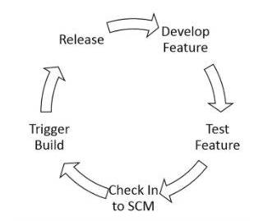
What is Continuous Deployment?
Variance between tested code in SCM and live production is minimal
When code is checked in, it is automatically deployed
Promotes
Business agility
Technical agility
Operational agility
Notes:
Business agility – With continuous deployment, you build a process for continuously improving the quality of your product
Technical agility – the ability to quickly respond to technical requirements like adding new featurs, fixing defects, and retracting features. Technical agility in turn improves business agility.
Operational agility – respond to infrastructure events like security breaches, system lockups, scale up/down and operation cost management.

Slide 11
Staged Deployment
Deploy your website to a separate deployment slot instead of the default production slot
Available in the Standard app service plan.
Swap the sites and site configurations between two deployment slots, including the production slot.
Benefits:
You can validate website changes in a staging deployment slot before swapping it with the production slot
After a swap, the slot with previously staged site now has the previous production site
Deploying a site to a slot first and swapping it into production ensures that all instances of the slot are warmed up before being swapped into production
Four deployment slots in addition to the production slot are supported for each website in the Standard plan.
Notes:
http://azure.microsoft.com/en-us/documentation/articles/web-sites-staged-publishing/

Slide 12
Demo: Continuous Deployment
Notes:
Although it may be simpler to use Git, here we want to use VS Online so we can stick with the Microsoft platform. This is up to the instructor however since in order to use VS Online, you have to have already created a VS Online account. See the instructions at Demo2_DeployWVSOnline.
Also reference http://www.windowsazure.com/en-us/develop/net/common-tasks/publishing-with-tfs/ for an example.
[EDITOR] Biju
08 October 2013 Kindly provide the document name.

Slide 13
Hosting and Scaling Options
Notes:
[EDITOR] Gaiyasi:
Thursday, October 03, 2013 Does PVM stand for Parallel Virtual Machine?
[EDITOR] Biju
08 October 2013 Kindly validate the edits.

Slide 14
Compute Scaling
Scale Up
– aka Vertical Scaling
Increase resources capacity within existing node
Scale Out
– aka Horizontal Scaling
Increase resources capacity by adding nodes
Notes:
With Azure Compute, you have two options for scaling:
Scale up – changing a Small VM to an Extra Large VM – adds RAM and CPUs. You would generally see this on-premises in the case of a stateful application
Scale Out – adding a larger number of machines so that processes can run in parallel. Typical scenario is a web farm that can be scaled out to handle a larger number of incoming requests

Slide 15
Web App Scaling Options
 | Free | Shared (Preview) | Basic | Standard | Premium (Preview)
Websites | 10 | 100 | Unlimited | Unlimited | Unlimited
Storage | 1 GB | 1 GB | 10 GB | 50 GB | 250 GB
Backup | None | None | None | Once Daily | 50 Times Daily
Compute Instance | Shared | Shared | Dedicated | Dedicated | Dedicated
Deployment Slots | None | None | None | 5 | 20
Scale-Out (max instances) |  | 6 shared instances | 3 dedicated instances | 10 dedicated instances | 20 dedicated instances
SLA |  |  | 99.9% | 99.9% | 99.9%
Notes:
Slide Objectives
Explain Microsoft Azure Compute.
Speaker Notes
This is an extract of the different sizes of Azure Websites with some of the main criteria of differentiation.
We guarantee that all websites running in a customer subscription will respond to client requests 99.9% of the time.
Availability is calculated over a monthly billing cycle. No SLA is provided for Websites under either the Free or Shared tiers.
All details about sizing and pricing for Azure Websites:
http://azure.microsoft.com/en-us/pricing/details/websites/
How To for scaling of Azure Websites:
http://azure.microsoft.com/en-us/documentation/articles/web-sites-scale/

Slide 16
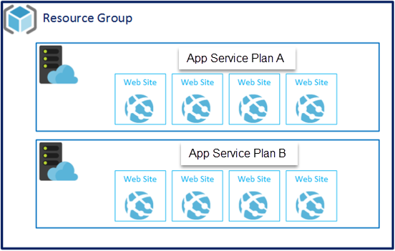
App Service Plans
Supports the 5 Azure Web app pricing tiers
Web apps need to be in the same subscription, resource group and region to share a app service plan
A web app can only be associated with one app service plan
All web apps that use the same app service plan will be placed on the same resource hardware
You must first create an initial web app if you want to create your own app service plan
You can have multiple app service plans in a single resource group to allow for difference capacity needs
Notes:
http://azure.microsoft.com/en-us/documentation/articles/azure-web-sites-web-hosting-plans-in-depth-overview/
Supports the 5 Azure Web App pricing tiers – App Service Plans (ASP) are associated with the tiers in that each tier has its own capacity which would be reflected in what you can choose for a web plan
Websites need to be in the same subscription, resource group and region to share a ASP– ASPcan no span subscriptions, resource groups or data centers
A website can only be associated with one ASP– a single website can not be put on multiple ASP
All websites that use the same hosting plan will be placed on the same resource hardware – refer back to the previous slide. Where is says you can have ‘x’ amount of websites for a given tier, if you want them to all reside on the same hardware, they have to all use the same ASP
You must first create an initial website if you want to create your own ASP– although there are some default ASPavailable, if you want to create one with your own naming convention, you need to create at least one web site
You can have multiple ASPin a single resource group to allow for difference capacity needs – think of this concept like a Cloud Service that has multiple roles, each with it’s own capacitiy.

Slide 17
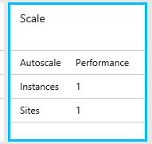
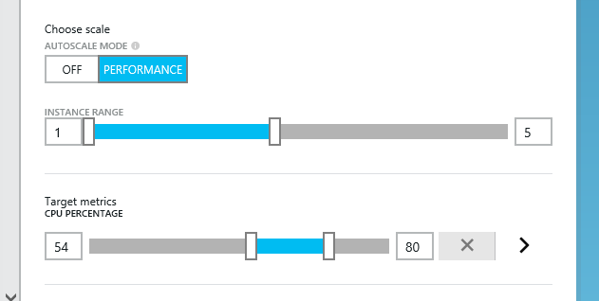
Web App Scaling by Instance/CPU (Standard Plan)
Notes:
This is a view from the Preview portal.
Explain to the student, that at minimum you have to be using a Standard plan within your website (not basic). If you choose basic, AutoScaling will be disabled.
In the screenshot above, you would click on the Scale icon in the blade and then another adjacent blade will appear that shows you, by default, scaling by CPU. Other metrics are shown on the next slide.
http://azure.microsoft.com/blog/2013/07/11/scaling-up-and-scaling-out-in-windows-azure-web-sites/
http://azure.microsoft.com/en-us/documentation/articles/web-sites-scale/

Slide 18
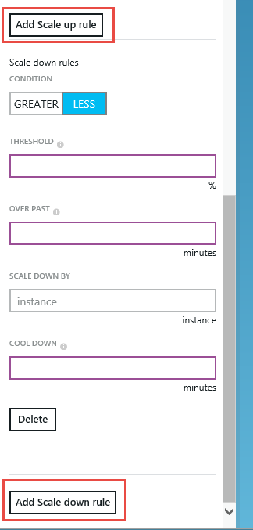
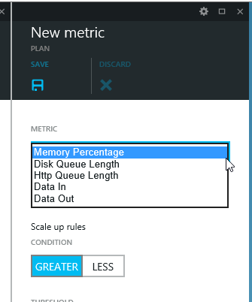
Web App Auto-Scaling – Adding metrics
New metrics also allow scale up and scale down rules
Notes:
When you click on the Add Metric button from the previous slides blade, you will see other options for scaling.
“In the Azure Preview Portal, you can scale not only on CPU percentage, but also on the additional metrics of Memory Percentage, Disk Queue Length, HTTP Queue Length, Data In, and Data Out. You can also create one or more Scale up and Scale down rules that give you even more custom control over scaling. For more information, see How to Scale a Website in the Azure Preview Portal documentation.

Slide 19
Demo: Azure Web App Scaling
Notes:
Using the last demo as the starting point, go through the UI with the student
[EDITOR] Biju
08 October 2013 Kindly provide the document name.

Slide 20
WebJobs
Notes:
[EDITOR] Gaiyasi:
Thursday, October 03, 2013 Does PVM stand for Parallel Virtual Machine?
[EDITOR] Biju
08 October 2013 Kindly validate the edits.

Slide 21
Azure WebJobs
Host and schedule lightweight jobs on an existing website
Triggered once, by schedule or run continuously
Support:
batch (.exe/.cmd/.bat)
bash (.sh)
javascript (.js as node.js)
php (.php)
python (.py)
Notes:
Azure Websites are different than Azure Cloud Services in that they typically do not have a background processing engine like you might find in web roles and worker roles.
A webjob is a lightweight job engine that you can associated with your Azure website (there is a menu in the website portal dashboard).
Webjobs can be written in a variety of languages such as batch files/.sh/javascript etc and you can schedule the web job to run once, continuously or on a schedule
You also have a separate dashboard where you can see metrics regarding the webjob – you will only have a dashboard experience if the webjob is associated with an Azure website. Those webjobs created via the WebJobs SDK will not have any output in the UI
WebJobs recommended resources
http://www.asp.net/aspnet/overview/developing-apps-with-windows-azure/azure-webjobs-recommended-resources

Slide 22
Scenarios for WebJobs
Image processing or other CPU-intensive work
Queue processing
RSS aggregation
File maintenance, such as aggregating or cleaning up log files
Other long-running tasks that you want to run in a background thread, such as sending emails.

Slide 23
Azure WebApp/WebJob Architecture
Web App
Search WebJob
Email WebJob
request
email
blob
queue
Notes:
So what is the difference between this architecture and the previous slide with Cloud Services? Basically, the creation of worker roles requires more code and a slightly different (and what could be) more complex deployment. Also, the webjobs could be combined into one single web job if performed with the WebJobs SDK.
So although the architecture looks the same with the names changed, in fact the architecture here is more simple.
Something to note here is that the webjobs, although they may be associated with a website, are not activated or executed directly by any code in the website. You can do that with the WebJobs SDK though.

Slide 24
How can I deploy a WebJob?
Directly via the Azure Portal – upload .zip file – requires website
Visual Studio 2015 add-in for console webjobs – allows web project to deploy console webjob with it
Deploy WebJob with a web project – webjob will run in the same website that it is deployed with
Deploy WebJob without a web project – webjob will run in a website by itself, with no web application running
Notes:
http://azure.microsoft.com/en-us/documentation/articles/websites-dotnet-deploy-webjobs/
Directly via the Azure Portal – upload .zip file – we will step through this first scenario in our first demo
Visual Studio 2013 add-in for console webjobs
Deploy WebJob with a web project – webjob will run in the same website that it is deployed with - Configure an existing Console Application project so that it automatically deploys as a WebJob when you deploy a web project. Use this option when you want to run your WebJob in the same website in which you run the related web application.
Deploy WebJob without a web project – webjob will run in a website by itself, with no web application running - Configure an existing Console Application project to deploy as a WebJob by itself, with no link to a web project. Use this option when you want to run a WebJob in a website by itself, with no web application running in the website. You might want to do this in order to be able to scale your WebJob resources independently of your web application resources.

Slide 25
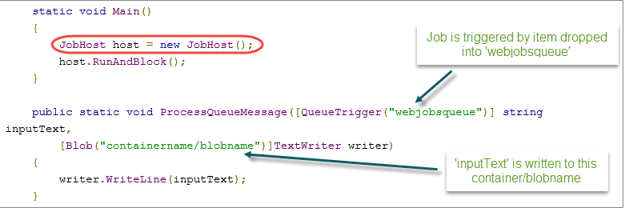
Using the WebJobs SDK
JobHost object – container for background functions
Monitors functions
Watches for events that trigger functions
Executes triggers when events occur
[QueueTrigger] – Attribute to signify that function should be called when an item is dropped into the queue.
[Blob] – Attribute to signify which blob to write to
Notes:
Full example can be found here:
http://azure.microsoft.com/en-us/documentation/articles/websites-dotnet-webjobs-sdk-get-started/
Very specific you should not in this document:

Slide 26
Demo: Azure WebJobs SDK
Notes:
Go through the steps of the Demo7_WebJobsSDK. You may have to move the solution up to a directory where you won’t get path length problems. This demo shows the usage of the WebJobs SDK which greatly simplifies how to create triggered webjobs against Azure storage queues and blobs
[EDITOR] Biju
08 October 2013 Kindly provide the document name.

