Slide 1
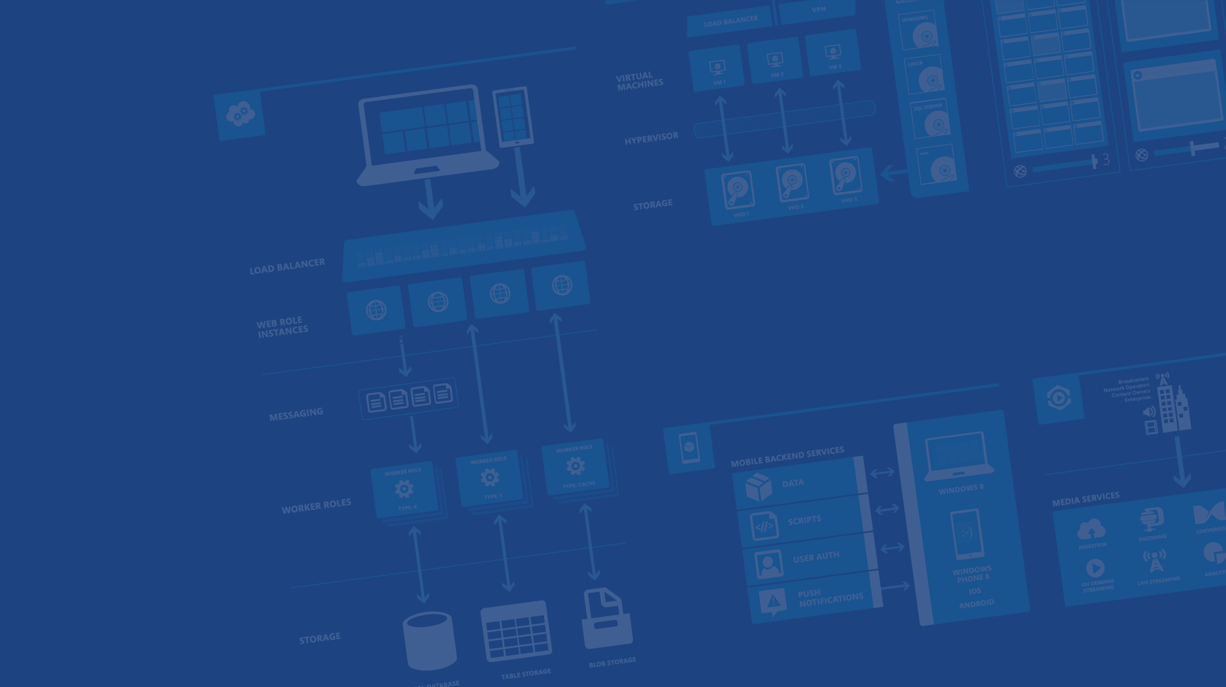
Що е тo Cloud и Azure?
Ventsy Popov
vepopov@Microsoft.com
Microsoft Azure

Slide 2
Agenda
Reasons for the Cloud
Azure Services
Discussion

Slide 3
Why the cloud?
Hosting models
Business model
On Premises
Infrastructure
(as a Service)
Platform
(as a Service)
Software
(as a Service)
Applications
Applications
You manage
Applications
Applications
You scale, make resilient and manage
You scale, make
resilient & manage
Data
Data
Data
Data
Runtime
Runtime
Runtime
Runtime
Scale, resilience and management by vendor
Middleware
Middleware
Middleware
Scale, resilience and management by vendor
Middleware
O/S
O/S
O/S
O/S
Virtualization
Virtualization
Managed by vendor
Virtualization
Virtualization
Servers
Servers
Servers
Servers
Storage
Storage
Storage
Storage
Networking
Networking
Networking
Networking

Slide 4
Benefits of the Cloud
Costs Optimization
Quick “Go Live”
Scalability and Global Reach
Security and Maintenance
Microsoft Azure

Slide 5
Let’s compare with On Premises
Necessity of upfront investments
Maintenance of resources
Potential loss of business focus
Low level of flexibility
Microsoft Azure

Slide 6

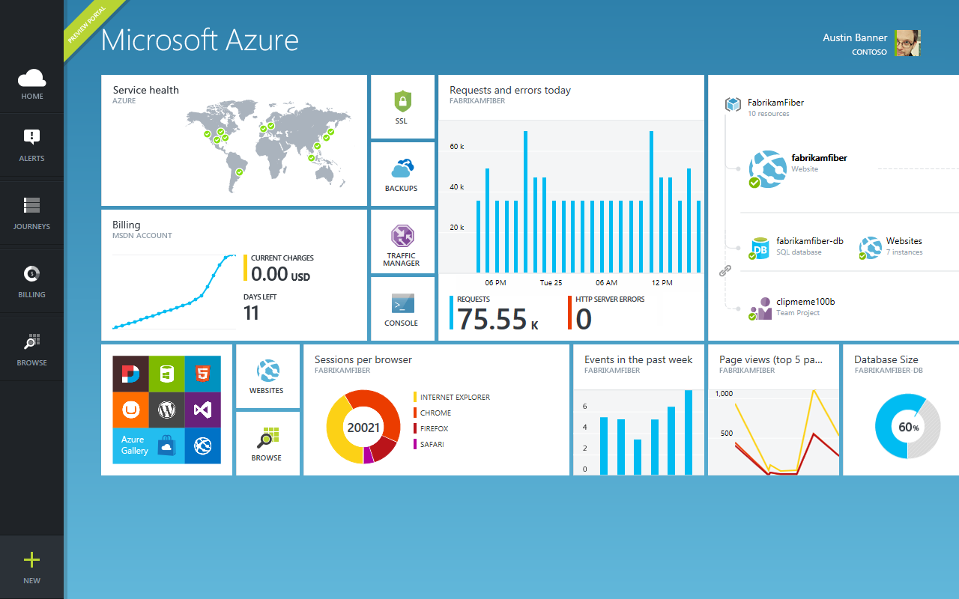
Azure?

Slide 7
19 Datacenteres Worldwide
Azure footprint

Slide 8
>57%
Greater than
1,000,000
>250k
Fortune 500 using Azure
Active websites
SQL Databases in Azure
>20
>1
TRILLION storage objects
>300
MILLION
AD users
MILLION
Developers registered with Visual Studio Online
>2
MILLION requests/sec
>13
BILLION
authentication/wk

Slide 9
>250k
Greater than
1,000,000
Active websites
SQL Databases in Azure
>300
MILLION
AD users

Slide 10






Azure Services?
Office Add-in
PC
Tablet
Phone
Browser
Games console
On-premises service
On-premises database
Client layer
(on-premises)
Access Control
Layer
AD
Multifactor
Authentication
BizTalk Services
Service Bus
CDN
Traffic Manager
Virtual Networks
Express Route
Integration
layer
API Mgmt
Mobile Services
Websites
Cloud Services
VM
Media Services
Notification Hubs
Scheduler
Automation
Application
layer
Blobs
Tables
Queues
SQL Database
Machine Learning
HD Insight
Caching
Backup and Recovery
StorSimple
Data Layer
Storage
Data

Slide 11
Azure Services to Start with?
Access Control
Layer
AD
Multifactor
Authentication
Traffic Manager
Virtual Networks
Integration
layer
Websites
Cloud Services
VM
Application
layer
Blobs
SQL Database
Data Layer
Storage
Data

Slide 12
What’s in it for Devs and Operations
Multiple programing languages (PHP, Java, Python, C#, Node.js, ….)
Multiple environments/slots
Pre-production
A/B testing
Continuous Development Integration
TFS, Git, DropBox, etc…
Practically unlimited computing power and storage
Create/Upload/Download your own VM images and spin as much as needed
Easy load balancing and intelligent DNS resolving (traffic management)
Convenient/custom control on the services
Monitoring dashboards
Configurable common features through management portal
APIs for custom management tasks

Slide 14
What to Look For
Need of global scale
Spikes/On-Off scenarios for computing resources
Innovation testing/PoCs
More “power” in the hands of the developer
Offloading hardware (+part of the software) management burden*
High level automation for the computing resource management
Opex vs. Capex
*Including some “by default” protection (i.e. DDoS)

