Slide 1


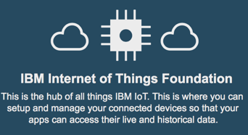


IBM Cloud
Hands-on Lab - IoT
Hands-on Lab - Analytics
Simulate Taxis and have a WebUI with Node-RED
Design Taxi Data visualization and Taxi data anomaly detection with IBM Data Science Experience
Send data
Receive data
Store data
Get data
Using the Notebook
IBM Watson IoT
IBM ObjectStorage
Apache Spark

