Slide 1
Infrastructure as Code with Schematics — Ryan Tiffany – CDE Tinkerer

Slide 2

Agenda
Schematics Overview
Workspaces
Terraform Refresher
Workspace Flow
Actions
Ansible Refresher
Actions Flow
Demo Time
Q & A
IBM Cloud / © 2020 IBM Corporation

Slide 3
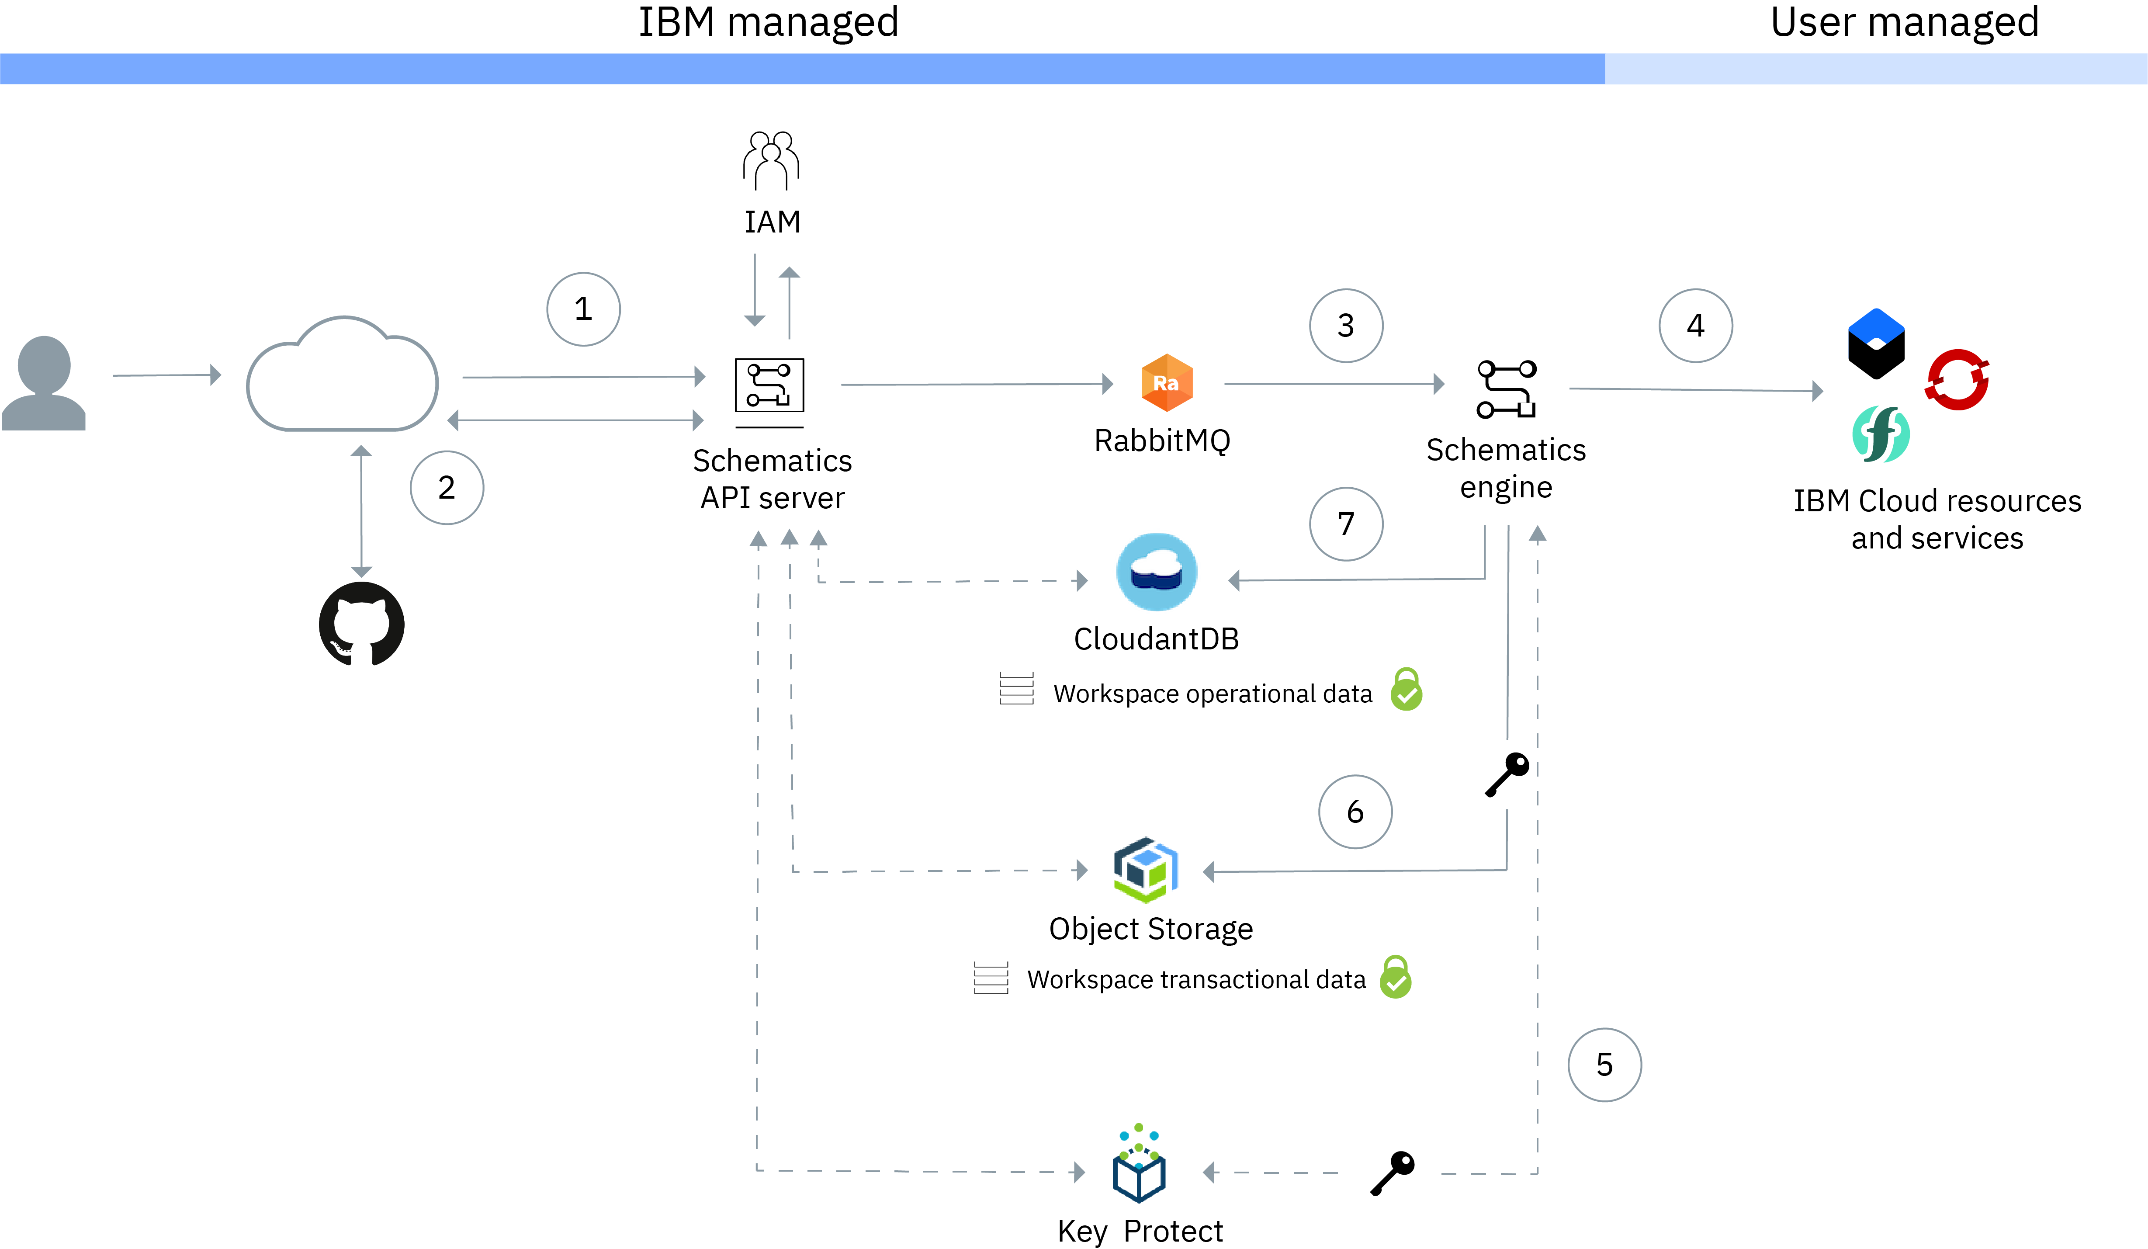
Schematics
Utilizes Open Source Projects:
Terraform
Ansible
Cloud Operators
Helm Charts
Notes:
IBM Cloud Schematics provides powerful tools to automate your cloud infrastructure provisioning and management process, the configuration and operation of your cloud resources, and the deployment of your app workloads.
Schematics leverages open source projects, such as Terraform, Ansible, OpenShift, Operators, and Helm, and delivers these capabilities to you as a managed service.
Rather than installing each open source project on your machine, and learning the API or CLI, you declare the tasks that you want to run in IBM Cloud and watch Schematics run these tasks for you.

Slide 4
Workspaces
Notes:
Schematics workspaces deliver Terraform-as-a-Service capabilities hosted on IBM Cloud. The service allows you to automate the provisioning and management of IBM Cloud resources. If you need to stand up environments in other clouds, or roll out a multi-cloud deployment, simply add your Terraform provider plugins to your Workspace and Schematics takes care of the rest.

Slide 5
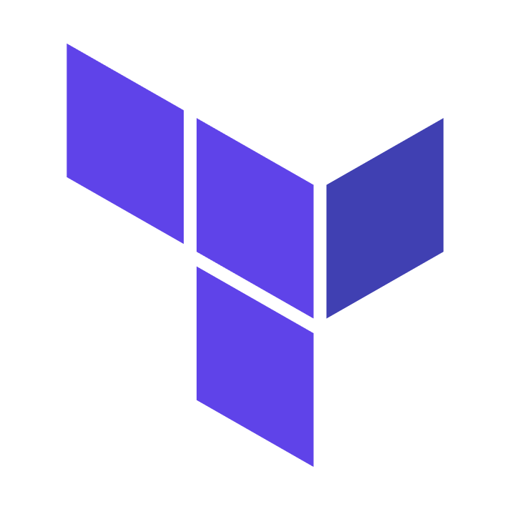
Terraform Refresher
Infrastructure as Code
IaC allows for the managing and provisioning of infrastructure through code instead of through manual processes.
Idempotency
Property of an operation whereby it can applied multiple times without changing the result beyond the initial application
Imperative vs Declarative
Specific commands vs declaration of desired state
Notes:
A declarative approach defines the desired state of the system, including what resources you need and any properties they should have, and an IaC tool will configure it for you.
A declarative approach also keeps a list of the current state of your system objects, which makes taking down the infrastructure simpler to manage.
An imperative approach instead defines the specific commands needed to achieve the desired configuration, and those commands then need to be executed in the correct order.
Many IaC tools use a declarative approach and will automatically provision the desired infrastructure. If you make changes to the desired state, a declarative IaC tool will apply those changes for you. An imperative tool will require you to figure out how those changes should be applied.

Slide 6
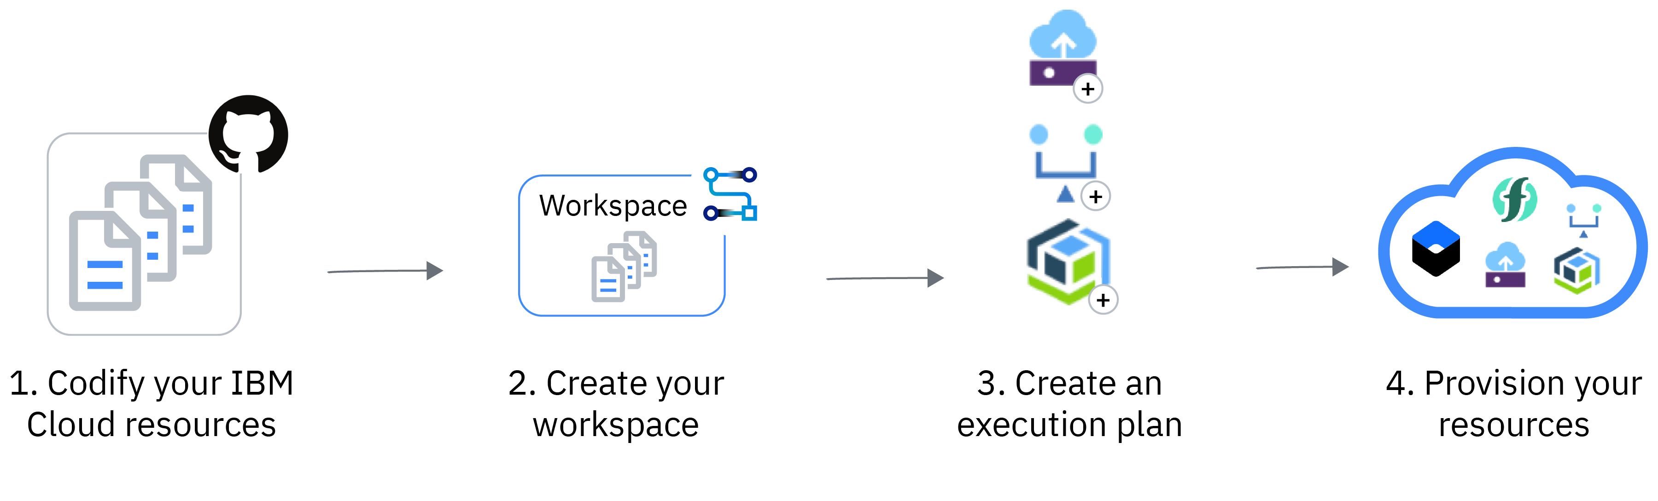
Schematics Workspace Flow
Codify Resources
Create template files stored in a version control system
Create Workspace
Define source repository and declare variables
Generate Plan
Create an execution plan to bring desired state in line with current state
Apply Plan
Make changes to resources and match desired state
Notes:
Workspace Flow
Getting started with Workspaces requires a few basic steps:
Codify your IBM Cloud resources: Create HCL or JSON Terraform deployment files and store them in a version control system such as GitHub, GitLab, or Bitbucket.
Create your workspace: In this step we define the source repository for the deployment, pick our Terraform version, and add or update deployment variables.
Create an execution plan: Terraform works on the idea of state. You define your desired state (number of machines, load balancers, etc) and then Terraform creates an execution plan and describes the actions that need to be run to get to that desired state.
Apply the execution plan: When you are ready to make changes to your cloud environment, you can apply your generated execution plan and Schematics gets to work.
(Optional) Enable continuous delivery: Connect a DevOps toolchain to your workspace, and enable IBM Cloud Continuous Delivery to automatically apply changes from your source repository to your resources in IBM Cloud.

Slide 7
Actions
Notes:
Schematics actions deliver Ansible-as-a-Service capabilities to you so that you can automate the configuration and management of your Cloud environments.

Slide 8
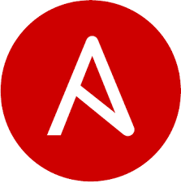
Ansible Refresher
Automation Engine
Automate repetitive tasks against a vast number of compute and service resources
Agentless
Ansible uses SSH and WinRM to communicate with hosts that need to be configured.
Orchestrate (almost) Anything
Can be used for configuration management, initial provisioning, workflow orchestration, and more.

Slide 9
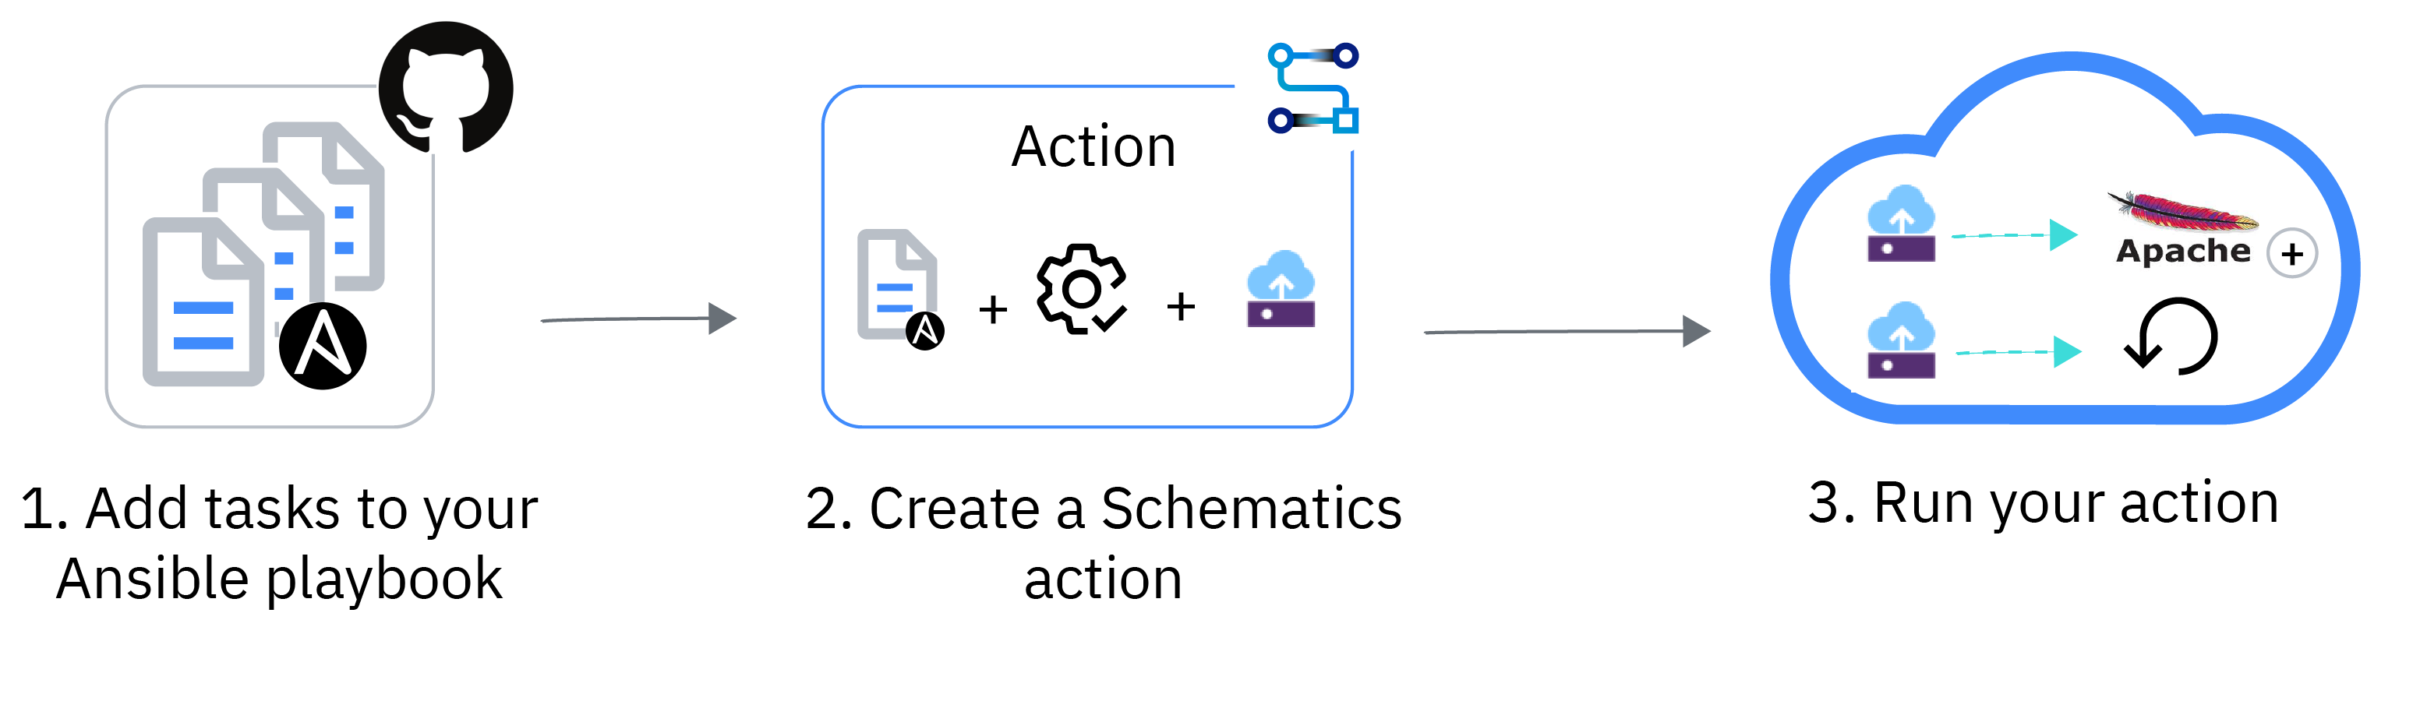
Schematics Actions Flow
Codify Resources
Create template files stored in a version control system
Create Workspace
Define source repository and declare variables
Generate Plan
Create an execution plan to bring desired state in line with current state
Apply Plan
Make changes to resources and match desired state
Notes:
Actions Flow
Getting started with Actions requires a few basic steps:
Add tasks to your playbook: Use Ansible YAML syntax to describe the configuration tasks that you want to run on your cloud infrastructure, such as installing software or starting, stopping, and rebooting a virtual server.
Create a Schematics action: Point your action to the repository that stores your Ansible playbooks. Then, you select the cloud resources where you want to run the tasks that are defined in your Ansible playbook.
Run your action: Schematics uses the built-in Ansible capabilities to connect to your target hosts via SSH, and execute the tasks that are defined in your Ansible playbook.

Slide 10
Do It Live!
Notes:
Schematics workspaces deliver Terraform-as-a-Service capabilities hosted on IBM Cloud. The service allows you to automate the provisioning and management of IBM Cloud resources. If you need to stand up environments in other clouds, or roll out a multi-cloud deployment, simply add your Terraform provider plugins to your Workspace and Schematics takes care of the rest.

