Slide 1
AWS-DAY4
Ravi Kulkarni

Slide 2
Index
AWS Security & Compliance
AWS Networking
AWS Kendra- an intelligent enterprise search service

Slide 3
Overview: Security & Compliance
Security and compliance are essential for all organizations that want to protect their data, systems, and applications from cyberattacks and other threats.
Security is the practice of protecting data and systems from unauthorized access, use, disclosure, disruption, modification, or destruction.
Compliance is the process of adhering to a set of rules or standards. In the context of security, compliance refers to adhering to security best practices and industry-specific regulations
AWS supports 143 security standards and compliance certifications, including PCI-DSS, HIPAA/HITECH, FedRAMP, GDPR, FIPS 140-2, and NIST 800-171, helping customers satisfy compliance requirements around the globe.

Slide 4
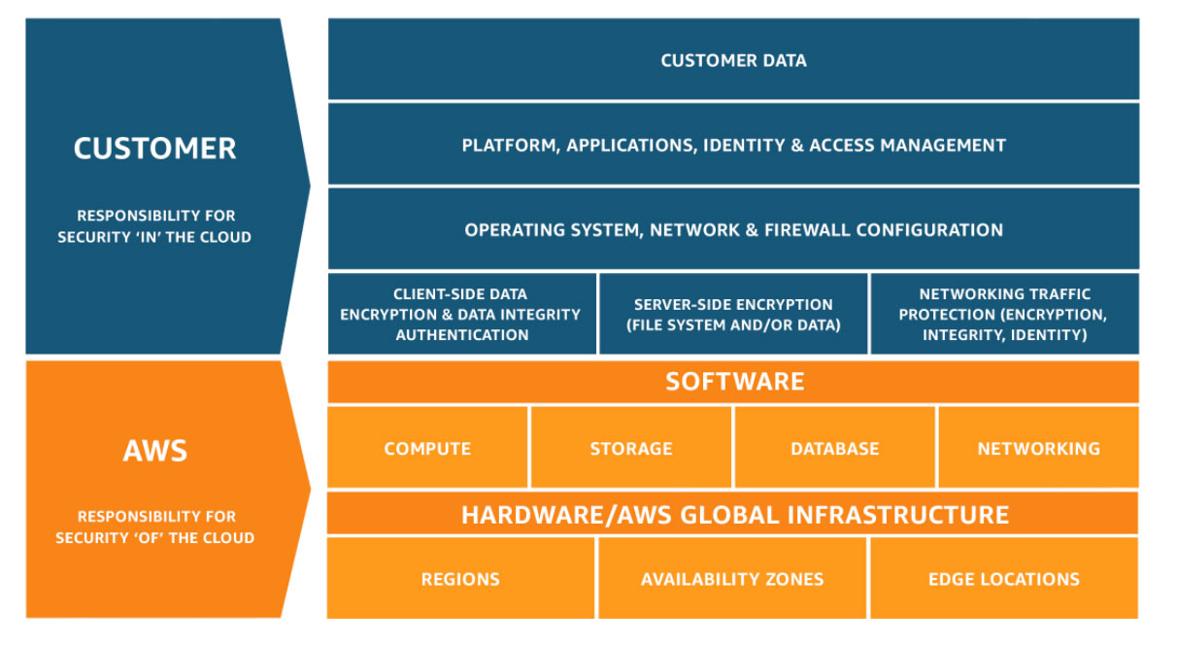
Compliance on AWS
Security and Compliance is a shared responsibility between AWS and the customer
REF PIC: AWS

Slide 5
Benefits of Compliance on AWS
Third-party validation for 1,000s of global requirements
Inherit the latest security controls AWS uses on its own infrastructure
Streamline and automate compliance
Automated Compliance Reporting

Slide 6
DDOS
DDOS stands for distributed denial-of-service.
A DDoS attack is a type of cyberattack in which the attacker attempts to overwhelm a target server or network with traffic from multiple sources, making it unavailable to legitimate users.
DDoS attacks can be carried out using a variety of methods, including:
Botnets: Botnets are networks of compromised computers that can be used to launch DDoS attacks.
Reflection attacks: Reflection attacks exploit vulnerabilities in networking protocols to amplify the amount of traffic sent to the target.
Volumetric attacks: Volumetric attacks flood the target with a large amount of traffic, overwhelming its bandwidth.

Slide 7
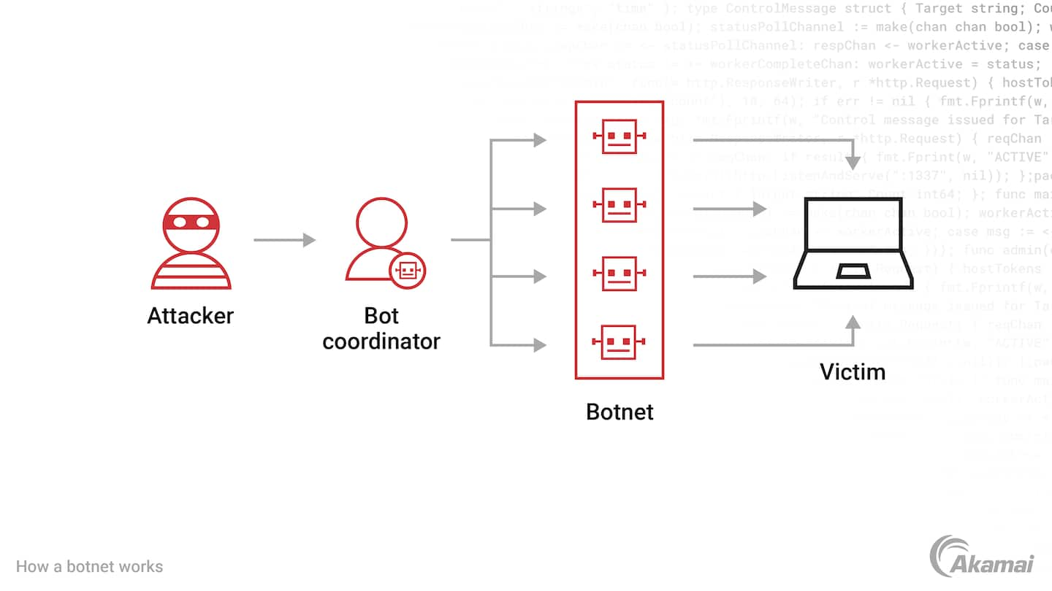
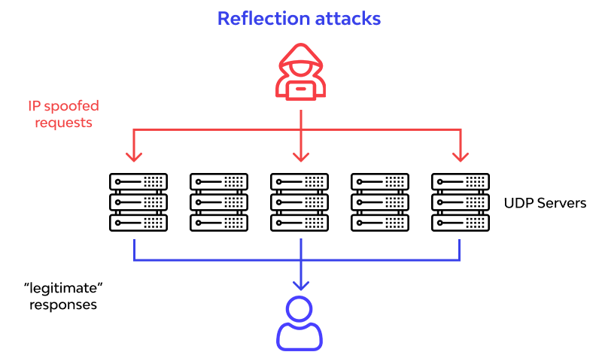
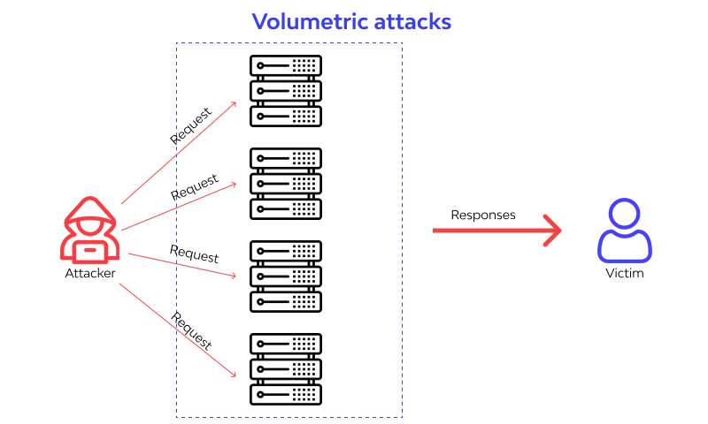

Slide 8
AWS Shield
AWS Shield is a managed DDoS protection service that safeguards applications running on AWS
Use cases:
Protect applications and APIs from SYN floods, UDP floods, or other reflection attacks.
Deploy inline mitigations such as deterministic packet filtering and priority-based traffic shaping to stop basic network-layer attacks.
Activate automatic detection, mitigation, or protection for each resource type per AWS account.

Slide 9
AWS Marketplace Security Products
AWS Marketplace offers a wide range of security products from vetted software sellers
Popular security products available in AWS Marketplace:
Cloud Security Posture Management (CSPM): CSPM tools help you identify and remediate security risks in your AWS environment.
Security Information and Event Management (SIEM): SIEM tools collect and analyze security logs from your AWS environment to help you detect and respond to security threats.
Web Application Firewalls (WAFs): WAFs protect your web applications from common attacks, such as SQL injection and cross-site scripting.
Intrusion Detection Systems (IDSs)/Intrusion Prevention Systems (IPSs): IDSs/IPSs monitor your network traffic for suspicious activity and can block malicious traffic.
Data Loss Prevention (DLP): DLP tools help you prevent sensitive data from being leaked or lost.

Slide 10
Choosing security products from AWS Marketplace:
Identify your needs: What specific security challenges are you trying to address?
Evaluate products: Compare different products to find the ones that best meet your needs.
Read reviews: See what other customers have to say about different products.
Choose from reputable sellers: Make sure to choose products from sellers with a good track record.

Slide 11
IAM Custom Policies
An IAM custom policy is a policy that you create to define permissions for IAM users, groups, or roles.
Custom policies are written in JSON and can be used to grant or deny specific permissions to users or roles.

Slide 12
Roles & Custom Policies
AWS roles are IAM entities that are used to grant permissions to users and services.
Roles can be assumed by users, other roles, or AWS services.
You can use custom policies to attach permissions to roles.
This allows you to grant users or services the permissions they need to perform their tasks, without having to grant them direct access to AWS resources.
For example, you could create a role for your development team that allows them to create and manage EC2 instances, but only in a specific VPC.
You could then attach a custom policy to the role that defines these permissions.

Slide 13
MFA & Reporting With IAM
Multi-factor authentication (MFA) and reporting are two important features of IAM that can help you to improve the security and compliance of your AWS environment
MFA adds an extra layer of security to your IAM accounts by requiring users to enter a code from a physical device in addition to their password when signing in.
Reporting with IAM allows you to track and monitor user activity in your AWS environment. This can help you to identify suspicious activity and to troubleshoot problems.

Slide 14
MFA & Reporting With IAM-2
IAM supports a variety of MFA devices, including:
Hardware tokens
Software tokens
Virtual MFA devices
IAM provides a variety of reports
User activity report
IAM group and user report
MFA report
Access key report

Slide 15
Security Token Service (STS)
AWS Security Token Service (STS) is a web service that enables you to request temporary security credentials for AWS Identity and Access Management (IAM) users or for users that you authenticate.

Slide 16
Security & Logging
Logging is an important part of maintaining the security of your AWS environment.
By logging activity in your AWS environment, you can detect suspicious activity and investigate security incidents.
AWS provides a variety of logging services that you can use to monitor and log activity in your AWS environment
CloudTrail: CloudTrail is a service that logs all API calls made to your AWS account.
CloudWatch Logs: CloudWatch Logs is a service that collects and stores logs from AWS services, applications, and custom sources.
VPC Flow Logs: VPC Flow Logs captures information about the IP traffic going to and from network interfaces in your VPC.
Route 53 Query Logs: Route 53 Query Logs captures information about the DNS queries that are made to your Route 53 hosted zones.

Slide 17
AWS Hypervisors
AWS Hypervisors are the software layer that manages and virtualizes the hardware resources of the host machine.
They enable the creation and management of multiple virtual machines (instances) on a single physical server.
AWS uses two types of hypervisors:
Xen: Xen is a type-1 hypervisor, which means that it runs directly on the host hardware and provides a bare-metal virtualization environment.
- Xen is used by AWS to power its EC2, EBS, and ElastiCache services.
Nitro: Nitro is a custom-built hypervisor that is designed to optimize the performance and security of AWS services.
- Nitro is used by AWS to power its EC2, EBS, and ElastiCache services.
Xen and Nitro are both open-source hypervisors, but AWS has made significant modifications to both hypervisors to optimize them for AWS cloud computing.

Slide 18
Dedicated Instances Vs Dedicated Hosts
Dedicated Instances and Dedicated Hosts are two AWS services that allow you to dedicate physical servers for your use
Dedicated Instances are Amazon EC2 instances that run on physical servers that are dedicated for your use.
Dedicated Instances are isolated from other instances on the same physical server, but they may share hardware with other instances from the same AWS account.
Dedicated Hosts are physical servers that are dedicated for your use.
Dedicated Hosts give you visibility and control over how instances are placed on the server.
You can also consistently deploy your instances to the same physical server over time.

Slide 19
Dedicated Instances Vs Dedicated Hosts
Feature | Dedicated Instances | Dedicated Hosts
Isolation | Dedicated Instances are isolated from other instances on the same physical server. | Dedicated Hosts give you visibility and control over how instances are placed on the server.
Hardware sharing | Dedicated Instances may share hardware with other instances from the same AWS account. | Dedicated Hosts are dedicated for your use.
Pricing | Dedicated Instances are priced per instance. | Dedicated Hosts are priced per host.
NOTE: Which service is right for you depends on your specific needs. If you need dedicated hardware but do not need fine-grained control over instance placement, then Dedicated Instances may be a good option for you. If you need fine-grained control over instance placement, or if you need to comply with specific regulations, then Dedicated Hosts may be a better option for you.

Slide 20
AWS Systems Manager EC2 Run Command
This console allows you to send commands to EC2 instances, either individually or in groups.
Run Command can be used to perform a variety of tasks, such as:
Installing software
Configuring settings
Running scripts

Slide 21
AWS Systems Manager Parameter Store
This console allows you to store and manage configuration data and secrets.
Parameter Store can be used to store a variety of data, such as:
Database connection strings
API keys
Passwords
License keys
Other configuration data

Slide 22
Pre-signed URLs with S3
Amazon Simple Storage Service (Amazon S3) allows you to generate pre-signed URLs that provide temporary access to private objects stored in your S3 buckets.
These URLs are often used when you need to grant temporary, time-limited access to objects, such as for downloading files without making them public.

Slide 23
AWS Config With S3
AWS Config is a service that helps you assess, audit, and evaluate the configurations of your AWS resources.
By integrating AWS Config with Amazon S3, you can store and manage configuration snapshots in a secure and scalable manner.

Slide 24
Inspector vs Trusted Advisor
AWS Inspector is a service that assesses the security of your EC2 instances.
It does this by running automated checks to identify vulnerabilities, malware, and other security issues.
AWS Trusted Advisor is a service that provides recommendations on how to improve the security, performance, and cost-effectiveness of your AWS environment
Feature | AWS Inspector | AWS Trusted Advisor
Focus | Security | Security, performance, and cost-effectiveness
Scope | EC2 instances | Entire AWS environment
Agent required | Yes | No

Slide 25
AWS Networking
AWS networking refers to the networking infrastructure and services provided by Amazon Web Services (AWS) for creating, managing, and optimizing network resources within the AWS cloud environment.
Virtual Private Cloud (VPC) Subnetting Elastic Load Balancing (ELB) Amazon Route 53 (DNS) Direct Connect Virtual Private Network (VPN) Security Groups and Network ACLs | Transit Gateway VPC Peering Monitoring and Logging Hybrid Cloud Connectivity Network Security Advanced Architectures Certification and Training Scalability and Performance

Slide 26
Build Your Own Custom VPC
Amazon Virtual Private Cloud (Amazon VPC) allows you to create a private, isolated section of the AWS Cloud where you can launch AWS resources.

Slide 27
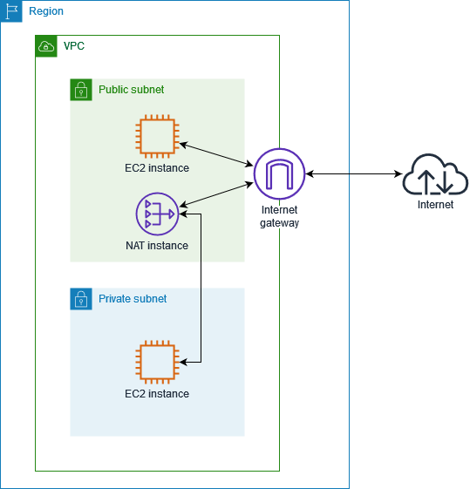
Creating a NAT Instance
Network Address Translation (NAT) instance in AWS allows your private instances within a Virtual Private Cloud (VPC) to access the internet while remaining hidden behind the NAT instance's public IP address.
This is useful for scenarios where your private instances need to download software updates, access external services, or communicate with the AWS service endpoints.

Slide 28
Network ACLs and Security Groups
Network ACLs are applied at the subnet level and filter all traffic entering or leaving the subnet.
They can be used to allow or deny traffic based on source and destination IP address, port, and protocol.
Security groups are applied at the instance level and filter all traffic entering or leaving the instance.
They can be used to allow or deny traffic based on source and destination IP address, port, protocol, and security group.
Network ACLs and security groups can be used together to provide a layered security approach. For example, you could use a network ACL to allow all traffic from within your VPC to flow freely, and then use security groups to restrict traffic to specific instances.

Slide 29
VPC Endpoints
A VPC endpoint is a networking interface that enables communication between instances in a VPC and services hosted outside the VPC without requiring an internet gateway, NAT device, VPN connection, or AWS Direct Connect connection.
VPC endpoints can be used to connect to:
AWS services, such as S3, DynamoDB, and RDS
On-premises services
Services hosted by other AWS accounts

Slide 30
VPC Flow Logs
VPC Flow Logs is a feature that enables you to capture information about the IP traffic going to and from network interfaces in your VPC.
This information includes the source and destination IP addresses, port numbers, protocols, and packet counts
VPC Flow Logs can be used to:
Monitor network traffic: VPC Flow Logs can be used to monitor network traffic in your VPC. This can help you to identify suspicious activity and troubleshoot problems.
Plan capacity: VPC Flow Logs can be used to plan capacity for your VPC. This can help you to ensure that your VPC has enough bandwidth to meet your needs.
Comply with regulations: VPC Flow Logs can be used to comply with regulations that require you to track network traffic.

Slide 31
VPC Clean Up
The process consists of the following steps:
Terminate all instances in the VPC. This will ensure that there are no running instances that are using the VPC resources.
Delete all security groups in the VPC. This will ensure that there are no security groups that are allowing or denying traffic to the VPC resources.
Delete all network ACLs in the VPC. This will ensure that there are no network ACLs that are filtering traffic to and from the VPC resources.
Delete all subnets in the VPC. This will ensure that there are no subnets that are using the VPC resources.
Delete the VPC. This will delete all of the VPC resources, including the VPC itself.

Slide 32
VPC CIDR Calculations
o calculate the CIDR blocks for your VPC, you need to consider the following factors:
The number of IP addresses that you need for your VPC.
The number of subnets that you want to create in your VPC.
The size of each subnet.

Slide 33
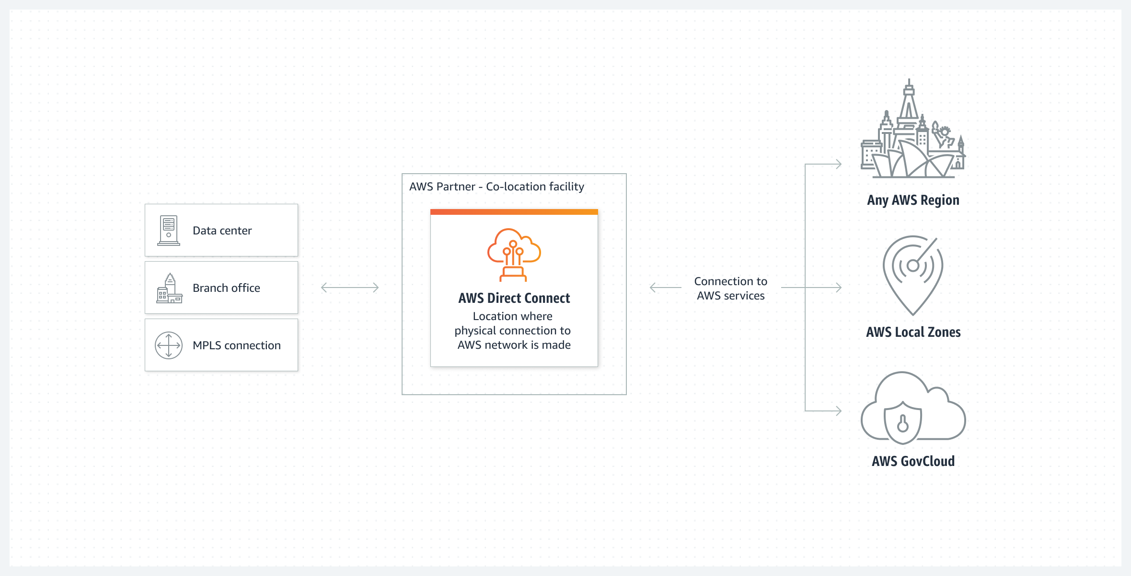
AWS Direct Connect
AWS Direct Connect is a dedicated network connection from your on-premises network to AWS. AWS Direct Connect provides a reliable, secure, and high-performance connection to AWS services.

Slide 34
AWS Direct Connect-2
To use AWS Direct Connect, you will need to create a connection between your on-premises network and an AWS Direct Connect location. You can create a connection using a variety of methods, including:
Dedicated connection: A dedicated connection is a physical Ethernet connection that is associated with a single customer.
Hosted connection: A hosted connection is a physical Ethernet connection that is provisioned by an AWS Direct Connect Partner on behalf of a customer.

Slide 35
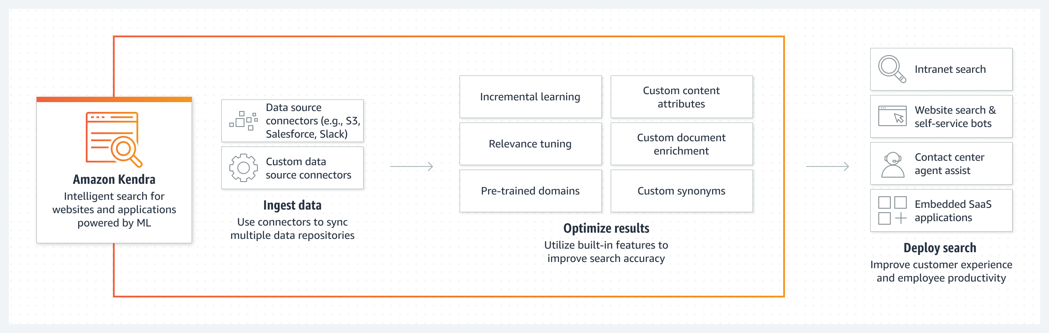
AWS Kendra
AWS Kendra is an intelligent search service that uses machine learning to help you find information across your organization.
It can index and search content from a variety of sources, including Amazon S3 buckets, Microsoft SharePoint, Salesforce, and ServiceNow.
AWS Kendra also supports document metadata and synonyms, which can help you improve the relevance of your search results.

Slide 36
AWS Kendra-2
Working with AWS Kendra involves the following steps:
Create an index. An index is a collection of documents that you want to search. To create an index, you need to specify a data source.
A data source is a location where your documents are stored, such as an Amazon S3 bucket or a Microsoft SharePoint site.
Ingest documents. Once you have created an index, you need to ingest documents into it.
You can ingest documents manually or automatically.
To ingest documents manually, you can use the Amazon Kendra console or the Amazon Kendra SDK.
To ingest documents automatically, you can use a connector.
A connector is a tool that connects AWS Kendra to a data source and ingests documents from that data source into AWS Kendra.
Query the index. Once you have ingested documents into an index, you can start querying the index to find the information you need.
You can query the index using the Amazon Kendra console, the Amazon Kendra SDK, or a third-party search application.

Slide 37
Examples of how AWS Kendra can be used
Search for information in a company's internal knowledge base. AWS Kendra can be used to search for information in a company's internal knowledge base, such as FAQs, product documentation, and training materials.
This can help employees find the information they need to do their jobs more efficiently.
Search for information in a customer support database. AWS Kendra can be used to search for information in a customer support database, such as tickets, chat logs, and emails.
This can help customer support representatives find the information they need to resolve customer issues more quickly.
Search for information in a research database. AWS Kendra can be used to search for information in a research database, such as scientific journals, patents, and grant proposals.
This can help researchers find the information they need to conduct their research more efficiently.

Slide 38
References
https://aws.amazon.com/compliance/
https://d0.awsstatic.com/whitepapers/compliance/Intro_to_Security_by_Design.pdf
https://aws.amazon.com/compliance/programs/
https://www.akamai.com/glossary/what-is-a-botnet
https://www.wallarm.com/what/types-of-ddos-attack-and-measures-protection
https://docs.aws.amazon.com/vpc/latest/userguide/VPC_NAT_Instance.html

