Slide 1




Git, Bitbucket, Sourcetree & Branching Strategies
Ravi Kulkarni
HYBRID TECHNOLOGY COURSES

Slide 2
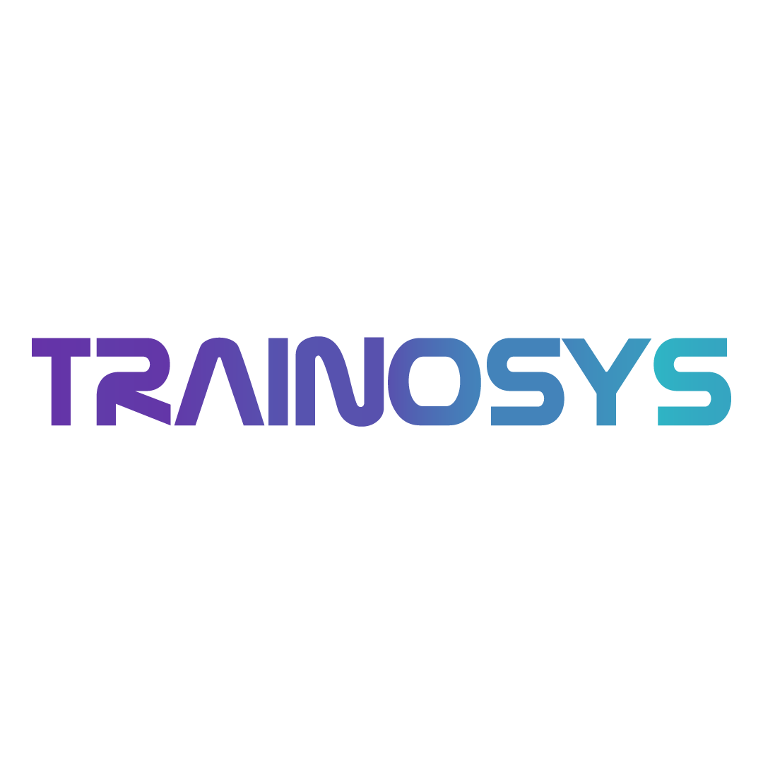
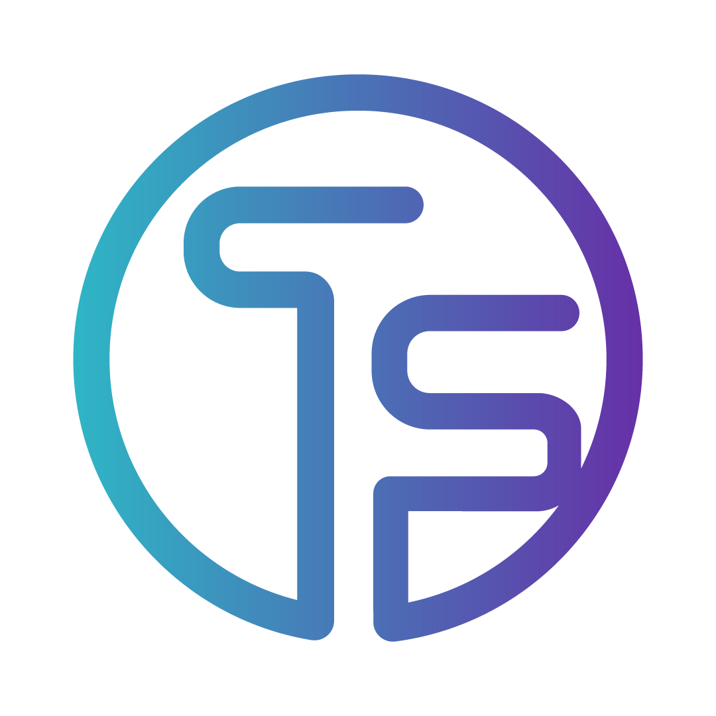
Program Outline: Day1
Session 1
Session 2
Bitbucket: teams, branches, permissions
Pull request lifecycle: create, review, merge
Sourcetree overview
Git Flow vs Trunk-based vs Feature Branching
Choosing what fits team workflows
Reset, revert, stash
Best practices to undo mistakes safely
What is Git? Local vs Remote
Git configuration and common commands
Branching, merging, rebase vs merge
Conflict resolution and troubleshooting
Git logs: log, diff, blame, reflog
HYBRID TECHNOLOGY COURSES
www.trainosys.com

Slide 3
Program Outline: Day2
Session 1
Session 2
Quality gates
QA role in monitoring code quality trends
What is an artifact? Build lifecycle
Upload/download flow for QA testing
End-to-End CI/CD Lab + Mini Challenge
Real-world best practices for teams
• Tips for QA handoff, rollback strategies, log tracing
What is Jenkins, and how does the team use it?
• Jobs vs Pipelines, Key plugins
• Jenkinsfile structure and syntax
• Build → Unit Test → Code Lint → Artifact
What is SonarQube? Static code analysis
HYBRID TECHNOLOGY COURSES
www.trainosys.com

Slide 4
What is Jenkins?
Jenkins is an open-source automation server used to automate the building, testing, and deployment of software projects.
Key Features of Jenkins
Extensible: Over 1800 plugins for integrating with tools like Git, Maven, Docker, Kubernetes, etc.
Cross-platform: Works on Windows, Linux, macOS.
Distributed builds: Can run jobs across multiple nodes.
Customizable Pipelines: Create scripted or declarative workflows as code.
HYBRID TECHNOLOGY COURSES
www.trainosys.com

Slide 5
Jenkins Plugins
Plugins enable Jenkins to integrate with various tools across the CI/CD pipeline: source control, build tools, testing frameworks, deployment, notifications, and more.
There are over 1,500 plugins available in the Jenkins plugin ecosystem
How Plugins Work
Installed and managed via Jenkins’ Plugin Manager.
Can be enabled, disabled, updated independently.
Many plugins provide pipeline steps so you can use them inside Jenkinsfiles.
HYBRID TECHNOLOGY COURSES
www.trainosys.com

Slide 6
Key Jenkins Plugins (Recommended)
🧱 Core Pipeline Plugins: Pipeline (workflow) plugin Pipeline: GitHub / Git SCM integration Pipeline: Stage View Pipeline Utility Steps | 🧪 Quality & Security: SonarQube Scanner for Jenkins OWASP Dependency-Check Plugin Checkmarx / Snyk Plugins (optional)
💡 Build/SCM: Git Plugin Bitbucket Plugin GitHub Branch Source | 📦 Artifact Management: Artifactory Plugin (JFrog) Nexus Artifact Uploader (if using Nexus)
HYBRID TECHNOLOGY COURSES
www.trainosys.com

Slide 7
What is a Jenkins Pipeline?
A Jenkins Pipeline is a suite of plugins that supports automation of complex workflows through code. It defines the steps involved in your CI/CD process.
🛠️ Pipeline as Code
Written in Groovy-based DSL inside a Jenkinsfile
Version-controlled with the source code
Supports stages, steps, parallelism, error handling
HYBRID TECHNOLOGY COURSES
www.trainosys.com

Slide 8
Jenkins Jobs vs Pipelines
Feature | Freestyle Jobs | Pipelines
Definition | Configured via UI using GUI forms | Written as code (Jenkinsfile)
Flexibility | Limited to predefined steps | Highly customizable with stages, conditions, loops
Version Control | Not easily tracked in source control | Stored as code in Git (Pipeline-as-Code)
Complexity Handling | Hard to manage complex workflows | Designed for complex, multi-step, multi-branch flows
Error Handling | Minimal | Can handle retry, post-actions, exception logic
Parallel Execution | No | Yes, natively supported
Auditability | Manual | Easy audit via VCS (Git)
Maintenance | UI-based, harder to replicate across teams | Code-based, reusable, and portable
HYBRID TECHNOLOGY COURSES
www.trainosys.com

Slide 9
Type | Description
Declarative Pipeline | Simpler syntax, easier to read and write. Enforces structure.
Scripted Pipeline | More flexible, uses full Groovy scripting for advanced use cases.
Stage | Purpose
Checkout | Pull code from version control (e.g., Git)
Build | Compile source code
Test | Run unit/integration tests
Package | Create build artifacts (e.g., JAR, Docker image)
Deploy | Push code to staging/production environments
Common Pipeline Stages
HYBRID TECHNOLOGY COURSES
www.trainosys.com

Slide 10

Jenkins Pipeline Concept
Jenkins Pipeline is essentially a way to automate the process of building, testing, and deploying software applications.
It's like creating a blueprint for your software's journey from development to production.
Agent
Checkpoint
Pipeline
Stages
Steps
HYBRID TECHNOLOGY COURSES
www.trainosys.com

Slide 11
Declarative Pipeline | Scripted Pipeline
pipeline { agent any stages { stage('Build') { steps { echo 'Building...' } } stage('Test') { steps { echo 'Testing...' } } } post { success { echo 'Pipeline succeeded.' } } | node { stage('Build') { echo 'Building...' } stage('Test') { echo 'Testing...' } stage('Deploy') { echo 'Deploying...' } }
Jenkins
Pipeline
Examples
HYBRID TECHNOLOGY COURSES
www.trainosys.com

Slide 12
What is SonarQube? Static code analysis
SonarQube is an open-source platform for continuous inspection of code quality. It performs static code analysis to detect bugs, code smells, vulnerabilities, and other quality issues in your source code.
SonarQube helps teams maintain clean, reliable, and secure codebases by automatically scanning code whenever it changes.
Static Code Analysis Static code analysis examines source code without executing it. It identifies potential issues like syntax errors, security vulnerabilities, duplicated code, complexity, and violations of coding standards. Helps catch problems early, reducing bugs and improving maintainability.
HYBRID TECHNOLOGY COURSES
www.trainosys.com

Slide 13
What Is a Quality Gate?
A Quality Gate in SonarQube is a set of predefined rules and thresholds that a codebase must meet to be considered of acceptable quality. It acts as an automated checkpoint in your CI/CD pipeline to approve or reject code based on metrics like bugs, vulnerabilities, code coverage, and duplication
HYBRID TECHNOLOGY COURSES
www.trainosys.com

Slide 14
PR Quality Gate Status
Once the analysis is complete and results are available, the Quality Gate status will be displayed on the PR. This indicates whether the PR is meeting the defined code quality standards set by the team or organization.
Passed Quality Gate: The PR is clean and meets the agreed-upon quality standards (e.g., no critical bugs, sufficient test coverage).
Failed Quality Gate: The PR doesn’t meet the standards and needs to be fixed before merging.
SonarQube supports various quality gates such as:
No new critical issues in the code.
At least 80% test coverage.
HYBRID TECHNOLOGY COURSES
www.trainosys.com

Slide 15
Key points to understand
What to look for in scan results: Prioritize issues by severity: Blocker, Critical, Major, Minor, Info. Focus first on blockers and critical bugs or vulnerabilities. Code smells indicate maintainability issues that might not break code but should be fixed over time | False positives: Sometimes SonarQube reports issues that are not actual problems (false positives). When allowed, you can mark these in SonarQube as "Won't Fix" or "False Positive" to avoid confusion
How to fix a typical issue: Review the issue description and recommendation provided by SonarQube. Refactor or rewrite the affected code. Run tests to confirm the fix. Re-scan to ensure the issue is resolved. | When to ask for an exemption: If a detected issue is justified due to specific context (e.g., legacy code or third-party limitations). Formalize this via a code review or QA approval process. Document exemptions for audit and transparency.
HYBRID TECHNOLOGY COURSES
www.trainosys.com

Slide 16
Custom Quality Profiles
A Quality Profile is a set of rules SonarQube uses to evaluate your code. You can:
Use defaults (like “Sonar Way”)
Clone and customize them (e.g., stricter rules for security projects)
Why it matters: Each team or project can apply rules that match their domain, language, and coding standards.
HYBRID TECHNOLOGY COURSES
www.trainosys.com

Slide 17
ISSUE types
Type | Meaning | Example
Bug | An error that will likely cause incorrect behavior. | An unhandled exception or null pointer.
Vulnerability | A flaw that could be exploited by attackers. | SQL injection, hard-coded passwords.
Code Smell | Poor design or practice that may not cause errors but makes code harder to maintain. | A function that's 300 lines long.
Security Hotspot | Code that might be insecure and needs human review. | Use of eval() in JavaScript.
HYBRID TECHNOLOGY COURSES
www.trainosys.com

Slide 18
QA Role in Monitoring Code Quality Trends
QA teams monitor quality metrics over time using SonarQube dashboards.
Look for trends in code coverage, technical debt, new issues, and code duplication.
Help prioritize testing efforts based on code quality.
Collaborate with developers to enforce quality gates and improve the overall health of the codebase.
HYBRID TECHNOLOGY COURSES
www.trainosys.com

Slide 19
Best Practices for SonarQube + Bitbucket Integration
Define a Clear Quality Gate: Set strict rules around code coverage, vulnerabilities, and code smells.
Use Pull Request Decoration: Ensure developers see SonarQube's feedback directly within Bitbucket to streamline the review process.
Use Custom Quality Profiles: Tailor SonarQube’s rule sets based on the project’s needs (e.g., stricter security rules for a financial app).
Fix Issues Continuously: Prioritize new issues introduced rather than trying to fix legacy code in a single sweep.
Educate the Team: Make sure everyone understands SonarQube’s reports and how to use the insights for better code quality.
HYBRID TECHNOLOGY COURSES
www.trainosys.com

Slide 20
What is JFrog Artifactory?
JFrog Artifactory is a universal artifact repository manager that stores, manages, and organizes your software artifacts throughout the development lifecycle.
It acts as a central hub for storing build artifacts such as binaries, libraries, Docker images, and more.
Supports multiple package formats including Maven, Gradle, npm, Docker, Helm, and more.
Provides version control, metadata management, and secure access to artifacts.
Integrates seamlessly with CI/CD tools like Jenkins, GitLab, and Bamboo.
Enables efficient artifact promotion from development to QA, staging, and production environments.
Supports high availability, scalability, and enterprise security features.
HYBRID TECHNOLOGY COURSES
www.trainosys.com

Slide 21
What is an Artifact?
An artifact is any file or binary produced as a result of a software build process. This can include:
Compiled code packages (like JAR, WAR, or DLL files)
Executable binaries
Configuration files
Docker images
Scripts or libraries
Artifacts represent the output that moves through the software delivery pipeline from development to production
HYBRID TECHNOLOGY COURSES
www.trainosys.com

Slide 22
Build Lifecycle
The build lifecycle is the sequence of steps to convert source code into deployable software:
Source Code: Developers write and commit code to a version control system (e.g., Git, Bitbucket).
Build: Build tools (e.g., Maven, Gradle, npm) compile the code, run tests, and package it into artifacts.
Artifact Creation: The build produces one or more artifacts — the final output ready for deployment or testing.
Artifact Storage: Artifacts are uploaded to an artifact repository like JFrog Artifactory to store and manage versions securely.
Deployment: Artifacts are downloaded from the repository during deployment to various environments (QA, staging, production).
HYBRID TECHNOLOGY COURSES
www.trainosys.com

Slide 23
Upload/Download Flow for QA Testing
Upload Flow:
After a successful build, artifacts are automatically or manually uploaded to the artifact repository (e.g., Artifactory).
This ensures that the exact build outputs are stored centrally and versioned.
Download Flow for QA:
QA teams download specific versions of artifacts from the repository to deploy into test environments.
Using artifacts from the repository ensures consistency—QA tests exactly what developers built.
Artifacts can be promoted across environments as they pass testing, maintaining traceability.
HYBRID TECHNOLOGY COURSES
www.trainosys.com

Slide 24
Tips for QA handoff
Use Artifact Repositories: Ensure QA gets the exact build artifact versions from repositories like JFrog Artifactory for consistency.
Documentation: Provide release notes, environment setup details, and test cases to QA teams.
Automate Deployments: Use automated scripts or CI/CD pipelines to deploy builds to QA environments to reduce human error.
Environment Parity: Keep QA environments as close as possible to production to catch environment-specific bugs.
Communication: Maintain clear communication channels between Dev, QA, and Ops teams for quick issue resolution.
HYBRID TECHNOLOGY COURSES
www.trainosys.com

Slide 25
Rollback Strategies
Versioned Artifacts: Always deploy versioned artifacts so you can easily revert to a previous stable version if needed.
Blue-Green Deployment: Run two identical production environments; switch traffic to the new version and revert quickly if issues arise.
Canary Releases: Gradually roll out changes to a small user subset first, allowing quick rollback if problems occur.
Automated Rollbacks: Implement automated rollback scripts triggered by monitoring alerts or failed health checks.
Database Rollbacks: Carefully manage database schema changes to support backward compatibility or scripted rollbacks.
HYBRID TECHNOLOGY COURSES
www.trainosys.com

Slide 26
Log Tracing Best Practices
Centralized Logging: Use tools like AWS CloudWatch, ELK Stack, or Splunk to collect and aggregate logs from all services.
Structured Logging: Log in JSON or key-value formats to enable easier searching and filtering.
Correlation IDs: Use unique request or transaction IDs to trace requests across microservices and logs.
Log Levels: Use appropriate log levels (INFO, DEBUG, ERROR) and avoid excessive logging in production.
Alerting: Set alerts on error patterns or anomalies to proactively detect issues.
Retain Logs: Maintain logs for an adequate period to support troubleshooting and audits.
HYBRID TECHNOLOGY COURSES
www.trainosys.com

Slide 27
Real-world best practices for teams
Collaborate Early and Often: Break down silos between development, QA, and operations. Use shared tools and communication channels (Slack, Jira, Confluence). Automate Everything: Automate builds, tests, deployments, and rollbacks with CI/CD pipelines. Use Infrastructure as Code (IaC) tools like Terraform or CloudFormation for environment provisioning. | Maintain Environment Parity: Keep development, testing, staging, and production environments as similar as possible to avoid environment-specific issues. Continuous Monitoring and Feedback: Implement proactive monitoring and alerting with tools like CloudWatch, Prometheus, or ELK.
Version Control for Everything:
Keep code, configurations, and infrastructure definitions under version control.
Tag releases and artifacts clearly for traceability
HYBRID TECHNOLOGY COURSES
www.trainosys.com

Slide 28



TITLE TEXT HERE
TRAINOSYS
Training the Future Today
Reach Us!
Visit Us
12th/F The Trade & Financial Tower Unit 1206
32nd Street & 7th Avenue Bonifacio Global City,
Taguig 1634 Philippines
Subtitle
Email Us
inquiry@trainosys.com
Browse Our Website
www.trainosys.com

Slide 29





TITLE TEXT HERE
TRAINOSYS
Subtitle
Training the Future Today

