Slide 1
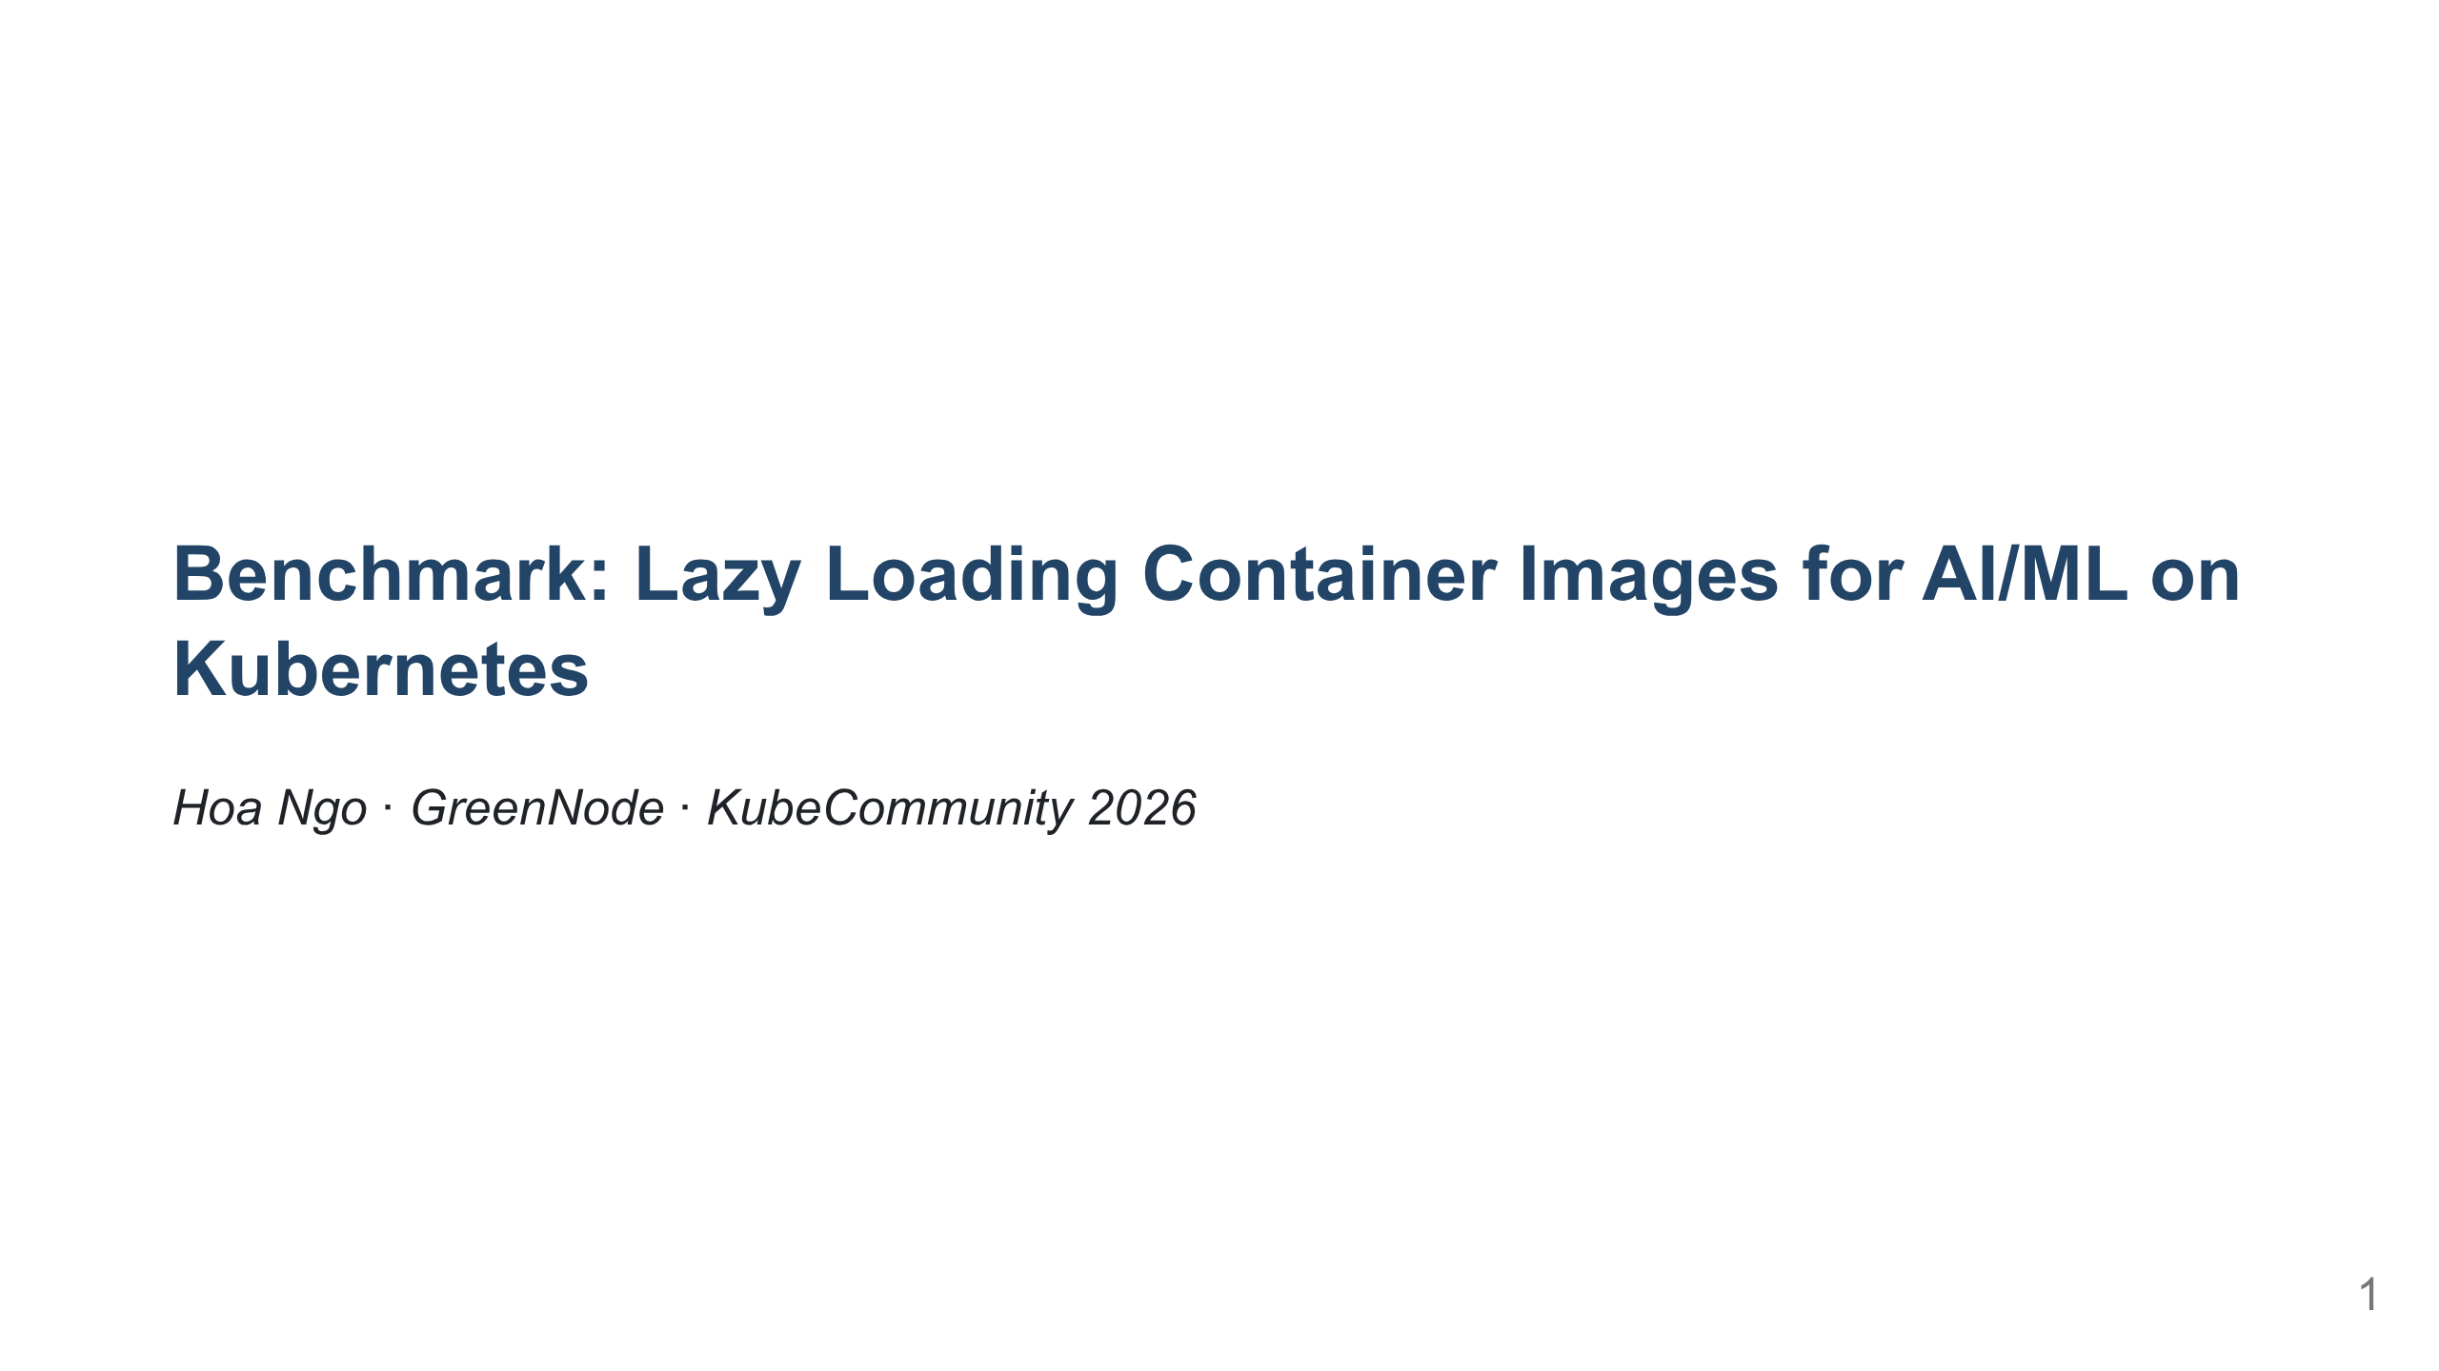
Notes:
The talk has two halves — benchmark first, then how to actually run it in production.

Slide 2
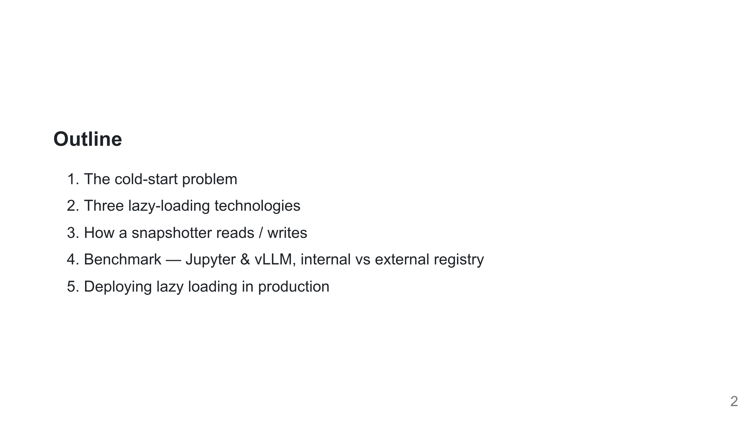
Notes:
Tell them the shape of the talk. The pivot from "what to use" to "how to run it" comes after the benchmark.

Slide 3
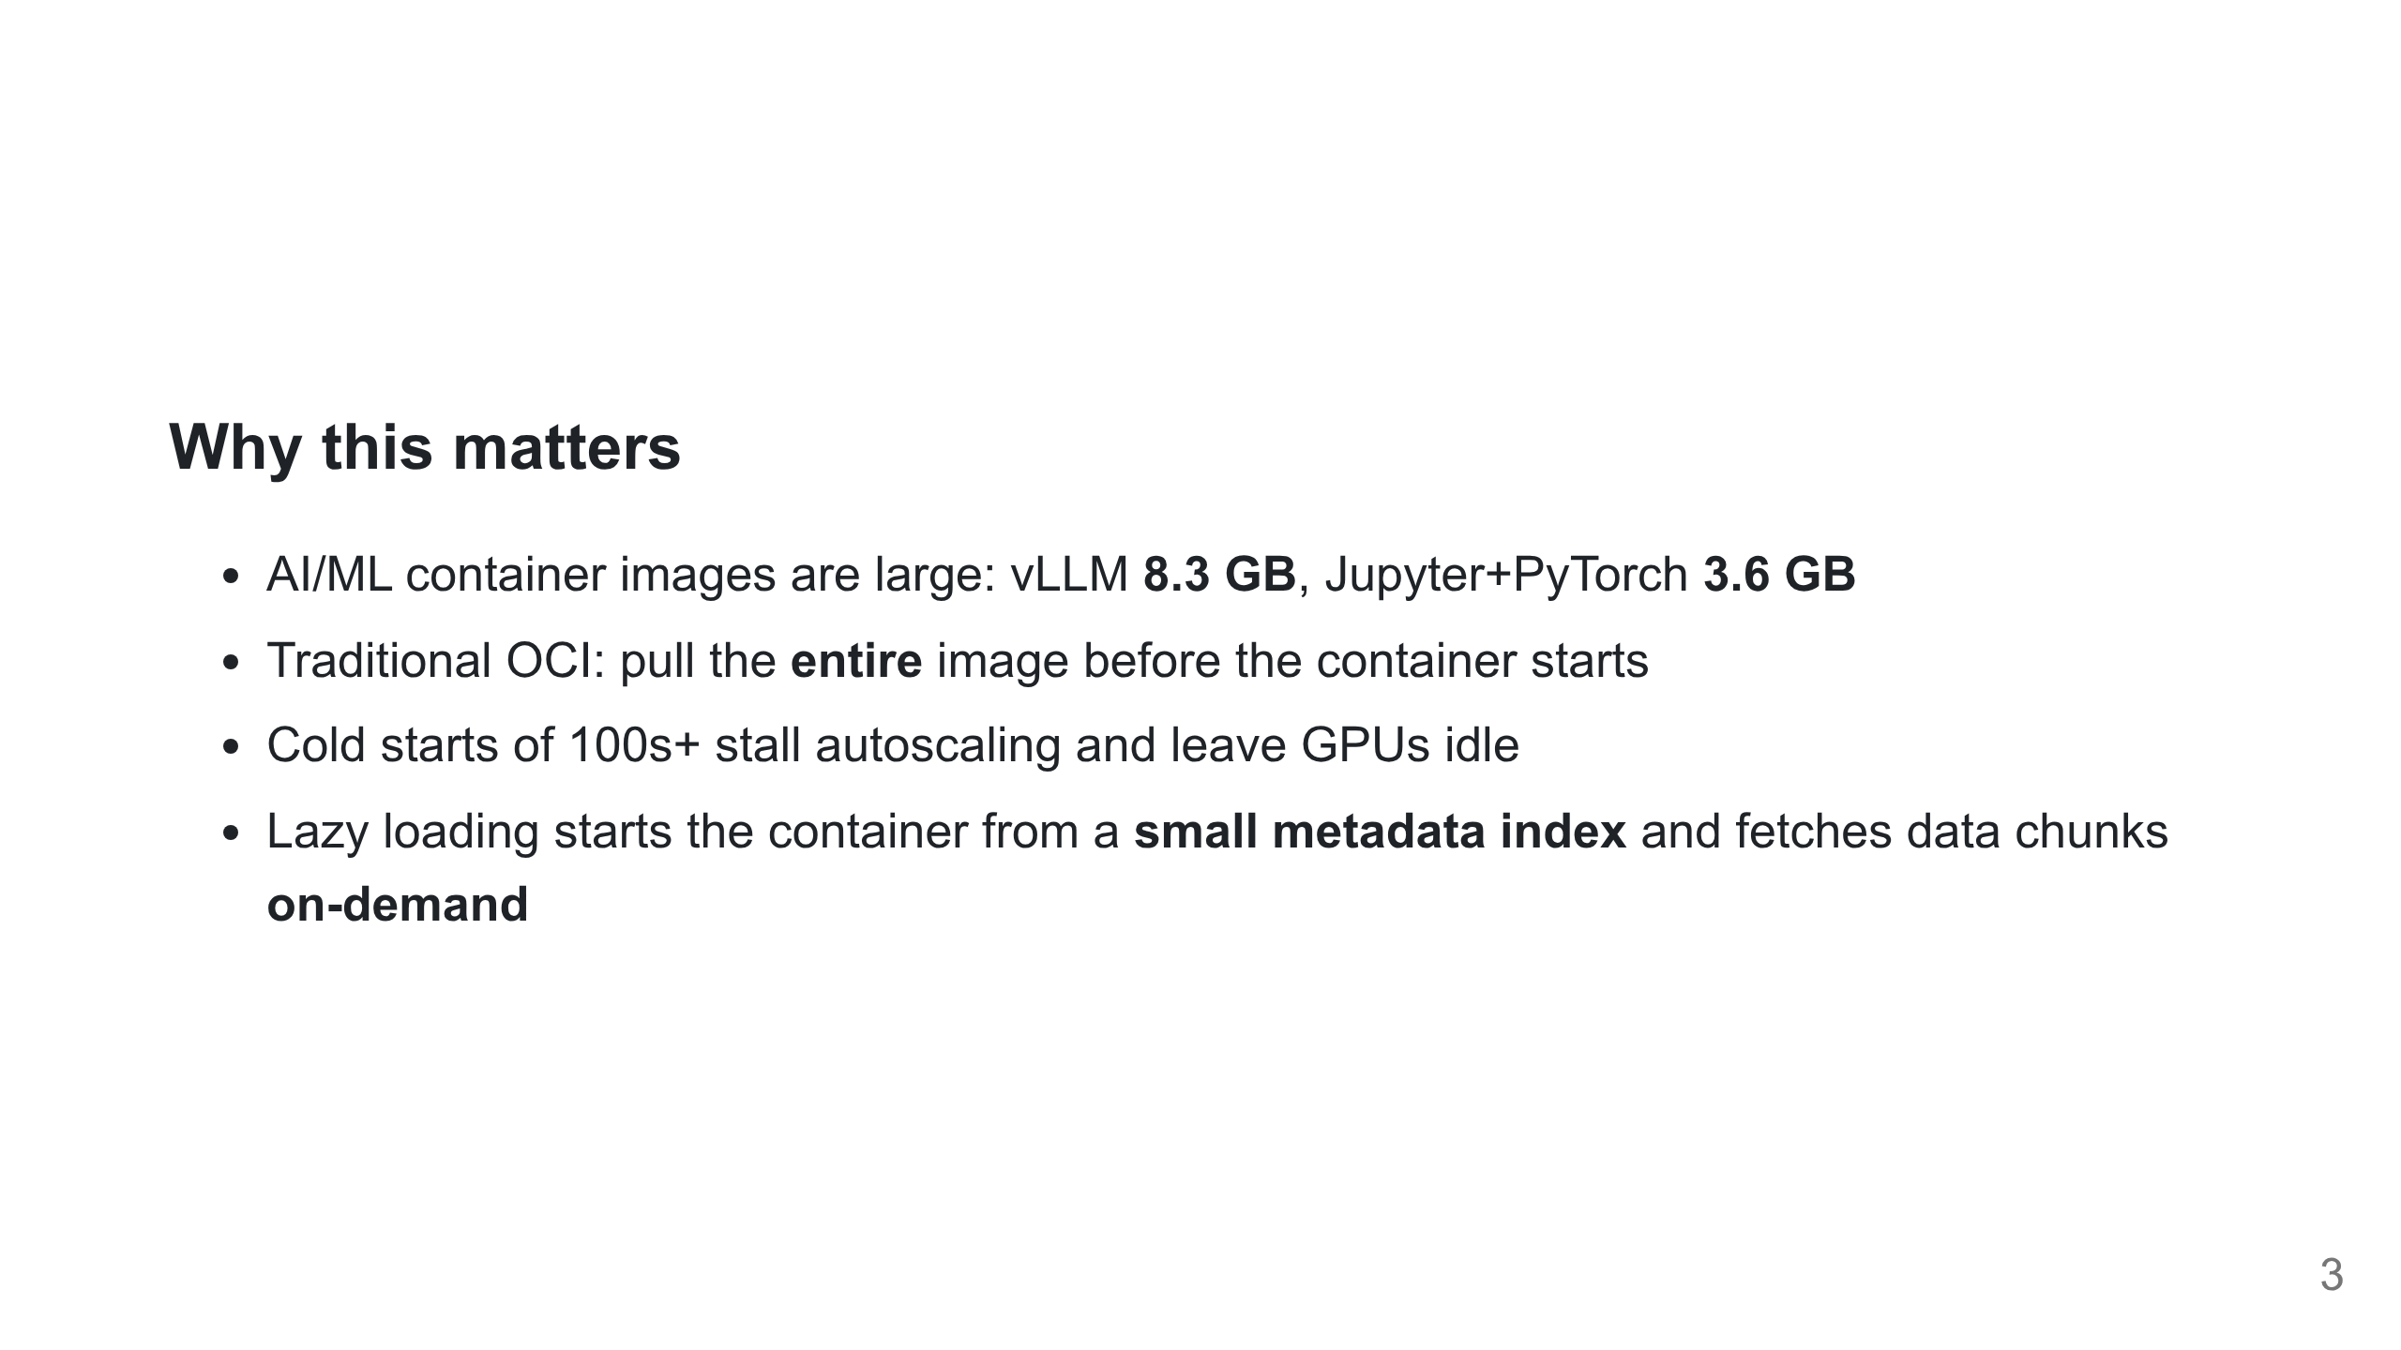
Notes:
This is the same framing as the report's overview. Set the problem before naming any technology.

Slide 4
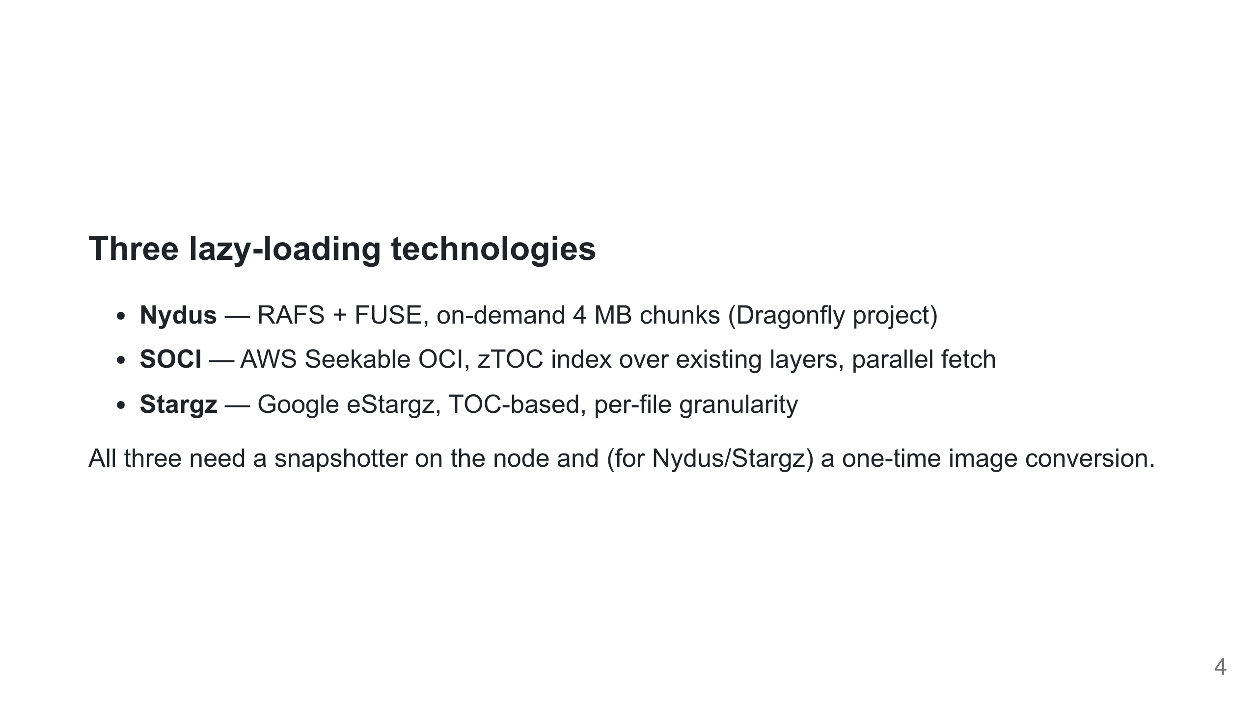
Notes:
SOCI is appealing because it doesn't rebuild the image. The benchmark shows why that's not enough.

Slide 5
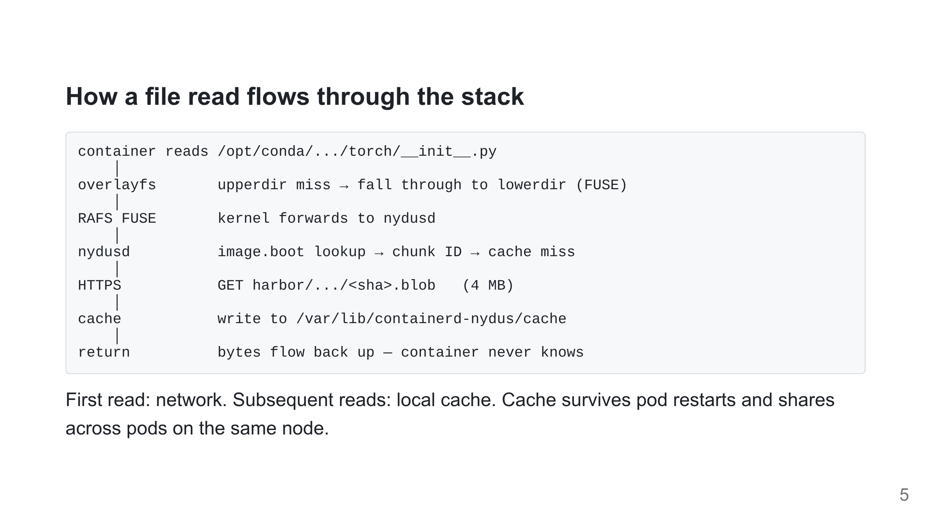
Notes:
Walk it once top-to-bottom. Sets up why registry locality and chunk size matter when we hit the benchmark slides.

Slide 6
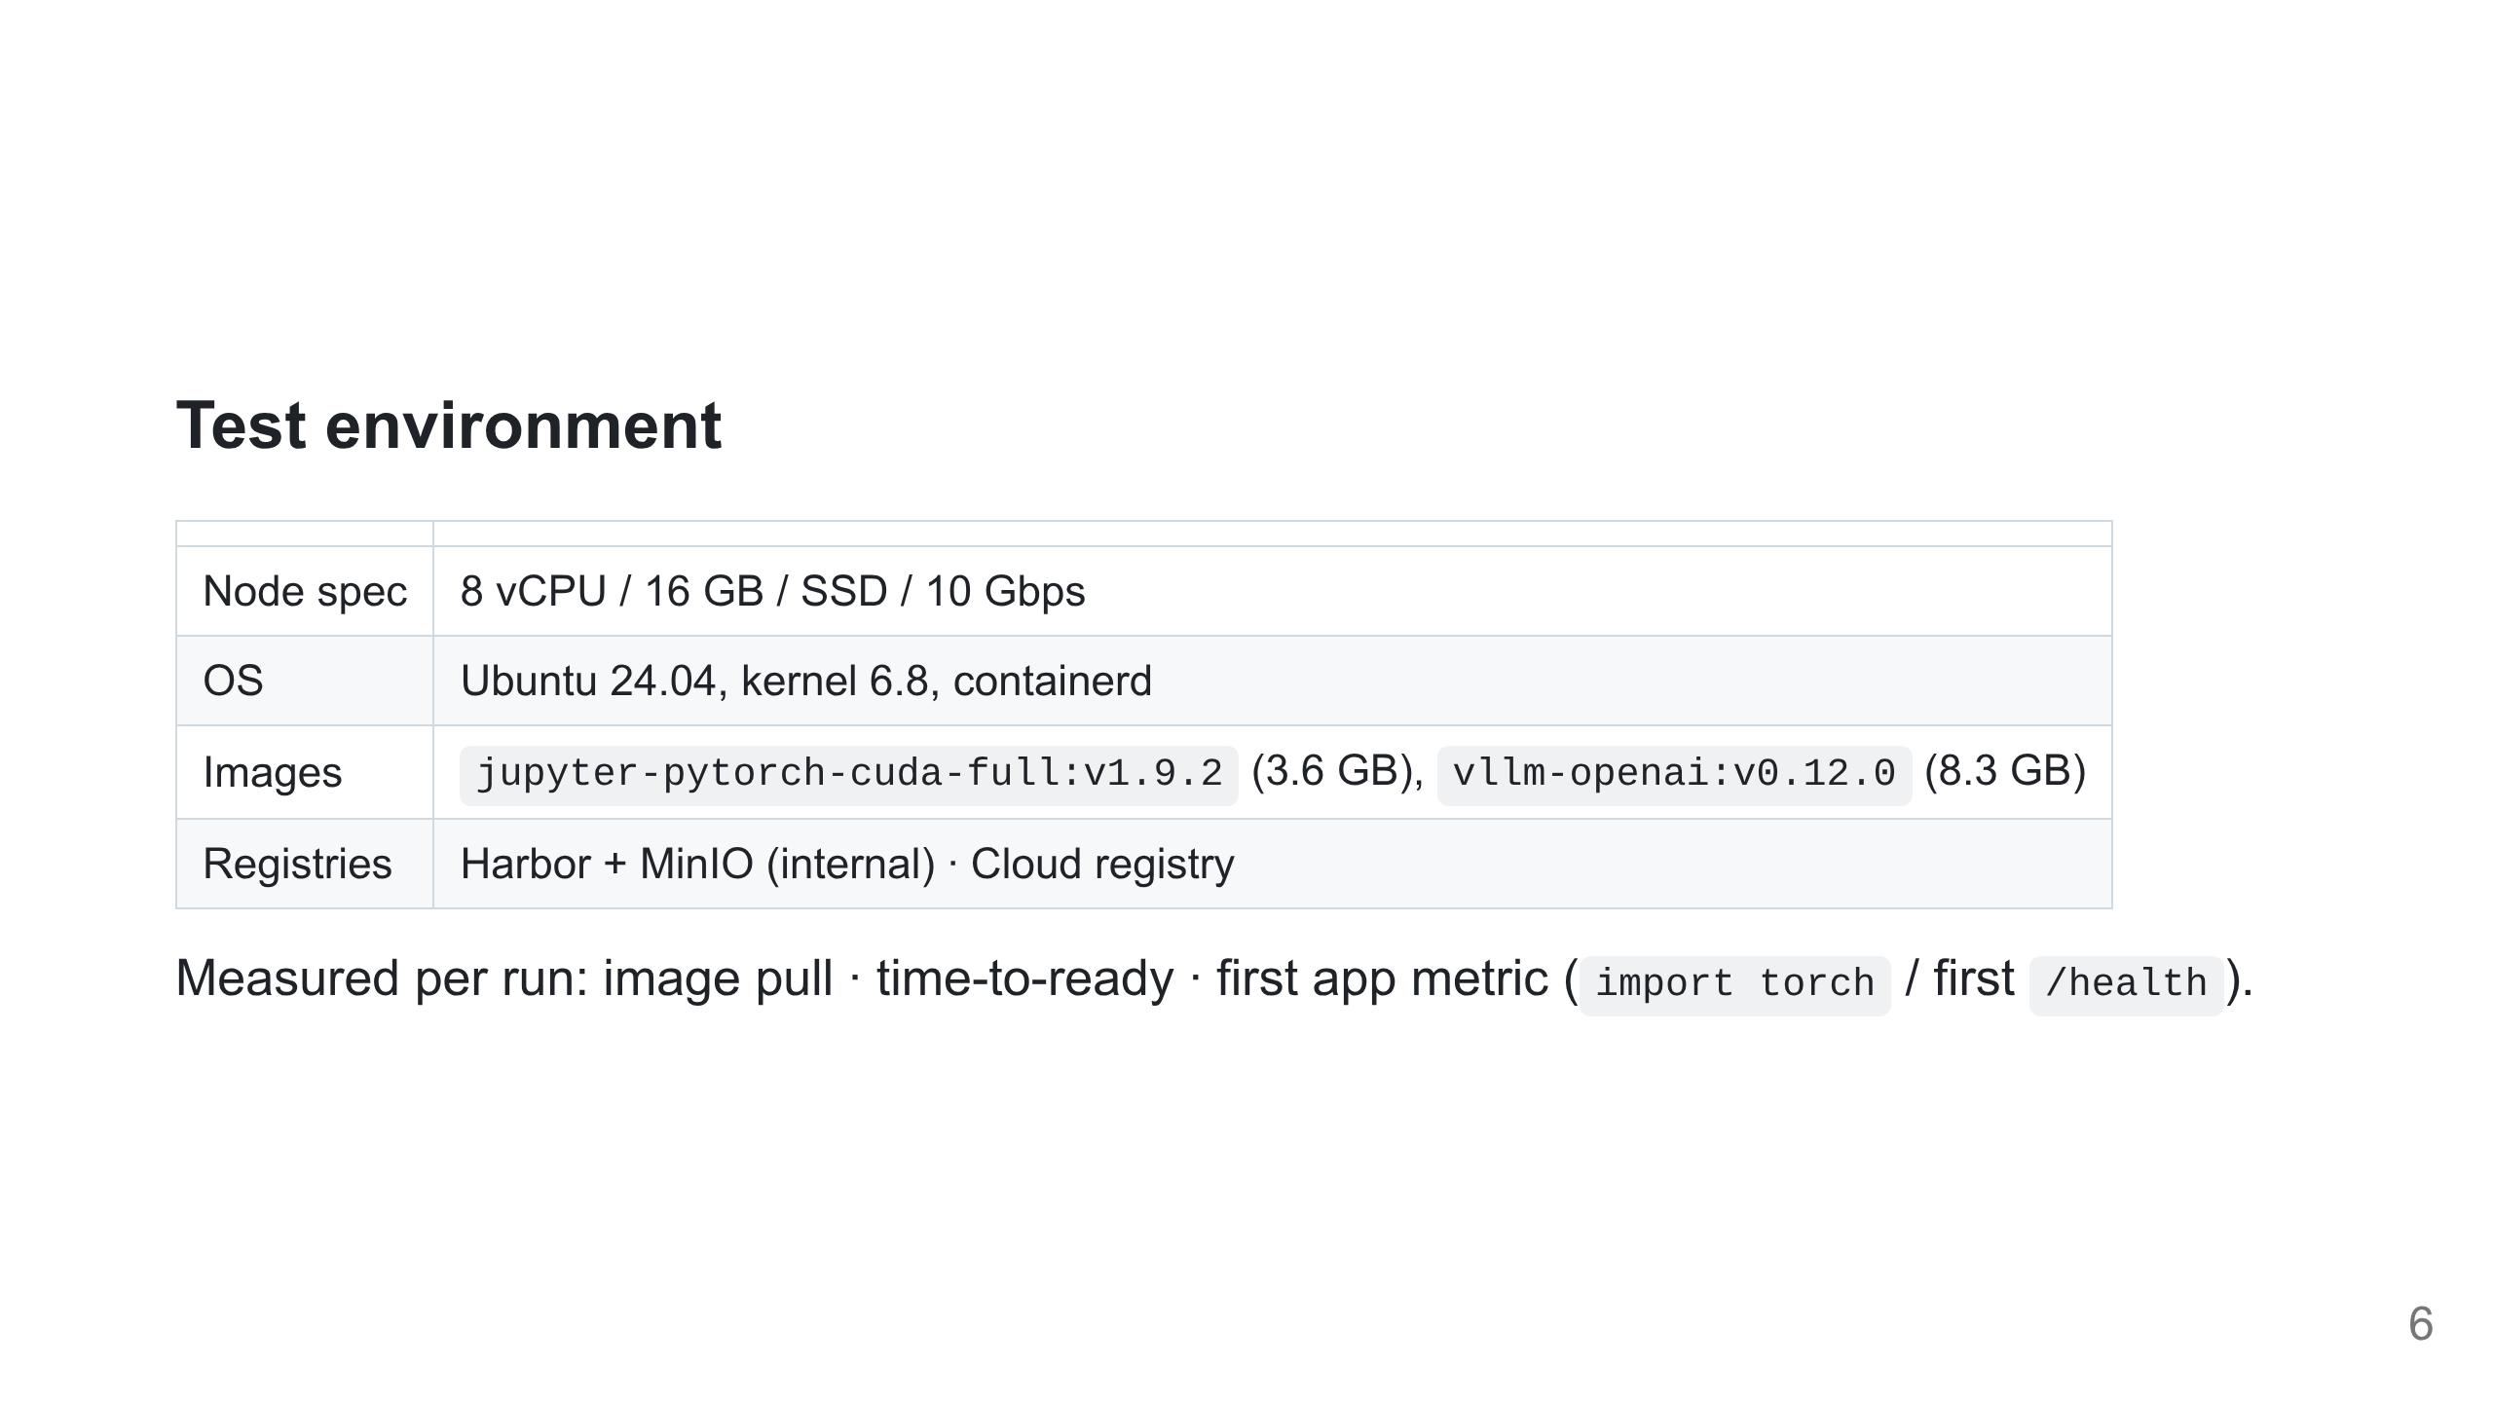
Notes:
Registry locality is a deliberate variable — we want to know if lazy loading still helps when blobs are far away.

Slide 7
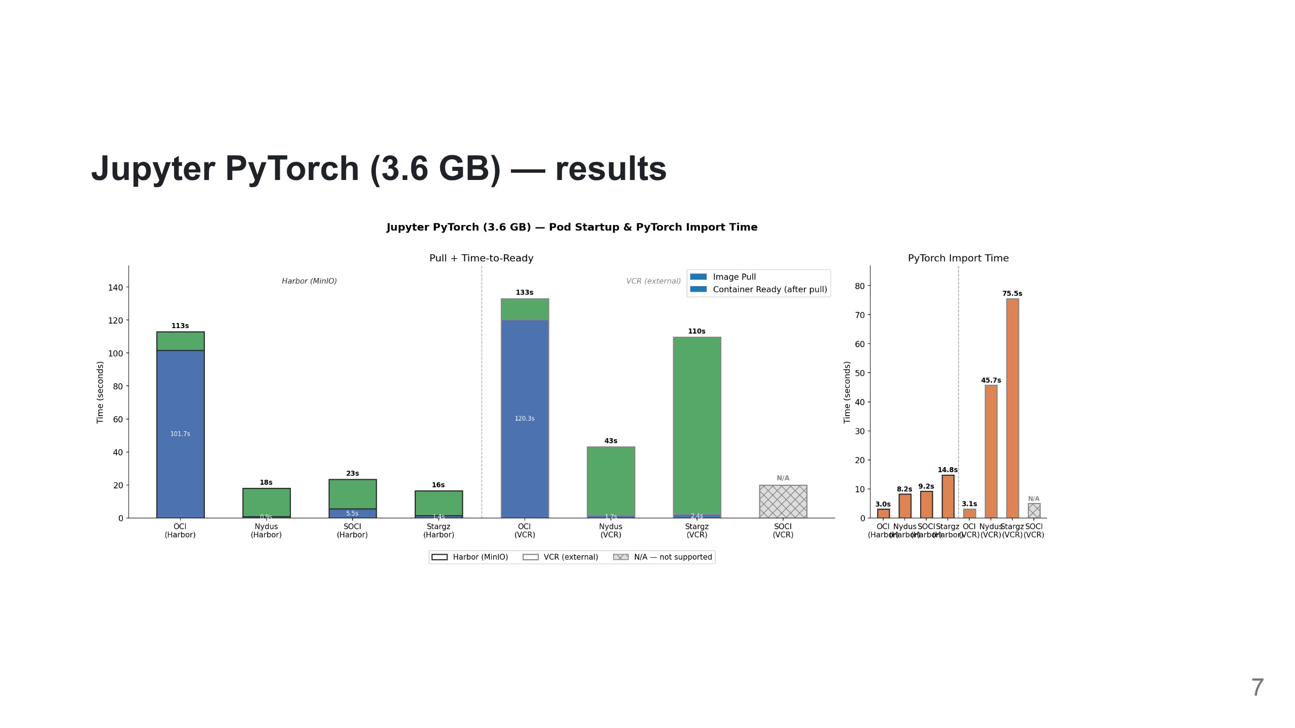
Notes:
Harbor — OCI 113s, Nydus 17.9s, Stargz 16.4s, SOCI 23.4s. VCR — OCI 133s, Nydus 43s, Stargz 110s, SOCI N/A (VCR didn't expose the index format SOCI needs). `import torch` after ready: Nydus/Harbor 8s, Nydus/VCR 46s.

Slide 8
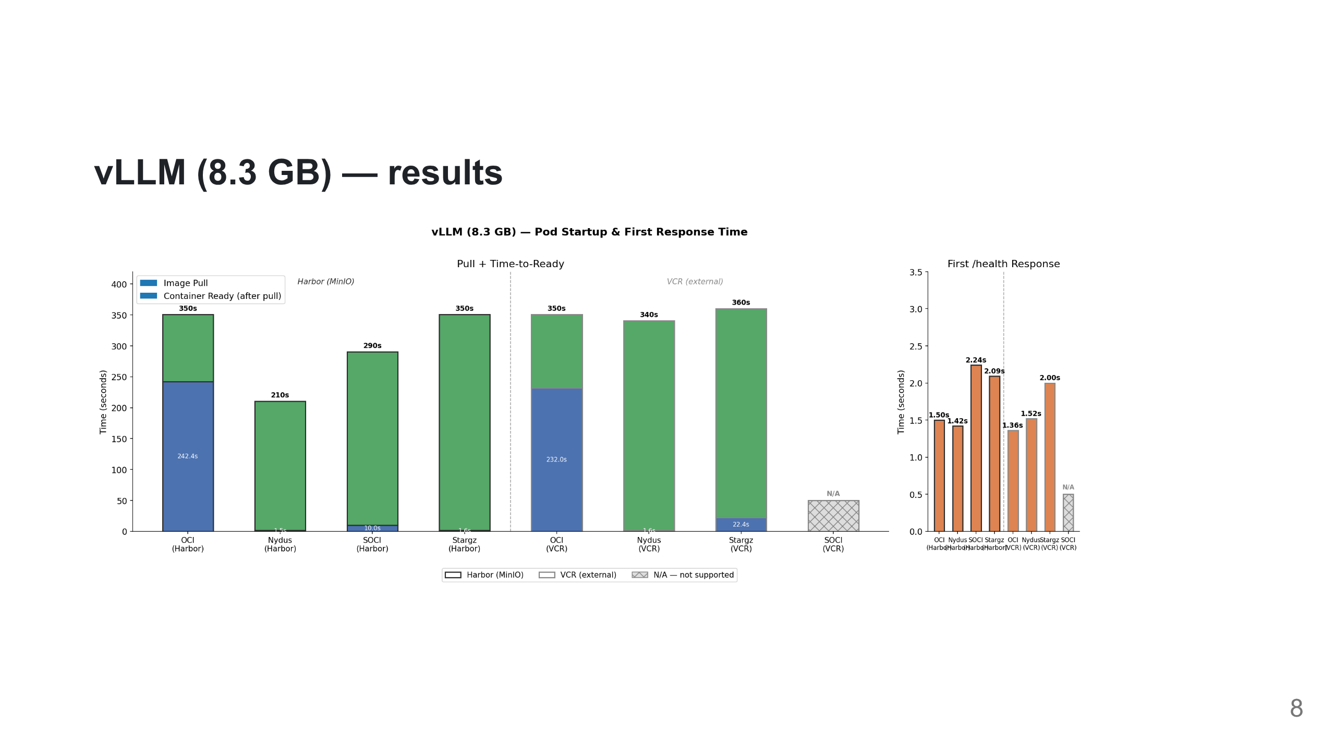
Notes:
Harbor — OCI 350s, Nydus 210s, SOCI 290s, Stargz 350s. VCR — OCI 350s, Nydus 340s, Stargz 360s, SOCI N/A. First `/health` response 1.4–2.2s across all working configs. Smaller relative win on vLLM than on Jupyter — next slide explains why.

Slide 9
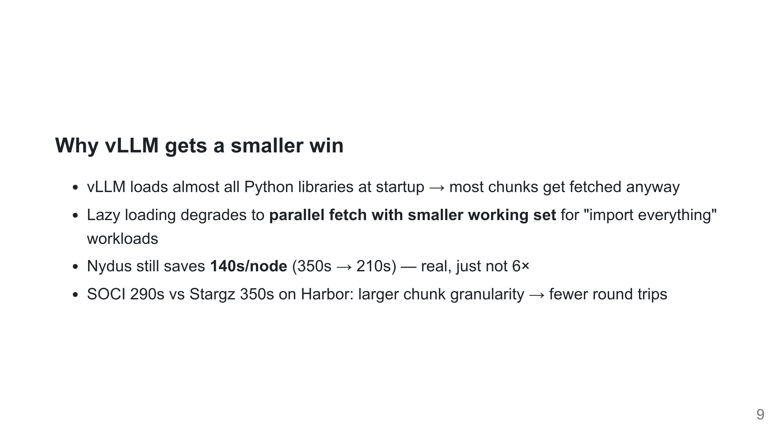
Notes:
Be honest with the audience. The report's key observations #1 and #2 land here.

Slide 10
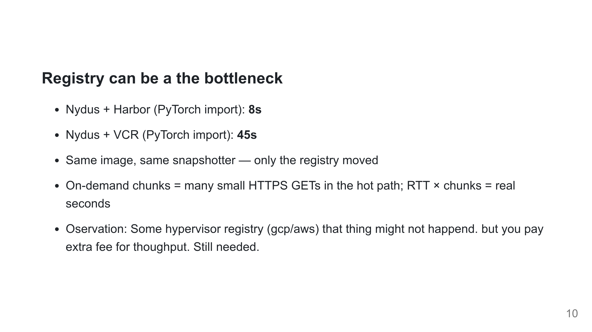
Notes:
This is the report's key observation #3. Push back on "use the public registry for now."

Slide 11
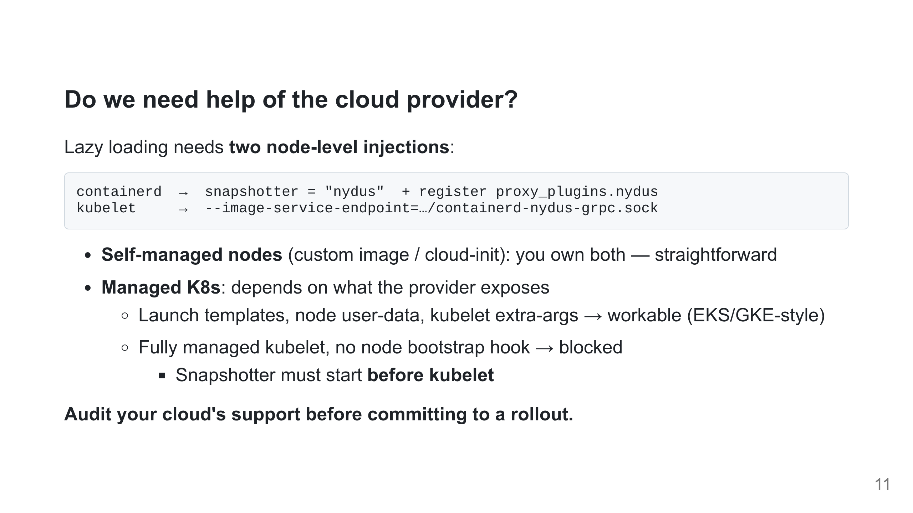
Notes:
Real-world friction lives here, not in nydus itself. The pod-vs-systemd ordering is why it has to be a host service. Full unit file and config layout are in the repo — point, don't read.

Slide 12
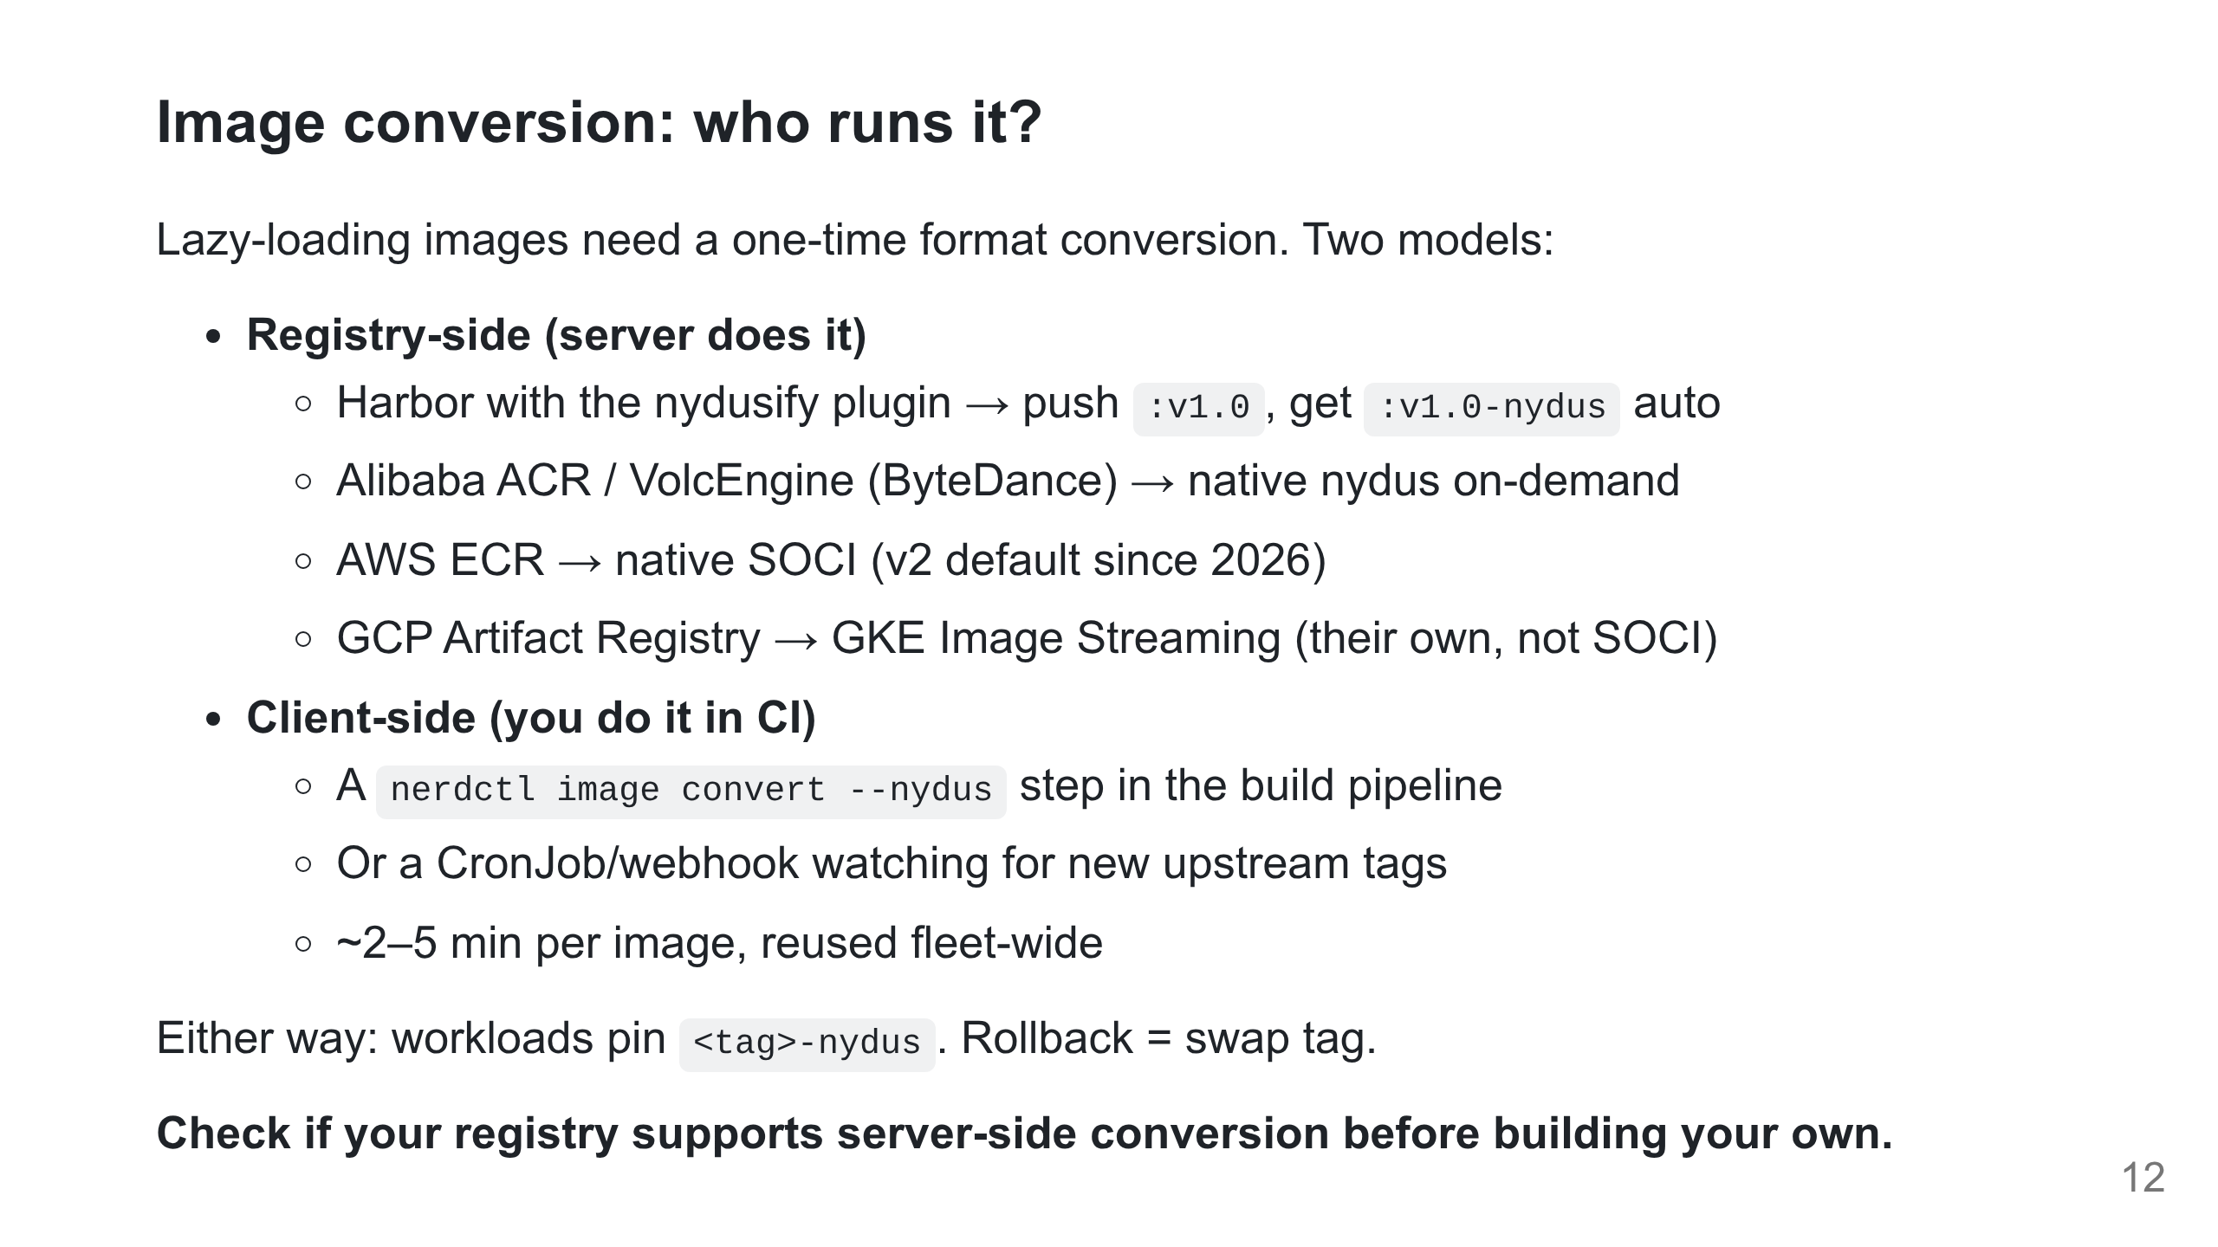
Notes:
Server-side conversion is a registry feature, not a Kubernetes feature — same theme as the kubelet/containerd slide: how much your provider gives you decides how much glue you write.

Slide 13
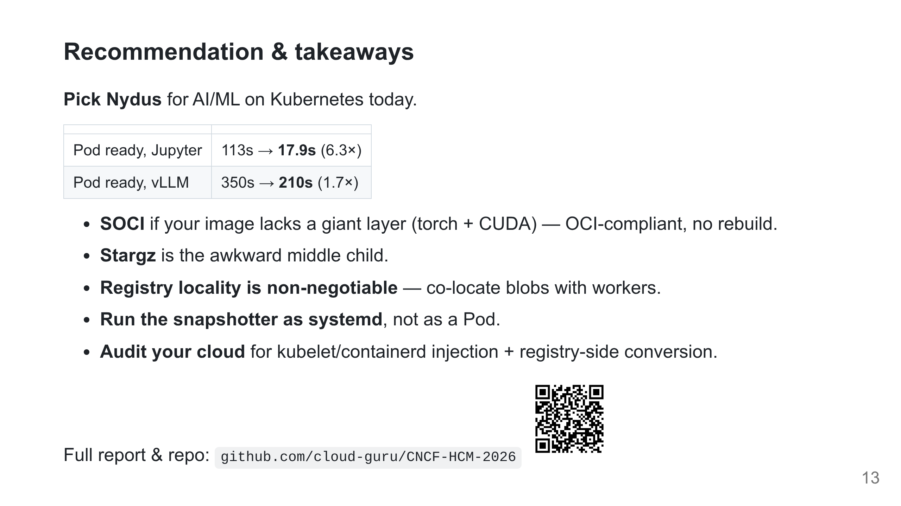
Notes:
Combined verdict + takeaways. Keep up during Q&A.

