Slide 1
The True Cost of Generative AI for your Enterprise

Slide 2
Inference cost — the cost of calling an LLM to generate a response
Tuning cost — the cost of tuning an LLM to drive tailored pre-trained model responses
Pre-training cost – the cost of training a new LLM from scratch
Hosting cost — the cost of deploying and maintaining a model behind an API, supporting inference or tuning
Notes:
There are four common costs to operationalizing generative AI within an enterprise. I will describe these in terms of an LLM because they are the most popular at the moment, but these costs apply to other types of generative models as well (e.g. diffusion models, GANs, VAEs, etc.).

Slide 3
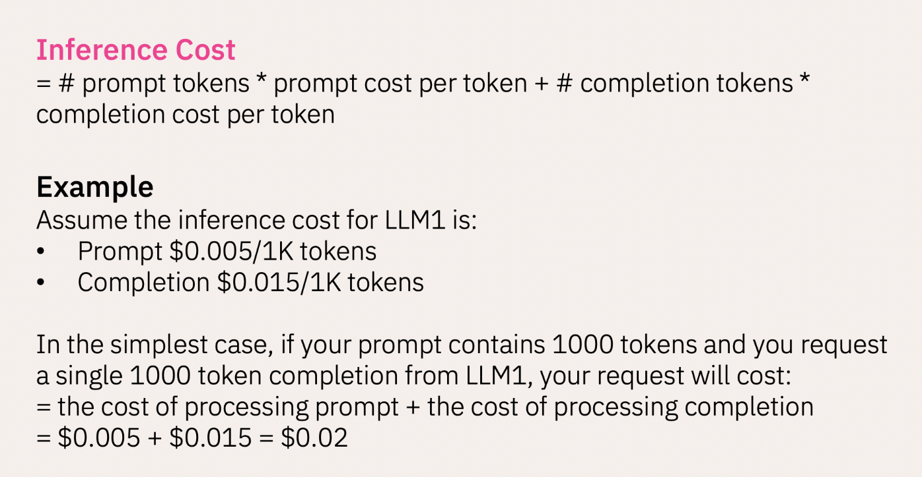
Inference cost
Inference is typically priced per 1K tokens (about 750 words)
Notes:
Each time you provide input to an LLM (the prompt) in order to generate an output (the completion), it uses compute resources. This process of invoking a trained LLM to generate an output is called inference. The cost of this process, primarily driven by GPU compute, is called the inference cost.
For LLMs, inference operates on discrete units of information called tokens. One token roughly consists of 3-5 characters of text.
The cost for a single inference includes the number of tokens in both the prompt and the completion.

Slide 4
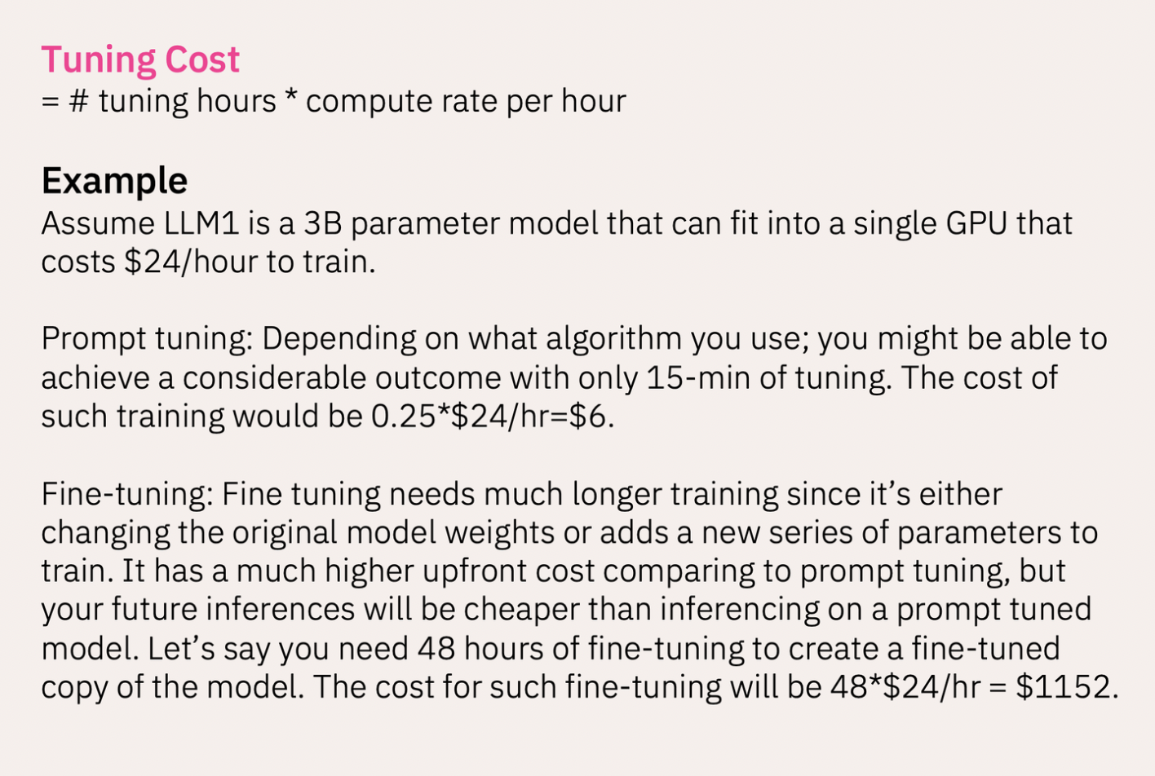
Tuning cost
Tuning is typically priced per compute hour
Notes:
Pre-trained models may be tuned in two ways in order to drive tailored responses: prompt tuning and fine tuning.
Prompt tuning is an efficient, low-cost way of adapting a pre-trained model to new tasks. It does not alter the pre-trained model.
Fine tuning is the process of adapting a pre-trained model to perform a specific task by conducting additional training with new data. Fine tuning a model alters the pre-trained model and therefore has a much higher training cost.
NOTE: The cost of tuning is a function of how much compute is required to perform the tuning operation. It is typically charged on a per compute hour basis, with the hourly rate depending on the type of GPU used to perform the tuning. Larger models will require more compute cycles for tuning, leading to a higher tuning cost.

Slide 5
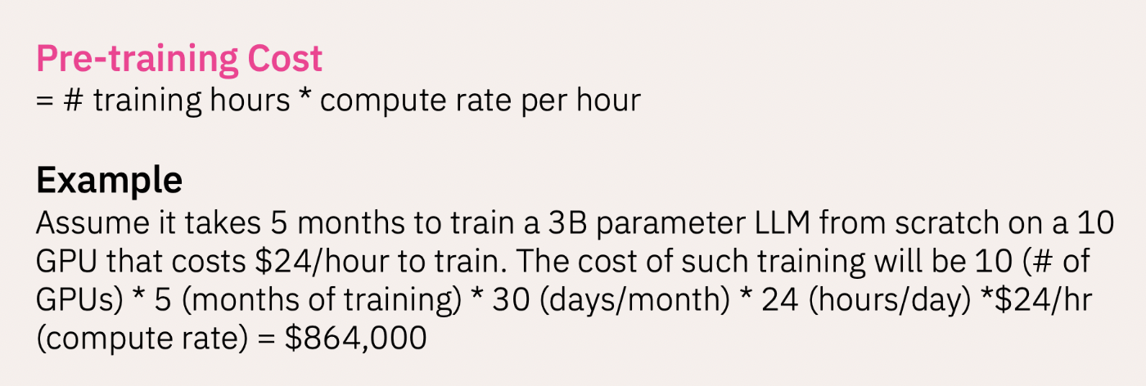
Pre-Training cost
Notes:
Pre-training is the process of training a new LLM from scratch. This process gives enterprises full control over the data used to train an LLM, but it can also be cost prohibitive.
As an example, GPT-3's pre-training was performed using 1,024 GPUs over the course of 34 days, costing $4.6M in compute resources alone. Hence, only a small number of model providers have emerged in the marketplace that have taken on the challenge of pre-training LLMs from scratch.

Slide 6
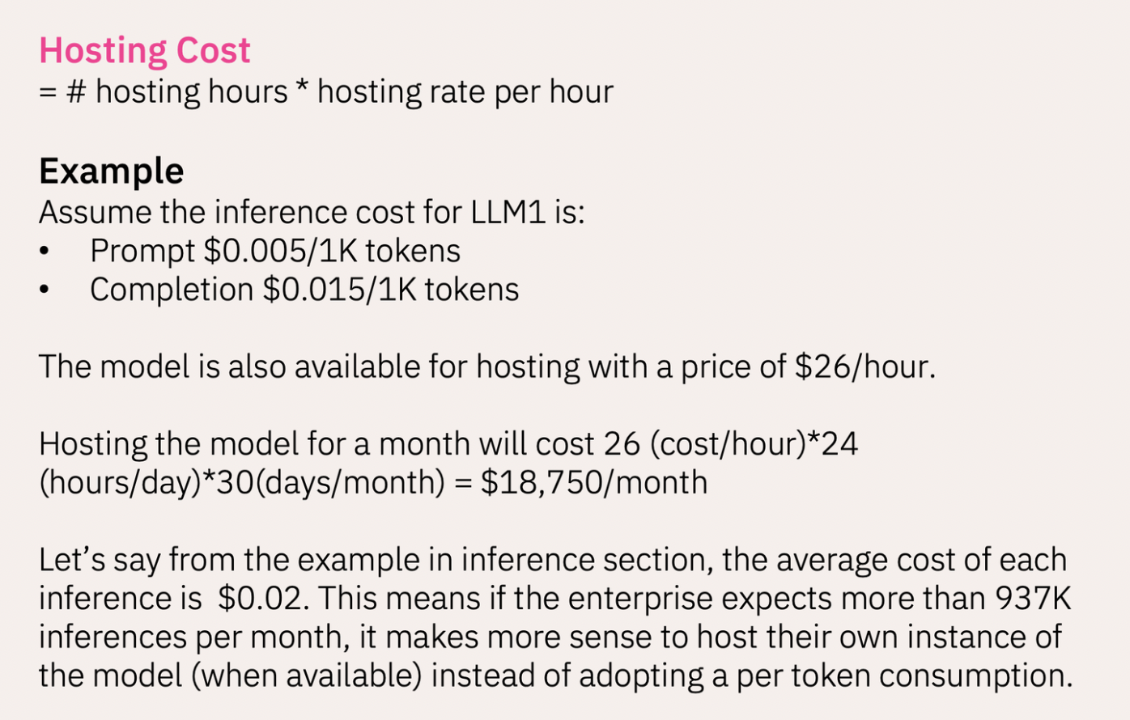
Hosting cost
Hosting is typically priced per hour
Notes:
There are two ways to make an LLM available for inference:
Inference API. The LLM is pre-deployed by a platform provider and made available via an API. The cost of inference for a single API call is based on the number of tokens processed (prompt plus completion) in that API call.
Hosting. The LLM is made available for deployment by a platform provider. Customers who wish to deploy a model (making it available for their application) pay based on the duration of that model's deployment.

