Slide 1
Optimizing inactive cloud workloads in CrownLabs
CrownLabs is used by many students for their course labs, and they tend to keep their services (e.g., VMs, containers) active even if they are no longer used.
This project aims at identifying which resources are no longer active from a given amount of time (e.g., 1 week) and send a warning message to the owner, asking him to log-in again to keep it active. If this action is not done after a given number of warning is issued (e.g., N warnings over N days), the service is removed from the cluster.
Optionally, a more sophisticated action policy can be implemented, e.g., depending on the nature of the workload:
stateless pod: it may be removed from the cluster (e.g., deleted);
stateful pod (VM): it could be "paused" and saved on disk, ready to be restored in the future;
pods whose workload is below a given threshold (e.g., web server with very low traffic): the resource limits in Kubernetes can be adjusted in order to be more aligned with the actual resource consumption (e.g., 1vCPU limit changed to 0.1vCPU)
Finally, as a further optional optimization, Kubernetes worker nodes can be drained and their pods can be moved to other workers, hence consolidating the workload on an inferior number of servers.

Slide 2
Identified Requirements
Inactive detection policy (initially based on Tenant last login, could be extended to instance metrics such as workload or ingress/proxy access)
Tenant notification when an inactive instance is detected (email)
Instance pause/deletion after max inactive time
(opt.) Adjust pod resource limits based on the actual consumptions
(opt.) Live migration for resource consolidation among worker nodes
(new idea) Ensure it is not a bot connection
(new idea) Allow for custom policies for special instances/tenants.

Slide 3
Inactive Detection Policy: Possible alternatives
Last Login Field in Tenant CRD: policy based on tenant last login date
Ingress connections (SSH and VNC): policy based on last
Instance workload metrics: policy based on CPU/Mem/Net utilizations
Track Human activity like keyboard and mouse

Slide 4
Granularity and Scope
- | differentiate among active VM | additional info for the single instance | specify different requirement for each instance | notes
Tenant Level | ⛔ | ⛔ | ⛔ | you may have several old inactive VMs but if you login to create another one, the field is updated and the VMs are not shut down
Instance Level | ✅ | ✅ | ✅

Slide 5
Pro and Cons: Tenant Last Login
Pros:
Easy to develop and maintain
It can be good for traditional Crownlabs use scenario
Cons:
Does not consider last login on instances, user could spawn tens of instances and use only one of them (Low resource optimization)
When inactivity detected, all instances will be deleted since no info about instance last login.

Slide 6
Pro and Cons: Ingress connection
Pros:
Guarantee coverage of most of use cases (non interactive and interactive access)
Reliable: no false negatives, no false positives (assuming to discriminate between human and bot connections)
Cons:
Need to discriminate between human and bot connection, e.g. with a simple numeric captcha in terminal and vnc (can be added as a feature later on).

Slide 7
Pro and Cons: Workload
Pros:
Easy to develop: Node Exporter already provides these metrics
Cons:
Unreliable: there is no fixed threshold, different templates may have different idle statuses.
Easy to bypass: a simple script could bypass the detection policy.

Slide 8
Pro and Cons: Human Activity
Pros:
Hard to bypass: need custom and sophisticated programs to elude the detection policy.
Cons:
Complex to develop and maintain due to different environment technologies (SSH, DEs)
Probably unnecessary

Slide 9
Hybrid approach: Tenant access and Instance access
A policy based on two metric could be implemented as follows: a more relaxed policy for Tenant last login (e.g. 3M) with deletion of entire Tenant Namespace, combined with a tighter Ingress connection policy (e.g. 1W) that operates on the single instance.
Pros:
Guarantee coverage of most of use cases (non interactive and interactive access)
Reliable: no false negatives, no false positives (assuming to discriminate between human and bot connections)
Discrete granularity
Cons:
Some sort of bot detection feature could be added later on

Slide 10
Summary
- | Reliability | Maintainability | Notes
Tenant Last Login | ★ ★ ★ ☆ ☆ | ★ ★ ★ ★ ★ | -
Ingress Connection | ★ ★ ★ ★ ☆ | ★ ★ ★ ★ ☆ | -
Workload | ★ ☆ ☆ ☆ ☆ | ★ ★ ☆ ☆ ☆ | -
Hybrid (tenant + ingress connection) | ★ ★ ★ ★ ★ | ★ ★ ★ ★ ☆ | -
Human Activity | ★ ★ ★ ★ ★ | ★ ☆ ☆ ☆ ☆ | -

Slide 11
Proposed solution: Hybrid (tenant+ingress)
Ingress exposes metrics about http connections to the instances. At the same time, a TCP Connection Tracker exposes TCP connection to the instances (Could be implemented as Bastion Sidecar?). Prometheus scrapes those metrics. The alert manager triggers webhooks whenever a connection to an instance is received. The webhook triggers the Instance Controller that updates the instance CRD by setting the LastConnectionDate field. The Instance Controller implements a Watchdog mechanisms that checks if the (actual date - LastConnectionDate) > a threshold. If yes, the instance controller triggers the SMTP server through a WebHook, sending the Tenant email as parameter. It then updates the AlertNumber field in the Instance.
At the same time, the tenant controller checks for the LastLogin field of the tenant in CrownLabs WebUI. If the actual time - LastLogin > TenantThreashold, a mail is sent in the same way, after N alert, the entire Tenant Namespace is deleted.
After a certain number of alerts, VMs can be stopped or new resource limits can be enforced.
Notes: TCP conn tracking allows to work with all remote desktop protocol (such as Guacamole, wetty, noVNC) as well as SSH connections.

Slide 12
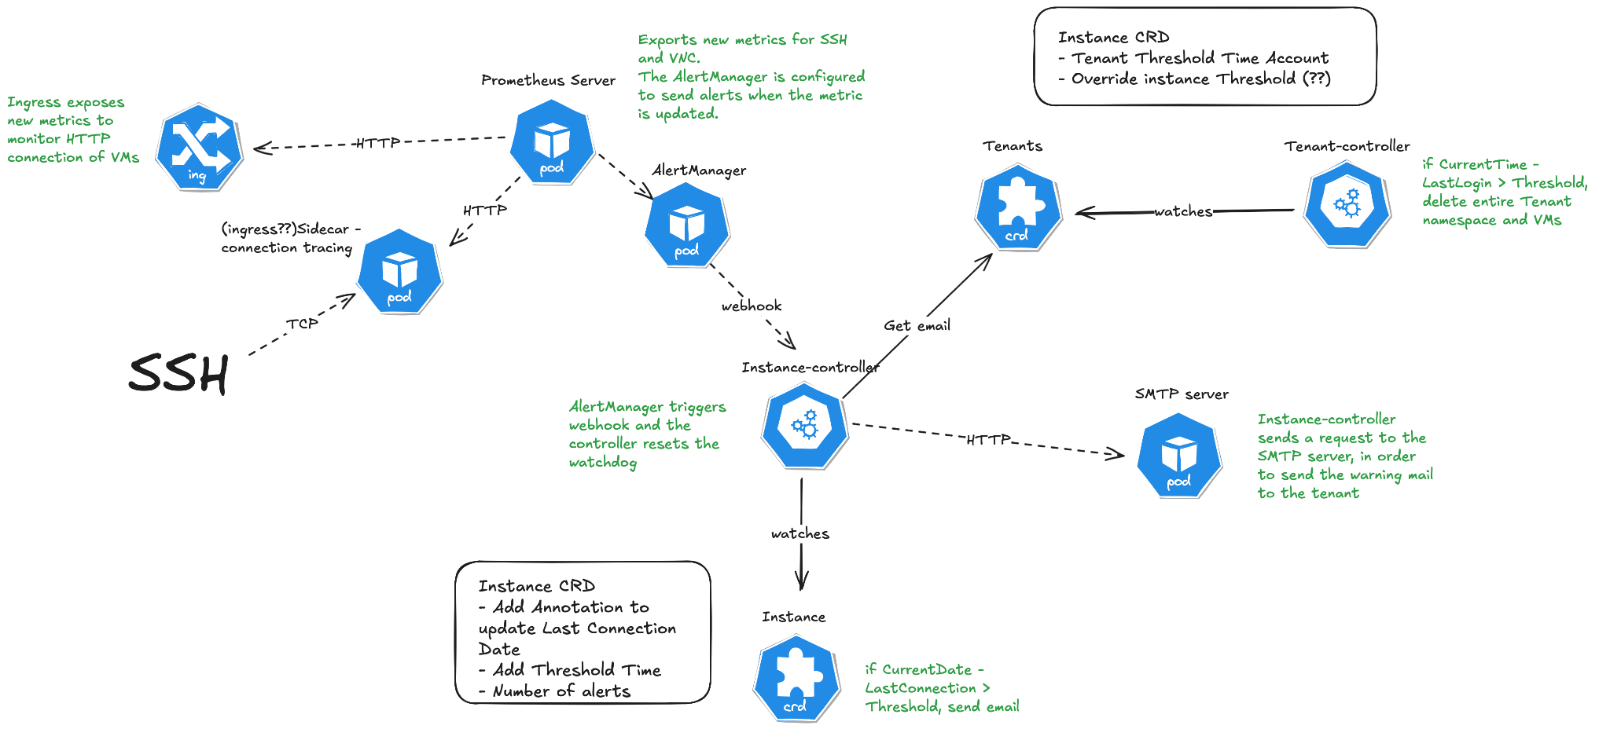
Proposed solution (2)

Slide 13
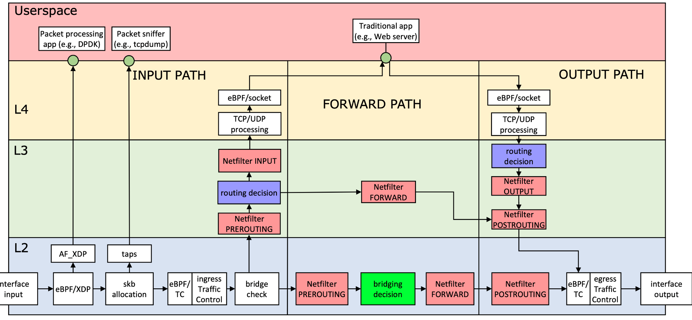
Proposed solution (3)
Does it make sense to do all in eBPF or leave http to ingress metrics? (more complex policies can be implemented in eBPF)

Slide 14


