Slide 1



Plan 9
A New Paradigm for Operating Systems

Slide 2

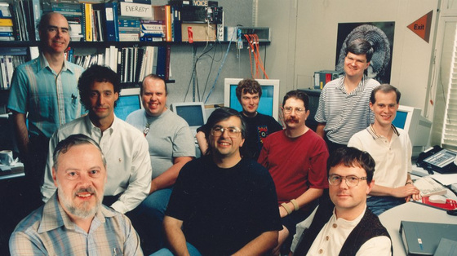
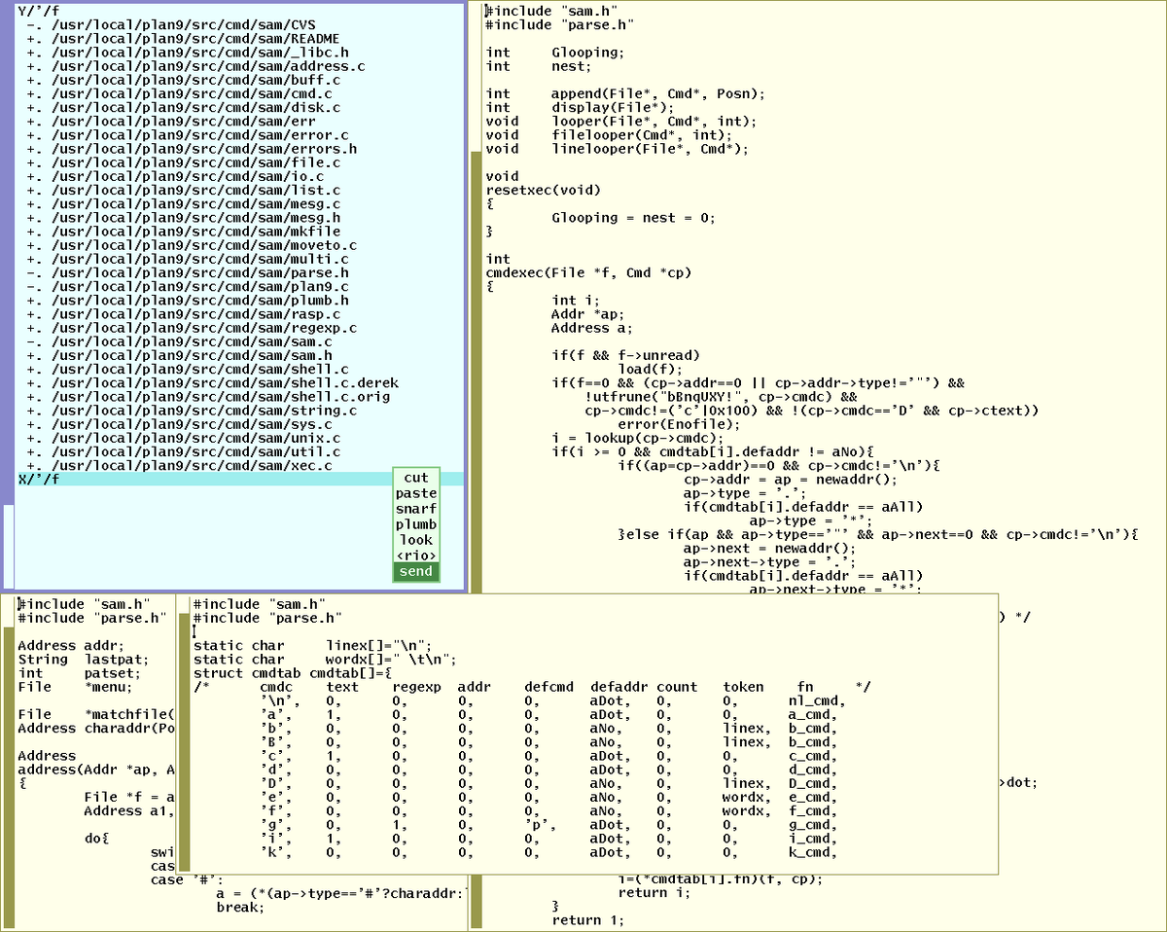
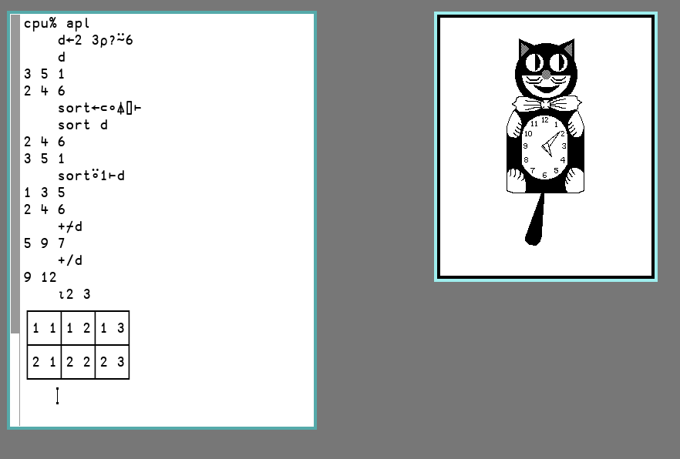
A Brief History
Began development in late 80s
Development led by a star-studded cast
Rob Pike, Brian Kernighan, Ken Thompson, Bjarne Stroustrup
Released to public in 1995
Fine-tuned for research and networking — not user-friendly
Unix: “Everything is a file”
Minimalism, portability, purity
Laid to rest Jan 10, 2015
Carried on by 9front, Inferno, 9legacy, etc.

Slide 3
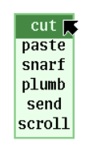
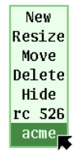
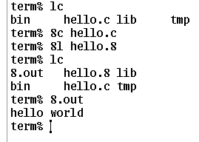
Idiosyncrasies
Independent C library
No GNU, and no GCC! A dialect of C.
Custom, but portable, C compilers
Unique compiler for each architecture
8c for x86, 6c for AMD, 5c for ARM, 0c for MIPS
9P network protocol
Used by Microsoft for WSL since 2019!
Independent windowing system (rio)
Doesn’t use X Window System
A distributed operating system
Total data communication transparency
Encourages cluster computing
Not Bash, not PowerShell, but rc!
Some commands are the same, many are different
No symbolic links, and no sudo (it’s unsafe!)

Slide 4
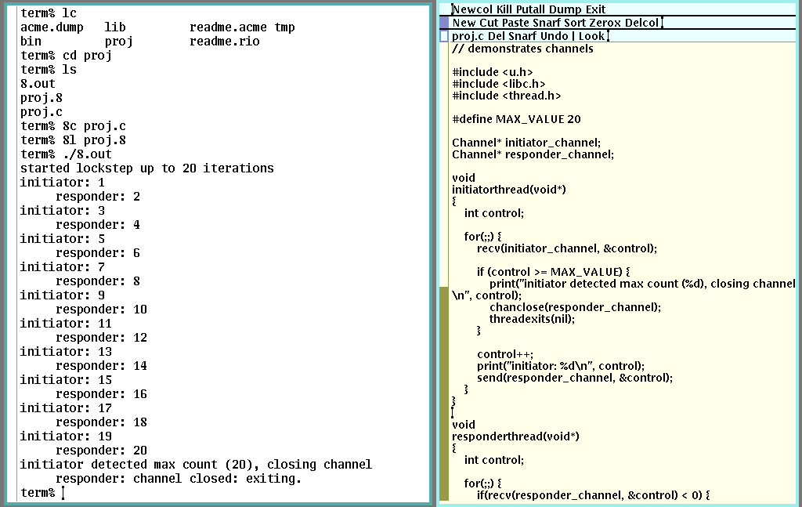
Synchronization via Channels
Threads communicate via channels
Mutexes, condition variables, and locks are not necessary
Although they are provided
send(): sends value through channel, blocks
recv(): receives value through channel, blocks
chancreate()/chanclose() enforce synchronization – no primitives needed
Channels are powerful enough to implement pipes, sockets, and semaphores

Slide 5
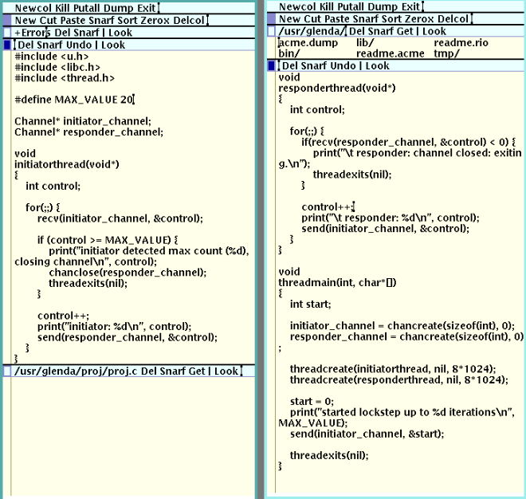
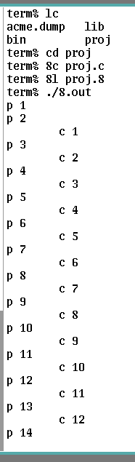
Concurrency in Plan 9
Same capabilities as POSIX threads, but with a different library
The iconic producer-consumer problem
Again, we use channels to avoid race conditions
Channels are “typed”, unlike Linux
Recall: send() vs. sendul(), and recv() vs. recvul()
Untyped (byte stream, pointers) vs. typed (direct, pass by value)
Unlike Linux, no thread attributes, no joining
Writers and readers automatically synchronize thanks to rendezvous communication

Slide 6
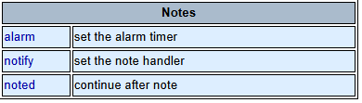
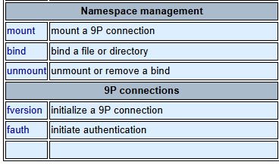
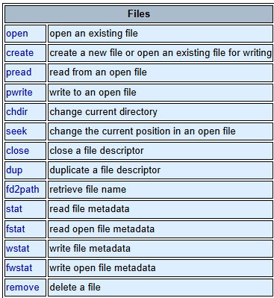
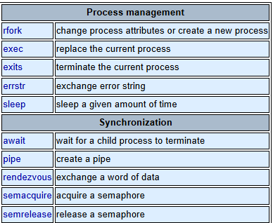
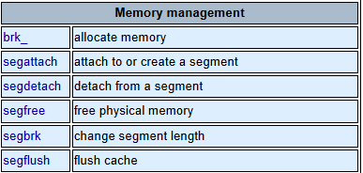
System Calls
Note the presence of a kernel-side note system
Pun not intended
Single words of data may be exchanged via rendezvous
Plan 9: 38 syscalls; Linux: Over 400
Note: Plan 9 has no kernel threads!

Slide 7








Significance and Impact
Once-native Plan 9 development tools, like rc, acme, and plumbing have been ported to Linux, Mac, and Windows
The 9P filesystem is made use of today by Windows’ WSL
Served as a catalyst for the software minimalism movement
A pioneering system in grid computing
Served as the backbone for years of innovative research at Bell Labs
Ran by Coraid hardware (data storage)
Influenced Google’s Go-lang
Inspired Inferno, 9front, and other OSes

