Slide 1

Multilevel queue scheduler
Abhinav Hazarika
Daniel Bokshan
Eric Wang
Vin Gluck

Slide 2
Design Decisions

Slide 3
MULTILEVEL QUEUE (OVERVIEW)
Order of Queues:
Round Robin (RR)
Shortest Time Remaining First (STRF)
First in First Out (FIFO)
Shortest Job First (SJF)
Reasoning:
Most important processes will get completed efficiently
Behavior is predictable
FIFO and SJF queues allow for specified task ordering
Different queues minimize overhead
Notes:
Anything placed in priority 1 should have the fairest and most even chance of running, so there’s round robin.
SRTCF is for tasks that are user-facing, but less interaction-based.
FIFO is good for slower-non-urgent tasks; we get the convoy effect for tasks of different sizes but it’s ok bc nothing is urgent here
SJF on the bottom suffers from starvation but once again it’s okay if it takes a long time to get to longer jobs because it’s whatever’s left

Slide 4
Order of the queues/Priority Levels
Round Robin is “fairest” and preemptive
Tasks like ui, drivers and real-time work
SRTCF optimizes for shorter jobs but still preemptive
System tasks that affect the user a lot; drivers, network connection handling, etc
FIFO
Slower, non-urgent tasks like file i/o
SJF
Whatever is left; complete the most jobs possible in a short time. Long tasks left here may starve but it’s low priority so it’s okay
Round Robin
SRTCF
FIFO
SJF
** FIFO and SJF can still be interrupted by a higher-priority queue
Notes:
Anything placed in priority 1 should have the fairest and most even chance of running, so there’s round robin.
SRTCF is for tasks that are user-facing, but less interaction-based.
FIFO is good for slower-non-urgent tasks; we get the convoy effect for tasks of different sizes but it’s ok bc nothing is urgent here
SJF on the bottom suffers from starvation but once again it’s okay if it takes a long time to get to longer jobs because it’s whatever’s left

Slide 5
Schedule-Main

Slide 6
Schedule-main
1
[A, B, C, D, 0, 0, 0, 0]
[E, 0, 0, 0, 0, 0, 0, 0]
2
[F, G, H, 0, 0, 0, 0, 0]
3
Daniel
[I, 0, 0, 0, 0, 0, 0, 0]
4

Slide 7
Schedule-main
1
[A, B, C, D, 0, 0, 0, 0]
[E, 0, 0, 0, 0, 0, 0, 0]
2
[F, G, H, 0, 0, 0, 0, 0]
3
Daniel
[I, 0, 0, 0, 0, 0, 0, 0]
4

Slide 8
Schedule-main
1
[0, 0, 0, 0, 0, 0, 0, 0]
[E, 0, 0, 0, 0, 0, 0, 0]
2
[F, G, H, 0, 0, 0, 0, 0]
3
Daniel
[I, 0, 0, 0, 0, 0, 0, 0]
4

Slide 9
Schedule-main
1
[0, 0, 0, 0, 0, 0, 0, 0]
[E, 0, 0, 0, 0, 0, 0, 0]
2
[F, G, H, 0, 0, 0, 0, 0]
3
Daniel
[I, 0, 0, 0, 0, 0, 0, 0]
4

Slide 10
Schedule-main
1
[0, 0, 0, 0, 0, 0, 0, 0]
[0, 0, 0, 0, 0, 0, 0, 0]
2
[F, G, H, 0, 0, 0, 0, 0]
3
Daniel
[I, 0, 0, 0, 0, 0, 0, 0]
4

Slide 11
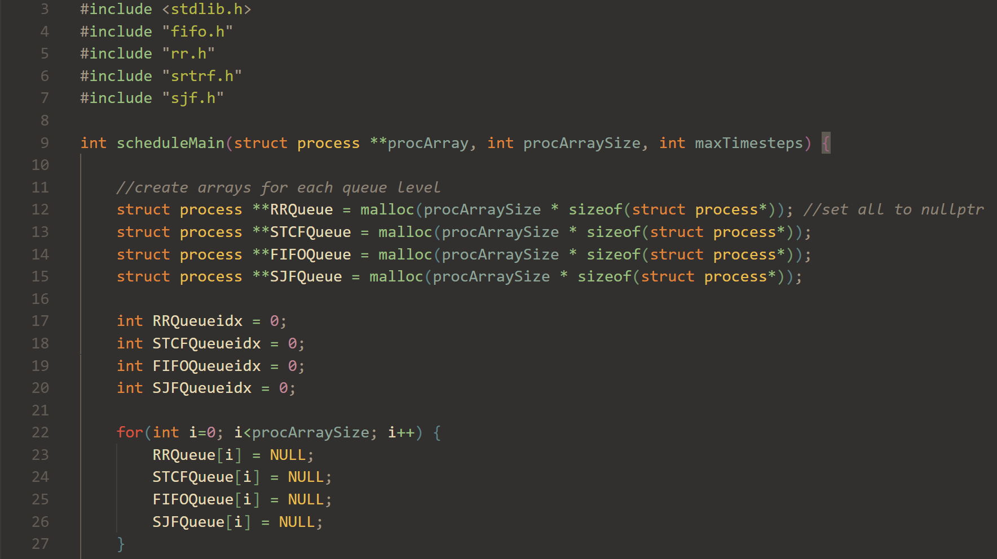

Slide 12
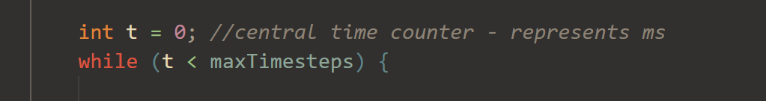
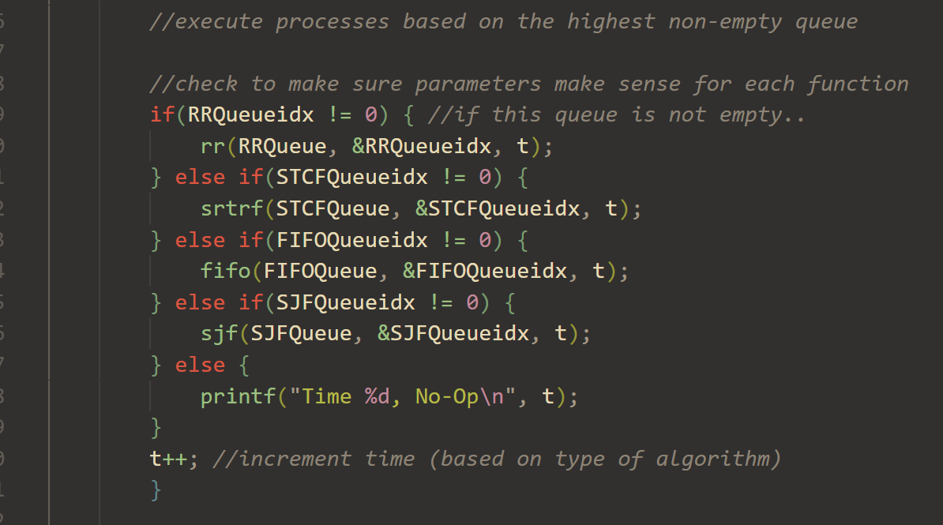
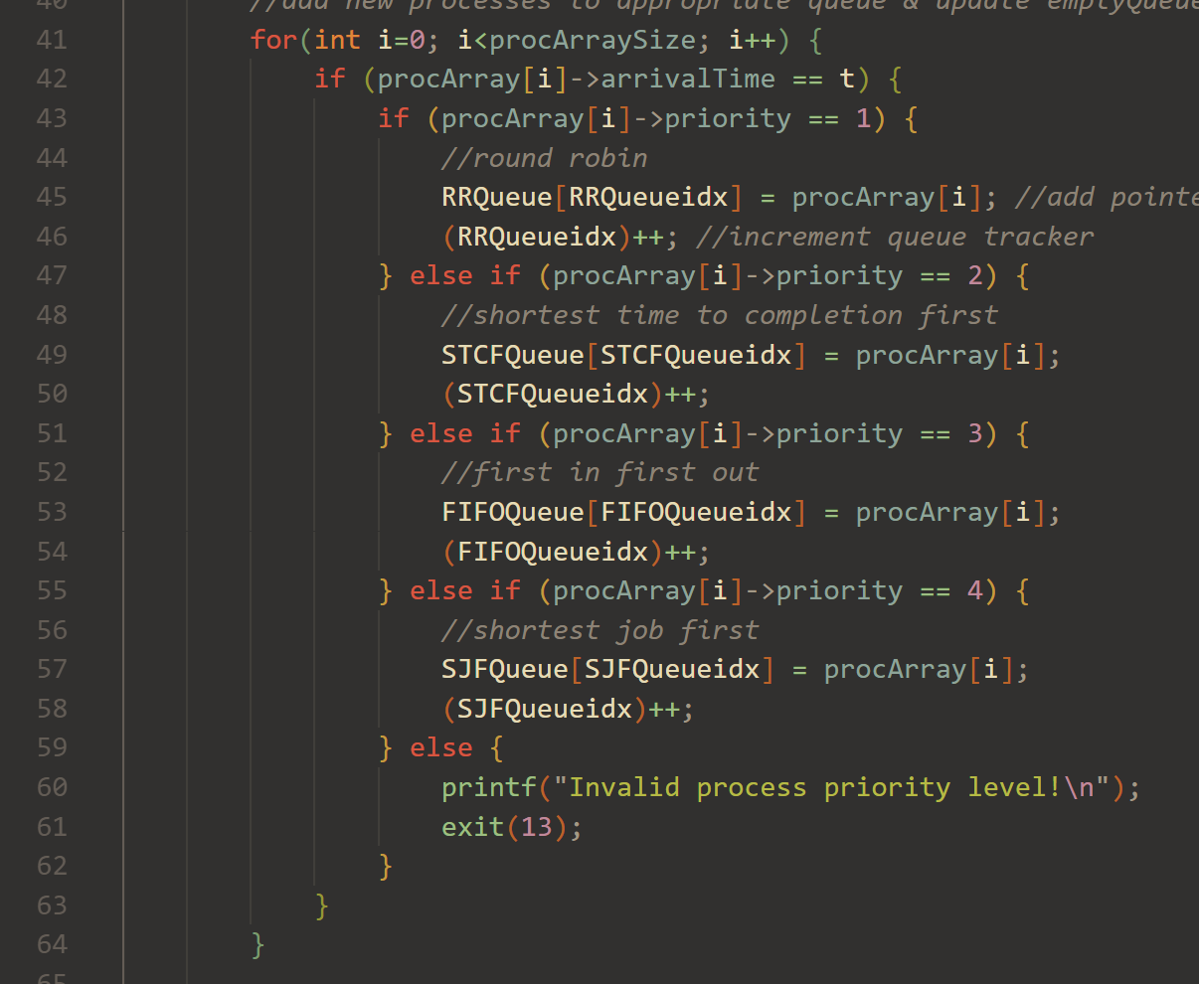
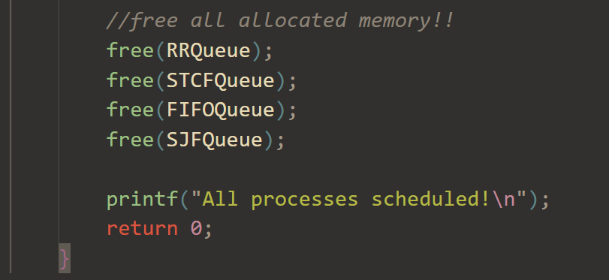

Slide 13
Round robin

Slide 14
Round Robin
Tracks the current process turn
Tracks the remaining time before moving onto another process
Time Quantum: 1 Quantum remaining: 1 Counter: 0​
0
1
The time quantum
Remaining Time: 9 3 5 4 6
Remaining Time: 10 3 5 4 6
[A, B, C, D, E]
TIME: 1
TIME: 0
TURN
Eric

Slide 15
Shortest time
Remaining first

Slide 16
STRCF
Remaining Time: 5 2
[A, B, 0, 0, 0, 0, 0, 0]
Abi

Slide 17
STRCF
Remaining Time: 1 5
[B, A, 0, 0, 0, 0, 0, 0]
Abi

Slide 18
STRCF
Remaining Time: 4
[A, 0, 0, 0, 0, 0, 0, 0]
Abi

Slide 19
STRCF
Remaining Time: 4 2
[A, C, 0, 0, 0, 0, 0, 0]
Abi

Slide 20
STRCF
Remaining Time: 1 4
[C, A, 0, 0, 0, 0, 0, 0]
Abi

Slide 21
STRCF
Remaining Time: 3 6
[A, D, 0, 0, 0, 0, 0, 0]
Abi

Slide 22
STRCF
Remaining Time: 2 6
[A, D, 0, 0, 0, 0, 0, 0]
A completes if no shorter jobs appear...
Abi

Slide 23
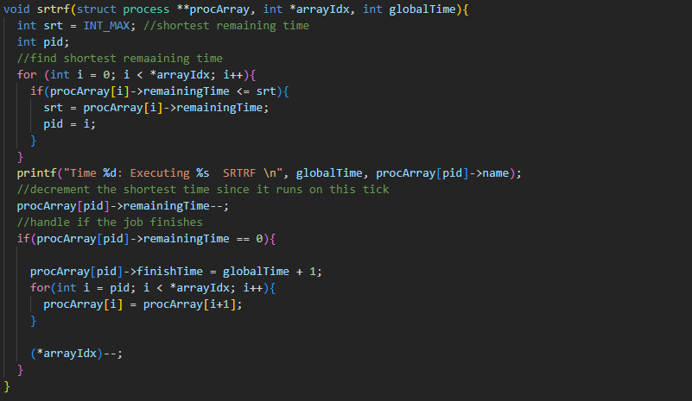

Slide 24
First In First out

Slide 25
FIFO
Insertion idx
[A, B, C, D, E, 0, 0, 0]
Daniel
Execution

Slide 26
FIFO
Insertion idx
[/0, B, C, D, E, 0, 0, 0]
Daniel
Execution
A

Slide 27
FIFO
Insertion idx
[B, C, D, E, 0, 0, 0, 0]
Daniel
Execution
A

Slide 28
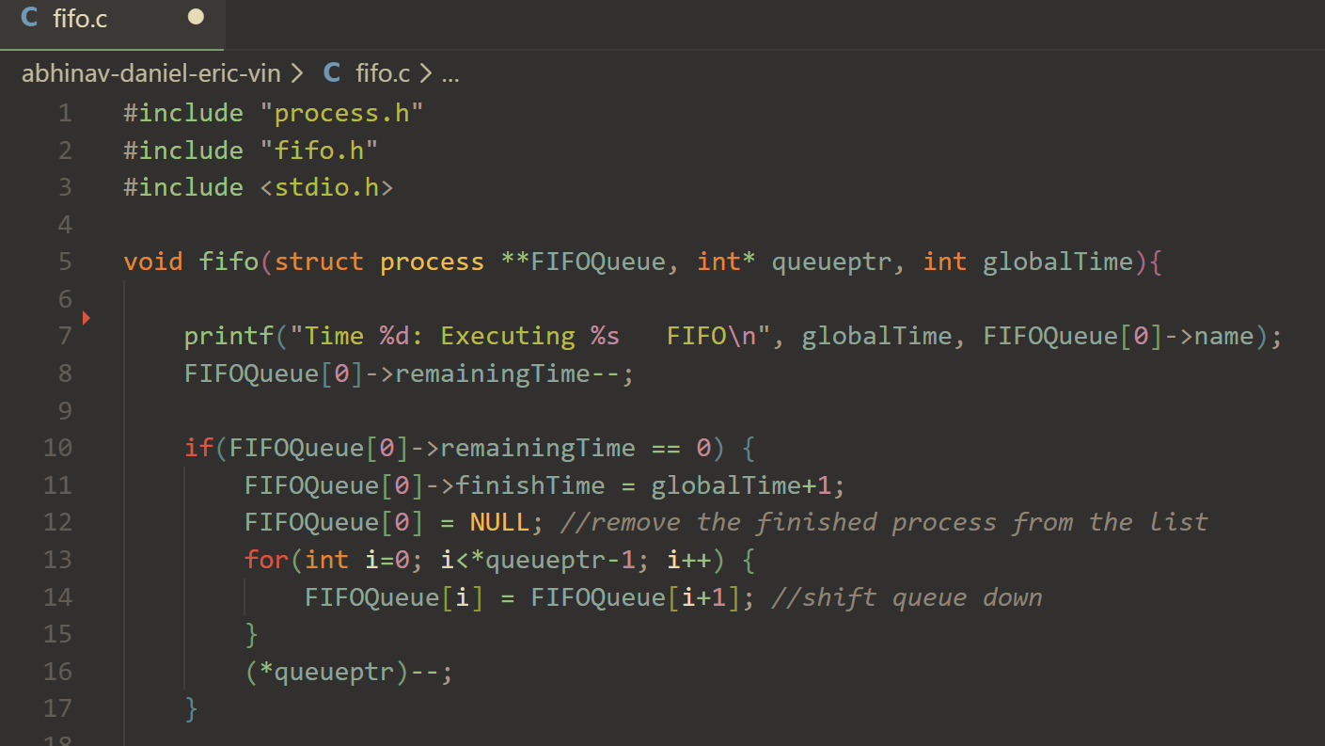

Slide 29
Shortest Job First

Slide 30
SHORTEST job first
Current Job: N/A
Remaining Time: 2 7 5
[A, B, C, 0, 0, 0, 0]
Vin

Slide 31
SHORTEST job first
Current Job: A
Remaining Time: 7 5
[B, C, 0, 0, 0, 0, 0]
Vin

Slide 32
SHORTEST job first
* JOB D GETS ADDED
Current Job: A
Remaining Time: 7 5 3
[B, C, D, 0, 0, 0, 0, 0]
Vin

Slide 33
SHORTEST job first
*Job A finishes and searches for next shortest job
Current Job: D
Remaining Time: 7 5
[B, C, 0, 0, 0, 0, 0, 0]
Vin

Slide 34
SHORTEST job first
*repeats process until all jobs are done
Current Job: C
Remaining Time: 7
[B, 0, 0, 0, 0, 0, 0, 0]
Vin

Slide 35
SHORTEST job first
Current Job: B
Remaining Time:
[0, 0, 0, 0, 0, 0, 0, 0]
Vin

Slide 36
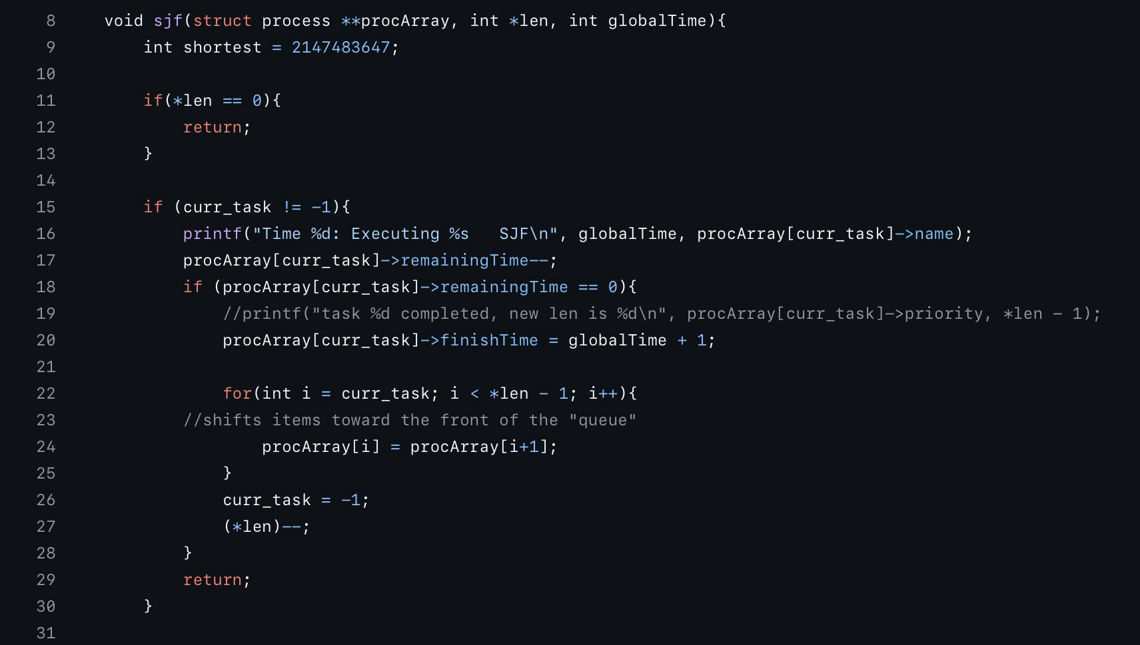
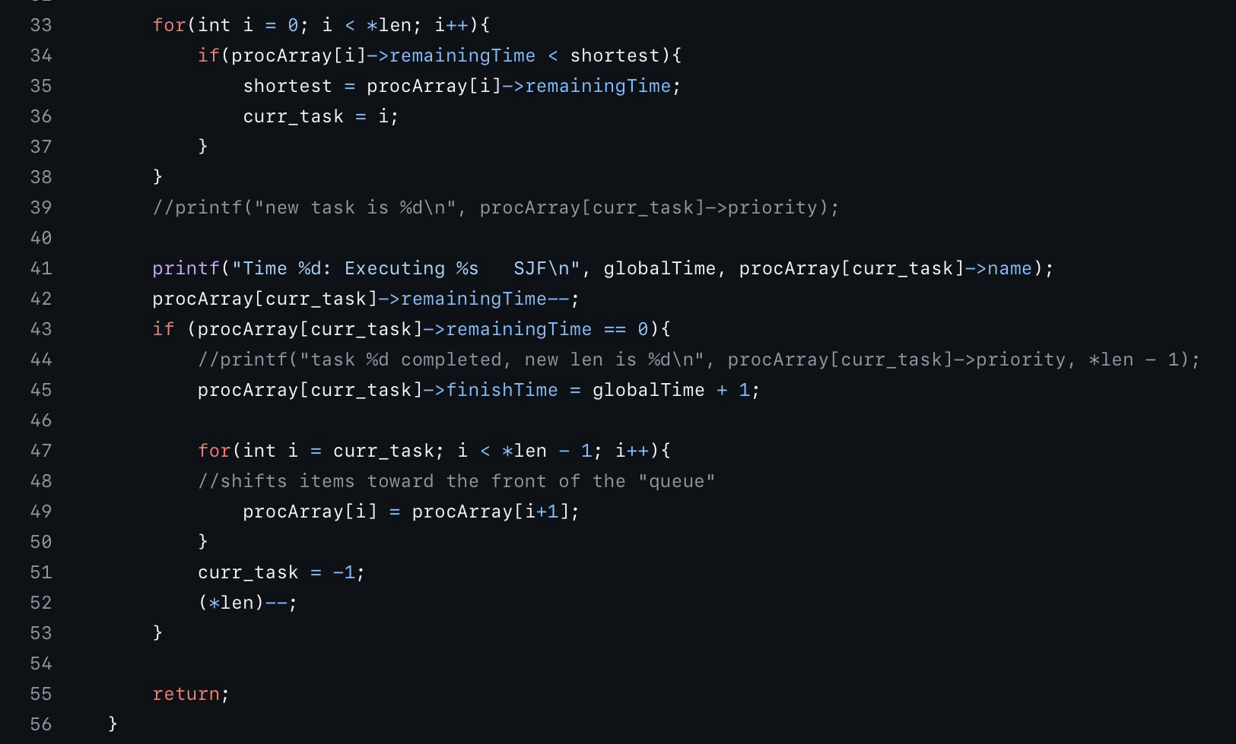
SHORTEST job first
If queue is empty
If current task exists
Choose a new task
Run the new task

Slide 37
Testing

Slide 38
Motivation and method
Test correctness of individual scheduling algorithms
Streamline implementation into main scheduler
Method:
Modify scheduleMain to not implement other algorithms

Slide 39
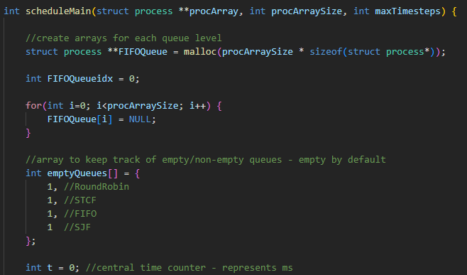
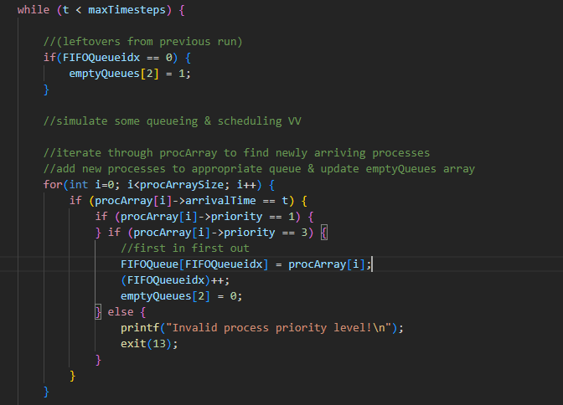
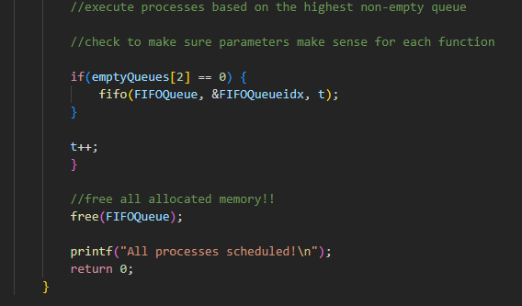
Example: fifo

Slide 40
Test.c
name
remainingTime
arrivalTime
finishTime
priority
processD | processE | processL | processM
processG | processH | processI | processN | processO
processC | processJ | processK
processA | processB | processF
RR
Process
SRTRF
schedule-main
assert(process -> finishTime)
FIFO
SJF
Eric

Slide 41
Test validation

Slide 42
Excel spreadsheet

Slide 43
Code Demonstration

Slide 44

Closing

