Slide 1

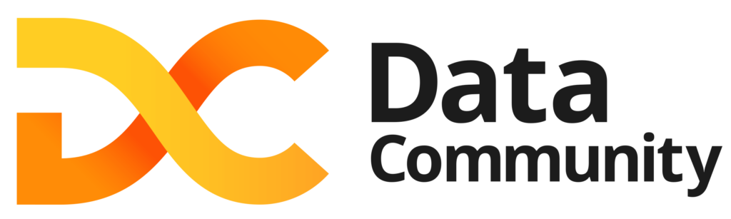

Data Virtualization i Polybase
w SQL Server 2022
Gliwice 2022.12.15
Tomasz Krawczyk

Slide 2
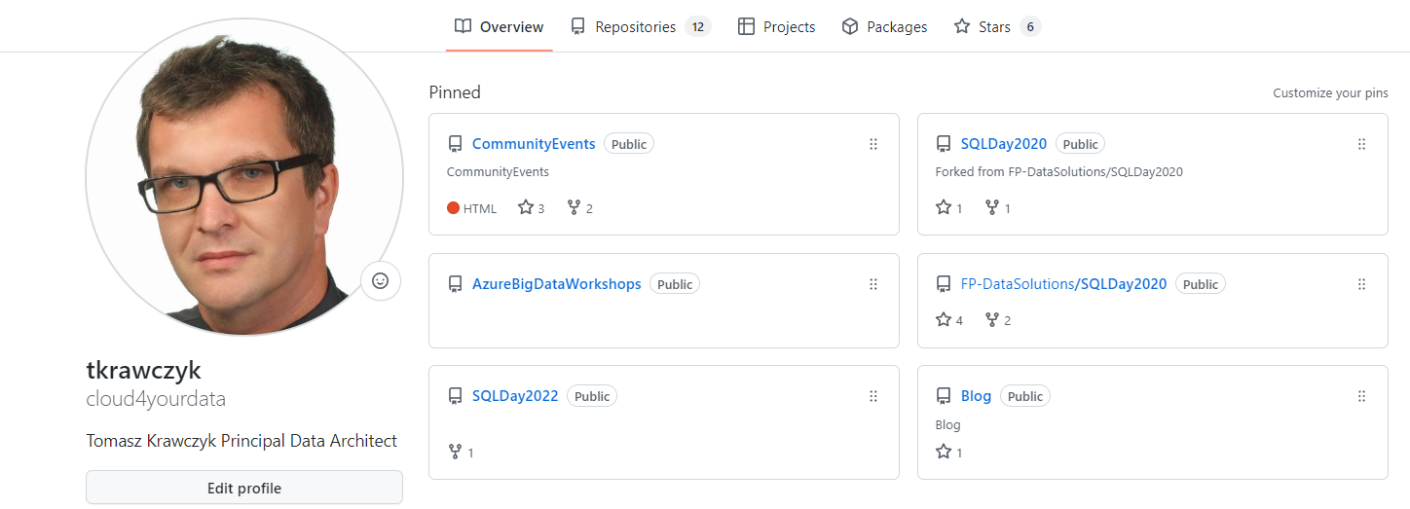


https://github.com/cloud4yourdata/CommunityEvents

Slide 3
Agenda
SQL Server 2022
Data Virtualization and/with Polybase
A Historical Review
Polybase and SQL Server 2022
Open Rowset
External tables
CETAS
S3
Performance(*)
Demo(s)
Q&A
Notes:
Kimball czy Data Vault

Slide 4
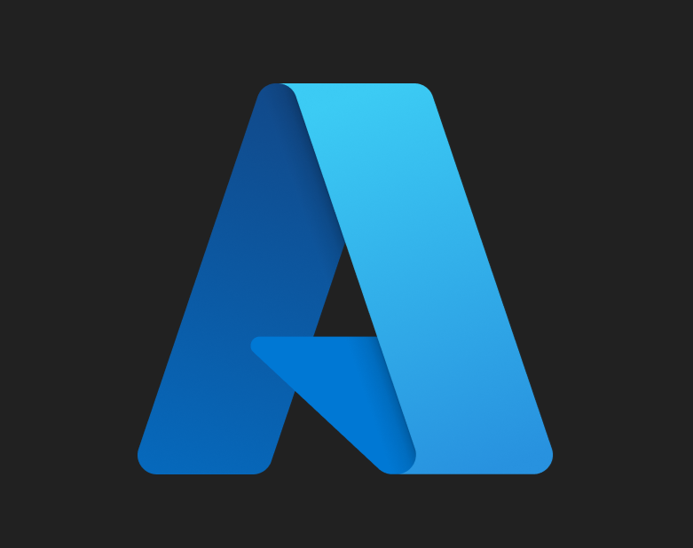
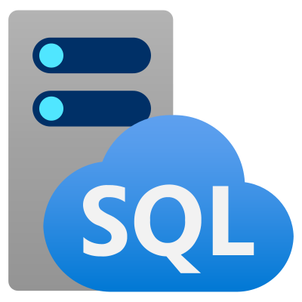





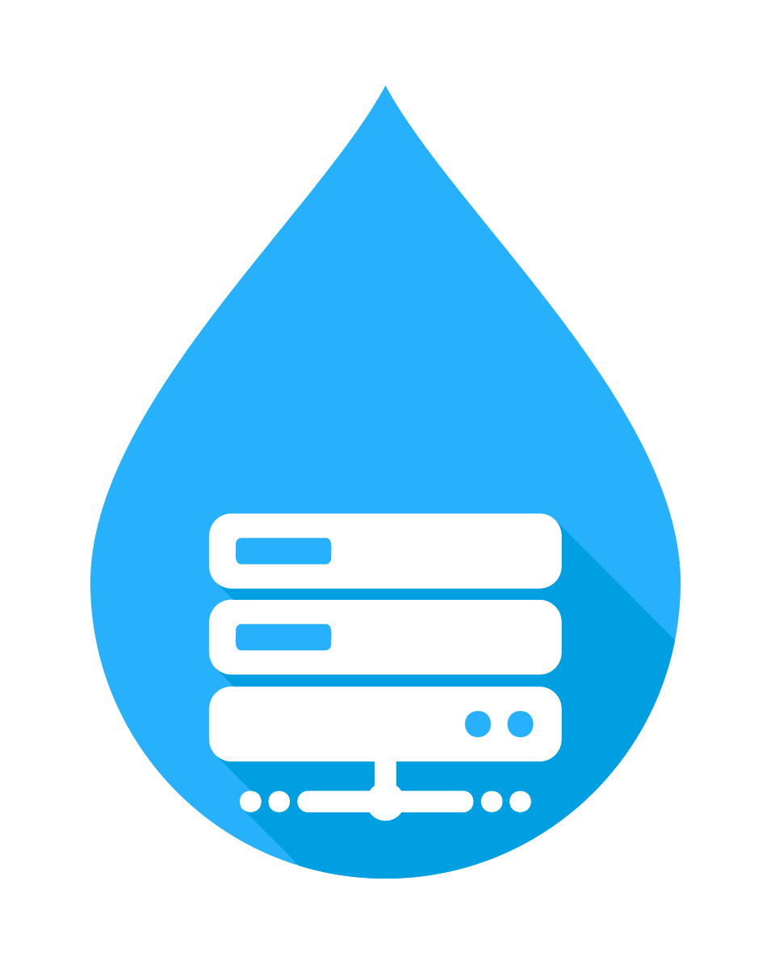

SQL Server 2022 capabilities
Cloud connected
Extending T-SQL
Built-in query intelligence
Data virtualization | Object storage
Security, scalability, availability
SQL Server 2022
Source: Bob Ward SQL Server 2022 Workshops

Slide 5
Data Virtualization and/with Polybase
Data virtualization is a technique that allows users to access and work with data from multiple, disparate sources as if it were all stored in a single, logical repository. It can be thought of as a way to "virtualize" data from different sources, making it easier for users to access and work with the data without having to worry about the underlying details of where the data is actually stored or how it is structured…
PolyBase is a technology that allows users to run queries on external data sources, such as Hadoop or Azure Storage, and combine the results with data stored in a relational database management system (RDBMS), such as SQL Server. It enables users to access and work with data from multiple sources in a single query, using the familiar SQL language…
Source: ChatGPT (openai.com)

Slide 6
A Brief History
Parallel Data Warehouse (2012): PolyBase introduced as a way to integrate SQL Server and Hadoop.
SQL Server 2016: PolyBase "V1" introduced.
Azure SQL Data Warehouse (now Azure Synapse Analytics): PolyBase used for data lake integrations.
SQL Server 2019: PolyBase "V2" introduced. PolyBase also brought into SQL Server Big Data Clusters (RIP).
SQL Server 2022: Some data virtualization outside PolyBase. This brings new functionality but also removes old features.

Slide 7
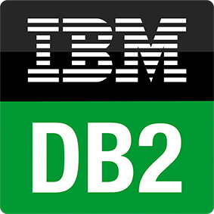



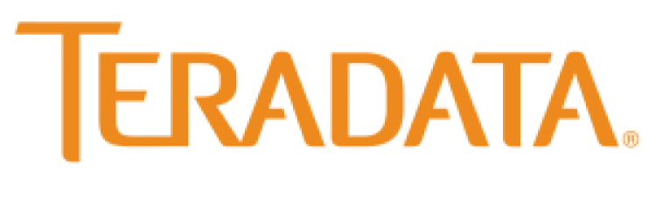



A Brief History
Polybase V1:
HDFS (Hadoop)
WASB (Blob Storage)
Polybase V2
V2 includes V1
SQL Server
Oracle
MongoDB/ Cosmos DB
Teradata
Any ODBC Connectors (e.g. Spark, Excel)*
(* - Windows only)
T-SQL
…
ODBC
NoSQL
Relational databases
Big Data
MongoDB
Azure SQL Database
Azure Cosmos DB
Excel

Slide 8
New History – SQL Server 2022
SQL Server 2022 eliminates V1 support.
In return, it introduces (or re-introduces):
Amazon S3
Azure Blob Storage (abs)
Azure Data Lake Storage Gen2 (adls), including Delta tables
SQL Server 2022

Slide 9
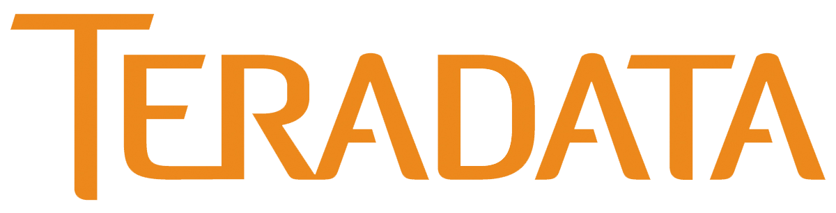




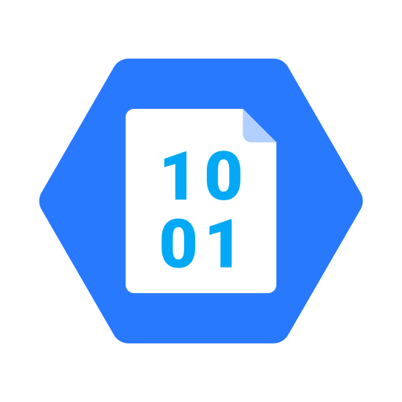








New History – SQL Server 2022
SQL Engine
OPENROWSET, EXTERNAL TABLE, CETAS
HTTPS REST API
adls/abs
S3 compatible storage
Polybase Services
adls
abs
abfs
wasb
Parquet, Delta, csv, text
Source: Bob Ward SQL Server 2022 Workshops

Slide 10









Polybase SQL Server 2022
SQL Engine
Database
database
scoped
credential
master
key
Install
polybase feature
system
tables
external file
format
external
data source
Polybase
instance configuration
User
tables
external
table
Performance Best
Practices
Ingest, CETAS, join
OPENROWSET
abs, adls, S3 compatible storage
Parquet, Delta, csv, text
Source: Bob Ward SQL Server 2022 Workshops

Slide 11
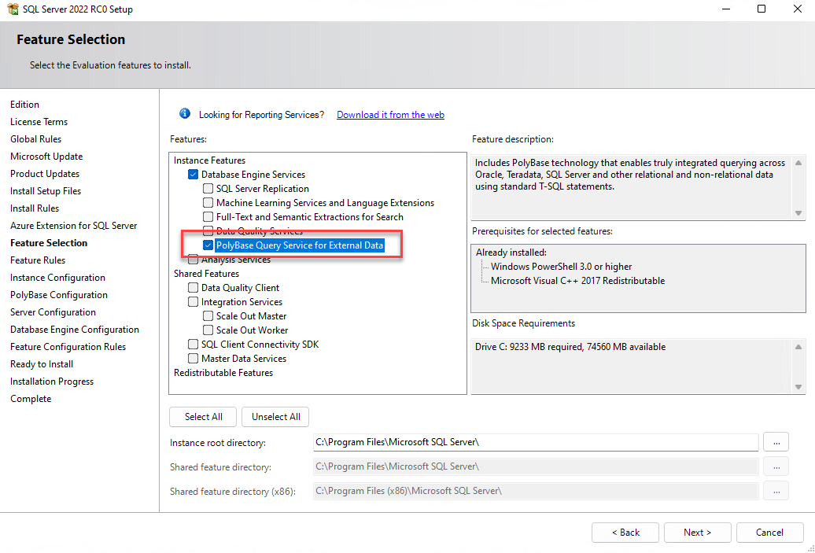
SQL Server
Polybase
Installation

Slide 12
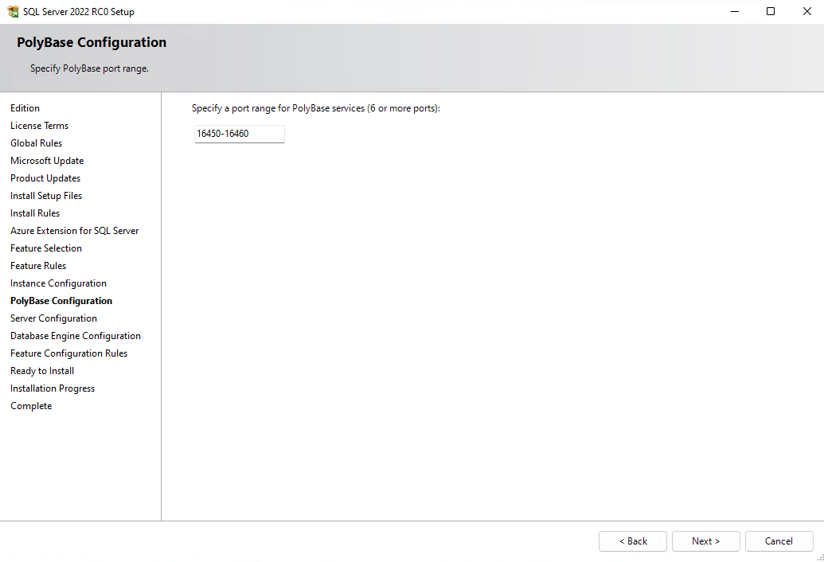
SQL Server
Polybase
Configuration

Slide 13
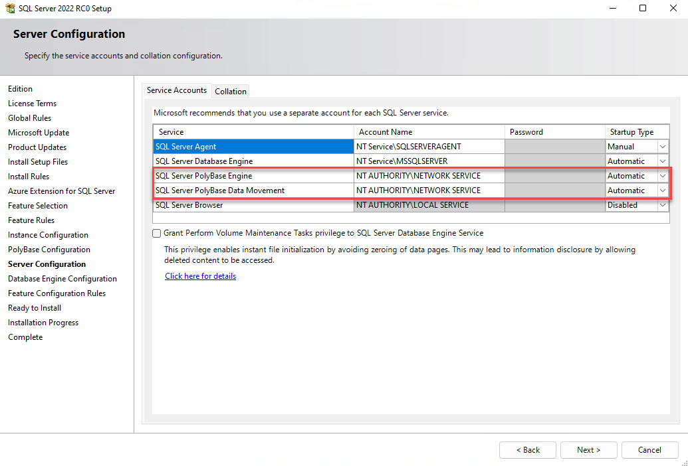
SQL Server
Polybase
Configuration

Slide 14
Polybase – configuration steps
Init polybase (sp_configure, restart)
Create master key in database
CREATE MASTER KEY…
Create credential
CREATE DATABASE SCOPE CREDENTAIL ,sys.database_scoped_credentials
Create external data source
CREATE EXTERNAL DATA SOURCE…, sys.external_data_sources
Create data fromat(*)
CREATE EXTERNAL FILE FORMAT…, sys.external_file_formats
Query data
OPENROWSET
Create external table(s)
CREATE EXTERNAL TABLE.., sys.external_tables

Slide 15
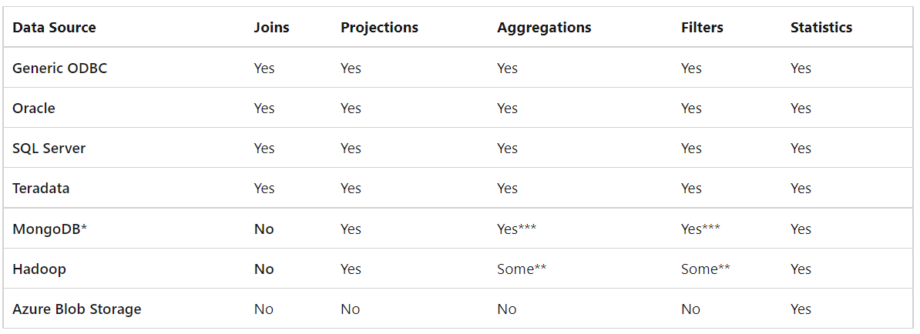
Polybase – Performance
Performance is not a key consideration!!!
EXTERNAL PUSHDOWN
External Tables vs Openrowset
Source: SQL Docs

Slide 16
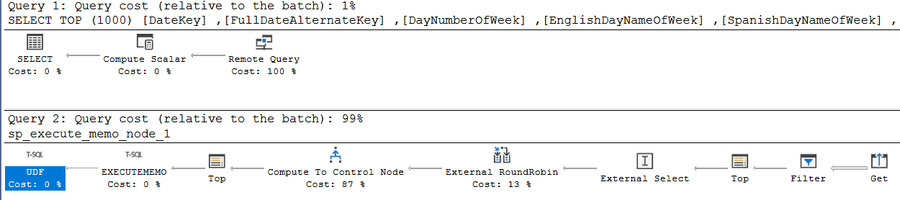
Polybase – Tracing
View the Estimated Execution Plan with trace flag 6408
View the read_command in the sys.dm_exec_external_work(*) dynamic management view
SELECT TOP (1000) * FROM [DV].[dbo].[DimDate] WHERE DateKey BETWEEN 20070319 AND 20070321

Slide 17
DEMO(s)

Slide 18
Summary
New REST API data sources include Azure Blob Storage, Azure Data Lake Storage Gen2, and S3 compatible object store providers
SQL Server 2022 now natively recognizes parquet and delta table file formats
SQL Server and backup and restore native backups to and from S3 compatible object store providers
SQL SERVER OBJECTS:
CREATE DATABASE SCOPE CREDENTAIL ,sys.database_scoped_credentials
CREATE EXTERNAL DATA SOURCE…, sys.external_data_sources
CREATE EXTERNAL FILE FORMAT…, sys.external_file_formats
OPENROWSET
CREATE EXTERNAL TABLE.., sys.external_tables
CREATE EXTERNAL TABLE AS SELECT (CETAS)

Slide 19
Q & A

Slide 20
Resources
My examples (and demos)
https://github.com/cloud4yourdata/CommunityEvents/tree/master/
Blogs,pages,documentation, articles
GitHub - microsoft/sqlworkshops-sql2022workshop: A workshop to learn about SQL Server 2022
https://learn.microsoft.com/en-us/sql/relational-databases/polybase/polybase-guide?view=sql-server-ver16

Slide 21
THANK YOU!
tkrawczyk@future-processing.com
tomasz.k.krawczyk@gmail.com

