Slide 1


Slide 2
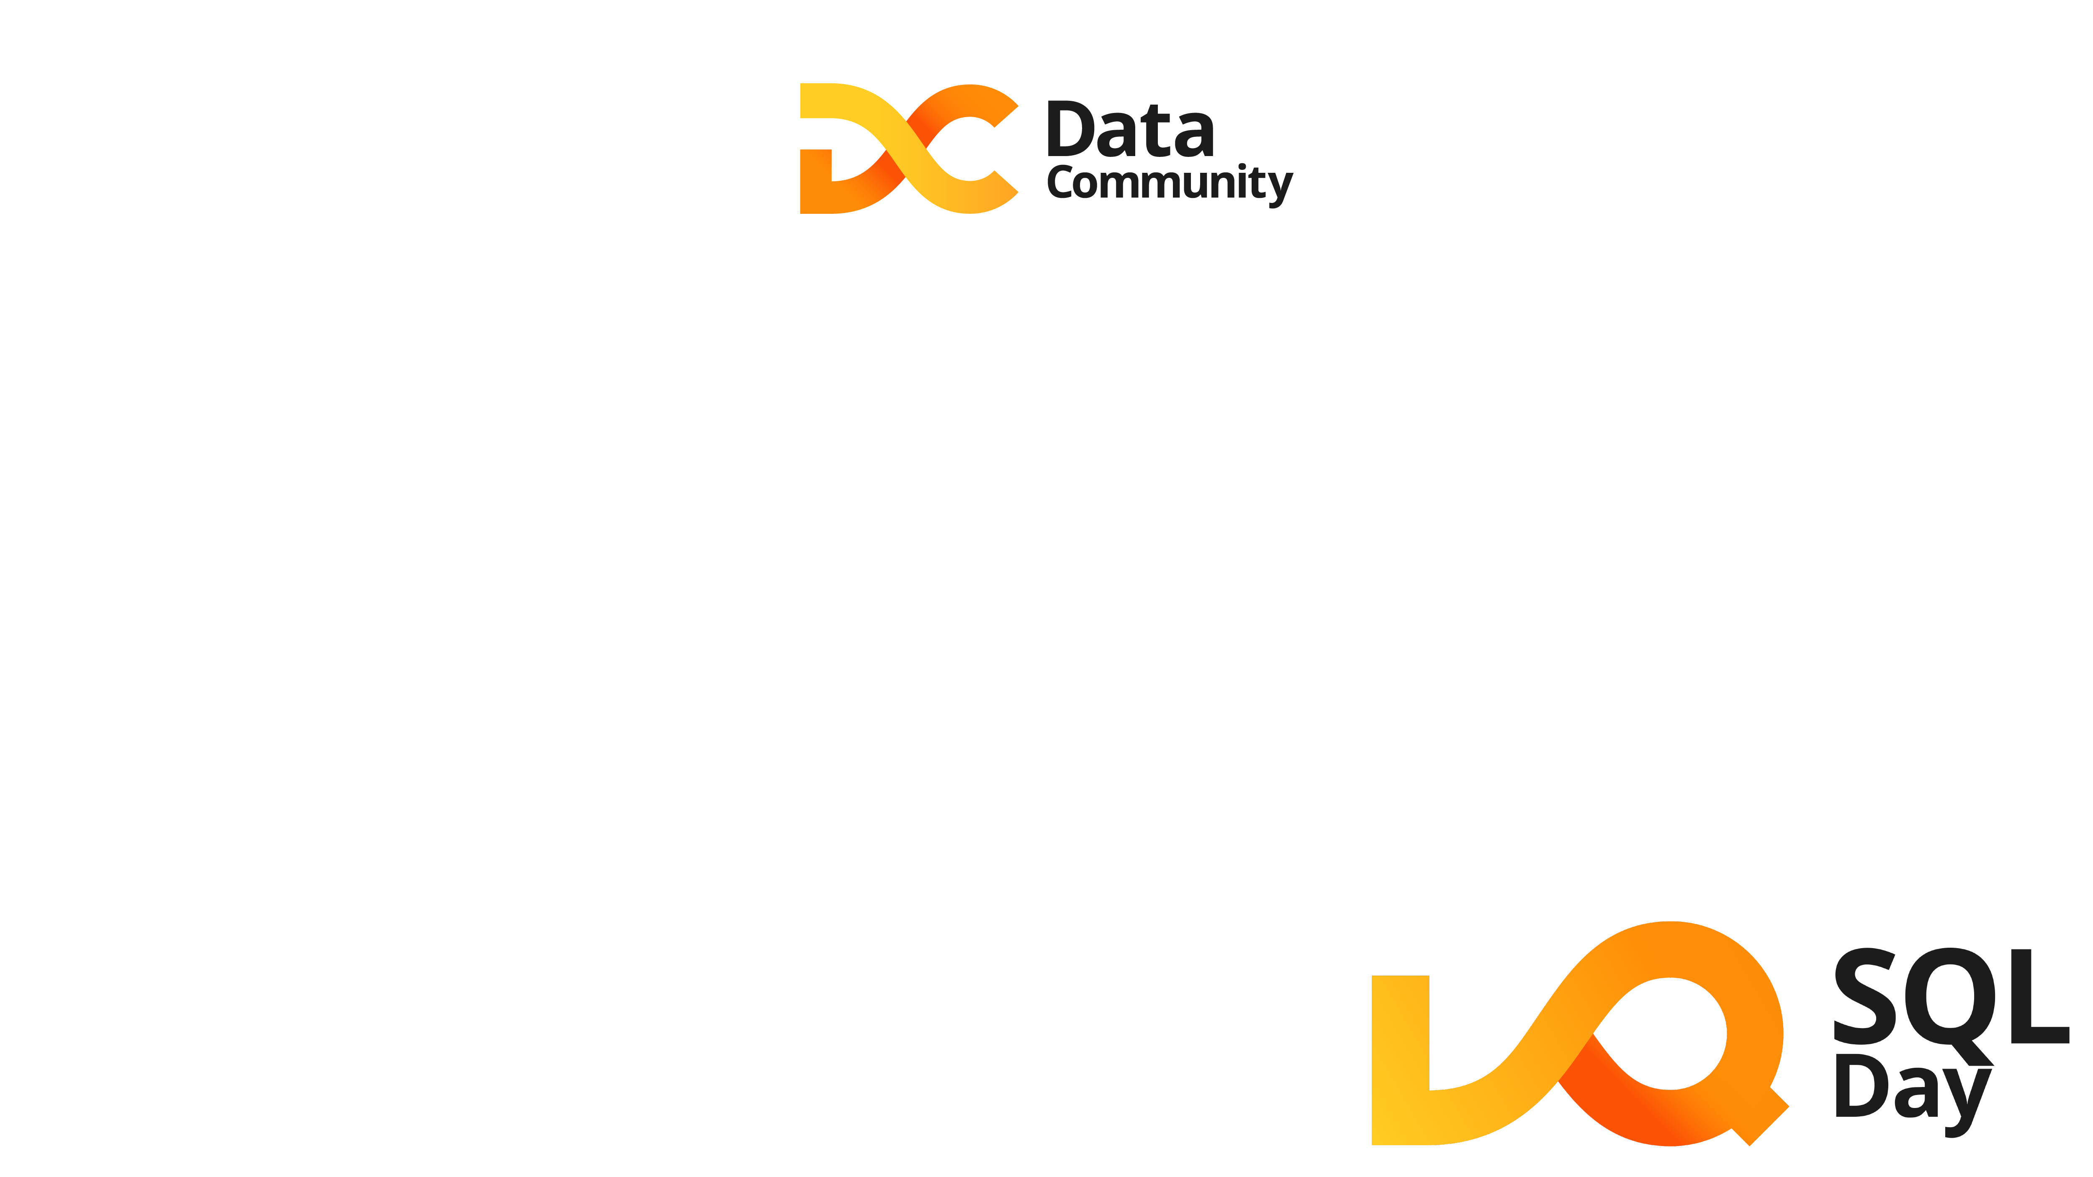
DATA LAKEHOUSE OD DEMO DO PRODUKCJI
TOMASZ KRAWCZYK
AZURE DATA ARCHITECT

Slide 3

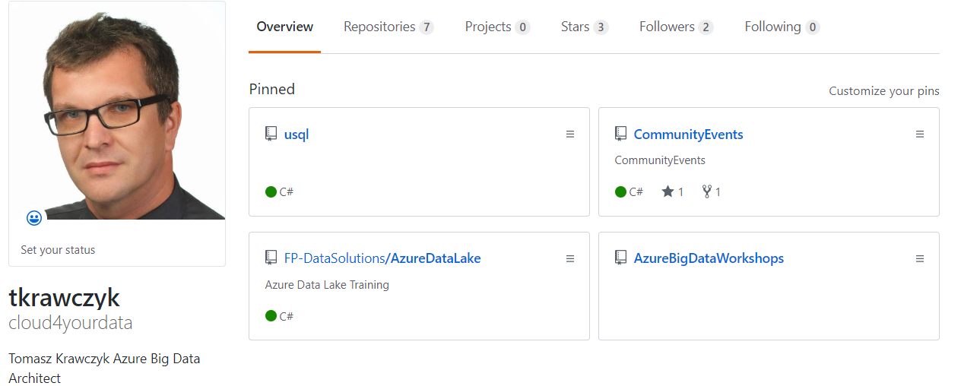


ABOUT ME
https://github.com/cloud4yourdata/CommunityEvents
https://github.com/FP-DataSolutions/

Slide 4
AGENDA
Data lakehouse overview
Concept and architecture
Data lakehouse -Data Flow
Data processing – framework
Azure Synapse Serverless -Serving Layer
Demo(s)
Q&A

Slide 5
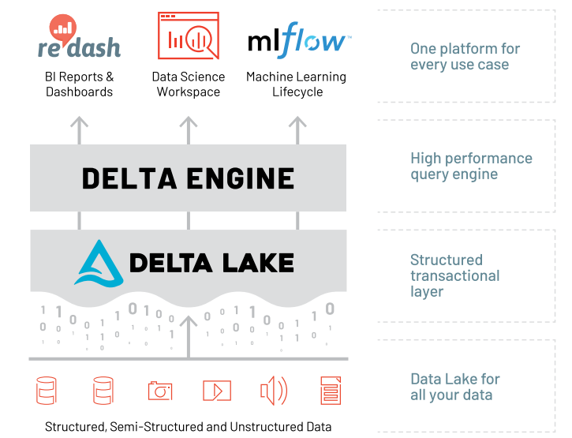
DATA LAKEHOUSE
Delta Lake is an open-source storage layer that
brings ACID transactions to Apache Spark and big
data workloads.
Why Lakehouse:
Unifies data warehousing and machine learning (ML)
Reduces cost
Simplifies data governance
Simplifies ETL jobs
Removes data redundancy
Enables direct data access
Connects directly to BI tools

Slide 6
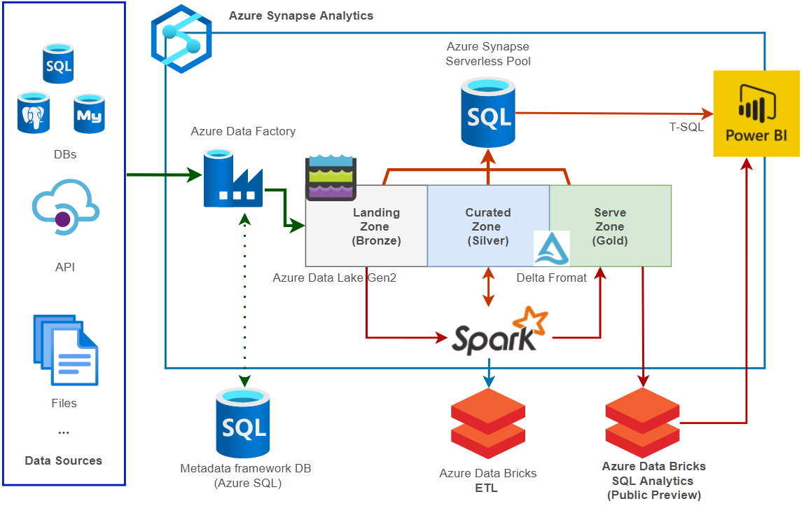
DATA LAKEHOUSE ARCHITECTURE

Slide 7
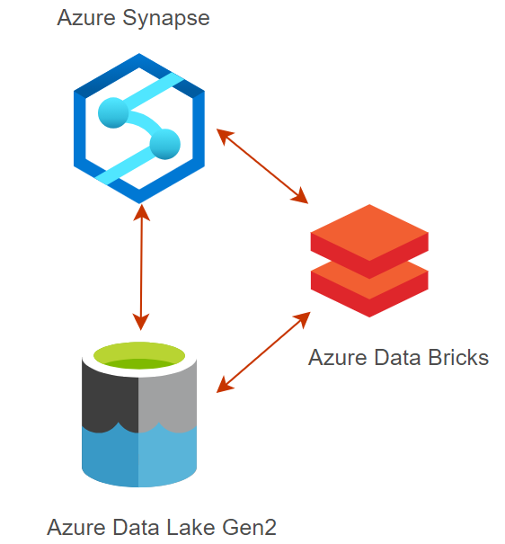
SYNAPSE SPARK VS DATABRICKS
Azure Synapse Spark Pool:
Spark 2.4
SQL DELETE/MERGE/UPDATE are not supported (only Scala or Python)
OPTIMZE is not supported
Hyperspace (https://microsoft.github.io/hyperspace/)
Shared HIVE Metastore
Delta format is not supported
Only Parquet
Source: https://mrpaulandrew.com/2021/01/29/is-azure-synapse-analytics-ready-for-production/
https://techcommunity.microsoft.com/t5/azure-synapse-analytics/apache-spark-in-azure-synapse-performance-update/ba-p/2243534

Slide 8
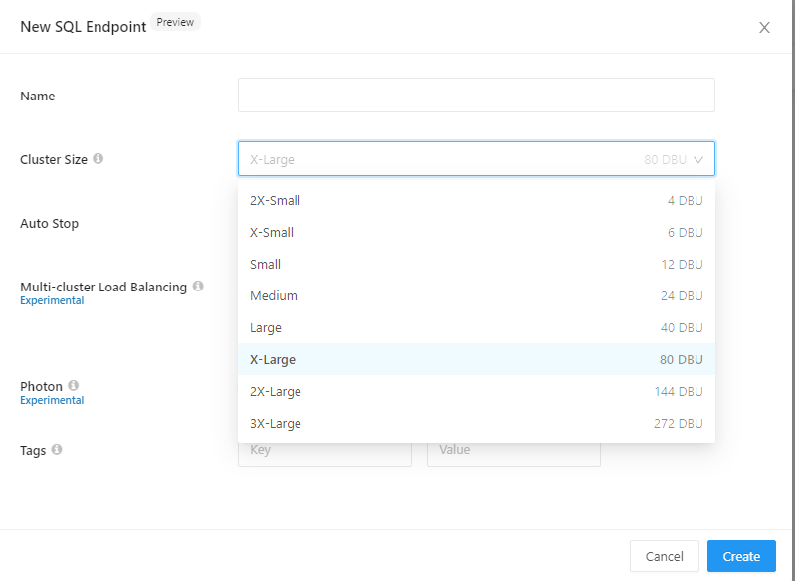
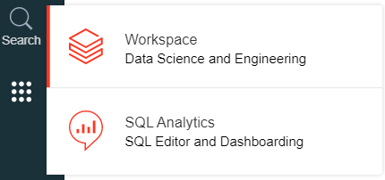
DATABRICKS SQL ANALYTICS
SQL Analytics allows customers to operate
a multi-cloud lakehouse architecture that provides data warehousing performance at data lake economics.
Public Preview
Source: https://databricks.com/product/sql-analytics

Slide 9
DATA LAKEHOUSE - DATA FLOW
Source System(s)
Relational databases
Flat files (CSV)
API (REST)
Landing Zone (Bronze)
EL Processes:
Metadata framework
Azure Data Factory
Azure Synapse Integration Pipelines
Data structure
Folders
Data partitioning
By load date
Data Format
Parquet (**)
Native (Json, Avro, Csv)
Curated Zone (Silver)
ETL Processes:
Metadata framework
Spark (Databricks)
Transformations
Slowly Changing Dimensions Type 2
Data Format
Delta
Spark Tables (one to one : source -> curated zone)
Serving data
Azure Synapse Serverless
Views on Delta Tables
Model based on views
Azure Databricks SQL Analytics (Public Preview)
Serve Zone (Gold)
ETL Processes:
Metadata framework
Spark (Databricks)
Transformations
Data Model (Kimball)
Data Format
Delta
Spark Tables
Serving data
Azure Synapse Serverless
Views on Delta Tables
Azure Databricks SQL Analytics (Public Preview)

Slide 10
DEMO
DEMO
Demo001-Synapse - Synapse Spark meta store integration
Demo Merge SCD Type2
Spark Databrikcs (Demo001)
Metadata framework (Azure SQL Db queries)
Azure Synapse Integration Pipelines (DataProc)

Slide 11
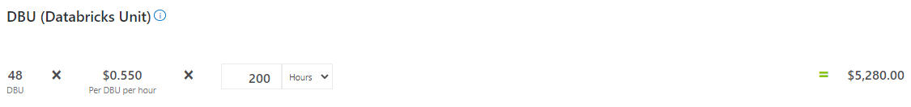
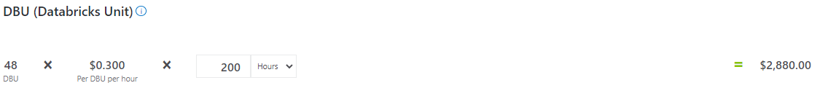
AZURE DATABRICKS CLUSTER TYPES
Cluster Types:
All-purpose cluster
Multiple users can share such clusters to do collaborative interactive analysis
Job Cluster
The Azure Databricks job scheduler creates a job cluster when you run a job on a new job cluster
and terminates the cluster when the job is complete. You cannot restart a job cluster.
Costs: All-purpose cluster
Costs: Job Cluster

Slide 12
DEMO
DEMO
Demo Job Cluster
Azure Synapse Integration Pipeline
Spark Databricks (Parallel runs)

Slide 13
SERVING LAYER AZURE SYNAPSE SERVERLESS
Delta format is not supported yet (will be supported soon)
Workaround:
Manifest files (Spark)
SET spark.databricks.delta.symlinkFormatManifest.fileSystemCheck.enabled = false;
CREATE TABLE IF NOT EXISTS Test (Val INT) USING DELTA
TBLPROPERTIES(delta.compatibility.symlinkFormatManifest.enabled=true);
GENERATE symlink_format_manifest FOR
TABLE delta.`dbfs:/mnt/datalake/analytics_zone/DWHS/DeltaDWH/dimuser`;
PARQUET format + filename() (Azure Synapse Serverless)
WHERE r.filename() IN
(SELECT f.fileName FROM dataFileNames AS f )
Source: https://docs.databricks.com/delta/delta-utility.html#delta-generate

Slide 14
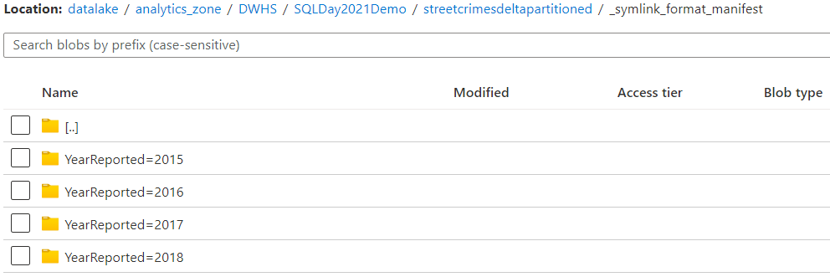
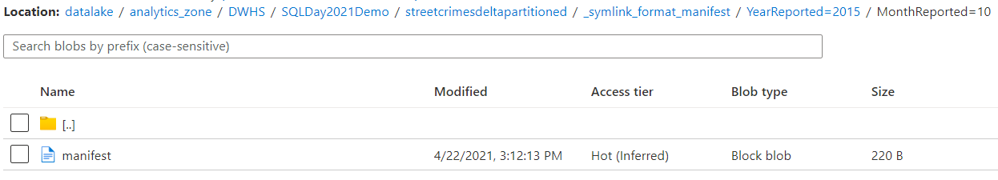
DELTA , MANIFEST AND DATA PARTITIONING
SELECT
RIGHT(f.C1, CHARINDEX('/', REVERSE(f.C1)) -1)
AS fileName FROM
OPENROWSET(
BULK ’…/SQLDay2021Demo/streetcrimesdeltapartitioned/_symlink_format_manifest/*/*/manifest',
FORMAT='CSV',
PARSER_VERSION = '2.0',
firstrow = 0
) AS f

Slide 15
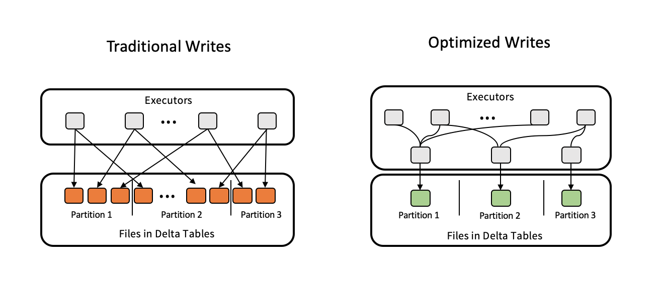
DELTA FORMAT – SPARK SETTINGS
delta.autoOptimize.optimizeWrite = true
delta.autoOptimize.autoCompact = true
OPTIMIZE Command
Only Databricks
ZORDER BY
1 GB files
Source: Auto Optimize - Azure Databricks - Workspace | Microsoft Docs

Slide 16
DEMO
DEMO
Demo Spark Settings
Demo003

Slide 17
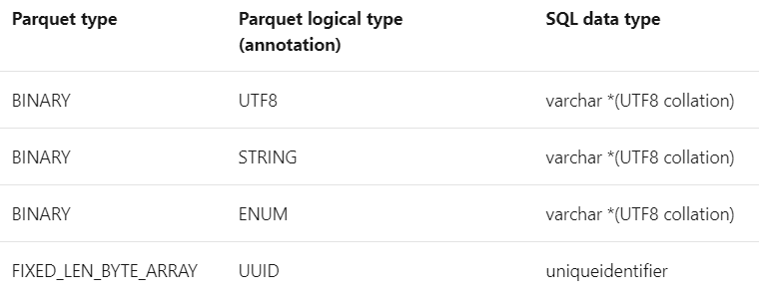
SYNAPSE SERVERLESS –TYPES MAPPING
Database collation:
COLLATE Latin1_General_100_BIN2_UTF8
Default type mapping:
No WITH clause
EXEC sp_describe_first_result_set
N'SELECT TOP 1 * FROM
dbo.vwDimUser’
Type mapping for Parquet
Performance
Schema evolution
Source: How to use OPENROWSET in serverless SQL pool - Azure Synapse Analytics | Microsoft Docs

Slide 18
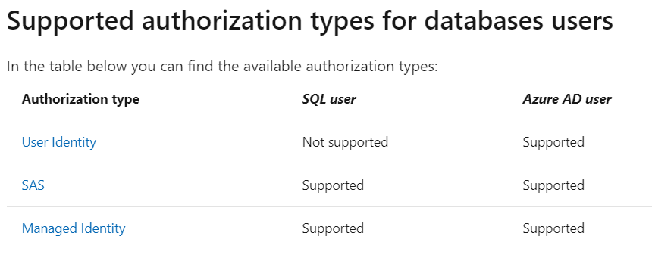
SYNAPSE SERVERLESS - SECURITY
Security:
Storage level
SQL service level
Storage authorization types:
User Identity - Azure AD
pass-through
Shared access signature (SAS)
Managed Identity (MSI)
Source: Control storage account access for serverless SQL pool - Azure Synapse Analytics | Microsoft Docs

Slide 19
DEMO
DEMO
Azure Synapse
Demo001_Manifest
Demo002_Delta (dynamic vs static)
Demo003_TypeMappings
Framework –Refreshing views
Security

Slide 20
Q&A
Q & A
Contact:
tomasz.k.krawczyk@gmail.com
tkrawczyk@future-processing.com

Slide 21
RESOURCES
My examples (and demos)
https://github.com/cloud4yourdata/CommunityEvents/tree/master/SQLDay2021
Blogs,pages,documentation, articles
https://www.jamesserra.com/archive/2021/01/data-lakehouse-defined/
https://techcommunity.microsoft.com/t5/azure-architecture-blog/understanding-azure-synapse-private-endpoints/ba-p/2281463
https://mrpaulandrew.com/2021/01/29/is-azure-synapse-analytics-ready-for-production/
https://docs.microsoft.com/en-us/azure/synapse-analytics/sql/develop-storage-files-storage-access-control?tabs=user-identity
https://docs.microsoft.com/en-us/azure/databricks/delta/optimizations/auto-optimize
https://pivotalbi.com/local-databricks-development-on-windows/

