Slide 1

Przenieś swój .Net Code do rozwiązań Big Data
Kraków 2018.10.15
Authors:
Tomasz Krawczyk

Slide 2

?

Slide 3
Agenda
Big Data – quick overview
Azure Data Lake – quick overview
U-SQL – quick overview
U-SQL Extensions
.Net
Q&A

Slide 4
3Vs of Big Data
40 Zetta bytes by 2020 and 163 Zetta bytes by 2025
Data Volume
Byte One grain of rice
Kilobyte Cup of rice
Megabyte 8 bags of rice
Gigabyte 3 semi trucks
Terabyte 2 container ships
Petabyte Blankets Manhattan
Exabyte Blankets west coast states
Zettabyte Fills the Pacific Ocean
Yottabyte As earth-sized rice ball
Data Variety
Structured
Unstructured
Semi-structured
All the above
Data Velocity
Near to Real Time
Batch

Slide 5
How do you process all the data ?

Slide 6
Schema-on-Read vs Schema-on-Write
Schema-on-Read
(Hadoop or ADLS):
Schema-on-Write (RDBMS):
Copy data in its native format
Create schema + parser
Query Data in its native format (does ETL on the fly)
Create static DB schema
Transform data into RDBMS
Query data in RDBMS format

Slide 7




Big Data on Azure
Analytics
Azure Databricks
Storage

Slide 8
Azure Data Lake Analytics
A distributed analytics service built on Apache YARN that dynamically scales to your needs
Pay PER QUERY & Scale PER QUERY
FEDERATED QUERY across Azure data sources
Includes U-SQL, a language that unifies the benefits of SQL with the expressive power of C#
No limits to SCALE
Optimized to work with ADL STORE

Slide 9
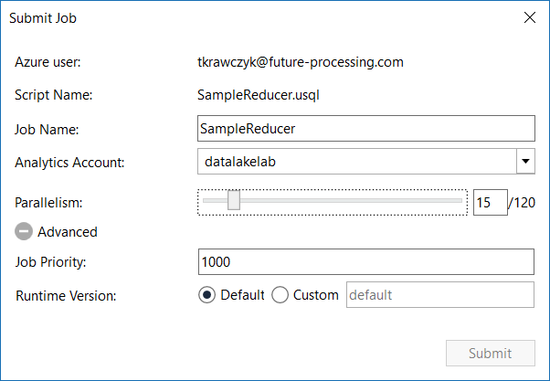
Data Lake Analytics Runtime
1 ADLAU ~= A VM with 2 cores and 6 GB of memory
Limited Network Access *
Parallelism N = N ADLAUs

Slide 10
U–SQL - new language for Big Data
Familiar syntax to millions of SQL & .NET developers
Unifies declarative nature of SQL with the imperative power of C#
Unifies structured, semi-structured and unstructured data
Distributed query support over all data
SCOPE
T-SQL/ ANSI SQL
C#
Hive
SQL DECLARATIVITY + C# EXTENSIBILITY = U-SQL

Slide 11
U–SQL Language Overview
DECLARE @projectsInput string = @"Projects\{file}.csv";
DECLARE @eventDate DateTime = System.DateTime.Parse("2018/10/15");
DECLARE @numbers int = 2;
REFERENCE ASSEMBLY USQLCSharpDemo;
USING ImageColorsProcessor = USQLCSharpDemo.ImageColorProducer;
@projects =
EXTRACT project string,
startDate DateTime,
endDate DateTime,
file string
FROM @projectsInput
USING Extractors.Csv(skipFirstNRows : 1, quoting : true);
@rs =
EXTRACT content byte[],
fileName string
FROM @imgFiles
USING new BinaryExtractor();
@assignments =
SELECT user.ToUpper() AS user,
new SqlArray<string>(projects.Split(new char[]{'|'}, StringSplitOptions.RemoveEmptyEntries)) AS projs
FROM @usersprojects;
@agg =
SELECT project,
COUNT( * ) AS units
FROM @details WHERE project.StartsWith("My")
GROUP BY project;
@myprojects =
SELECT us.project,
p.endDate
FROM @details AS us
JOIN
@projects AS p
ON p.project == us.project
WHERE user.StartsWith("Me")
ORDER BY p.endDate DESC
FETCH 10 ROWS;
OUTPUT @myprojects
TO "myprojects.csv"
USING Outputters.Csv();
C# Types
.NET Assemblies
Apply Schema on Read
Extractor
Rowset(s)
External Extractor
SQL Dialect (SELECT FROM)
SQL Aggregation(s)
.NET Methods
SQL Dialect (JOIN, WHERE, ORDER BY ...)
Output

Slide 12
U-SQL Data Types
Numeric – sbyte – int – long – float – double – decimal – short – byte – uint – ulong – ushort
Text – char – String (128 kB) › Complex – MAP<k,v> – ARRAY<v> › Miscellaneous – bool – Guid – DateTime – byte[] › RowSets
SQL.ARRAY<T> == IList<T>
SQL.MAP<T,U> == IDictionary<T,U>
@m = SELECT new SqlArray<string> (tweet.Split( new char[]{' '}).Where(x => x.StartsWith("@"))) AS mentions FROM @t;
@m = SELECT m.Substring(1) AS m,"mention" AS category FROM @m
CROSS APPLY EXPLODE(mentions) AS t(m);

Slide 13
U-SQL Top 5’s Surprises for SQL Developers
U-SQL is case sensitive
AS is not as
C# keywords and SQL keywords overlap
= != ==
C# expression language
null IS NOT NULL
C# nulls are two-valued (HasValue)
No UPDATE, DELETE, nor MERGE

Slide 14
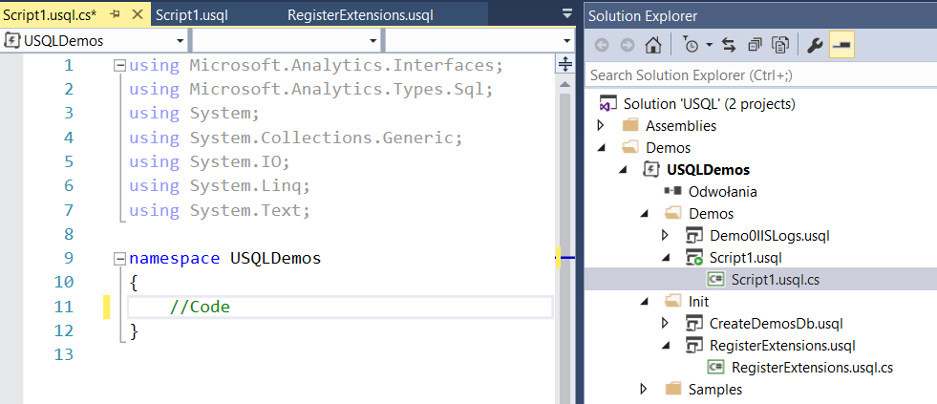
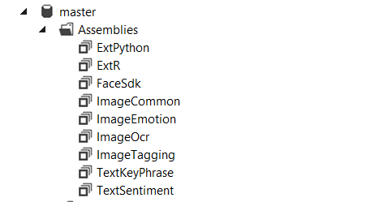
U-SQL .NET Extentions
C# Functions/Methods
C# UDTs
C# UDAggs
Extractors
Reducers
Processors
Appliers
Combiners
Outputters
How to create .Net Extensions?
C# UDO
.NET Assemblies

Slide 15

U-SQL .Net Framework and System Assemblies
U-SQL uses the .NET Framework version 4.5
(code in a 64-bit (x64) format)
Preloaded System Assemblies
mscorlib.dll
System.dll
System.Core.dll
System.Data.dll
Microsoft.Analytics.Interfaces.dll
Microsoft.Analytics.Types.dll
Example:
REFERENCE SYSTEM ASSEMBLY [System.XML];

Slide 16
U-SQL Creating Extentions
Methods
Class + static method
public class IpConverter { public static string ToIp4Format(string ip) { return IPAddress.Parse(ip).MapToIPv4().ToString(); } }
Extractors, Reducers, Processors, Appliers, Combiners, Outputters
New project type: Class Library (For U-SQL Applications)
Abstract classes
IExtractors IReducer, IProcessor, IApplier, ICombiners, IOutputters
public class NameReverseProcessor : IProcessor { public override IRow Process(IRow input, IUpdatableRow output) { var s = input.Get<string>("name"); output.Set<string>("reversed", Reverse(s)); return output.AsReadOnly(); } private static string Reverse(string s) { char[] charArray = s.ToCharArray(); Array.Reverse(charArray); return new string(charArray); } }

Slide 17
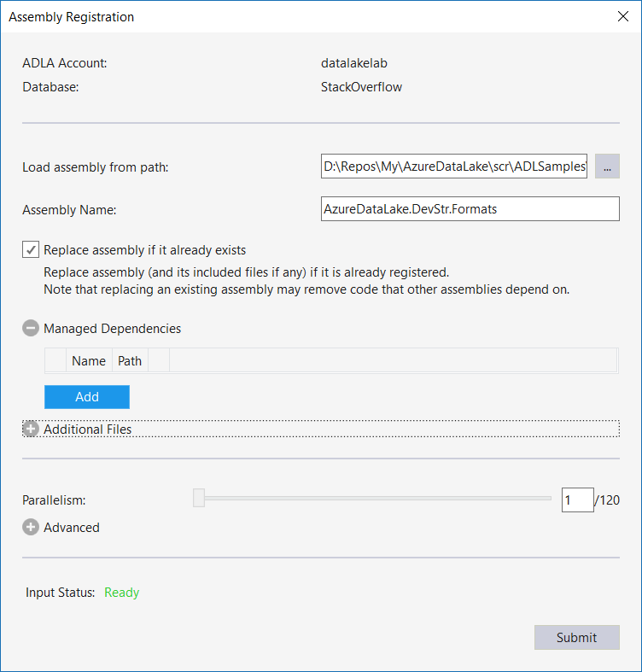
U-SQL Registering .Net Assemblies
DECLARE @AssemblyPath string = @"Assemblies/";
DECLARE @AssemblyExt string = @AssemblyPath+"ADLAExt.dll";
USE 4Developers;
DROP ASSEMBLY IF EXISTS ADLAExt;
CREATE ASSEMBLY ADLAExt FROM @AssemblyExt;

Slide 18
U-SQL Using .Net Assemblies
USE DATABASE [4Developers];
REFERENCE ASSEMBLY [ADLAExt];
USING IpConverter = ADLAExt.Utils.IpConverter;
@ds =
SELECT IpConverter.ToIp4Format(c_ip) AS Ip,
date.Date AS Date
FROM @iisLogs;
Use data base (optional)
Add reference to assembly
Create alias
Use method from assembly

Slide 19
ADLA Compilation & Deployment
DEPLOYED TO VERTICES
U-SQL Metadata Service
C#
managed dll
C++
Unmanaged dll
REFERENCE ASSEMBLY
R
R Engine & Libs
Python
Python Engine & Libs
Compilation and Optimization
Cogitive
Cognitive Models and Libs
Algebra
ADLS
Additional R/Python Scripts
Other files
(system files, deployed resources, user assemblies, etc.)
DEPLOY RESOURCE

Slide 20
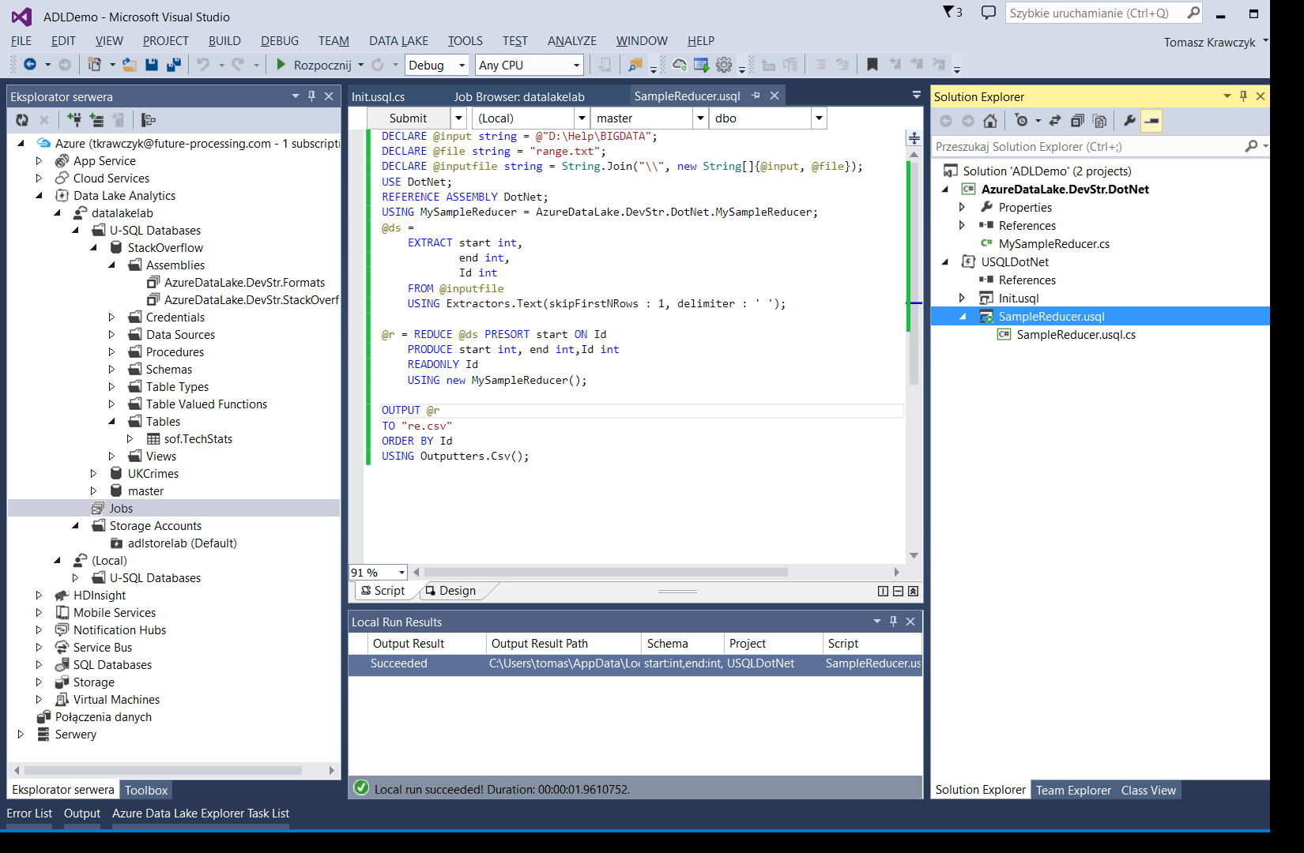
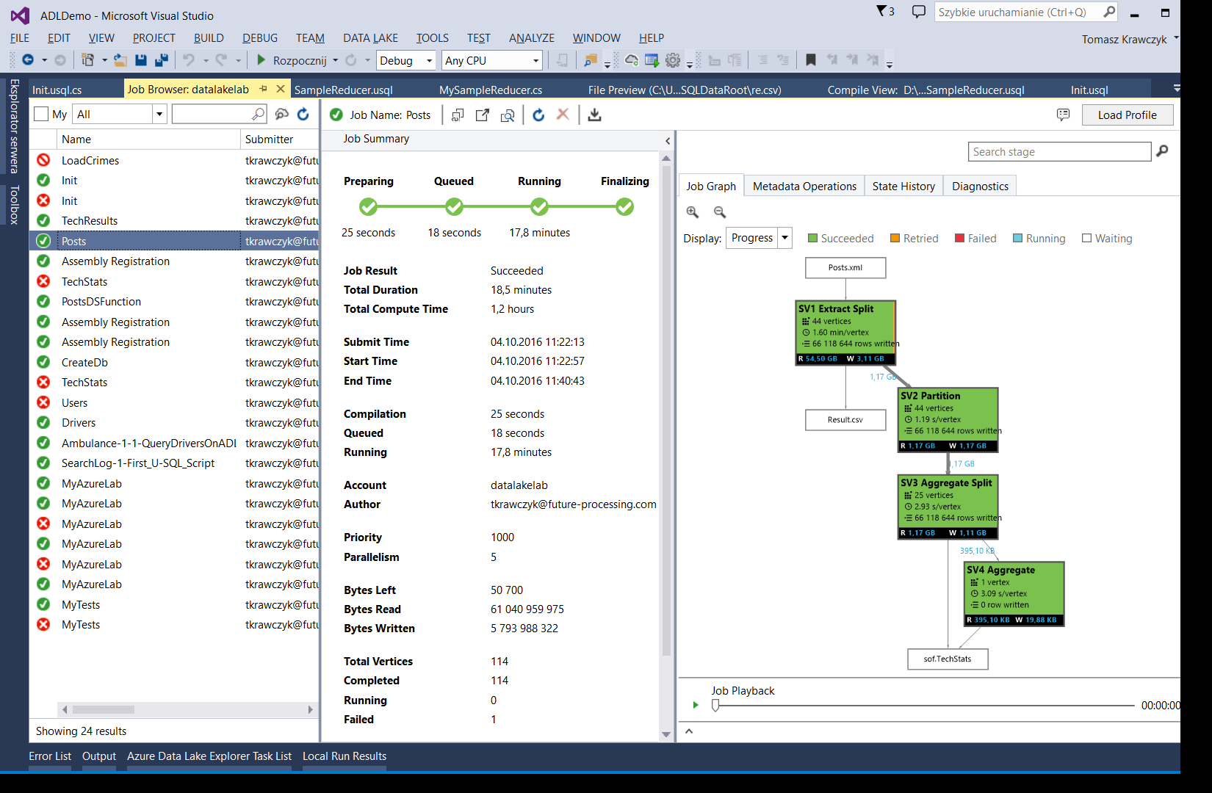
Data Lake and Stream Analytics Tools for Visual Studio

Slide 21
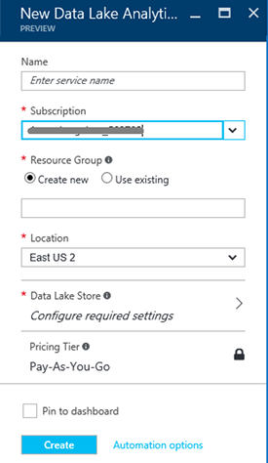
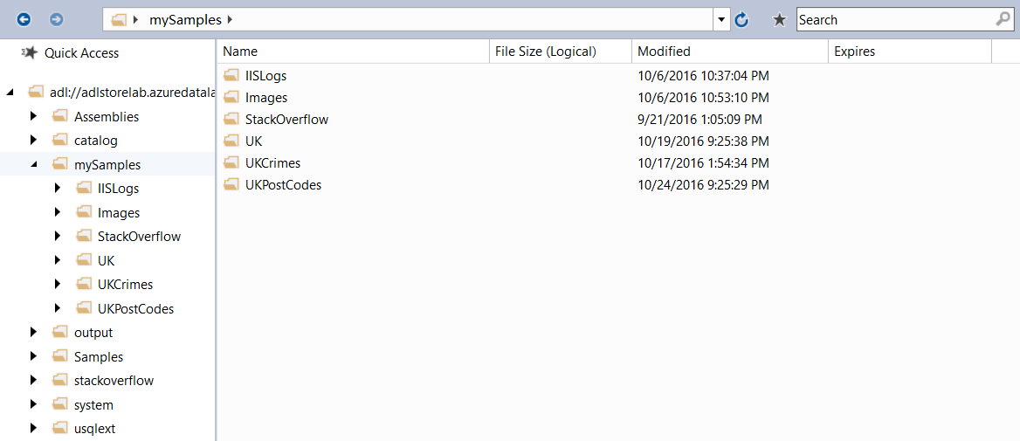
Building „End-to-End” Solution

Slide 22
DEMO

Slide 23
U-SQL REDUCE
Id | begin | end | value
1 | 2017-01-01 05:00:00 | 2017-01-01 06:00:00 | 100
1 | 2017-01-01 06:01:00 | 2017-01-01 07:00:00 | 200
1 | 2017-01-01 08:00:00 | 2017-01-01 09:00:00 | 900
2 | 2017-01-01 06:01:00 | 2017-01-01 07:00:00 | 2
2 | 2017-01-01 07:01:00 | 2017-01-01 09:01:00 | 9
REDUCER
Id | begin | end | value
1 | 2017-01-01 05:00:00 | 2017-01-01 07:00:00 | 300
1 | 2017-01-01 08:00:00 | 2017-01-01 09:00:00 | 900
2 | 2017-01-01 05:00:00 | 2017-01-01 09:00:00 | 11

Slide 24
Q & A

Slide 25
Resources
My examples (and demos)
https://github.com/cloud4yourdata/demos/tree/master/4DevKrakow2018 https://github.com/cloud4yourdata/usql/
Blogs and pages
http://aka.ms/AzureDataLake
http://usql.io
http://blogs.msdn.microsoft.com/mrys/
http://blogs.msdn.microsoft.com/azuredatalake/
Documentation, articles ...
http://aka.ms/usql_reference
https://azure.microsoft.com/enus/documentation/services/data-lake-analytics/
https://msdn.microsoft.com/en-us/magazine/mt614251
https://channel9.msdn.com/Search?term=U-SQL#ch9Search
https://www.youtube.com/results?search_query=U-SQL

Slide 26
THANK YOU!
tkrawczyk@future-processing.com

