Slide 1
Przetwarzanie Big Data w oparciu
o architekturę Lambda
na platformie Azure
Tomasz Krawczyk
Future Processing

Slide 2
Agenda
Big Data
Processing (Theory)
First Project
Azure Platform
Big Data Services
Demo and Q&A

Slide 3
3Vs of Big Data
40 Zetta bytes by 2020 and 163 Zetta bytes by 2025
Data Volume
Byte One grain of rice
Kilobyte Cup of rice
Megabyte 8 bags of rice
Gigabyte 3 semi trucks
Terabyte 2 container ships
Petabyte Blankets Manhattan
Exabyte Blankets west coast states
Zettabyte Fills the Pacific Ocean
Yottabyte As earth-sized rice ball
Data Variety
Structured
Unstructured
Semi-structured
All the above
Data Velocity
Near to Real Time
Batch

Slide 4
Lambda architecture
COLD PATH
Input
Data
All Data
Precomputed Views
BATCH LAYER
Batch View
Queries
Real Time View
Recent Data
Incremental Views
SPEED LAYER
HOT PATH

Slide 5
Kappa architecture
HOT PATH
Input
Data
Real-time Engine
Real Time View
Queries
Batch View
Mirror data
to Long Term Store
LONG
TERM STORE
Data Store
Batch Processing

Slide 6
Data Lake Approach
What is a Data Lake ?
“If you think of a datamart (a subset of a data warehouse)
as a store of bottled water – cleansed and packaged and structured for easy consumption – the data lake is a large body of water in a more natural state „
Pentaho CTO James Dixon

Slide 7
Schema-on-Read vs Schema-on-Write
Schema-on-Read (Hadoop or ADLS):
Schema-on-Write (RDBMS):
Copy data in its native format
Create schema + parser
Query Data in its native format (does ETL on the fly)
New data can start flowing any time and will appear retroactively once the schema/parser properly describes it.
Create static DB schema
Transform data into RDBMS
Query data in RDBMS format
New columns must be added explicitly before new data can propagate into the system.

Slide 8
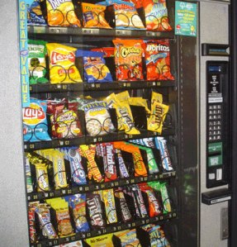
First Project
Sweets Machines
Monitor POC
Source: https://myvendingmachine.wordpress.com/2013/10/11/the-advantages-of-quality-vending-machine/

Slide 9
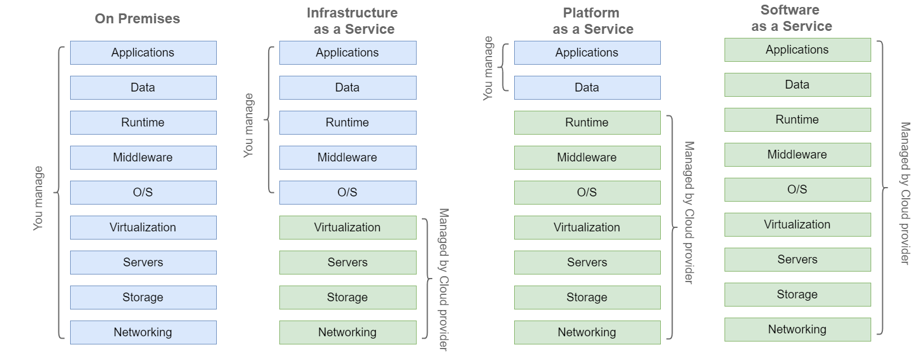
Cloud Models
CLUSTER AS A SERVICE
JOB/QUERY AS A SERVICE

Slide 10
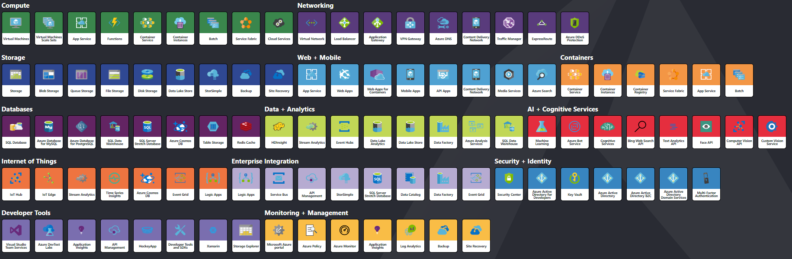
Azure Cloud
http://azureinteractives.azurewebsites.net/Azure101Cards/default.html

Slide 11







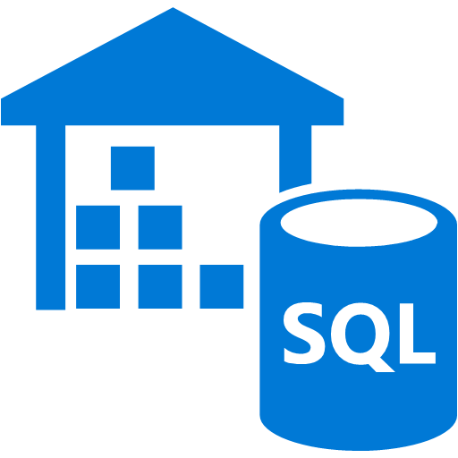
Azure – Lambda architecture (Cold Path)
Storage
Input
Data
Azure Blob Storage
Azure Data Lake Storage
Ingest
Azure Data Factory
PULL
Azure HDInsight
Azure Data
Lake Analytics
Azure Data
Warehouse
Azure Databricks
Azure ML
Analyse

Slide 12




Azure – Kappa architecture
Input
Data
Input
Stream Analytics
Processing
Event Hub
Gateway
Web Jobs
IoT Hub
Azure Databricks
Batch Processing
PUSH
Azure Blob Storage
Azure Data Lake Storage
Store

Slide 13
Data Lake Store vs Blob Storage
Azure Data Lake Store
Azure Blob Storage
Optimized storage for big data analytics workloads
Hierarchical file system
REST API over HTTPS
WebHDFS-compatible REST interface
Unlimited storage, petabyte files
General purpose object store for a wide variety of storage scenarios
Object store with flat namespace
REST API over HTTPS
For account-level authorization – Use Account Access Keys

Slide 14
Azure Event Hub vs IoT Hub
Azure Event Hub is a highly scalable data streaming platform and event ingestion service, capable of receiving and processing millions of events per second
Azure IoT Hub is a fully managed service that enables reliable and secure bidirectional communications between millions of IoT devices and a solution back end
Area | IoT Hub | Event Hub
Device protocol support | Supports MQTT, MQTT over WebSockets, AMQP, AMQP over WebSockets, and HTTPS. | Supports AMQP, AMQP over WebSockets, and HTTPS.
Device state information | Device twins can store and query device state information. | No device state information can be stored

Slide 15
Azure Stream Analytics
Azure Stream Analytics is a managed event-processing engine set up real-time analytic computations on streaming data.
Data Sources:
Data Stream and Reference Data
SQL -like language for querying live data streams
Supports SELECT, FROM, WHERE, GROUP BY, and other common Data Manipulation Language (DML) statements
Supports COUNT, AVG, DATEDIFF, and other common functions
Supports temporal grouping of events via "windowing“
Tumbling Window, Hopping Window, Sliding Window

Slide 16
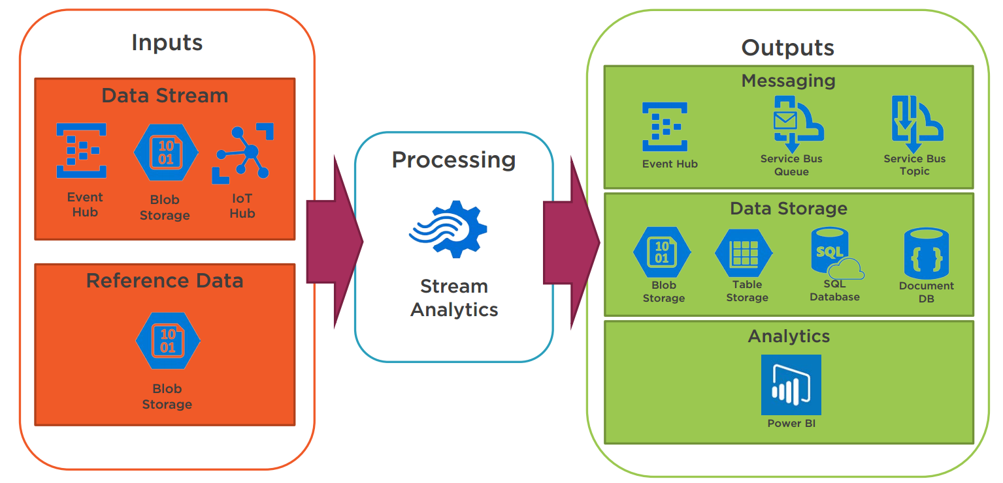
Azure Stream Analytics at work
Source: Alan Smith

Slide 17
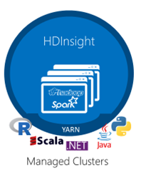
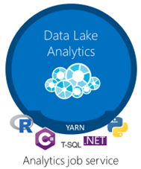
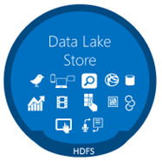
Data Lake
Analytics
Azure Data Bricks
Storage

Slide 18
Azure HDInsight vs Azure Data Lake Analytics vs Azure Databricks
Azure HDInsight
Cluster as a Service
Hadoop, Hbase, Storm, Spark, R Server, Kafka
Azure Data Lake Analytics
Job/Query as a Service
USQL (.Net ,Python, R Language, Cognitive)
Azure Databricks
Is an Apache Spark -based analytics platform
Optimized for the Microsoft Azure cloud services platform

Slide 19
Azure Data Lake Analytics
A distributed analytics service built on Apache YARN that dynamically scales to your needs
Pay PER QUERY & Scale PER QUERY
FEDERATED QUERY across Azure data sources
Includes U-SQL, a language that unifies the benefits of SQL with the expressive power of C#
No limits to SCALE
Optimized to work with ADL STORE

Slide 20
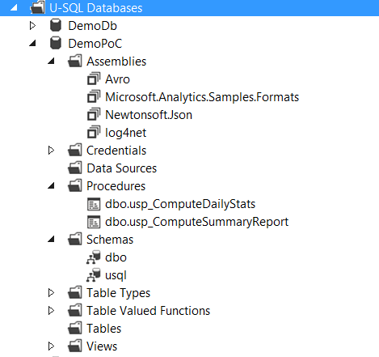
U–SQL - A new language for Big Data
DECLARE @projectsInput string = @"Projects\{file}.csv";
DECLARE @eventDate DateTime = System.DateTime.Parse("2017/04/01");
DECLARE @numbers int = 2;
REFERENCE ASSEMBLY USQLCSharpDemo;
USING ImageColorsProcessor = USQLCSharpDemo.ImageColorProducer;
@projects =
EXTRACT project string,
startDate DateTime,
endDate DateTime,
file string
FROM @projectsInput
USING Extractors.Csv(skipFirstNRows : 1, quoting : true);
@agg =
SELECT project,
COUNT( * ) AS units
FROM @details WHERE project.StartsWith("My")
GROUP BY project;
@myprojects =
SELECT us.project,
p.endDate
FROM @details AS us
JOIN
@projects AS p
ON p.project == us.project
WHERE user.StartsWith("Me")
ORDER BY p.endDate DESC
FETCH 10 ROWS;
OUTPUT @myprojects
TO "myprojects.csv"
USING Outputters.Csv();
USQL ( + .Net ,Python, R Language, Cognitive)

Slide 21
Azure Databricks
Azure Databricks is an Apache Spark-based analytics platform optimized for the Microsoft Azure cloud services platform
Integration with Azure services:
SQL Data Warehouse
Cosmos DB
Data Lake Store
Blob Storage
Event Hub
Integration with Azure Active Directory
Notebooks : R, Python, Scala, or SQL

Slide 22
Azure Data Factory
Fully managed service to support orchestration of data movement and transformation
Connect to relational or non-relational data that is on-premises or in the cloud
Allows monitor and manage data processing pipelines
Version 1 and 2 (+SSIS)

Slide 23
Azure Data Factory
Azure Data Factory V1 - GA Version
Azure Data Factory V2 - Public Preview+Designer (2018-01-16)
What’s new
New pipeline model
Rich pipeline orchestration
Triggers –ondemand,schedule,events
SSIS Package Execution
Lift my existing packages to the cloud
Author & Monitor
Python,.Net
Visual Tools
Data Movement as as Service
Cloud,Hybrid
64 connectors

Slide 24

Azure Data Factory
Dataset
(eg. tables, files)
Activity
(eg. Copy, Hive job,
SP, ADLA job)
Pipeline
(schedule,monitor,
manage)
Consumes
Is a
logical
grouping of
Produces
Represents
data item(s)
stored in
Runs on
Linked Services
(eg. SQL Server,
HDInsight,ADLA)

Slide 25
Azure Data Factory
Data movement activities :
Copy Activity
Data transformation activities :
Hive
Pig
MapReduce
Hadoop Streaming
Spark
Machine Learning activities: Batch Execution and Update Resource
Stored Procedure
Data Lake Analytics U-SQL
DotNet
Databricks Notebook

Slide 26
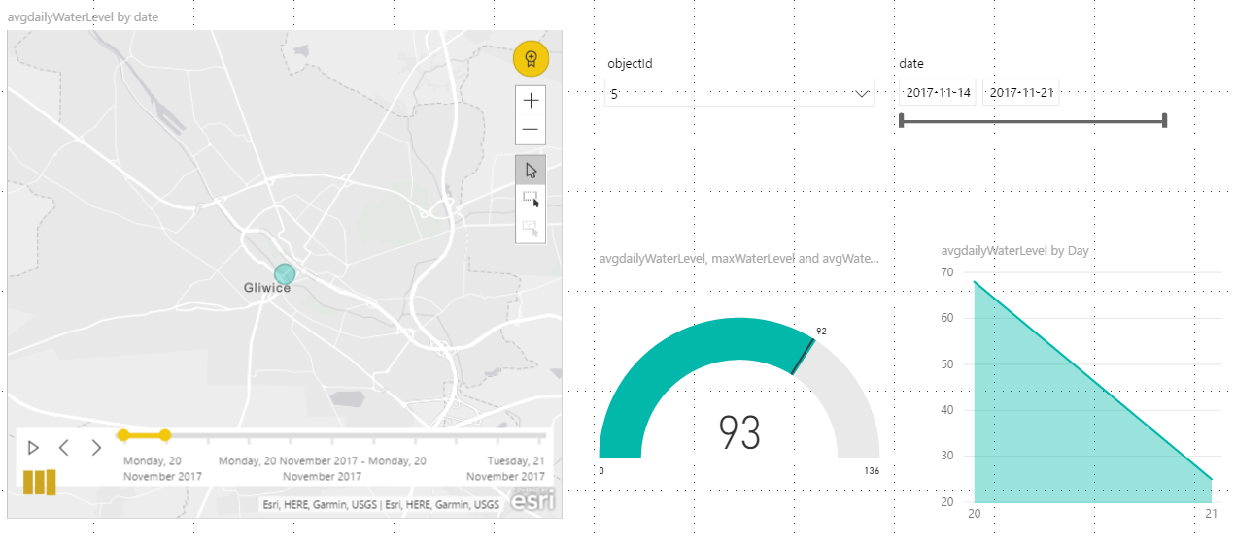
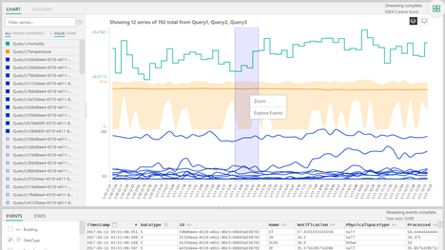
Azure Serving Layers
Power BI
Time Series Insight
Excel
API

Slide 27
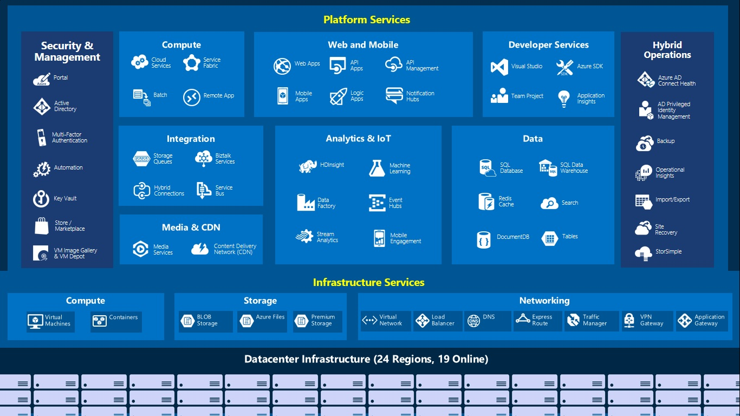
Azure as a Big Data Platform - What else?
Azure Data Warehouse
Azure Cosmos DB
Azure Notebooks
Azure Databricks
IoT Hub (IoT Edge)
+ Azure IoT Suite
Azure Data Catalog
Azure Cognitive Services
Azure ML Studio
Azure App Functions
Azure AD
Azure Batches

Slide 28
First Big Data Project
Sample Solution
Notes:
Musimy się zastanowiść jak analizować tak duże zbiory danych
Jakich nardzędzi użyć
Czy ma to być przetwarzanie real time czy przetwarzanie batchowe
Jakie jest pierwsze skojarzenie związane z analizą Big Data
Hadoop
Ale dziś nie o Hadoop
Dziś o chmurze Azure
Czy ktoś stawiał klaster Hadoop (HDInside)
I czy są z tym związane jakieś problemy

Slide 29




Azure Blob Storage
Event Hub
App Function
Input
Data
PUSH
Gateway
Stream Analytics
Event Hub
Azure Data Lake Store
Power BI
Azure Data Factory
Azure Data Lake Analytics
Azure Databricks

Slide 30
Resources:
https://docs.microsoft.com/en-us/azure/
https://github.com/cloud4yourdata
Contact:
tkrawczyk@future-processing.com

Slide 31

Twoja opinia na temat mojej prelekcji jest dla mnie bardzo ważna.
1. Wejdź w mój wykład znajdujący się w agendzie w aplikacji Eventory.
2. Oceń moją prelekcję i dodaj swój komentarz.
Dzięki temu będę wiedział/a, co Ci się podobało a co powinienem/am ulepszyć!

