Slide 1
Azure as a Big Data Platform Kariera IT Katowice 2017-11-25
Tomasz Krawczyk
tkrawczyk@future-processing.com

Slide 2
Plan
Big Data
Processing (Theory)
First challenge
Azure Platform
Big Data Services
Demo and Q&A
Notes:
Prezentacja w języku angielskim bo cieżko tłumaczyć niektóre rzeczy np Storage = Magazyn

Slide 3
Why choose a career in Big Data?
Exponential Growth Rate
40 Zetta bytes by 2020
163 Zetta bytes by 2025
Big Data Analytics: A Top Priority in a lot of Organizations
Big Data Analytics is Used Everywhere!
Lack of Skilled Professionals
Easy to Start (SQL, Python, Java, Scala)
Fat Paychecks
Sources:
http://www.orangetreeglobal.com/6-reasons-why-big-data-analytics-is-a-smart-career-choice-in-2017/
http://bigdata-madesimple.com/10-reasons-why-you-should-learn-data-analytics/
https://www.edureka.co/blog/10-reasons-why-big-data-analytics-is-the-best-career-move
http://www.dataversity.net/20-reasons-big-data-analytics-best-career-move/
Notes:
W 2020 do 80 % procesów będzie bazować na Big Data
Firmy mają dane, które same są wartości – problem polega tylko na tym, że nie firmy nie bardzo jeszcze są świadome wartości danych które mają
Lub nie wiedzą jak wyorzytać te dane
Świat IoT, aktualnie ponad 6 miliardów urządzeń w 2020 około 50
Urządzenia, czyli różnego rozdzaju czujniki są wszędzie, np w urządzeniach agd, samochodach, samolotach miastach
Wszystko teraz musi być smart
(jeden lot to kilka tera bytów danych),
Każdy z nas – nawet siedząc tu na Sali generuje dane (tzn nasze telefony)
Nasze telefony generują codziennie ok kilku do klikuset MB danych
40 Zetta B danych 2020
Jak myślicie to dużo?

Slide 4
3Vs of Big Data
Data Volume
Byte One grain of rice
Kilobyte Cup of rice
Megabyte 8 bags of rice
Gigabyte 3 semi trucks
Terabyte 2 container ships
Petabyte Blankets Manhattan
Exabyte Blankets west coast states
Zettabyte Fills the Pacific Ocean
Yottabyte As earth-sized rice ball
Data Variety
Structured
Unstructured
Semi-structured
All the above
Data Velocity
Near to Real Time
Batch
Notes:
3 V
Rozmiar
Szybkość przyrastania danych
Różnorodność

Slide 5
How do you process all the data ?
Notes:
Musimy się zastanowiść jak analizować tak duże zbiory danych
Jakich nardzędzi użyć
Czy ma to być przetwarzanie real time czy przetwarzanie batchowe
Jakie jest pierwsze skojarzenie związane z analizą Big Data
Hadoop
Ale dziś nie o Hadoop
Dziś o chmurze Azure
Czy ktoś stawiał klaster Hadoop (HDInside)
I czy są z tym związane jakieś problemy

Slide 6
Lambda architecture
COLD PATH
Input
Data
All Data
Precomputed Views
BATCH LAYER
Batch View
Queries
Real Time View
Recent Data
Incremental Views
HOT PATH
SPEED LAYER

Slide 7
Kappa architecture
HOT PATH
Input
Data
Real-time Engine
Real Time View
Queries
Batch View
Mirror data
to Long Term Store
LONG TERM STORE
Data Store
Batch Processing

Slide 8
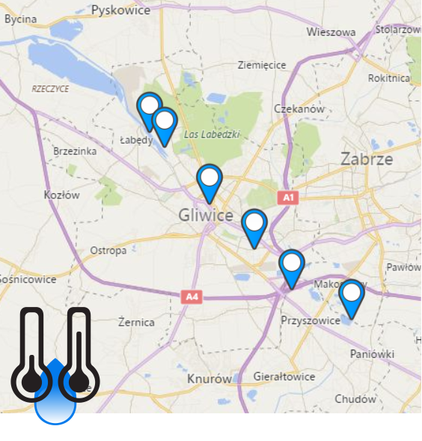
First Challange
PoC
Measuring devices
Online monitoring
Daily Statistics
Historical Data

Slide 9
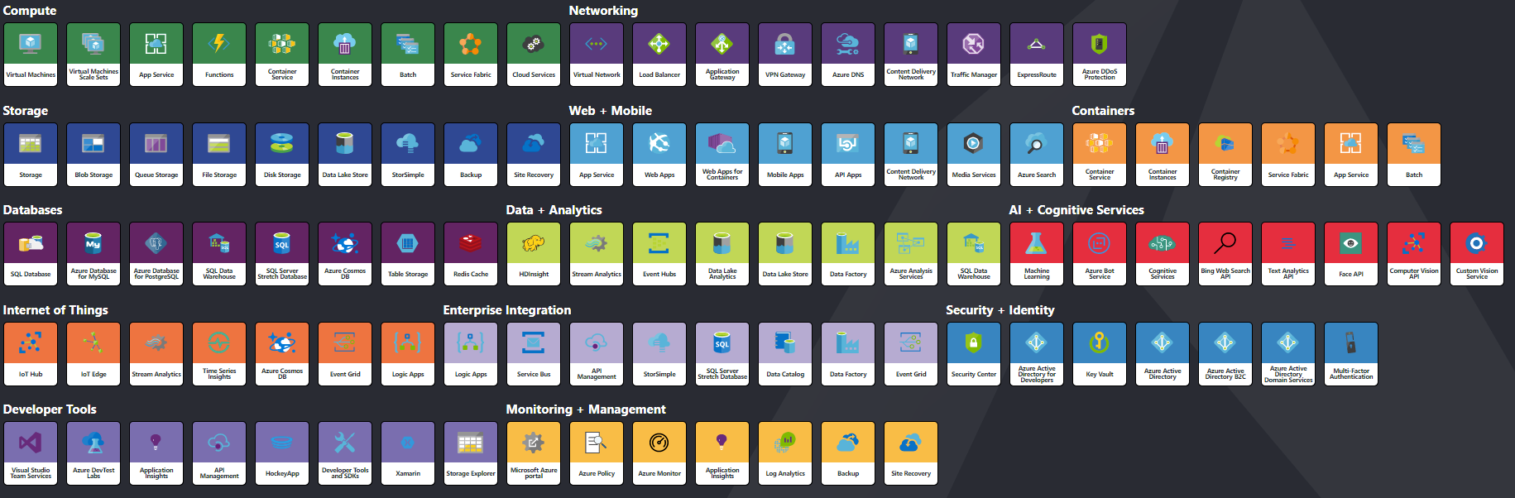
Azure Services
http://azureinteractives.azurewebsites.net/Azure101Cards/default.html
Notes:
Jak z tej układanki poskładać rozwiązanie

Slide 10






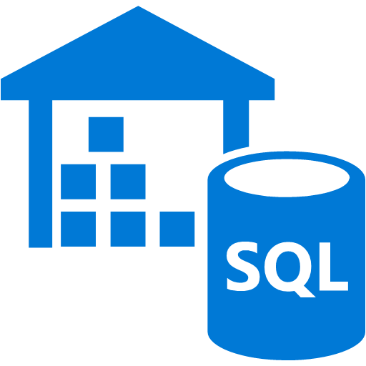
Azure – Lambda architecture (Cold Path)
Store
Input
Data
Ingest
Azure Blob Storage
Azure Data Lake Storage
Azure Data Factory
PULL
Azure HDInsight
Azure Data
Lake Analytics
Azure Batch
Azure Data
Warehouse
Analyse

Slide 11




Azure –Kappa architecture
Input
Data
Input
Processing
Event Hub
Stream Analytics
Gateway
IoT Hub
Web Jobs
PUSH
Batch Processing
Azure Blob Storage
Azure Data Lake Storage
Store

Slide 12

Azure Initial Load
Historical Data
Daily Data
Azure Import/Export Service
Azure Blob Storage

Slide 13
Data Lake Store vs Blob Storage
 | Azure Data Lake Store | Azure Blob Storage
Purpose | Optimized storage for big data analytics workloads | General purpose object store for a wide variety of storage scenarios
Use Cases | Batch, interactive, streaming analytics and machine learning data such as log files, IoT data, click streams, large datasets | Any type of text or binary data, such as application back end, backup data, media storage for streaming and general purpose data
Key Concepts | Data Lake Store account contains folders, which in turn contains data stored as files | Storage account has containers, which in turn has data in the form of blobs
Structure | Hierarchical file system | Object store with flat namespace
API | REST API over HTTPS | REST API over HTTP/HTTPS
Hadoop File System Client | Yes | Yes
Data Operations - Authentication | Based on Azure Active Directory Identities | Based on shared secrets - Account Access Keys and Shared Access Signature Keys.
Data Operations - Authorization | POSIX Access Control Lists (ACLs). ACLs based on Azure Active Directory Identities can be set file and folder level. | For account-level authorization – Use Account Access Keys For account, container, or blob authorization - Use Shared Access Signature Keys

Slide 14
Azure Event Hub vs IoT Hub
Azure Event Hub is a highly scalable data streaming platform and event ingestion service, capable of receiving and processing millions of events per second
Azure IoT Hub is a fully managed service that enables reliable and secure bidirectional communications between millions of IoT devices and a solution back end
Area | IoT Hub | Event Hub
Device protocol support | Supports MQTT, MQTT over WebSockets, AMQP, AMQP over WebSockets, and HTTPS. | Supports AMQP, AMQP over WebSockets, and HTTPS.
Device state information | Device twins can store and query device state information. | No device state information can be stored.
Source:https://docs.microsoft.com/en-us/azure/iot-hub/iot-hub-compare-event-hubs

Slide 15
Azure Stream Analytics
Azure Stream Analytics is a managed event-processing engine set up real-time analytic computations on streaming data. The data can come from devices, sensors, web sites, social media feeds, applications, infrastructure systems, and more.
Stream Analytics Query Language, a subset of T-SQL syntax
TIMESTAMP BY
WINDOWING
Tumbling Window
Sliding Window
Hopping Window

Slide 16
Azure HDInsight vs Azure Data Lake Analytics
Azure HDInsight
Cluster as a Service
Hadoop, Hbase,Storm, Spark, R Server, Kafka
Azure Data Lake Analytics
Job/Query as a Service
USQL (.Net ,Python, R Language, Cognitive)

Slide 17
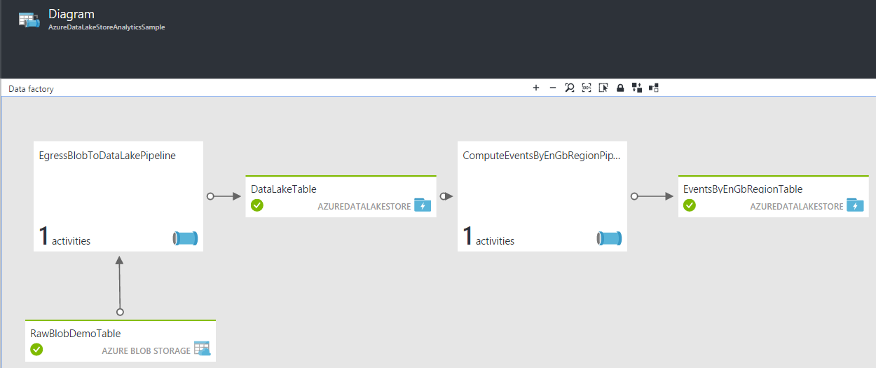
Azure Data Factory
Fully managed service to support orchestration of data movement and transformation
Connect to relational or non-relational data that is on-premises or in the cloud
Allows monitor and manage data processing pipelines
Version 1 and 2 (+SSIS)

Slide 18
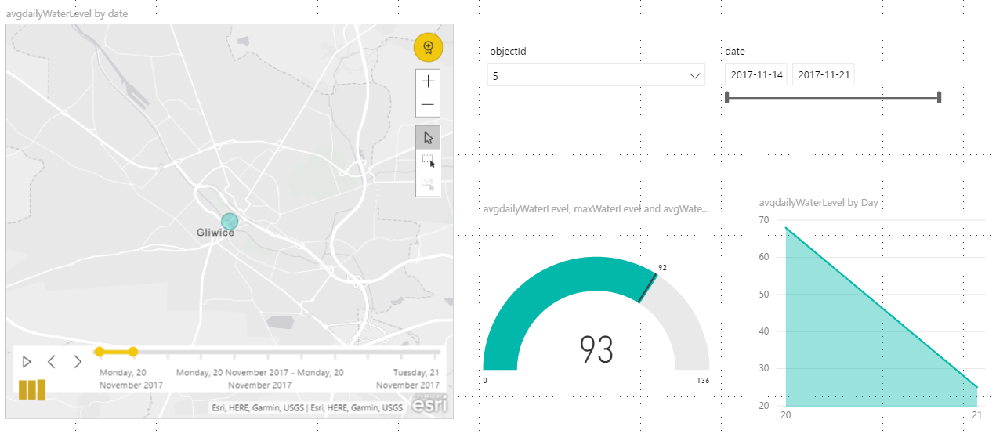
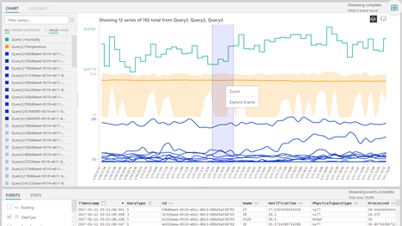
Azure Serving Layer
Power BI
Time Series Insight
Excel
API

Slide 19
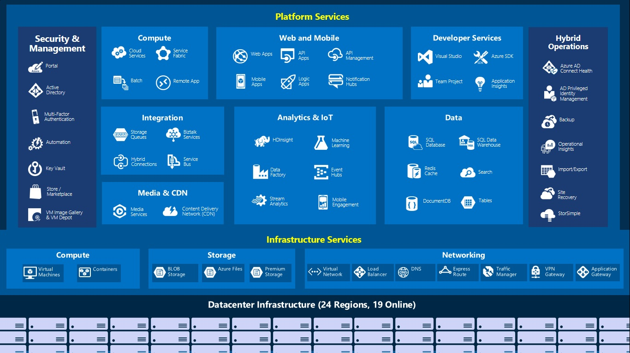
Azure as a Big Data Platform
Azure Data Warehouse
Azure Cosmos DB
Azure Notebooks
Azure Databricks
IoT Hub (IoT Edge)
+ Azure IoT Suite
Azure Data Catalog
Azure Cognitive Services
Azure ML Studio
Azure App Functions
Azure AD
Azure Batches

Slide 20



PoC Solution
Event Hub
App Function
Input
Data
Gateway
Stream Analytics
Event Hub
Time Series Insight
Event Hub
Azure Data Lake Storage
Azure Blob Storage
Power BI
PUSH
Azure Data Factory
Azure Data Lake Analytics

Slide 21
Azure as a Big Data Platform
DEMO(s)
Q&A
Notes:
Zanim demo zobaczmy nasze dane
Dwa datasety
Logi
Obrazy
Dema będą w większości lokalne (zobaczymy na ile starczy czasu, może uruchomimy jeden job na Azure)

Slide 22
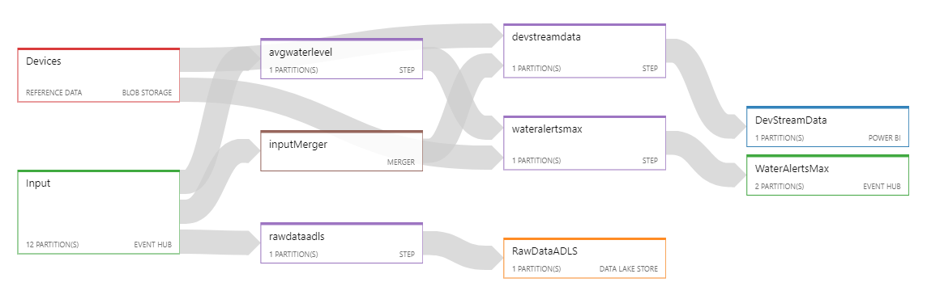
Demo
Azure Stream Analytics Job (Hot Path)

Slide 23
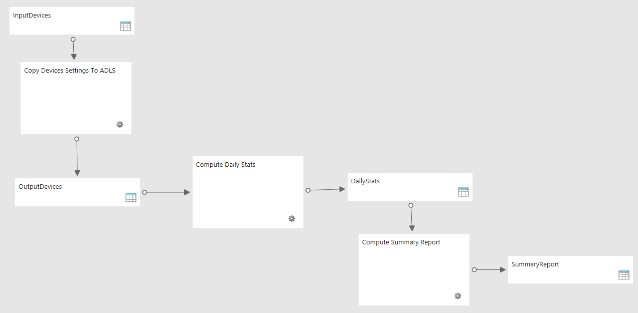
Demo
Azure Data Factory Pipeline (Cold Path)

Slide 24
Resources:
https://docs.microsoft.com/en-us/azure/
Examples:
https://github.com/cloud4yourdata/demos/tree/develop/AzureAsBigDataPlatfom
Contact:
tkrawczyk@future-processing.com
tomasz.k.krawczyk@gmail.com

