Slide 1









GOLD SPONSORS
SILVER SPONSORS
BRONZE SPONSOR
STRATEGIC PARTNER

Slide 2
“Lift and shift” SQL, .Net, Python and R code into Big Data solutions
Tomasz Krawczyk
tkrawczyk@future-processing.com

Slide 3
Agenda
Big Data – quick overview
Azure Data Lake – quick overview
U-SQL – quick overview
U-SQL Extensions
.Net
Cognitive
Python
R
Q&A

Slide 4
3Vs of Big Data
40 Zetta bytes by 2020 and 163 Zetta bytes by 2025
Data Volume
Byte One grain of rice
Kilobyte Cup of rice
Megabyte 8 bags of rice
Gigabyte 3 semi trucks
Terabyte 2 container ships
Petabyte Blankets Manhattan
Exabyte Blankets west coast states
Zettabyte Fills the Pacific Ocean
Yottabyte As earth-sized rice ball
Data Variety
Structured
Unstructured
Semi-structured
All the above
Data Velocity
Near to Real Time
Batch

Slide 5
How do you process all the data ?

Slide 6
Schema-on-Read vs Schema-on-Write
Schema-on-Read
(Hadoop or ADLS):
Schema-on-Write (RDBMS):
Copy data in its native format
Create schema + parser
Query Data in its native format (does ETL on the fly)
Create static DB schema
Transform data into RDBMS
Query data in RDBMS format

Slide 7
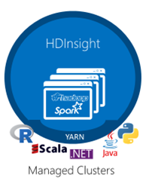
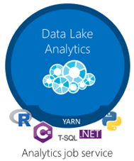


Data Lake on Azure
Analytics
Azure Databricks
Storage

Slide 8

Azure Data Lake Analytics
A distributed analytics service built on Apache YARN that dynamically scales to your needs
Pay PER QUERY & Scale PER QUERY
FEDERATED QUERY across Azure data sources
Includes U-SQL, a language that unifies the benefits of SQL with the expressive power of C#
No limits to SCALE
Optimized to work with ADL STORE

Slide 9
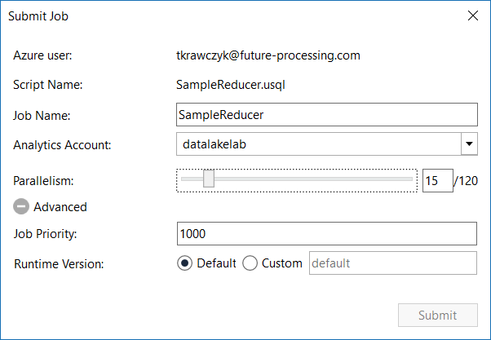
Data Lake Analytics Runtime
1 ADLAU ~= A VM with 2 cores and 6 GB of memory
Limited Network Access *
Parallelism N = N ADLAUs

Slide 10
U–SQL A new language for Big Data
Familiar syntax to millions of SQL & .NET developers
Unifies declarative nature of SQL with the imperative power of C#
Unifies structured, semi-structured and unstructured data
Distributed query support over all data
SCOPE
T-SQL/ ANSI SQL
C#
Hive
SQL DECLARATIVITY + C# EXTENSIBILITY = U-SQL
Notes:
U-SQL
Zupełnie nowy język na potrzeby Lake
Ale czy taki nowy
SCOPE
Czy ktoś zna SQL
A C#
A czemu taki fajny
Deklaratywność – określamy co ma być zrobione a nie określamy jak
Rozszerzalność (C#)
Zobaczmy jak wygląda U-SQL

Slide 11
U–SQL Language Overview
DECLARE @projectsInput string = @"Projects\{file}.csv";
DECLARE @eventDate DateTime = System.DateTime.Parse("2018/05/16");
DECLARE @numbers int = 2;
REFERENCE ASSEMBLY USQLCSharpDemo;
USING ImageColorsProcessor = USQLCSharpDemo.ImageColorProducer;
@projects =
EXTRACT project string,
startDate DateTime,
endDate DateTime,
file string
FROM @projectsInput
USING Extractors.Csv(skipFirstNRows : 1, quoting : true);
@rs =
EXTRACT content byte[],
fileName string
FROM @imgFiles
USING new BinaryExtractor();
@assignments =
SELECT user.ToUpper() AS user,
new SqlArray<string>(projects.Split(new char[]{'|'}, StringSplitOptions.RemoveEmptyEntries)) AS projs
FROM @usersprojects;
@agg =
SELECT project,
COUNT( * ) AS units
FROM @details WHERE project.StartsWith("My")
GROUP BY project;
@myprojects =
SELECT us.project,
p.endDate
FROM @details AS us
JOIN
@projects AS p
ON p.project == us.project
WHERE user.StartsWith("Me")
ORDER BY p.endDate DESC
FETCH 10 ROWS;
OUTPUT @myprojects
TO "myprojects.csv"
USING Outputters.Csv();
C# Types
.NET Assemblies
Apply Schema on Read
Extractor
Rowset(s)
External Extractor
SQL Dialect (SELECT FROM)
SQL Aggregation(s)
.NET Methods
SQL Dialect (JOIN, WHERE, ORDER BY ...)
Output
Notes:
No SQL
Schema on Read vs Schema on Write (up front)

Slide 12
ADLA Catalog
[1,n]
C# Extractors
Database
C# Reducers
Credentials
C# Fns
C# UDTs
C# UDAgg
C# Processors
C# Applier
[1,n]
C# Combiners
C# Outputters
Data Source
Schema
C# Assemblies
[0,n]
Ext. tables
Tables
Views
TVFs
Procedures
Table Types
Statistics
Clustered Index
Partitions
Source: Microsoft\M Rys

Slide 13
U-SQL Top 5’s Surprises for SQL Developers
U-SQL is case sensitive
AS is not as
C# keywords and SQL keywords overlap
= != ==
C# expression language
null IS NOT NULL
C# nulls are two-valued (HasValue)
No UPDATE, DELETE, nor MERGE

Slide 14
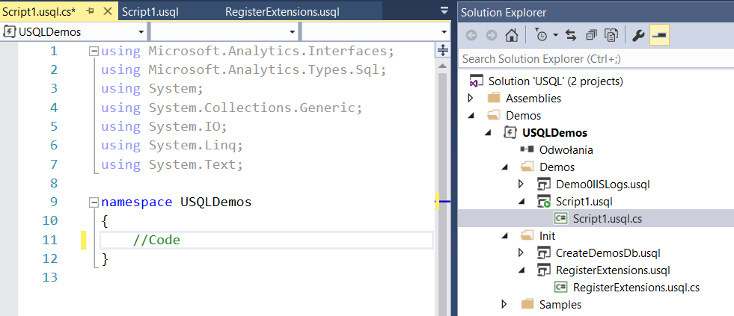
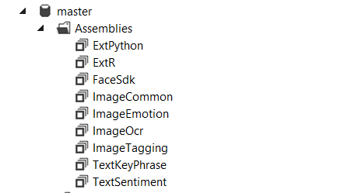
U-SQL .NET Extentions
C# Functions/Methods
C# UDTs
C# UDAggs
Extractors
Reducers
Processors
Appliers
Combiners
Outputers
How to create .Net Extensions?
C# UDO
.NET Assemblies

Slide 15

U-SQL .Net Framework and System Assemblies
U-SQL uses the .NET Framework version 4.5
(code in a 64-bit (x64) format)
Preloaded System Assemblies
mscorlib.dll
System.dll
System.Core.dll
System.Data.dll
Microsoft.Analytics.Interfaces.dll
Microsoft.Analytics.Types.dll
Example:
REFERENCE SYSTEM ASSEMBLY [System.XML];

Slide 16
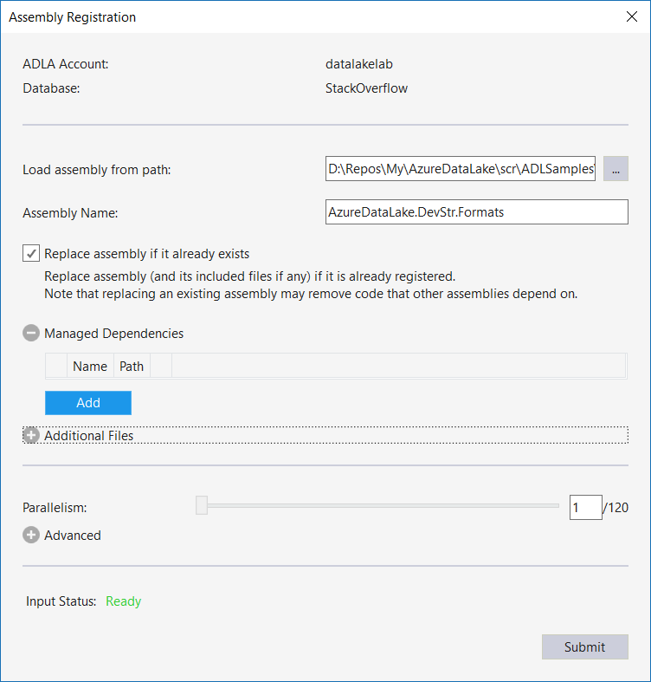
U-SQL Registering .Net Assemblies
DECLARE @AssemblyPath string = @"Assemblies/";
DECLARE @AssemblyExt string = @AssemblyPath+"ADLAExt.dll";
USE SQLDay2018;
DROP ASSEMBLY IF EXISTS ADLAExt;
CREATE ASSEMBLY ADLAExt FROM @AssemblyExt;

Slide 17
U-SQL Using .Net Assemblies
USE DATABASE [SQLDay2018];
REFERENCE ASSEMBLY [ADLAExt];
USING IpConverter = ADLAExt.Utils.IpConverter;
@ds =
SELECT IpConverter.ToIp4Format(c_ip) AS Ip,
date.Date AS Date
FROM @iisLogs;
Use data base (optional)
Add reference to assembly
Create alias
Use method from assembly

Slide 18
DEMO 1
VertexInfo
BinaryExtractor

Slide 19
U-SQL Advanced Analytics
Built-in Cognitive capabilities
Imaging: Detect faces
Imaging: Detect emotion
Imaging: Detect objects (tagging)
Imaging: OCR
Text: Key Phrase Extraction
Text: Sentiment Analysis
Extensions for Massively Parallel processing
R Language
Python
Cognitive
Python
R
.Net
U-SQL

Slide 20
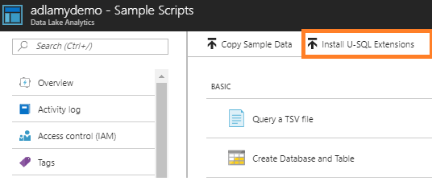
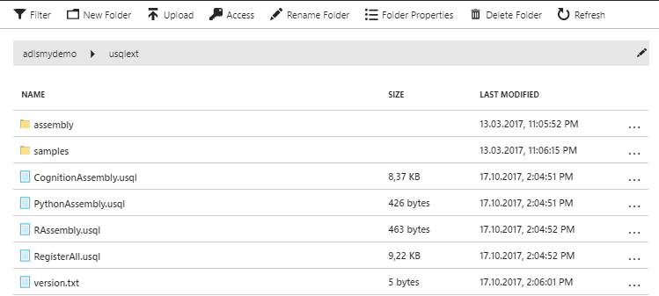
U-SQL Cognitive, R Language, Python
Install U-SQL Extensions
Register Assemblies
CognitionAssembly.usql
PythonAssembly.usql
RAssembly.usql
RegisterAll.usql

Slide 21
DEMO 2
CogitiveTagger
CogitiveFaces

Slide 22
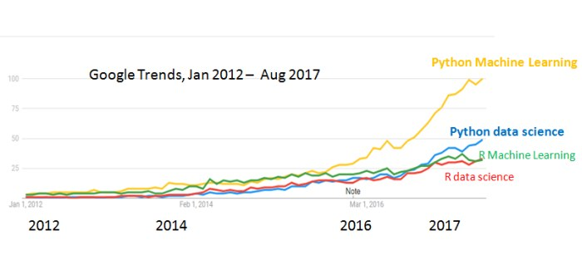
Why R and (or) Python ?
https://www.kdnuggets.com/2017/09/python-vs-r-data-science-machine-learning.html
R language is a golden child of machine learning
Python is a king of machine learning

Slide 23
U-SQL R/Python – How to run ?
Enable Extensions
REFERENCE ASSEMBLY [ExtPython]
REFERENCE ASSEMBLY [ExtR]
Execute Python or R code on Partitions via specialized reducers
Extension.Python.Reducer
Extension.R.Reducer

Slide 24
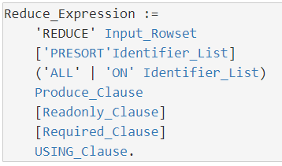
U-SQL REDUCE
@results =
REDUCE @sample
PRESORT begin
ON id
PRODUCE id,
begin,
end,
value double
READONLY id
REQUIRED begin,
end,
value
USING new BreakRangeReducer(180);
ROWSET
PRESORT
GROUP BY
NEW ROWSET
REDUCER
ALL | ON - The optional ALL indicates that the whole input rowset will become the group to be reduced. Similar to a GROUP BY ALL

Slide 25
U-SQL REDUCE
Id | begin | end | value
1 | 2017-01-01 05:00:00 | 2017-01-01 06:00:00 | 100
1 | 2017-01-01 06:01:00 | 2017-01-01 07:00:00 | 200
1 | 2017-01-01 08:00:00 | 2017-01-01 09:00:00 | 900
2 | 2017-01-01 06:01:00 | 2017-01-01 07:00:00 | 2
2 | 2017-01-01 07:01:00 | 2017-01-01 09:01:00 | 9
REDUCER
Id | begin | end | value
1 | 2017-01-01 05:00:00 | 2017-01-01 07:00:00 | 300
1 | 2017-01-01 08:00:00 | 2017-01-01 09:00:00 | 900
2 | 2017-01-01 05:00:00 | 2017-01-01 09:00:00 | 11

Slide 26
DEMO 3
.Net BreakRangeReducer

Slide 27
U-SQL R/Python REDUCE
@ROutput =
REDUCE @RInputDS
ON Par
PRODUCE Par,
RowId int,
ROutput string
READONLY Par
USING
new
Extension.R.Reducer
(command : @myRScript);
Partition Key
NOTE:
Reducer does
not have to aggregate

Slide 28
U-SQL R/Python REDUCE
Rowset Partition 1
Rowset Partition N
…
Python/R.Reducer (type mapping)
Python/R.Reducer (type mapping)
Python/R Code
Python/R Code
Data frame
Data frame
Data frame
Data frame
Reduce Vertex 1
Reduce Vertex N
Notes:
The U-SQL compiler & optimizer look at the U-SQL script and the input data creates a "plan" the execute the work. The plan itself is divided into smaller tasks - each task is a called a vertex. The smallest possible U-SQL job consists of one vertex. A large U-SQL job can consist of many thousands vertices.
https://blogs.msdn.microsoft.com/azuredatalake/2016/10/12/understanding-adl-analytics-unit/

Slide 29

U-SQL R Integration
require(signal)
k = 11
inputFromUSQL$sv <- c(filter(MedianFilter(k), inputFromUSQL$v))
outputToUSQL <- data.frame(Id = inputFromUSQL$Id,
sv = inputFromUSQL$sv,
md = inputFromUSQL$md,
mv = inputFromUSQL$nv)
Input
inputFromUSQL (data frame)
rightFromUSQL and leftFromUSQL (data frame) for Combiner(*)
Output
output2USQL (data frame)

Slide 30
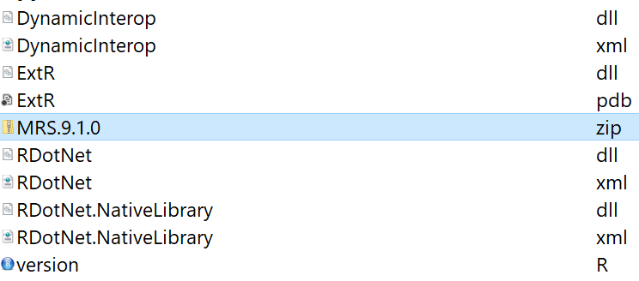
U-SQL R Integration
R U-SQL Runtime
R Versions
Microsoft R Server 9.1.0
R 3.3

Slide 31
U-SQL R Integration
Packages
All the standard R packages are included.
Additional R modules
RevoScaleR
RevoTreeView
RevoUtils
Install additional packages

Slide 32
U-SQL R Integration
Datatypes
String and numeric columns from U-SQL are converted
as-is between R DataFrame and U-SQL
[supported types: double, string, bool, integer, byte].
The Factor datatype is not supported in U-SQL.
byte[] must be serialized as a base64-encoded string.
SQL strings can be converted to factors in R code,
once U-SQL create R input dataframe or by setting the
reducer parameter stringsAsFactors: true

Slide 33

U-SQL Python Integration
'''
Python reducer UDO definition
'''
from scipy import signal
def usqlml_main(df):
k = 11
df['nv'] = signal.medfilt(df['v'],k)
return df
usqlml_main function
df -input pandas data frame
return pandas data frame

Slide 34
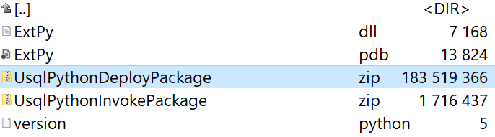
U-SQL Python Integration
Python U-SQL Runtime
Python Versions
Only Python 3.5.1 (compiled for Windows) is supported.

Slide 35
U-SQL Python Integration
Modules
All the standard Python modules are included.
Additional Python modules
pandas
numpy
sklearn
Python Custom Module
Datatypes
String and numeric columns from U-SQL are converted as-is
between Pandas and U-SQL
U-SQL Nulls are converted to and from Pandas NA values

Slide 36
U-SQL Python/R Limitations
Python Input and Output size limitations
the total size for the input and output cannot exceed 6 GB (max input dataframe size < 2 GB)
R Input and Output size limitations
Because the input and output DataFrames must exist in memory in the R code, the total size for the input and output cannot exceed 500 MB (*).
https://docs.microsoft.com/en-us/azure/data-lake-analytics/data-lake-analytics-u-sql-r-extensions
https://docs.microsoft.com/en-us/azure/data-lake-analytics/data-lake-analytics-u-sql-python-extensions

Slide 37
Data Lake Analytics Compilation & Deployment Cognitive/R/Python
C#
managed dll
REFERENCE ASSEMBLY [master].[ExtPython];
REFERENCE ASSEMBLY [master].[ExtR];
//Deploy Python script
DEPLOY RESOURCE @"/SQLDay2018/PythonIrisUseSVMModelUSQL.py";
//Deploy model
DEPLOY RESOURCE @"/SQLDay2018/iris_model_svm.bin";
//Deploy external package
DEPLOY RESOURCE @"/SQLDay2018/ExtRLibs/signal_0.7-6.zip";
…
@PyOutput =
REDUCE @Extended
ON Par
PRODUCE Par int,
SepalLength double,
SepalWidth double,
PetalLength double,
PetalWidth double,
Species string,
SepalRatio double,
PetalRatio double
USING new Extension.Python.Reducer("PythonIrisUseSVMModelUSQL.py");
@ROutput =
REDUCE @PyOutput
ON Par
PRODUCE Par,
RowId int,
ROutput string
READONLY Par
USING new Extension.R.Reducer(command : @myRScript);
C++
Unmanaged dll
R
R Engine & Libs
Python
Python Engine & Libs
Cogitive
Cognitive Models and Libs
Algebra
Additional R/Python Scripts
Other files
(system files, deployed resources, user assemblies, etc.)

Slide 38
U-SQL DEPLOY
//Deploy external package
DEPLOY RESOURCE @"/SQLDay2018/ExtRLibs/signal_0.7-6.zip";
DEPLOY RESOURCE @"/SQLDay2018/PythonIrisUseSVMModelUSQL.py";
DEPLOY RESOURCE @"/SQLDay2018/iris_model_svm.bin";
Source
Azure Data Lake Store
Azure Blob Storage
Size Limits
Single resource file limit is 400MB.
Overall limit for deployes resource files is 3GB.

Slide 39
DEMO 4
R Median Filter
R Revoscale
Python Median Filter
Python House Prices Model

Slide 40
Summary
We can Lift and shift our .Net, Python and R code (or pretrained models) and scale out it by U-SQL and Azure Data Lake Analytics

Slide 41
Q&A

Slide 42
U-SQL +.Net + Python/R Resources
My examples (and demos)
https://github.com/cloud4yourdata/usql/tree/develop
https://github.com/cloud4yourdata/demos/tree/develop/SQLDay2018
Blogs and pages
http://aka.ms/AzureDataLake
http://usql.io
http://blogs.msdn.microsoft.com/mrys/
http://blogs.msdn.microsoft.com/azuredatalake/
Documentation, articles ...
http://aka.ms/usql_reference
https://azure.microsoft.com/enus/documentation/services/data-lake-analytics/
https://msdn.microsoft.com/en-us/magazine/mt614251
https://channel9.msdn.com/Search?term=U-SQL#ch9Search
https://www.youtube.com/results?search_query=U-SQL

Slide 43
GOLD SPONSORS
SILVER SPONSORS
BRONZE SPONSOR
STRATEGIC PARTNER

