Slide 1









PLATINUM SPONSOR
GOLD SPONSORS
SILVER SPONSOR
BRONZE SPONSOR
STRATEGIC PARTNER

Slide 2
Partycjonowanie danych w rozwiązaniach Big Data
Tomasz Krawczyk
tkrawczyk@future-processing.com

Slide 3
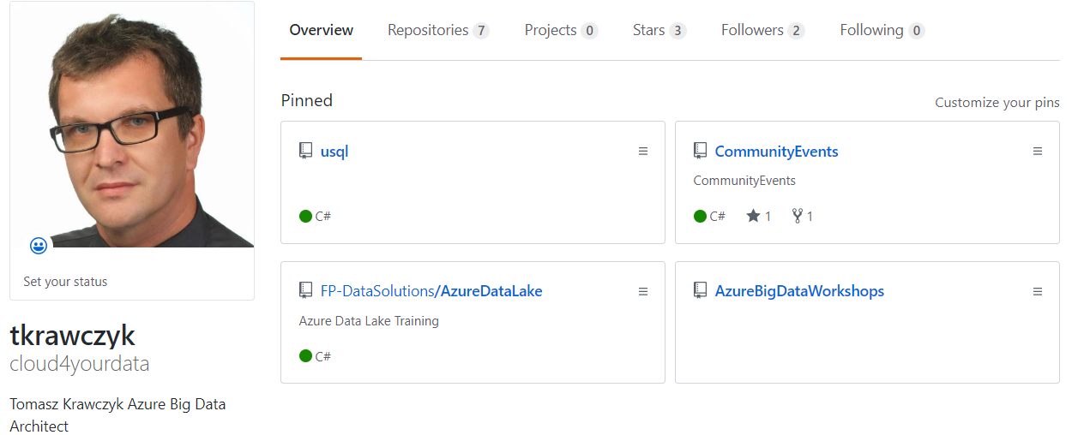


About Me
https://github.com/cloud4yourdata
{CommunityEvents}
Notes:
System paszportowy

Slide 4
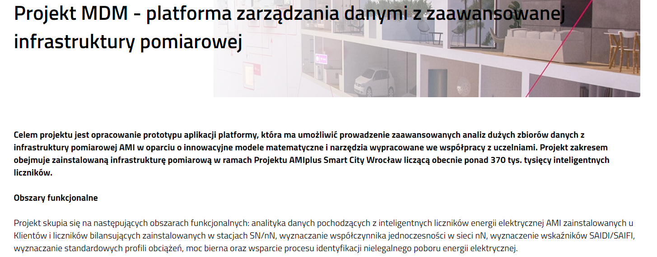
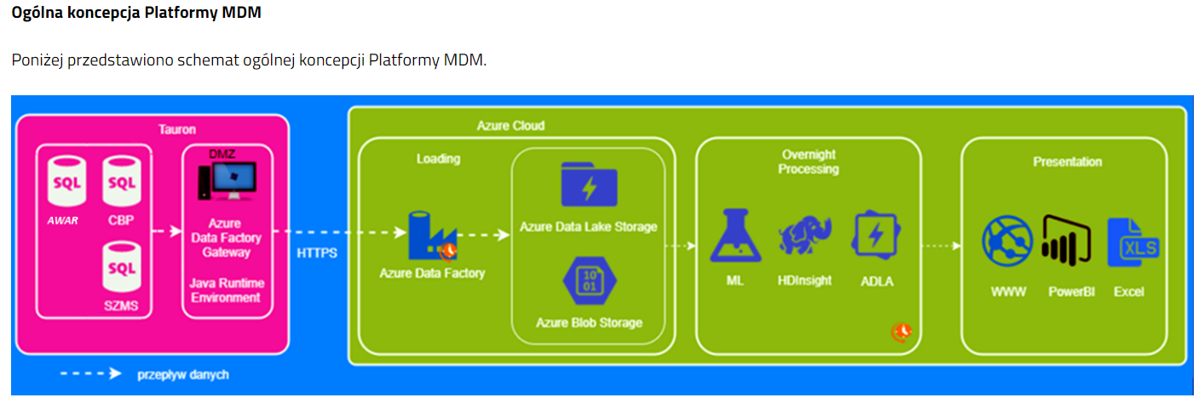
Project
https://www.tauron-dystrybucja.pl/o-spolce/innowacje-tauron/mdm
Notes:
Bawie sie chmura ,
Dostalem gadzet I teraz bedziemy mogli pobawic sie razem

Slide 5
Agenda
Big Data Game
Big Data Solutions (Azure)
Hive and Spark (and Azure Data Lake Analytics)
External and Manage Tables
Partitioning
Bucketing
Delta and Delta Lake
Demos

Slide 6
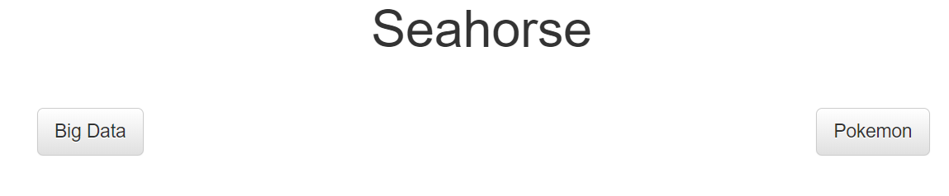
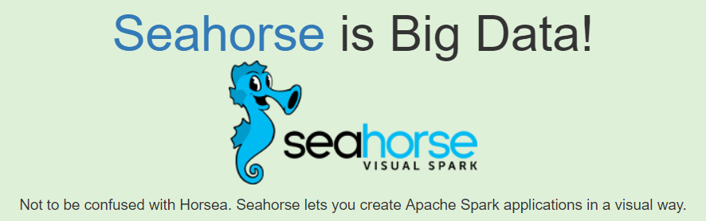
Big Data Game
Is it Pokemon or Big Data ?
https://pixelastic.github.io/pokemonorbigdata/

Slide 7

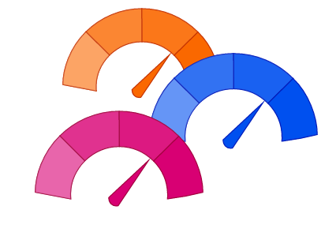
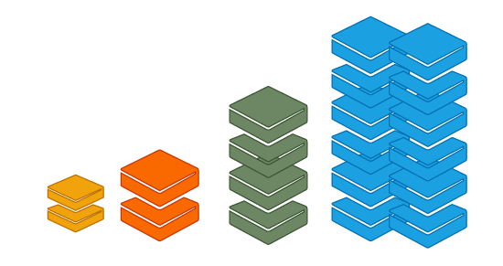
Big Data (3V)
Byte One grain of rice
Kilobyte Cup of rice
Megabyte 8 bags of rice
Gigabyte 3 semi trucks
Terabyte 2 container ships
Petabyte Blankets Manhattan
Exabyte Blankets west coast states
Zettabyte Fills the Pacific Ocean
Yottabyte As earth-sized rice ball
Data Volume
Data Variety
Data Velocity

Slide 8











Big Data Solutions and Azure
Azure
Azure Data Explorer
Azure HDInsight
Azure Databricks
Azure Data Lake Analytics
Azure Cosmos DB
Azure Blob Storage
Azure Data Lake Storage (Gen2)
Azure Data Lake Storage
(Gen1)
Azure Data Warehouse

Slide 9
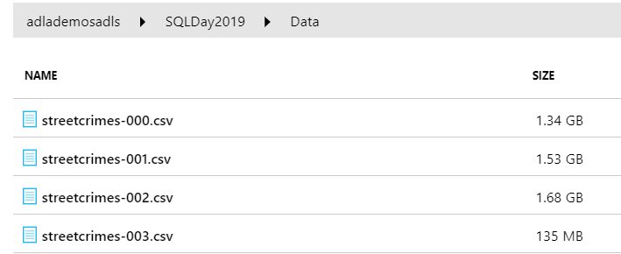
Challenge
Data Set:
Azure Data Lake Storage
(Gen1)
FILTER (PROCESS):
YearReported = 2017 AND MonthReported = 10
Notes:
Poglądowy scenariusz ☺

Slide 10

Big Data Solutions
Azure Data Lake Analytics is an on-demand analytics job service that simplifies big data. (Legacy)
The Apache Hive ™ data warehouse software facilitates reading, writing, and managing large datasets residing in distributed storage using SQL.
Apache Spark™ is a unified analytics engine for large-scale data processing
Scala, Python, R, SQL and .Net

Slide 11

Big Data and SQL
Using RDD (Spark)
data = sc.textFile(...).split("\t")
data.map(lambda x: (x[0], [int(x[1]), 1])) \
.reduceByKey(lambda x, y: [x[0] + y[0], x[1] + y[1]]) \
.map(lambda x: [x[0], x[1][0] / x[1][1]]) \
.collect()
Using SQL (Spark)
SELECT name, avg(age) FROM people GROUP BY name
„Phoenix Puts the SQL Back in NoSQL”

Slide 12

Data Processing Batch mode vs Interactive mode
Batch Mode
Interactive Mode
U-SQL Job/Query
HQL Job
Spark Job
SQL Query (ODBC/JDBC)
Azure Data Lake
Analytics
(LLAP)
Storage

Slide 13

Hive and Spark SQL
Hive Query Language
Metastore
Spark SQL
Hive Query Language
Hive Metastore allows mapping database structures
(database, table, partition, column) to HDFS directories and files

Slide 14
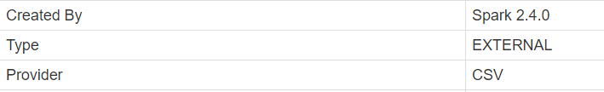
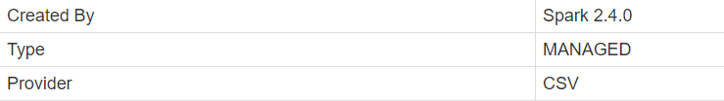
Hive and Spark SQL -Tables
External (unmanaged) tables
Managed (internal) tables
CREATE TABLE IF NOT EXISTS StreetCrimes
(
CrimeID STRING,
DateReported TIMESTAMP,
Month INT,
Year INT,
...
)
USING CSV
OPTIONS(header 'true')
LOCATION 'dbfs:/mnt/SQLDay2019/'
%sql
DESCRIBE EXTENDED {TABLENAME}
Providers: CSV, ORC, PARQUET, DELTA, JDBC
Notes:
Schema on read/ map data as a table

Slide 15
DEMO
ADLA
Demo-001.usql
Spark
001-ExtAndManagedTables

Slide 16
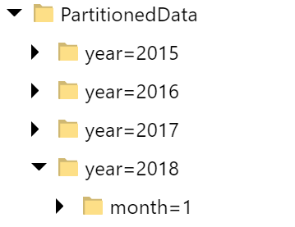
Partitioning and Partition Elimination
Partitioning is a way of dividing a table into related parts based on the values of partitioned columns.
Azure Event Hub
(Event data capturing)
Azure Stream Analytics
(Output)
Azure Data Factory
Load into Azure Storage
Partition year
Sub partition month
{Partition Key}={Partition Value}
Notes:
Lambda architecture/kappa

Slide 17
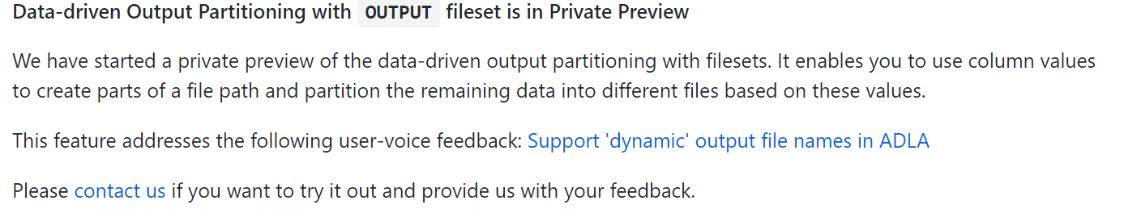
ADLA Partitioned Output
SET @@FeaturePreviews = "DataPartitionedOutput:on";
…;
DECLARE @outputPath string = @"/SQLDay2019/Out/PartitionedData/year={YearReported}/month={MonthReported}/streetcrimes.csv";
…
OUTPUT @inputData
TO @outputPath
USING Outputters.Csv();
Notes:
Back to out problem –how to partition data?
ADLA

Slide 18
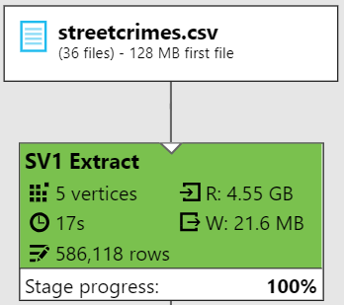
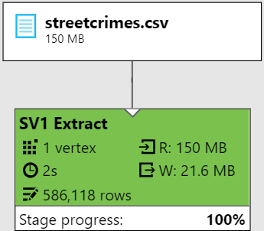
ADLA- Read Partitioned Data (Partition Elimination)
DECLARE @inputPath string =@“../year={Year}/month={Month}/{*}.csv";
@inputData =
EXTRACT…
Year string,
Month string;
@inputData =
EXTRACT…
Year int,
Month int;
@outputData =
SELECT * FROM @inputData WHERE
Convert.ToInt32(Year) == 2017
AND Convert.ToInt32(Month) == 10;
@outputData =
SELECT * FROM @inputData WHERE
Year == 2017
Month == 10;

Slide 19
Hive and Spark - Read Partitioned Data
CREATE EXTERNAL TABLE IF NOT EXISTS StreetCrimesParitioned
(
CrimeID STRING,
DateReported TIMESTAMP,
Month INT,
Year INT,
...
)
USING CSV
OPTIONS(header 'true')
PARTITIONED BY (Year,Month)
...
CREATE EXTERNAL TABLE IF NOT EXISTS StreetCrimesParitionedHive
(
CrimeID STRING,
DateReported TIMESTAMP,
...
)
PARTITIONED BY (year INT, month INT)
...
MSCK REPAIR TABLE { TableName }
Notes:
How get access to partitioned data

Slide 20
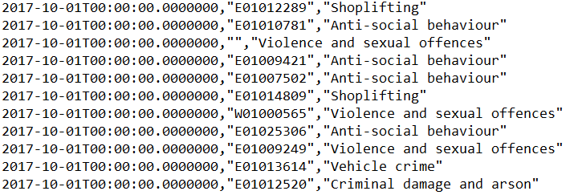


Data Formats
CSV(TEXT)
Free and open-source column-oriented data storage format of the Apache Hadoop ecosystem.
The smallest, fastest columnar storage for Hadoop workloads
Notes:
Snappy Google -1 Thread

Slide 21
Hive and Spark SQL – Managed Tables , Static and Dynamic Partition
Static Partitions
Dynamic Partitions
INSERT INTO
StreetCrimesParitionedParquet PARTITION(Year=2018,Month=1)
SELECT CrimeID,
DateReported,
...
FROM StreetCrimesParitioned
WHERE Year =2018 AND Month = 1
INSERT INTO StreetCrimesParitionedParquet PARTITION(Year,Month)
SELECT CrimeID,
DateReported,
...
Year, --Partitioned Column
Month --Partitioned Column
FROM StreetCrimesParitioned
WHERE Year <2018
Key=__HIVE_DEFAULT_PARTITION__
Notes:
How to load data into managed partitioned tables.
LOAD DATA INPATH '/user/myname/kv2.txt' OVERWRITE INTO TABLE invites PARTITION (ds='2008-08-15');

Slide 22
DEMO
ADLA
Demo-002.usql
Demo-003.usql
Demo-004.usql
Spark
002-ExtPartitionedTable
003-Partitions

Slide 23
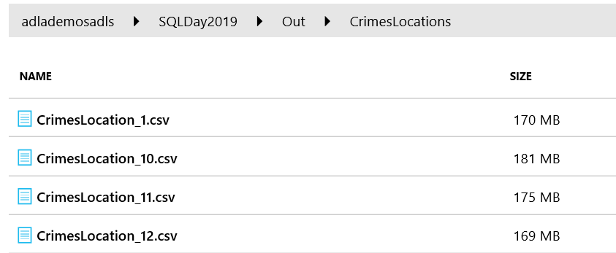
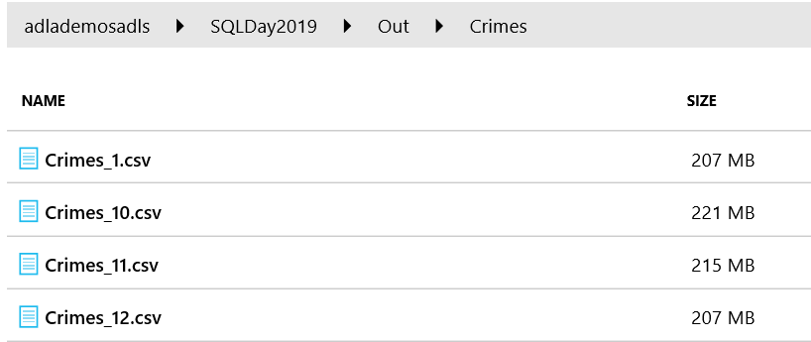
Challenge
DATA SET 1 (Crime Location)
DATA SET 2 (Crime Info)
SELECT COUNT(*) AS Total
FROM StreetCrimesLocationCSV cl
JOIN StreetCrimesInfoCSV cd ON cd.CrimeID = cl.CrimeID

Slide 24
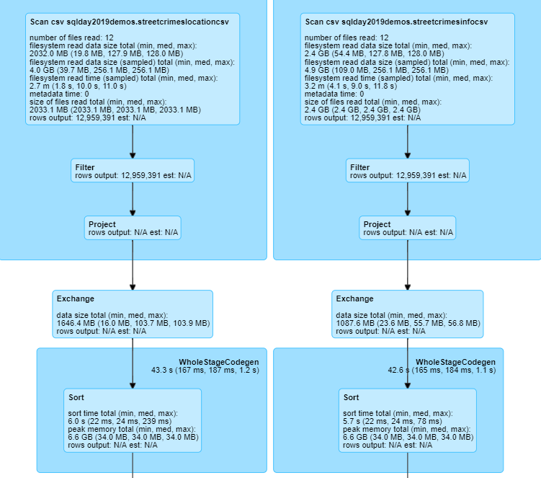
Challenge
SELECT COUNT(*) AS Total FROM StreetCrimesLocationCSV cl
JOIN StreetCrimesInfoCSV cd ON cd.CrimeID = cl.CrimeID
Shuffle (Exchange) operation is used in Spark to re-distribute data across multiple partitions.
It is a costly and complex operation.

Slide 25
Bucketing – optimization technique
Bucketing is another technique for decomposing data sets into
more manageable parts.
Buckets/Clusters
Bucket 0
(16)
File
1,23,45,987,26,16
Bucket 1
(1,45)
File
f(x)
Bucket 2
(26)
File
CREATE TABLE (…)
CLUSTERED BY (CrimeID)
SORTED BY (CrimeID)
INTO 4 BUCKETS;
Bucket 3
(23,987)
File
File
Notes:
spark.sql.sources.bucketing.enabled

Slide 26
DEMO
Spark
005-BucketingJoin
006-HivePartitionedAndBucketedTable
ODBC/JDBC Connector

Slide 27
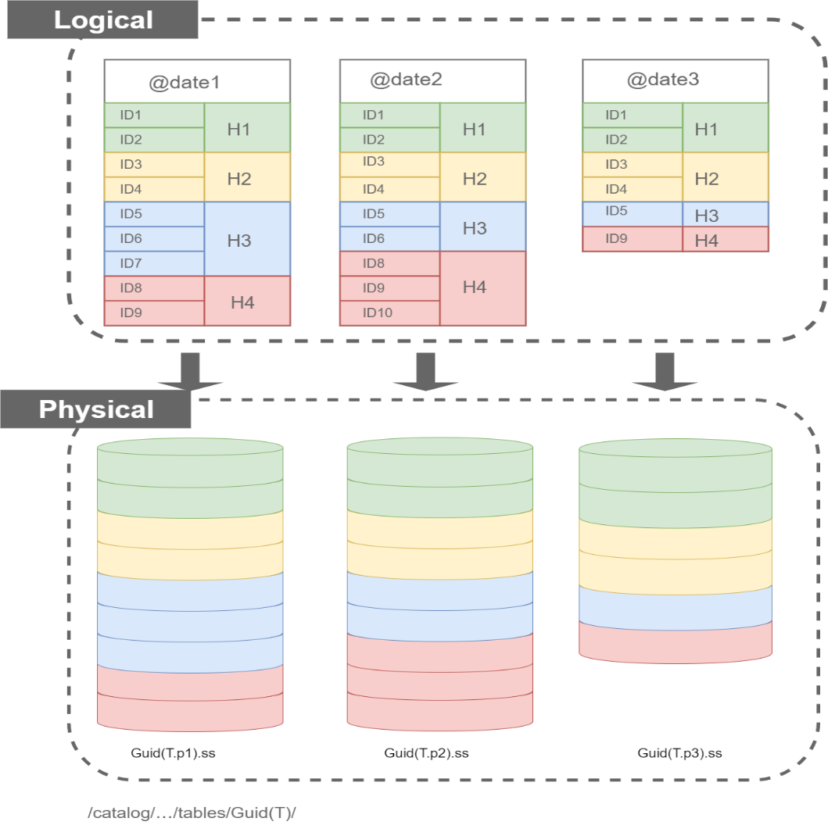
ADLA Tables, Partitioning and bucketing
CREATE TABLE T
(
id int,
date DateTime,
INDEX IDX
CLUSTERED(id)
PARTITIONED BY (date)
DISTRIBUTED BY
HASH(id)
INTO 4
);

Slide 28
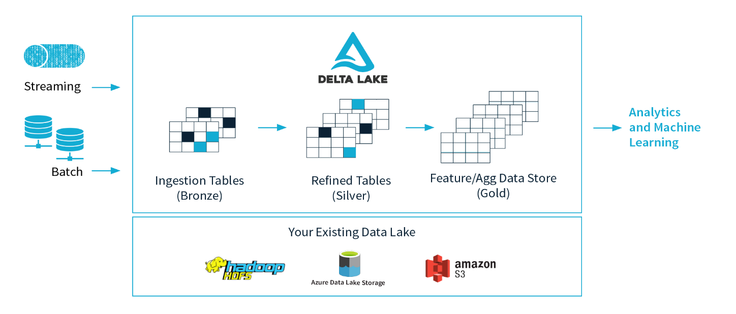
Delta Lake
Delta Lake is an open source storage layer that brings reliability to data lakes.
Full ACID Transactions
Unified Streaming and Batch
Data versioning
Native Support for
UPDATE
DELETE
MERGE
https://delta.io/
Notes:
Problems with data lake
Dirty data
2 paths in Lambda architecure
Problems with Update Data

Slide 29
Azure Databricks Delta
CREATE TABLE IF NOT EXISTS StreetCrimesParitionedParquet
(
CrimeID STRING,
DateReported TIMESTAMP,
Month INT,
Year INT,
...
)
USING Delta
PARTITIONED BY (Year,Month)
Delta
OPTIMIZE
Z-ORDER
(multi-dimensional clustering)
(WHERE x=1 OR y=2)
VACUUM

Slide 30
DEMO
ADLA
CreateTableDist.usql
LoadDataIntoStreetCrimesDistByCrimeType.usql
PartitionInfo.usql
Demo-005.usql
Spark
010-Delta

Slide 31
Summary
Open and Closed Big Data Solutions
Storage structure
Partitioning vs /and Bucketing (Horizontal and Vertical Partitioning)
Delta and Delta Lake

Slide 32
Resources
My examples (and demos)
https://github.com/cloud4yourdata/usql/tree/develop
https://github.com/cloud4yourdata/CommunityEvents/tree/master/DataCommunity201809_InteractiveQueries
https://github.com/cloud4yourdata/demos/tree/develop/SQLDay2018
External resources
https://docs.databricks.com/
https://delta.io/
https://spark.apache.org/
https://jaceklaskowski.gitbooks.io/mastering-spark-sql/spark-sql-properties.html
https://hive.apache.org/
https://dotnet.microsoft.com/apps/data/spark
http://usql.io
https://databricks.com/blog/2018/07/31/processing-petabytes-of-data-in-seconds-with-databricks-delta.html

Slide 33
PLATINUM SPONSOR
GOLD SPONSORS
SILVER SPONSOR
BRONZE SPONSOR
STRATEGIC PARTNER

