Slide 1
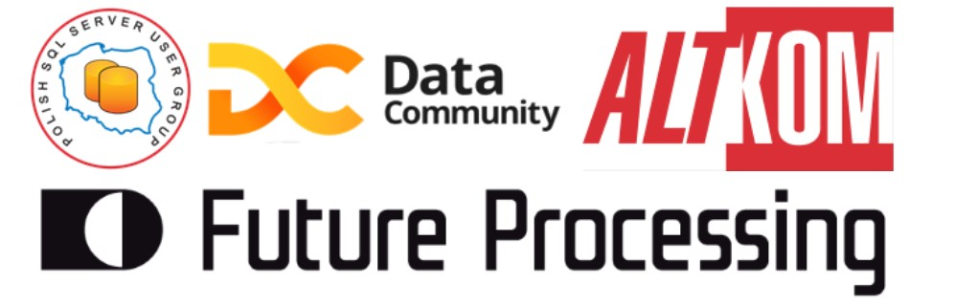

Slide 2
Azure Data Factory First Challenges
Tomasz Krawczyk
tkrawczyk@future-processing.com
Notes:
Przeczytalem wiekszosc ksiazek ktore napisal Marcin

Slide 3
Agenda
Azure Cloud Services
Data Integration
Integration Services
Azure Data Factory
Overview
V1 vs V2

Slide 4
First challenge
Hybrid Data World

Slide 5
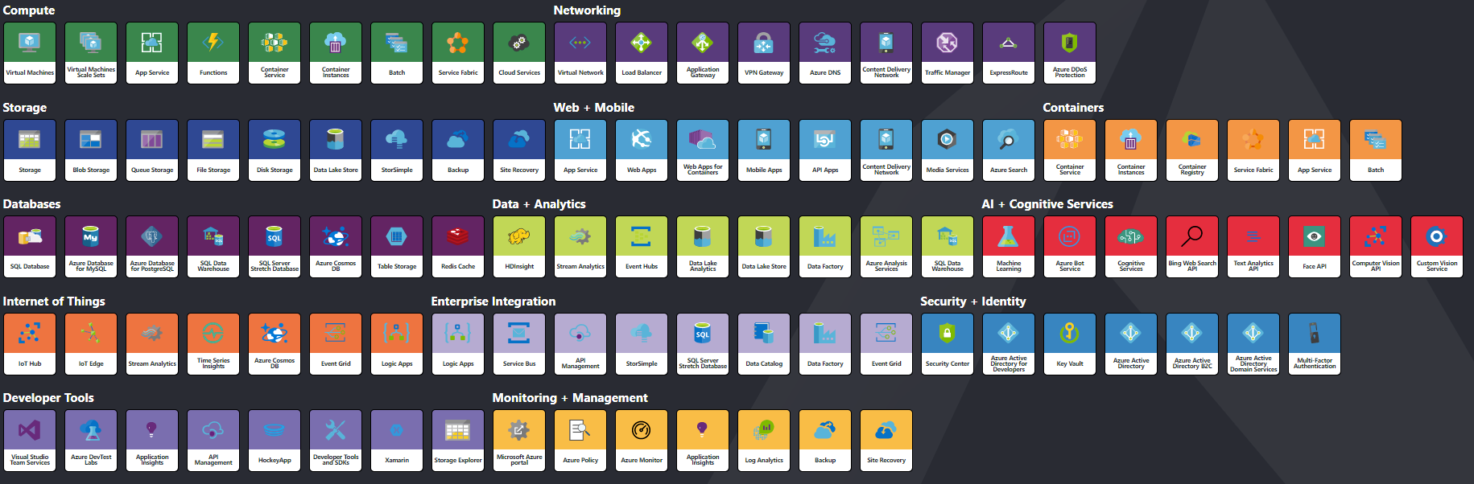
More than 100 Services on Azure
http://azureinteractives.azurewebsites.net/Azure101Cards/default.html
Notes:
Jak z tej układanki poskładać rozwiązanie

Slide 6
Data Integration on Azure What we have?
SSIS –SQL Server Integration Services
Part of SQL Server (Data Factory V2)
ETL to/from SQL Service
Rich desinger (and other tools e.g. BIML)
Azure Feature Pack for Integration Services
Azure Data Factory
Part of Azure (model PaaS)
Batch processing (based on time series orchestarction model)
Provides orchestraction ,movement services (on-premises and cloud) and monitoring service

Slide 7
Azure Feature Pack for Integration Services
Tasks
Data Flow Components
Azure Blob Upload/Download Task
Azure HDInsight Hive Task
Azure HDInsight Pig Task
Azure HDInsight Create/Delete Cluster Task
Azure SQL DW Upload Task
Azure Data Lake Store File System Task
Azure Blob Source
Azure Blob Destination
Azure Data Lake Store Source
Azure Data Lake Store Destination
Azure Blob & ADLS File Enumerator.

Slide 8
DEMO
(Azure Feature Pack for Integration Services)

Slide 9

Azure Data Factory
Fully managed service to support orchestration of data movement and transformation
Connect to relational or non-relational data that is on-premises or in the cloud
Allows monitor and manage data processing pipelines
Version 1 and 2 (+SSIS)

Slide 10
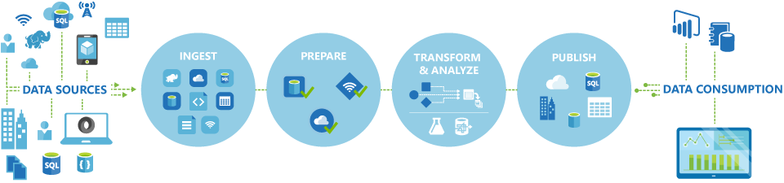
Azure Data Factory Overview

Slide 11
Second challenge
ADF V1 vs V2

Slide 12
Azure Data Factory –Current State
Azure Data Factory V1
Working version
Azure Data Factory V2
Public Preview
Web designer (2018-01-16)

Slide 13
Azure Data Factory Concept
Activities
Actions you perform on your data
Inputs turned into outputs
Pipelines
Logical grouping of activities for group operations
Data sets
A named reference/pointer to data you want to use as an input or output of an activity
Linked services
Connection of data factories to the resources and services you want to use
Connection of data stores like Azure storage and on-premises SQL Server
Connection of compute services like Azure Machine Learning, Azure HDInsight, and Azure Batch

Slide 14

Azure Data Factory Overview
Dataset
(eg. tables, files)
Activity
(eg. Copy, Hive job,
SP, ADLA job)
Pipeline
(schedule,monitor,
manage)
Consumes
Is a
logical
grouping of
Produces
Represents
data item(s)
stored in
Runs on
Linked Services
(eg. SQL Server,
HDInsight,ADLA)

Slide 15
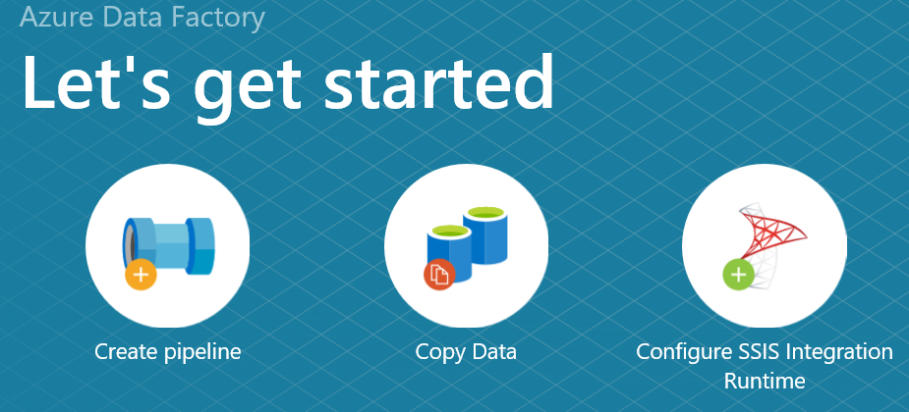
Azure Data Factory V2
Control Flow
Parameterized Pipelines
Flexible Scheduling

Slide 16
Azure Data Factory V2
What’s new
New pipeline model
Rich pipeline orchestration
Triggers –ondemand,schedule,events
SSIS Package Execution
Lift my existing packages to the cloud
Author & Monitor
Python,.Net
Visual Tools
Data Movement as aService
Cloud ,Hybrid
More than 60 connectors

Slide 17
Azure Data Factory Data activities
Data movement activities : Copy Activity
Data transformation activities :
Hive
Pig
MapReduce
Hadoop Streaming
Spark
Databricks Notebooks (V2)
Machine Learning activities: Batch Execution and Update Resource (*)
Stored Procedure
Data Lake Analytics U-SQL
DotNet (Custom)

Slide 18
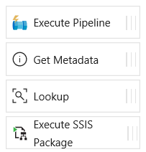
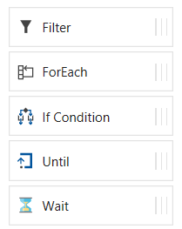
Azure Data Factory (V2)
Control flow activities
Execute Pipeline Activity
ForEach Activity
Web Activity
Lookup Activity
Get Metadata Activity
Until Activity
If Condition Activity
Wait Activity

Slide 19
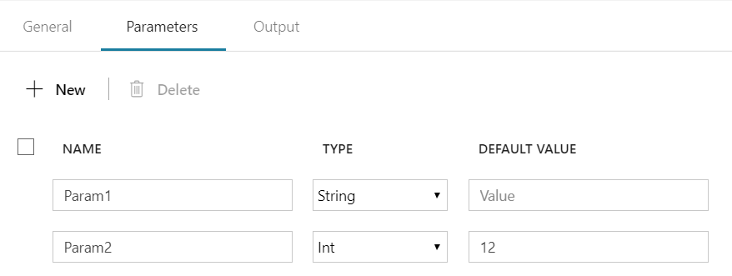
Azure Data Factory (V2)
Parameters - are key-value pairs of read-only configuration settings that are defined in pipelines
Name, Type, Default Value
@pipeline().parameters.Param1
@pipeline().parameters.Param1
Notes:
Multitenancy

Slide 20
Azure Data Factory System Variables
Pipeline scope:
@pipeline().DataFactory
@pipeline().Pipeline
@pipeline().RunId
@pipeline().TriggerType
@pipeline().TriggerId
Trigger scope:
@trigger().scheduledTime
@trigger().startTime
Notes:
@pipeline().DataFactory Name of the data factory the pipeline run is running within
@pipeline().Pipeline Name of the pipeline
@pipeline().RunId ID of the specific pipeline run
@pipeline().TriggerType Type of the trigger that invoked the pipeline (Manual, Scheduler)
@pipeline().TriggerId ID of the trigger that invokes the pipeline
@pipeline().TriggerName Name of the trigger that invokes the pipeline
@pipeline().TriggerTime

Slide 21
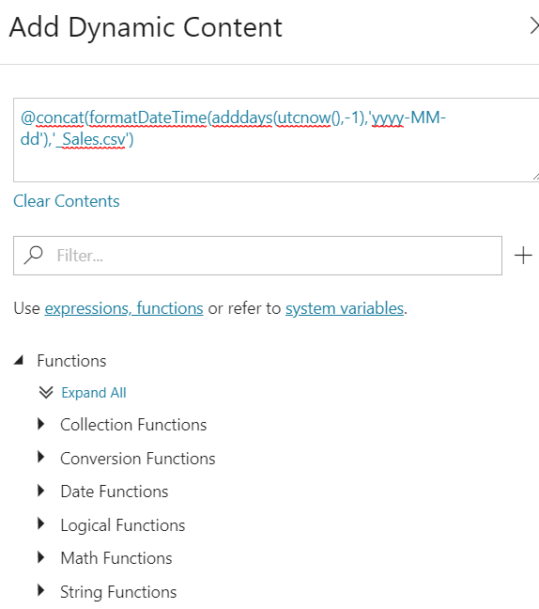
Azure Data Factory (V2) Expressions and Functions
Expressions
Dynamic Content
Functions
String functions
Collection functions
Logical functions
Conversion functions
Math functions
Date functions
Notes:
Multitenancy

Slide 22
Azure Data Factory (V2) Branching
Possible contains
On success
On failure
On completion
Activity 2
On success
Activity 1
(eg. Copy, Hive job,
SP, ADLA job)
Activity 3
On completion
On failure
Activity 4

Slide 23
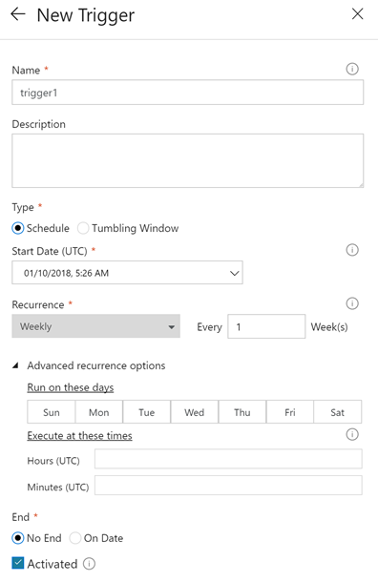
Pipeline execution and triggers in Azure Data Factory V2
Manual execution (on-demand)
The REST API
The .NET SDK
Trigger execution
Schedule trigger
Tumbling window trigger

Slide 24
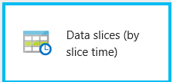
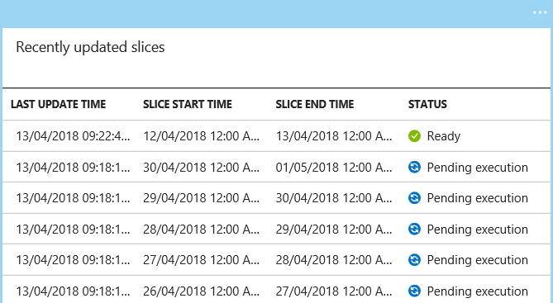
Azure Data Factory V1 -Overview
Dataset
Activity
Dataset
Activity
Dataset
Activity
Dataset

Slide 25
Azure Data Factory V2 -Overview
Foreach
Activity 1
Data Flow
Activity3
Params
Params
Execute
Pipeline
Params
On Error
Activity 1
Activity 4
Params
Pipeline Params
Schedule trigger(s)

Slide 26
Azure Data Factory V1 vs V2
Feature | Version 1 | Version 2
Datasets | Availability defines the processing window slicing model for the dataset (for example, hourly, daily, and so on). | Datasets are the same in V2. However, you do not need to define availability schedules for datasets. You can define a trigger resource that can schedule pipelines from a clock scheduler paradigm.
Linked services | Linked services are much like connection strings, which define the connection information that's necessary for Data Factory to connect to external resources. | Linked services are the same as in Data Factory V1, but with a new connectVia property to utilize the Data Factory V2 Integration Runtime compute environment.
Pipelines | A pipeline is a logical grouping of activities that together perform a task. You use startTime, endTime, and isPaused to schedule and run pipelines. | Pipelines do not have “windows” of time execution in Data Factory V2. The Data Factory V1 concepts of startTime, endTime, and isPaused are no longer present in Data Factory V2.
Activities | Activities define actions to perform on your data within a pipeline. Data movement (copy activity) and data transformation activities (such as Hive, Pig, and MapReduce) are supported. | In Data Factory V2, activities still are defined actions within a pipeline. V2 introduces new control flow activities. You use these activities in a control flow (looping and branching). Data movement and data transformation activities that were supported in V1 are supported in V2. You can define transformation activities without using datasets in V2.

Slide 27
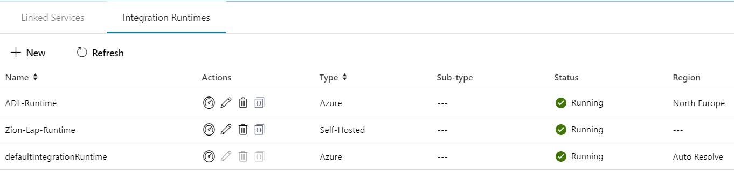
Integration runtime(s) in Azure Data Factory
The Integration Runtime (IR) is the compute infrastructure used by Azure Data Factory to provide the following data integration capabilities across different network environments
Integration runtime types:
Azure (Data movement and activity on Azure)
Self-hosted (Data movement and activity dispatch between public and private network)
Azure-SSIS (SSIS package execution)

Slide 28

Self Hosted Integration runtime
Now called Self Hosted Integration Runtime
Before Data Management Gateway
One version for ADF V1 and V2
SSL Port : 443
One to Many

Slide 29
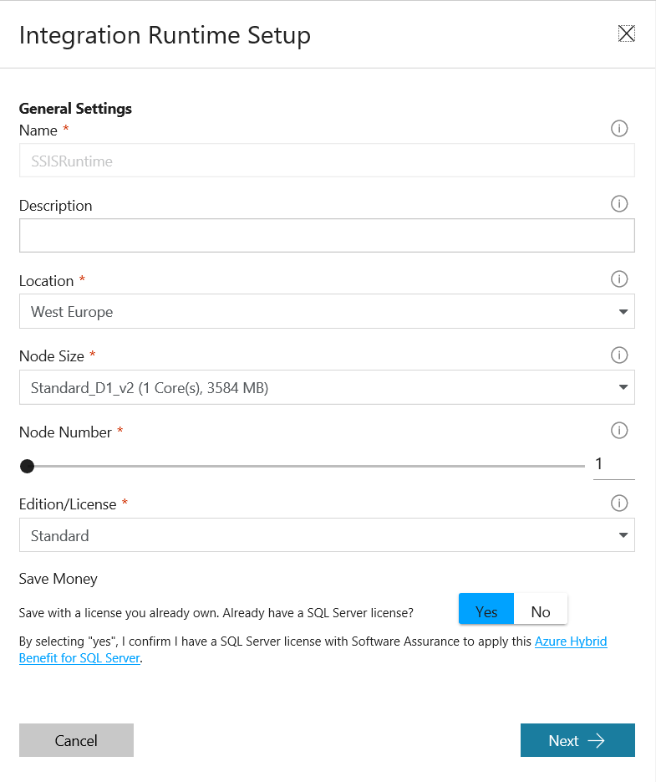
Azure-SSIS Integration Runtime
Azure-SSIS IR is a fully managed cluster of Azure VMs dedicated to run your SSIS packages.
Requirements:
Azure –SSIS IR
Azure SQL Database or Managed Instance (Preview) server
Azure virtual network (VNet)

Slide 30
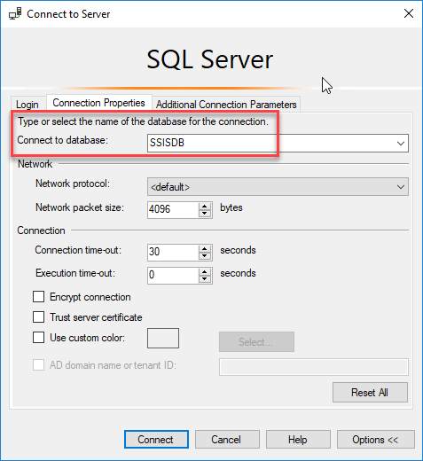
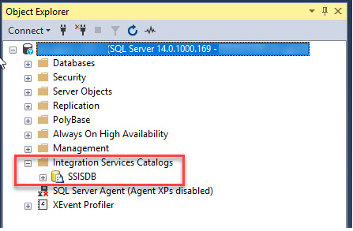
Azure-SSIS Integration Runtime
How to connect ?

Slide 31
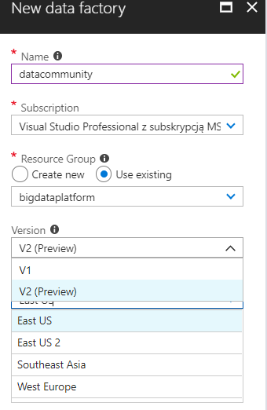
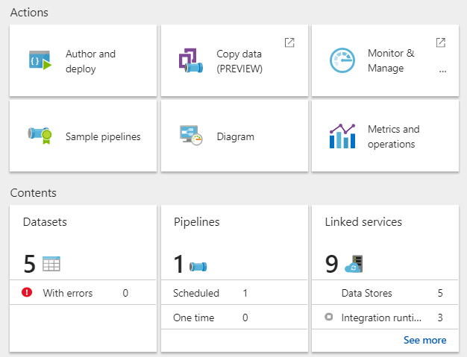
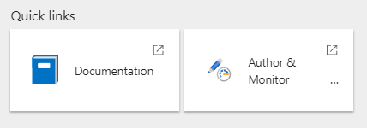
Create Azure Data Factory
V1
V2

Slide 32
Third challenge
Tools, Monitoring, Source Control

Slide 33
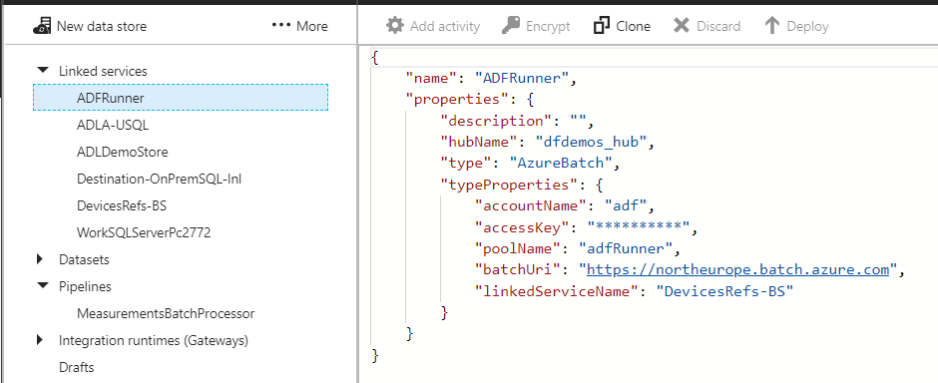
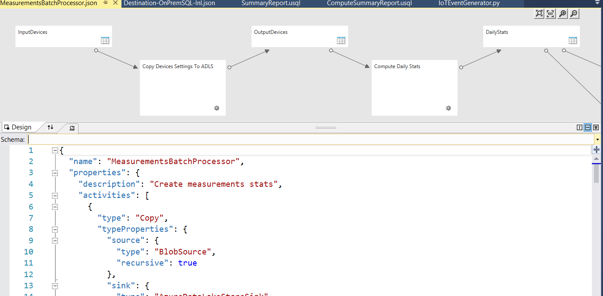
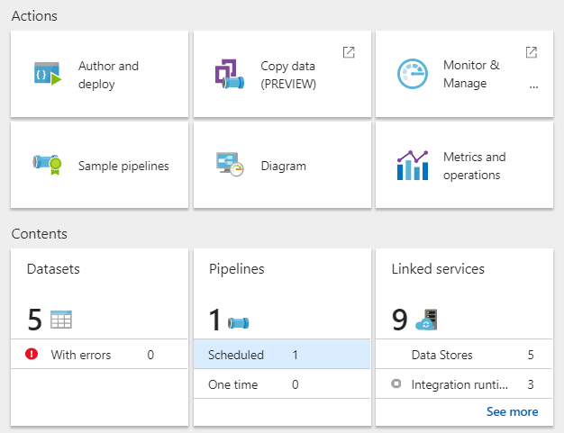
Azure Data Factory V1 Tools
ADF Web Designer (Azure Portal)
Copy data (wizard)
Azure Data Factory Visual Studio Extension for authoring pipelines
Visual Studio 2013
Visual Studio 2015
Visual Studio 2017

Slide 34
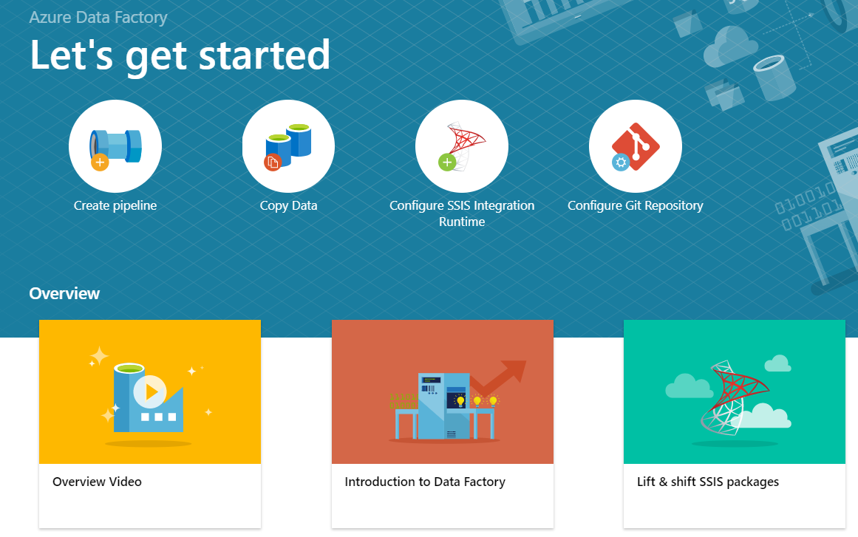
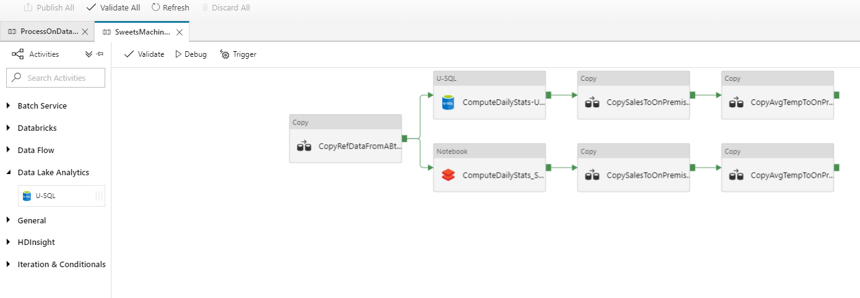
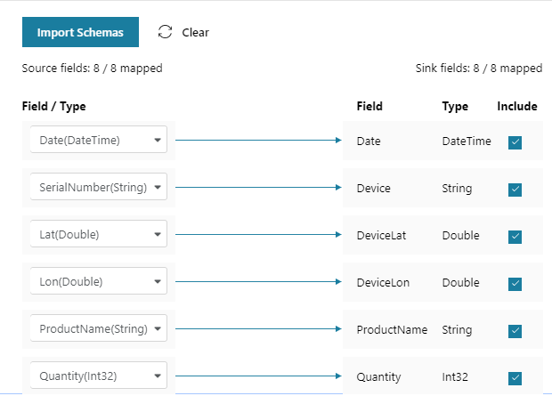
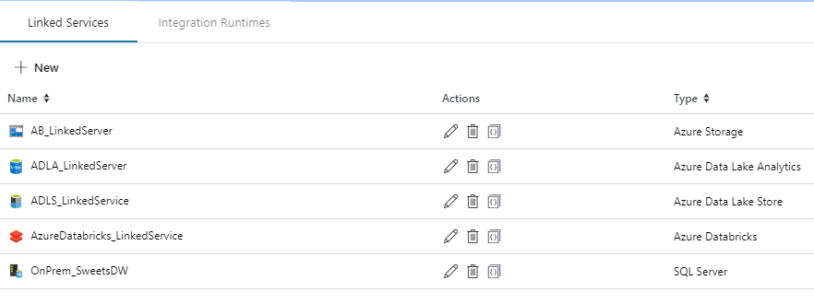
Azure Data Factory V2 Tools
ADF V2 Web Designer (Azure Portal)

Slide 35
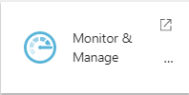
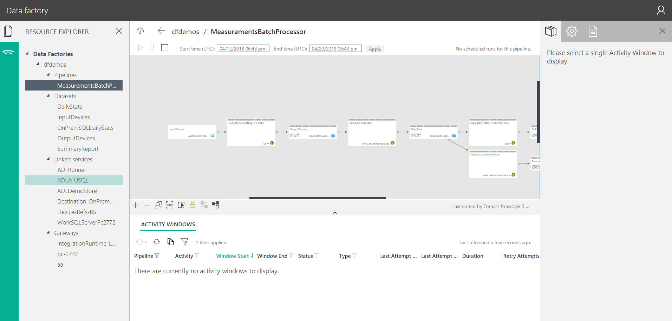
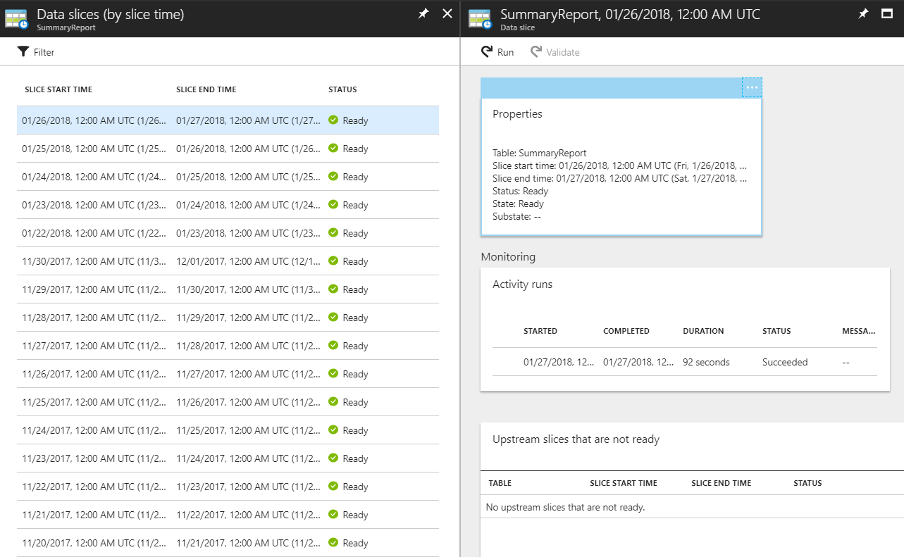
Azure Data Factory V1 Monitoring

Slide 36
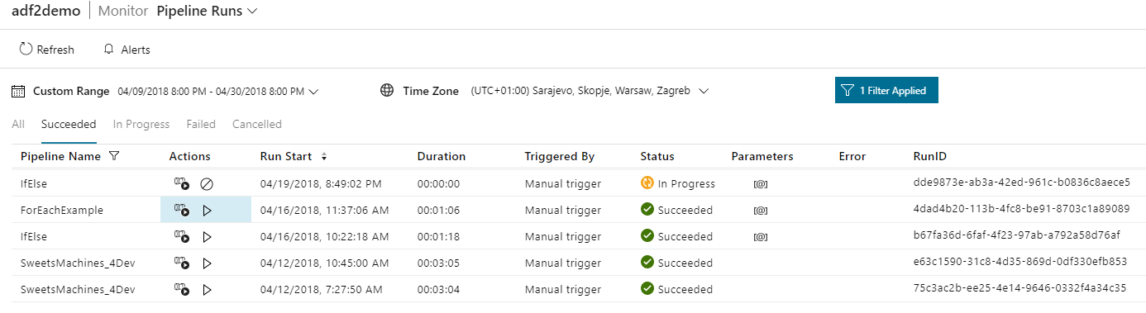
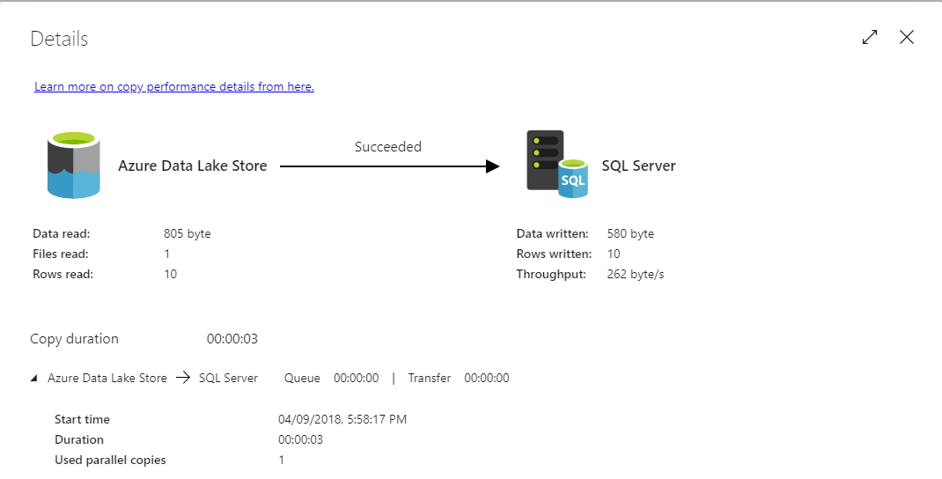
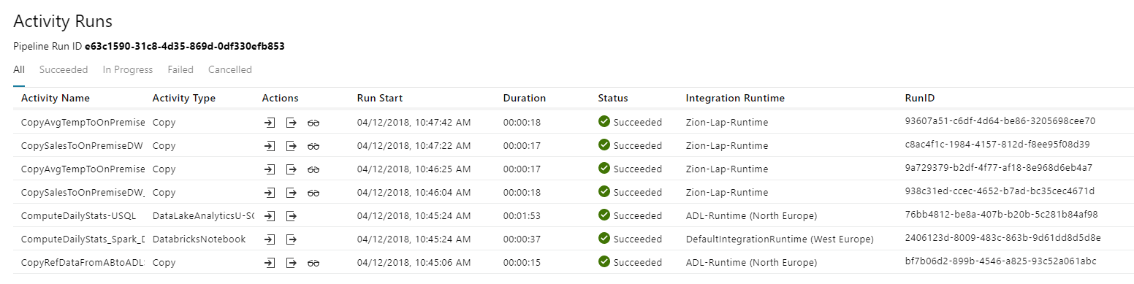
Azure Data Factory V2 Monitoring

Slide 37
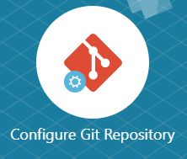
Azure Data Factory Source Control
Data Factory V1
Any Source Control Repository (Visual Studio Project)
Data Factory V2
Visual Studio Team Services (Azure Portal)
Import/Export ARM Templates
Continuous integration and deployment using Data Factory

Slide 38
Other challenges
Performance and Costs

Slide 39
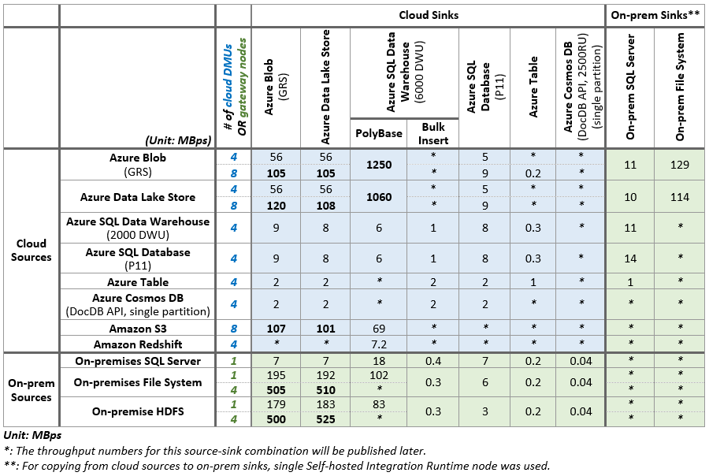
Azure Data Factory Performance
https://docs.microsoft.com/en-us/azure/data-factory/copy-activity-performance

Slide 40
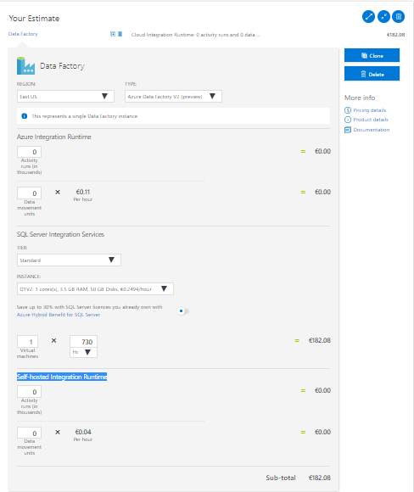
Azure Data Factory Costs
Costs depend on Integration Runtime:
Azure Integration Runtime
Activity runs (in thousands)
Data movement units
Self-hosted Integration Runtime
Activity runs (in thousands)
Data movement units
SQL Server Integration Services
Virtual machine(s) type e.g. D1V2 (h)
https://azure.microsoft.com/en-gb/pricing/calculator/

Slide 41
DEMO AND Q&A
Resources:
https://docs.microsoft.com/en-us/azure/data-factory/
https://github.com/kromerm/adflab
https://github.com/Azure/Azure-DataFactory
Contact:
tkrawczyk@future-processing.com

