Slide 1
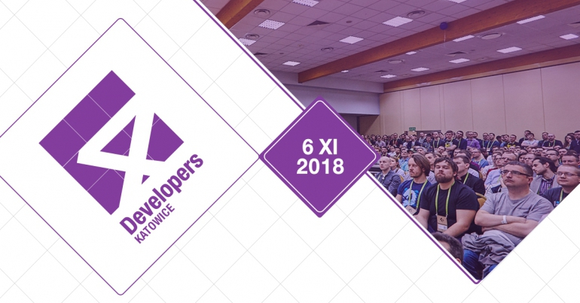
Rewolucja w analizie danych z RevoScaleR
oraz RevoScalePy
Katowice 2018.11.06
Author:
Tomasz Krawczyk
Azure Big Data Architect

Slide 2
Agenda
ML Server (Services) – History
SQL Server - R and Python
RevoscaleR and RevoscalePy
Real-time scoring
Native scoring
Q&A

Slide 3
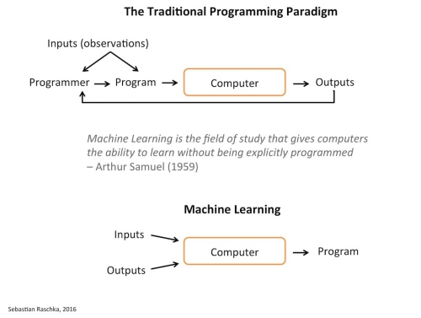
Machine Learning
Problems solved by Machine Learning
Spam detection
Product recommendation
Medical Diagnosis
Predictive maintenance
Financial analysis
Image recognition (Computer Vision)
Speech recognition

Slide 4
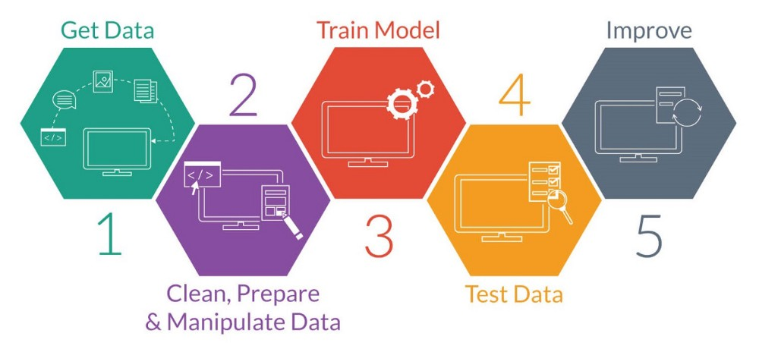



ML and Real World
Databases
Data
Application
DBA
?
Data
Model
Model
Data Scientist
BA
Development Team

Slide 5
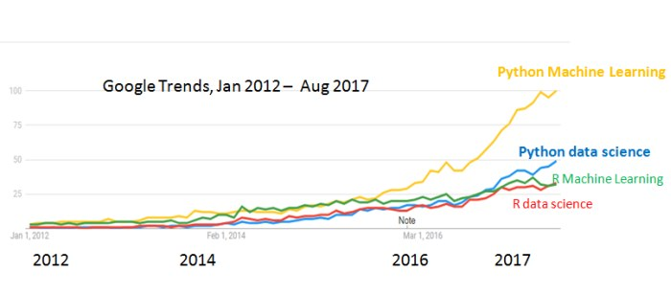
ML – Python and R
https://www.kdnuggets.com/2017/09/python-vs-r-data-science-machine-learning.html
R language is a golden child of machine learning
Python is a king of machine learning

Slide 6

R Language
Language
Statistics programming language
Data visualization tool
Open source
Community
2.5+M users
Taught in most universities
Popular with new and recent grads
Thriving user groups worldwide
Ecosystem
10,000+ packages in CRAN
Challenges of using R
Data movement
Deployment
Scale and performance
R needs data in memory
R is single threaded

Slide 7

R Language – Revolution Analytics
Revolution R Open
Free and open source R distribution
Enhanced and distributed by Revolution Analytics
Revolution R Enterprise
Secure, Scalable and Supported Distribution of R
On January 23, 2015 Revolution Analytics “joined” the Microsoft
Microsoft R Open
MRAN - https://mran.microsoft.com/
Microsoft R Server –Machine Learning Server

Slide 8
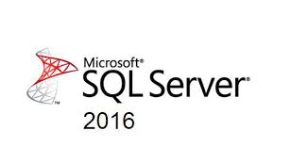
History
MS SQL Server 2016
R in SQL Server 2016
Microsoft R Server
RevoScaleR package
https://mran.microsoft.com/packages

Slide 9
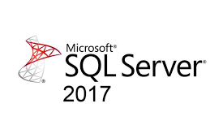

History
MS SQL Server 2017
Python in SQL Server 2017
Microsoft R Server -> Machine Learning Server (Services)
RevoScalePy
Microsoftml for Python

Slide 10



Future
MS SQL Server 2019
Java in SQL Server 2019
Spark

Slide 11

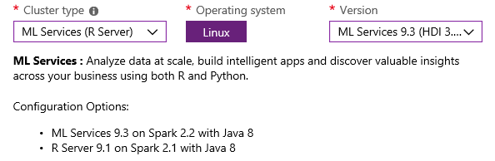
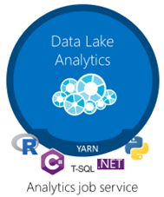
Multiplatform solution
Machine Learning Server 9.3
Machine Learning Server for Hadoop
Machine Learning for Linux
Machine Learning for Windows
SQL Server (ML Services)
Standalone
Microsoft R Server 9.1
R Server for Teradata
Azure Data Lake Analytics
Notes:
My dziś się skupimy na SQL Server oraz integracji SQL Server z R i Python

Slide 12
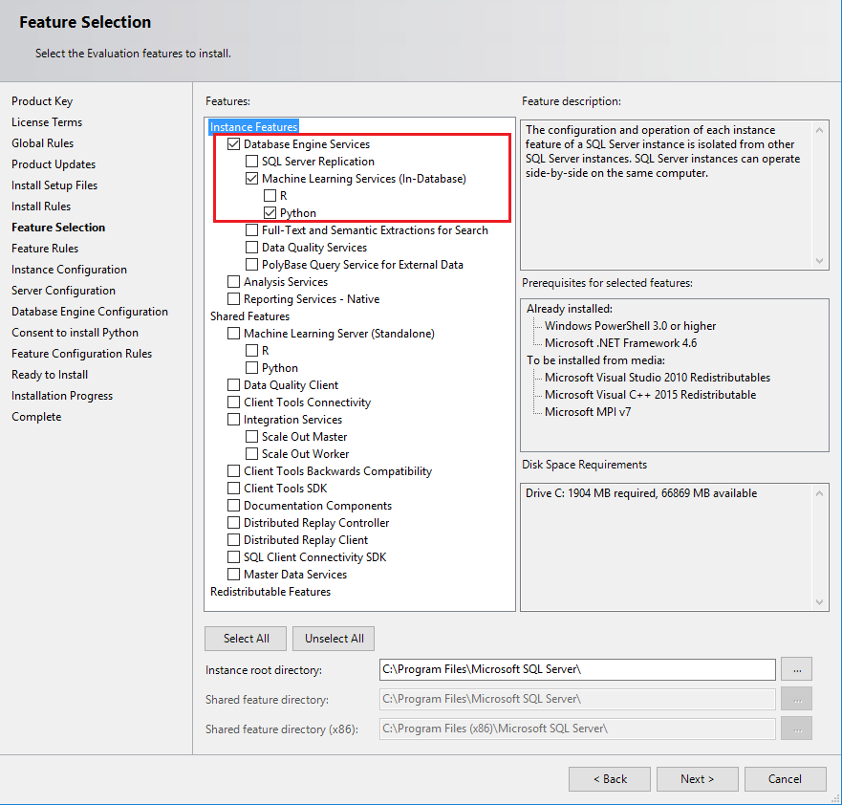
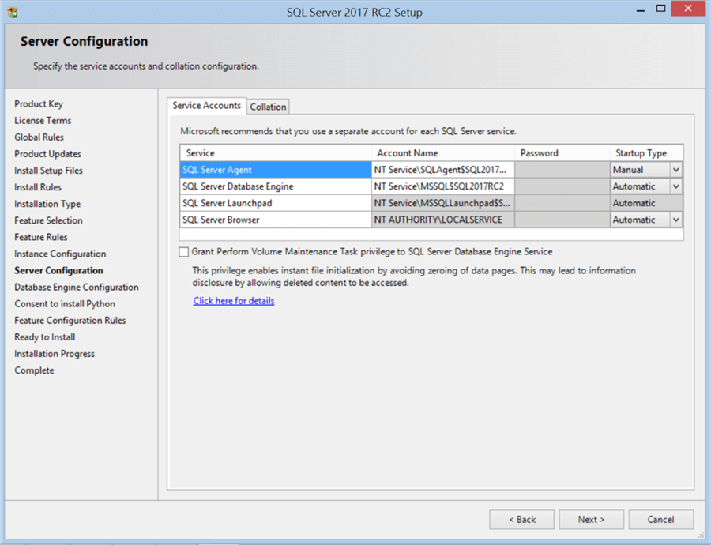
Install Machine Learning Services on SQL Server 2017

Slide 13
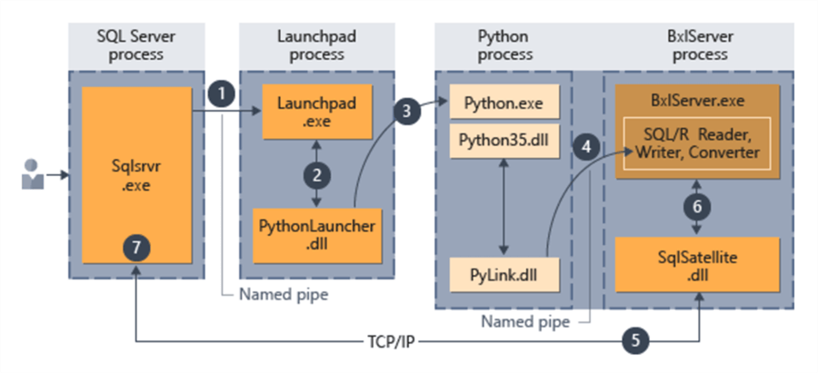
Python and SQL Server Integration Architecture

Slide 14
Enable Python or (R) script execution
Enable External Script Execution
EXEC sp_configure 'external scripts enabled', RECONFIGURE WITH OVERRIDE
Restart the SQL Server service for the SQL Server instance.
Verify that the external script execution feature is running
EXEC sp_configure 'external scripts enabled’
GRANT EXECUTE ANY EXTERNAL SCRIPT TO [User];

Slide 15
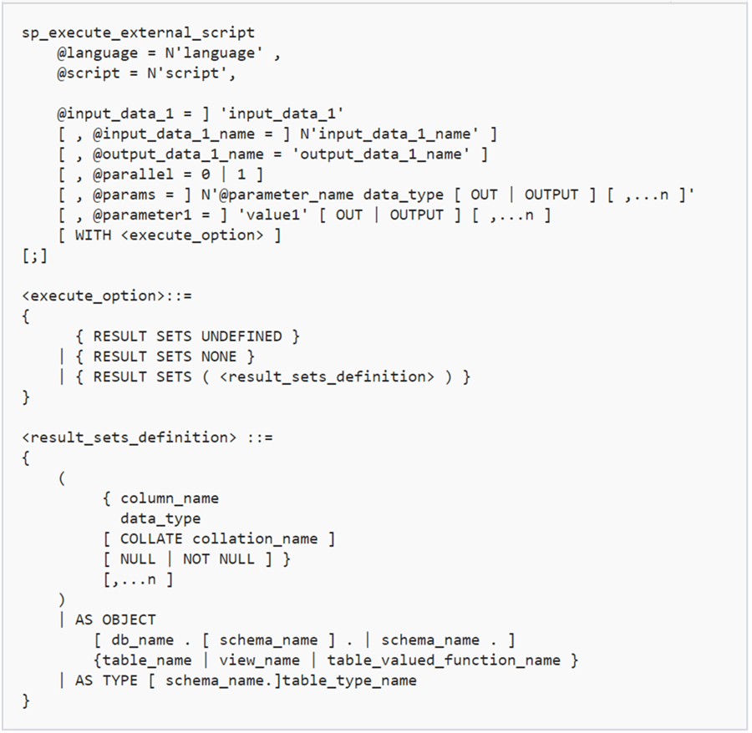
How to run Python or R Script?
sp_execute_external_script
execute sp_execute_external_script
@language = N'Python',
@script = N'
import sys
print("*************************")
print(sys.path)
print(sys.version)
print("Hello World")
print("*************************")'
Notes:
@input_data_1 -TSQL
@input_data_1_name InputDataSet (R Dataframe, Python pandas Dataframe)
@output_data_1_name OutputDataSet

Slide 16
RevoscaleR, RevoscalePy and Microsoft ML
The RevoScaleR library is a collection of portable, scalable, and distributable R functions for importing, transforming, and analyzing data at scale.
The RevoscalePy module is a collection of portable, scalable and distributable Python functions used for importing, transforming, and analyzing data at scale.
MicrosoftML adds state-of-the-art data transforms, machine learning algorithms, and pre-trained models to R and Python functionality.
Pre-trained models for sentiment analysis and image featurization can also be installed and deployed with MicrosoftML.
Source: Microsoft MSDN

Slide 17
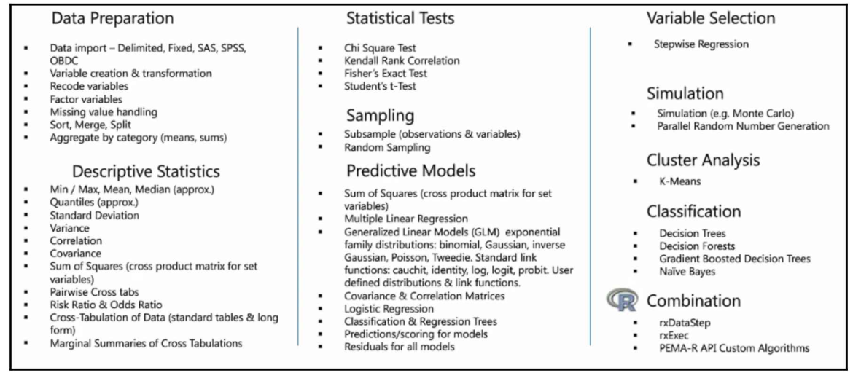
Revoscale functions
Source: Microsoft MSDN
Notes:
Funckje rx
Klika kategorii:
Przygotowanie danych (xdf)
Opis danych
Funckje zwiazane z przygotowaniem I weryfikacją modeli

Slide 18
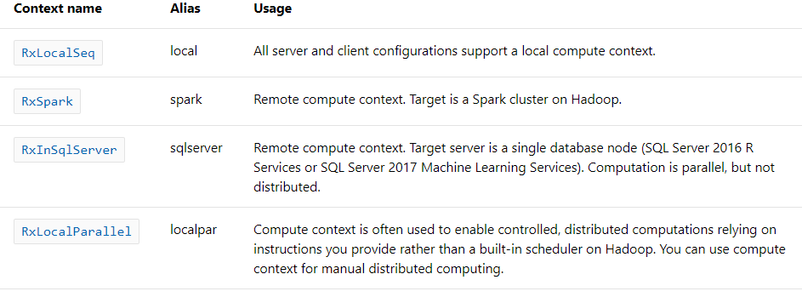
Compute Context
Source: Microsoft MSDN

Slide 19
Realtime Scoring
Real-time scoring uses the sp_rxPredict system stored procedure and the CLR extension capabilities in SQL Server for high-performance predictions or scores.
Prerequisites
Enabling CLR Integration
Enable the real-time scoring procedure
cd <SQLInstancePath>\R_SERVICES\library\RevoScaleR\rxLibs\x64\
RegisterRExt.exe /installRts [/instance:name] /database:databasename
EXEC sp_rxPredict
@model = @MLmodel,
@inputData = N'SELECT * FROM data'
Notes:
SQL 2016

Slide 20
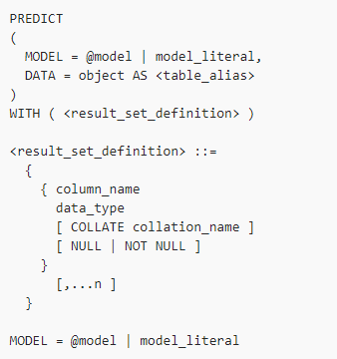
Native Scoring
Uses native C++ libraries from Microsoft can be used for scoring without having to call the R or Python interpreter
PREDICT (Transact-SQL)
SELECT p.Quality_Pred AS QualityP
,w.*
FROM PREDICT(MODEL = @model, DATA = wines AS w) WITH (
Quality_Pred FLOAT
) AS p;

Slide 21
Native Scoring Limitations
Not all models are supported
Supported Models
RevoScaleR models
rxLinMod
rxLogit
rxBTrees
rxDtree
rxdForest
Revoscalepy models
rx_lin_mod
rx_logit
rx_btrees
rx_dtree
rx_dforest

Slide 22
DEMO

Slide 23
Q & A

Slide 24
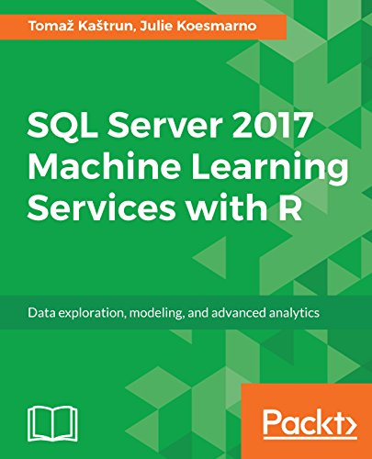
Resources
My examples (and demos)
https://github.com/cloud4yourdata/demos/tree/master/4DevKatowice2018
Documentation
https://docs.microsoft.com/en-us/machine-learning-server/
Books

Slide 25
THANK YOU!
tkrawczyk@future-processing.com

