Slide 1
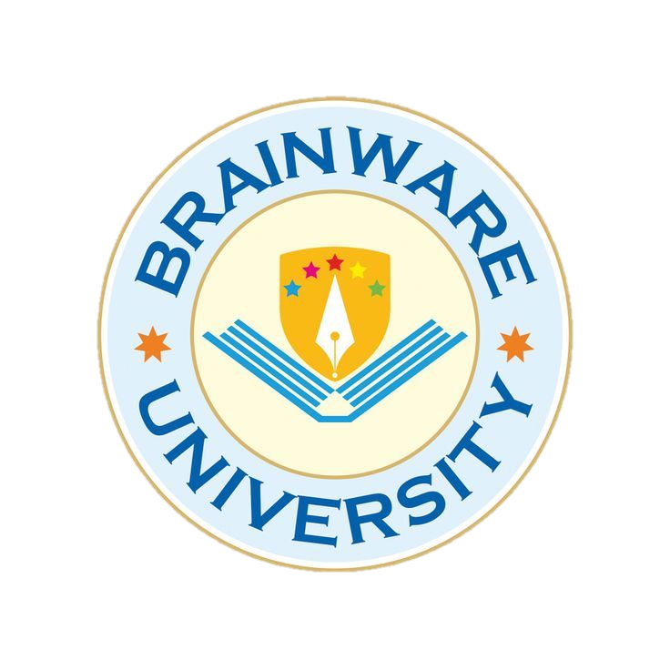
PERSONALIZED LEARNING RECOMMENDATION SYSTEM
Presented by:
Megha Pal
BWU/BCA/24/088
Department of Computational Sciences
Bachelor of Computer Applications (Honours)
Machine Learning (BCA57205(P))

Slide 2
Introduction
Online education provides access to a large number of learning resources.
Every student has different learning abilities, interests, and academic requirements.
A common learning resource may not be suitable for every student.
The Personalized Learning Recommendation System suggests suitable learning materials based on individual student profiles.
It uses Python, data processing, and recommendation techniques to generate relevant resources.

Slide 3
Problem Statement
Problem: Students often struggle to identify the most suitable learning resources according to their individual academic needs.
Major challenges:
  Difficulty identifying weak subjects and topics.
  Too many learning resources available online.
  Generic recommendations that do not consider individual needs.
  Recommending topics that students have already completed.
  Difficulty selecting resources according to available study time.
Proposed solution: Develop a system that analyses student profiles and recommends relevant learning resources.

Slide 4
Objectives
The major objectives are:
  To analyse individual student learning profiles.
  To identify weak and completed topics.
  To recommend suitable learning resources.
  To consider difficulty level and learning preferences.
  To avoid recommending already completed topics.
  To rank resources according to relevance scores.
  To display recommendations using graphical visualization.

Slide 5
Scope of the Project
Project Coverage
  Student profile management.
  Learning resource analysis.
  Weak-topic identification.
  Content-based recommendations.
  Difficulty and preference-based scoring.
  Recommendation visualization and evaluation.
Limitations
  Uses a predefined CSV dataset.
  Does not retrieve resources automatically from the internet.
  Recommendations depend on the quality of available data.
  Currently developed as a Python-based prototype

Slide 6
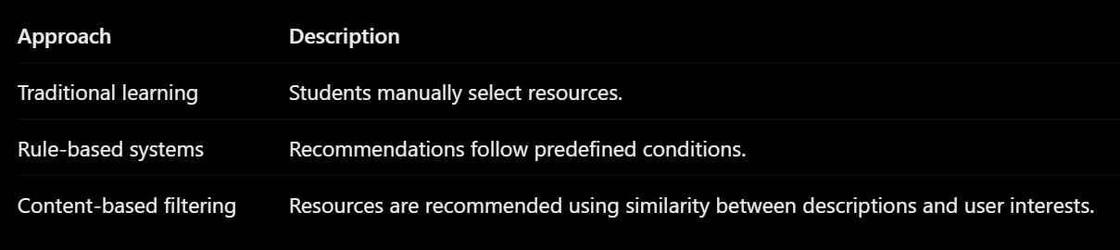
Literature Review / Existing System
Existing Approaches
Our Approach: Combine content-based similarity with rule-based scoring.

Slide 7
Proposed System
The proposed system generates personalized recommendations based on student information.
Key Features
  Student profile analysis.
  Weak-topic prioritization.
  Completed-topic filtering.
  Difficulty-level matching.
  Learning preference matching.
  Study-duration consideration.
  Top 3 resource recommendations.
  Graphical display of recommendation scores.

Slide 8
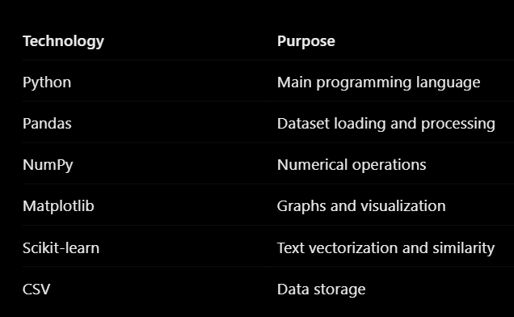
Project Methodology
Development Environment: Thonny
Technologies Used:
Recommendation Techniques:
  CountVectorizer
  Cosine Similarity
  Rule-based scoring
Database: No database is used.
  The project stores its data in CSV files.

Slide 9
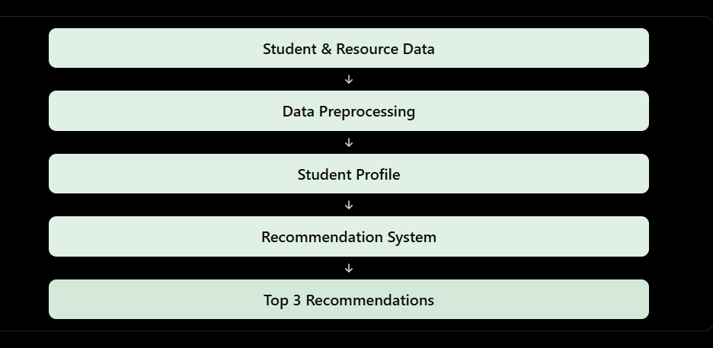
Project Internal Structure
System Workflow:
Main Python Files
  main.py
  student.py
  preprocessing.py
  recommendation.py
  eda.py
  evaluation.py
  evaluation_graph.py

Slide 10
Implementation
Major Implementation Modules
  Data Preprocessing: Loads CSV files, checks missing values and duplicates, and prepares datasets.
  Student Module: Creates Student objects and displays student information.
  Recommendation Module: Calculates cosine similarity and applies rule-based adjustments.
  Visualization Module: Displays recommendation scores through Matplotlib.
  Evaluation Module: Calculates recommendation evaluation metrics.
Dataset Information
  100 student records.
  60 learning resources.

Slide 11
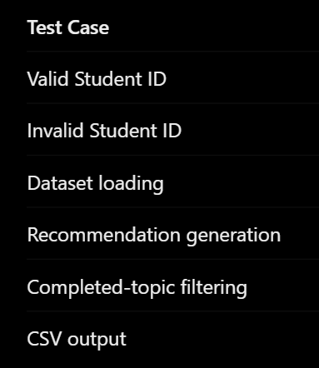
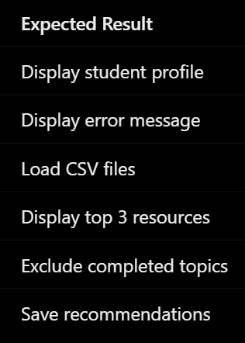
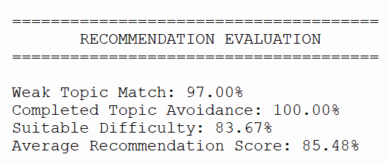
Testing and Results
Testing Performed
Evaluation Metrics
  Weak Topic Match
  Completed Topic Avoidance
  Suitable Difficulty
  Average Recommendation Score
Results:

Slide 12
Conclusion
Successfully developed a Personalized Learning Recommendation System using Python.
Analyses student profiles and learning preferences.
Uses cosine similarity and rule-based scoring.
Filters out already completed topics.
Generates the top three ranked learning resources.
Displays recommendation scores through graphical visualization.

Slide 13
Future Scope
Possible improvements include:
  Developing a web-based user interface.
  Adding more learning resources.
  Integrating verified online learning materials.
  Introducing student progress tracking.
  Collecting feedback on recommended resources.
  Improving recommendation techniques.
  Supporting multiple users through a deployed application.

Slide 14
References
Python Documentation: https://docs.python.org/3/
Pandas Documentation: https://pandas.pydata.org/docs/
NumPy Documentation: https://numpy.org/doc/
Matplotlib Documentation: https://matplotlib.org/stable/
Scikit-learn Documentation: https://scikit-learn.org/stable/
W3Schools Python Tutorial: https://www.w3schools.com/python/
Academic notes and study materials.

Slide 15
Thank you

