Slide 1
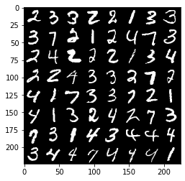
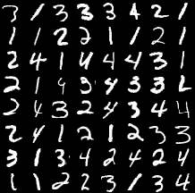

Slide 3
64 sub-images (size 28*28 pixels)
…

Slide 4
16 sub-images (size 112*112 pixels)
…

Slide 5
49 sub-images (size 42*42 pixels)
…

