Slide 1

Amazon S3 Media Manager
for Joomla! CMS

Slide 2
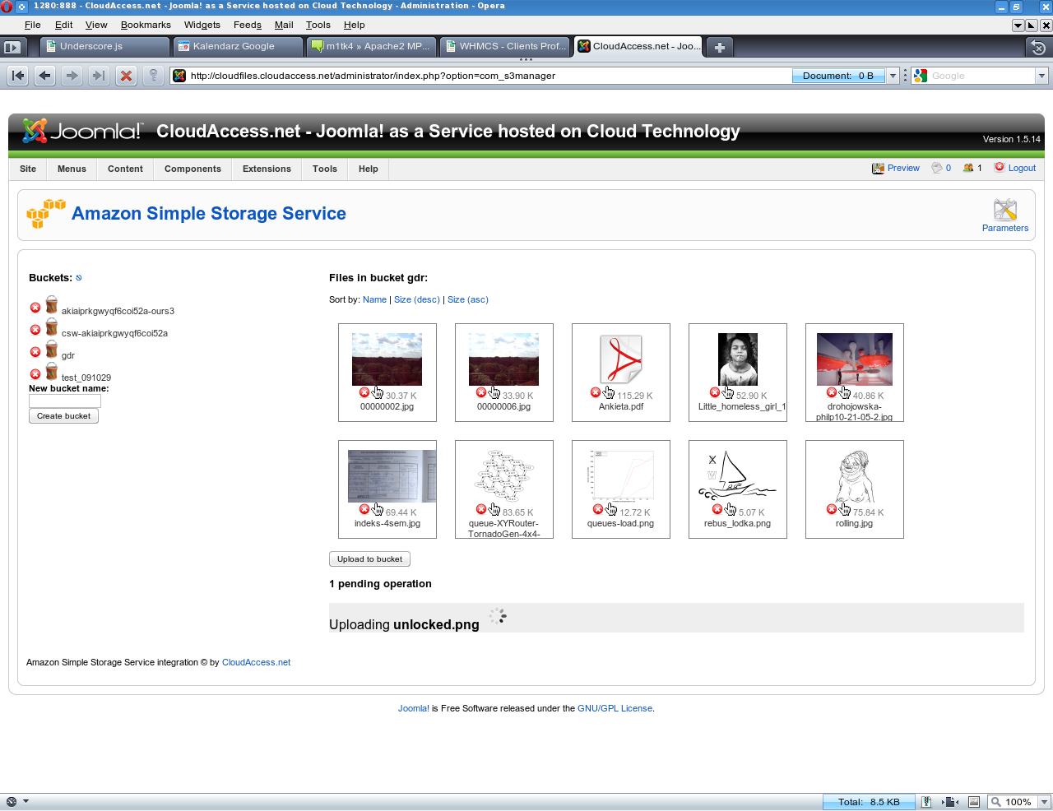
Introduction
This component is similar to Joomla! Media Manager but it operates on files in Amazon Simple Storage Service. You can use files hosted on S3 as images in articles, you can link to them from articles or whatever your imagination says you.

Slide 3
Features
Upload and manage files on S3
Settable maximum link validity period – so you don't go bankrupt if your image becomes too popular
Transparent generation of authenticated URLs
Fully AJAX

Slide 4
Requirements
libcURL for PHP is required
The installer will inform you if it's missing
Good hosting provider should include cURL
  If not, find a good hosting provider
Debian/Ubuntu: apt-get install php5-curl
RedHat/CentOS: already built-in
Other setups: http://www.php.net/manual/en/curl.setup.php

Slide 5
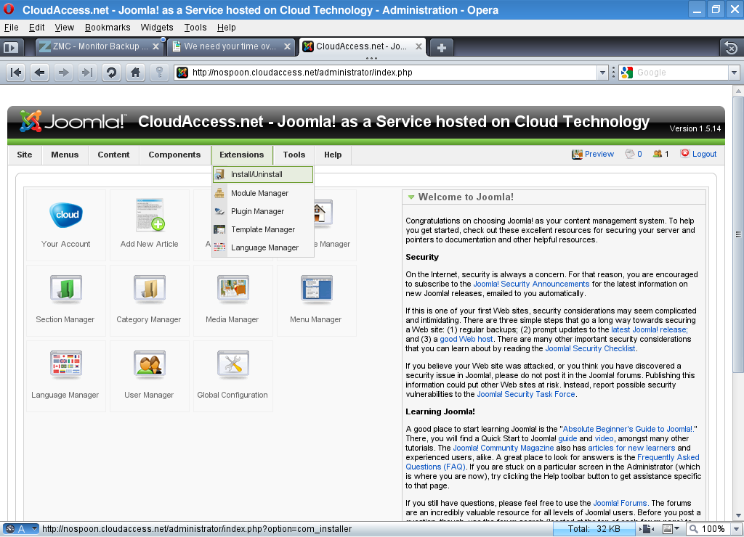
Installation
Log in to Administrator Area
Go to Extensions menu
Select Install/Uninstall

Slide 6
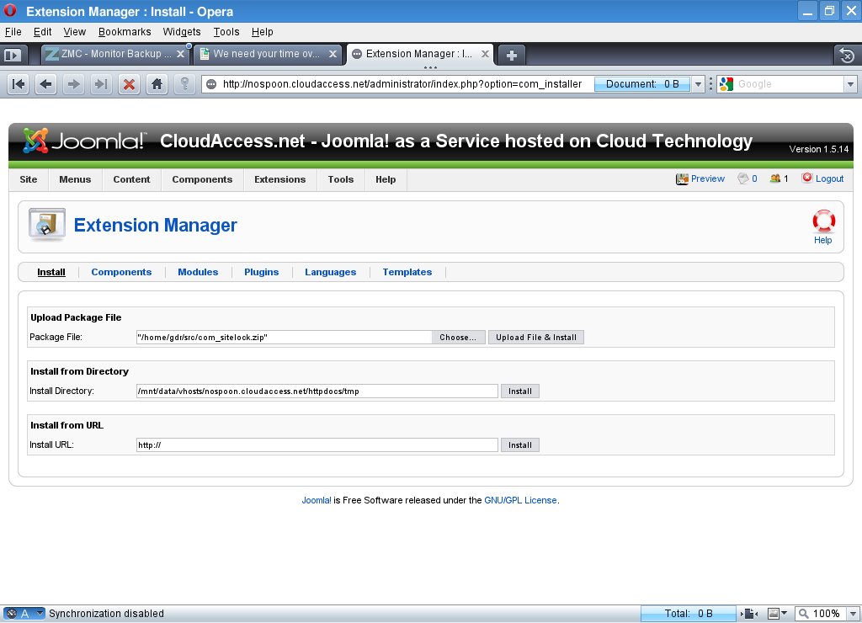
Installation
Click Choose
Select com_s3manager.zip file
Click Upload File & Install

Slide 7
Installation
Component is ready to use

Slide 8
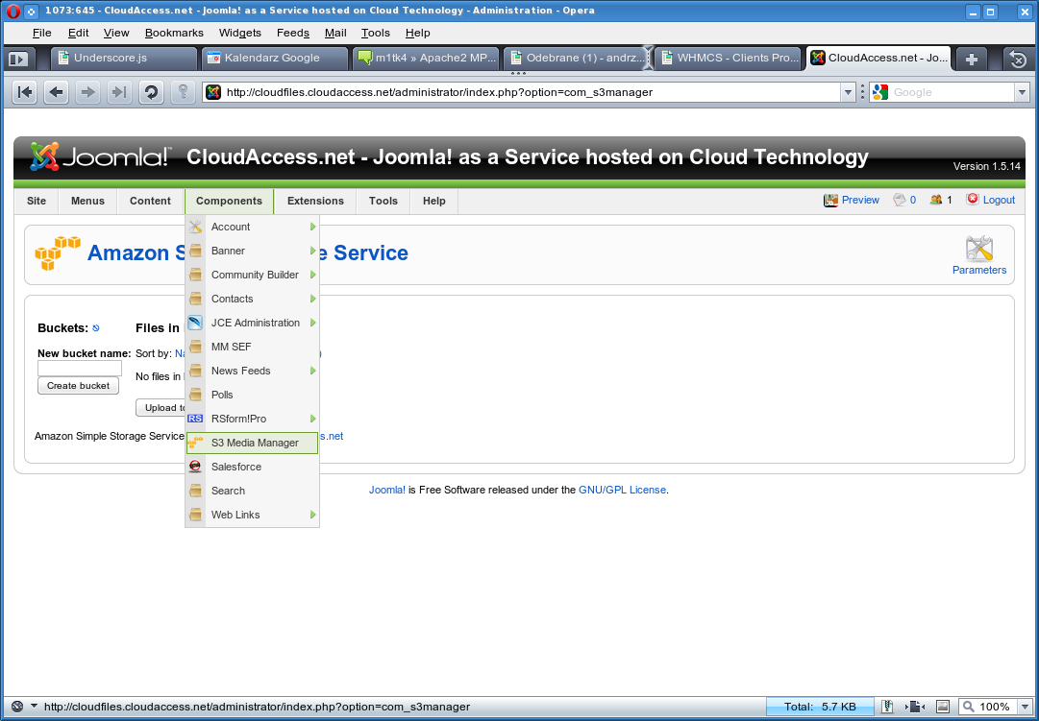
Basics
Go to Components menu
Click on S3 Media Manager

Slide 9
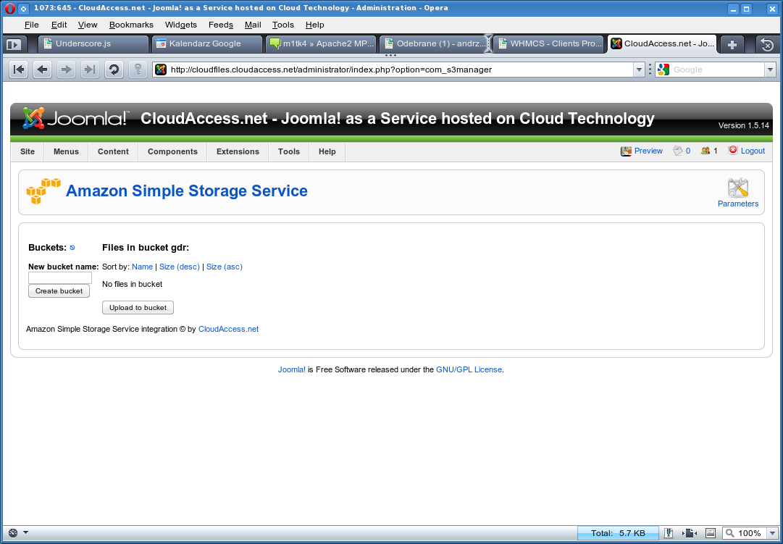
Basics
On the left side, there is a list of S3 buckets
On the right side, there is a list of files in selected bucket
Below files, pending operations appear

Slide 10
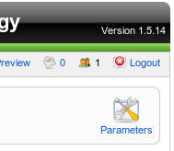
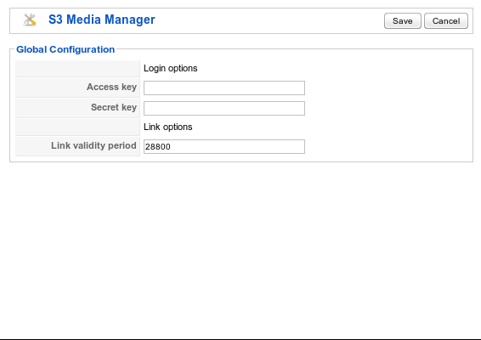
Configuration
In the top right of the screen, there is a button named Parameters. Click on it set up s3manager for your account
There are two parameters you need to fill in: Amazon Access key and Secret Key

Slide 11
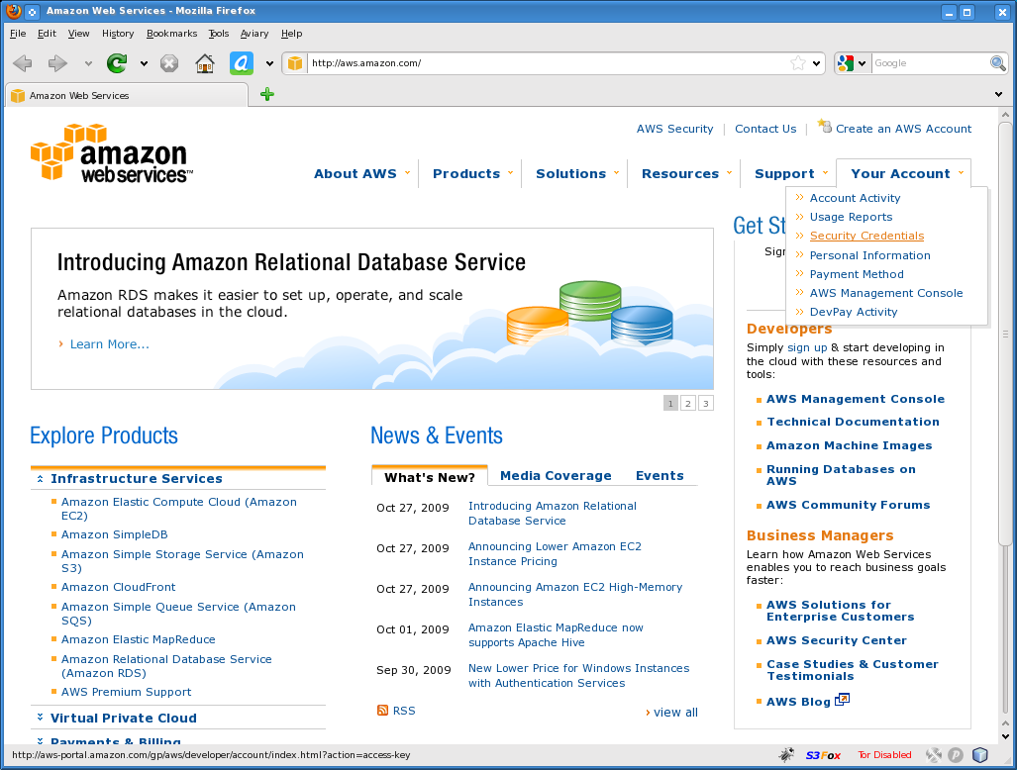
Configuration
You can get these parameters at http://aws.amazon.com/
Go to Your Account (top right) and select Security Credentials

Slide 12
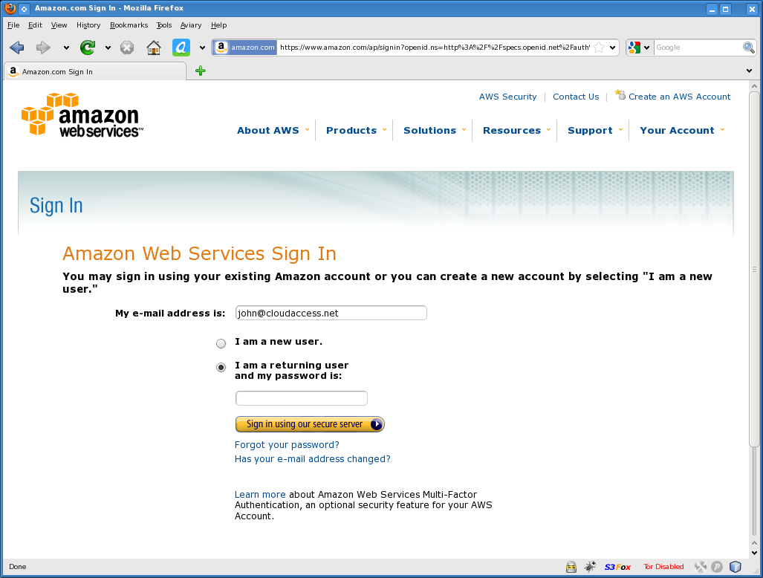
Configuration
Log in or create account if you are a new user

Slide 13
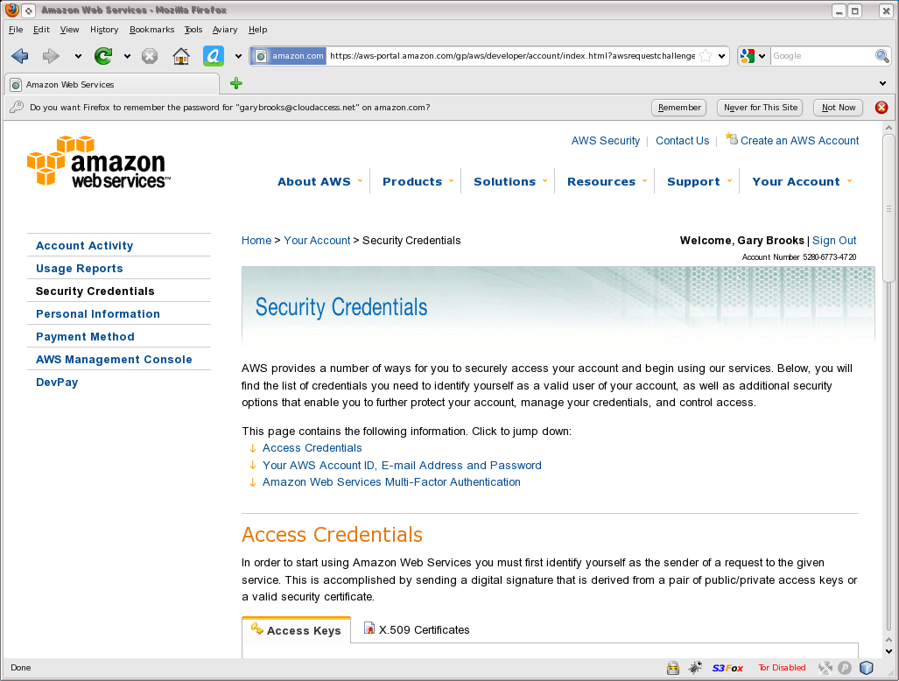
Configuration
This is how the page should look like. If after registration you are seeing something else, please go back to main AWS page and go to Security Credentials again.

Slide 14
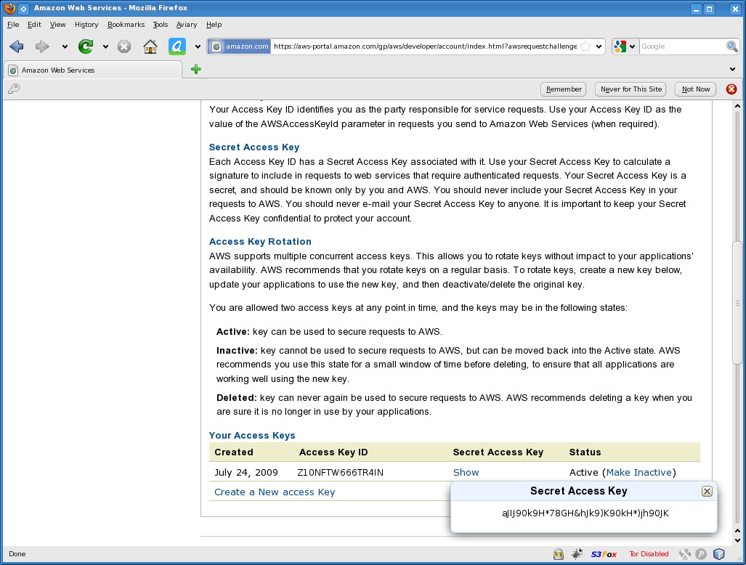
Configuration
Scroll down to the bottom of page to a section named “Your Access Keys”.
Access Key ID is “Access Key” in com_s3manager
Click “Show” under “Secret Access Key” to reveal Secret Key
Note: this seems to only work in Firefox browser.

Slide 15
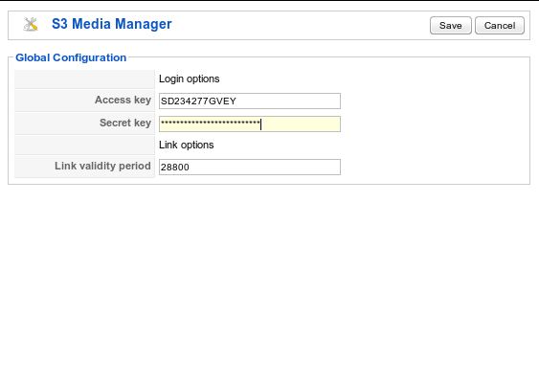
Configuration
Enter these values in Parameters page of S3 Media Manager
Click Save
If you already have some buckets in your S3 account, press refresh link next to “Buckets” marked ⎋

Slide 16
Link validity period
You can also change link validity period. If someone hotlinks to an S3 link found on your page, the link is valid only for at most this number of seconds
The default 28800 equals to 8 hours

Slide 17
Link validity period
If you set this too low, your S3 bills for number of requests may become high because new authenticated link needs to be generated often
If you set this too high and a link becomes popular, you risk being billed for a lot of traffic

Slide 18
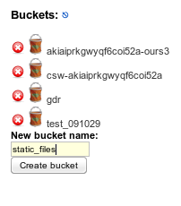
Adding buckets
Buckets are roughly equivalents of directories in S3
All files need to be in a bucket, so you need to create one first
Enter its name and click Create bucket

Slide 19
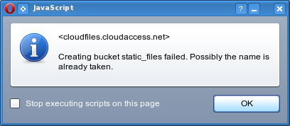

Adding buckets
Bucket names need to be unique across whole S3 system. This error appears when this name already exists.
Think about something unique as bucket name, like name of domain you own

Slide 20
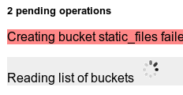

Adding buckets
Watch operation queue at bottom of page. It will inform you about progress of operations
Your newly created bucket should appear soon

Slide 21
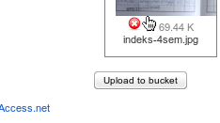
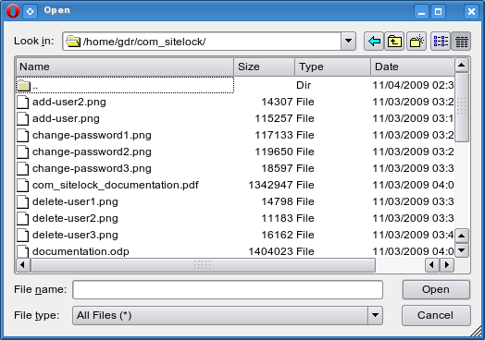
Uploading files
To upload files, first select a bucket where you want to upload
Then, click “Upload to bucket” button on the bottom of the screen and select a file to upload

Slide 22
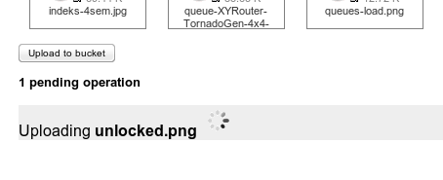
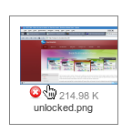
Uploading files
Just after you select the file to upload, it starts transferring
When it's finished, you should see its icon (or thumbnail, if it was an image).

Slide 23
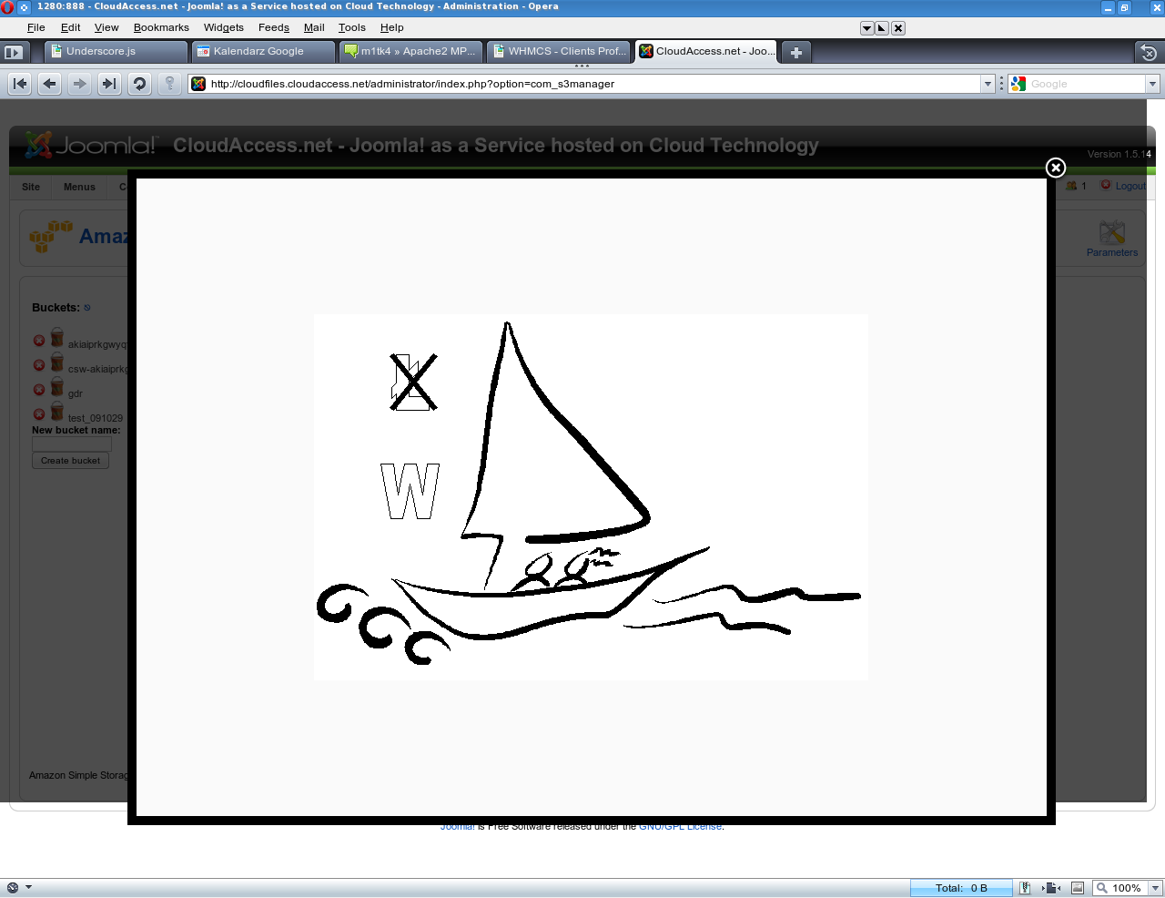
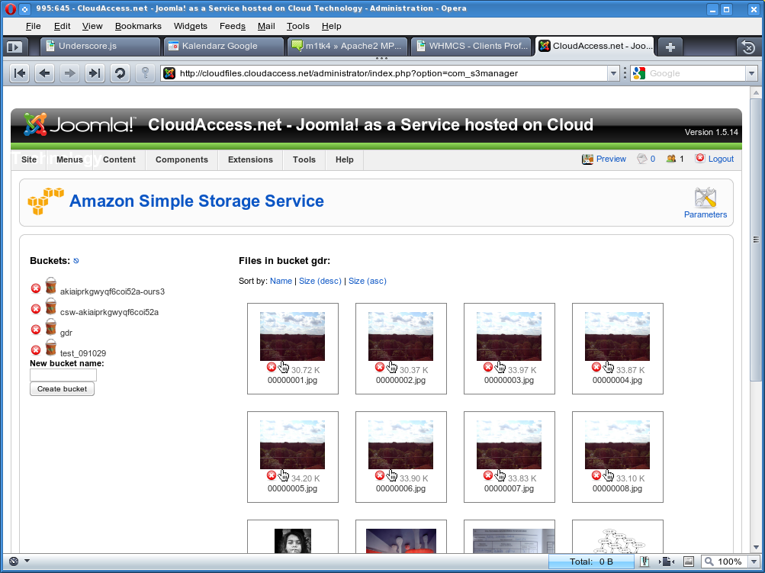
Viewing files
If you click on image thumbnail, you will see a full-screen preview of that image.
In case it's not an image, you will be proposed to download the file

Slide 24
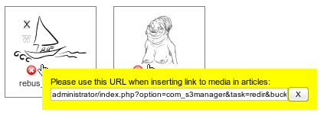
Using in articles
Click on the hand icon next to thumbnail to open a box containing link URL.
Right click on that URL and copy it
Note: Don't change this URL, even though it may look strange to you. It's transparently replaced later.

Slide 25


Using in articles
Go to article editor and select Insert image button
Right click on URL field and paste
Click Insert

Slide 26
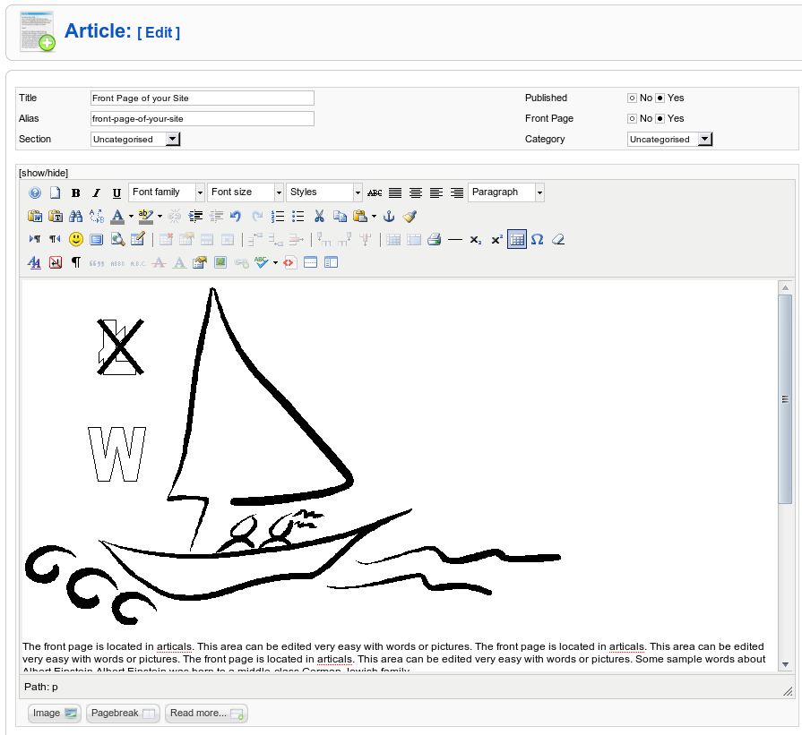
Using in articles
You will see the article editor with your image included
Click Save in the top right and visit main page to see the effect

Slide 27
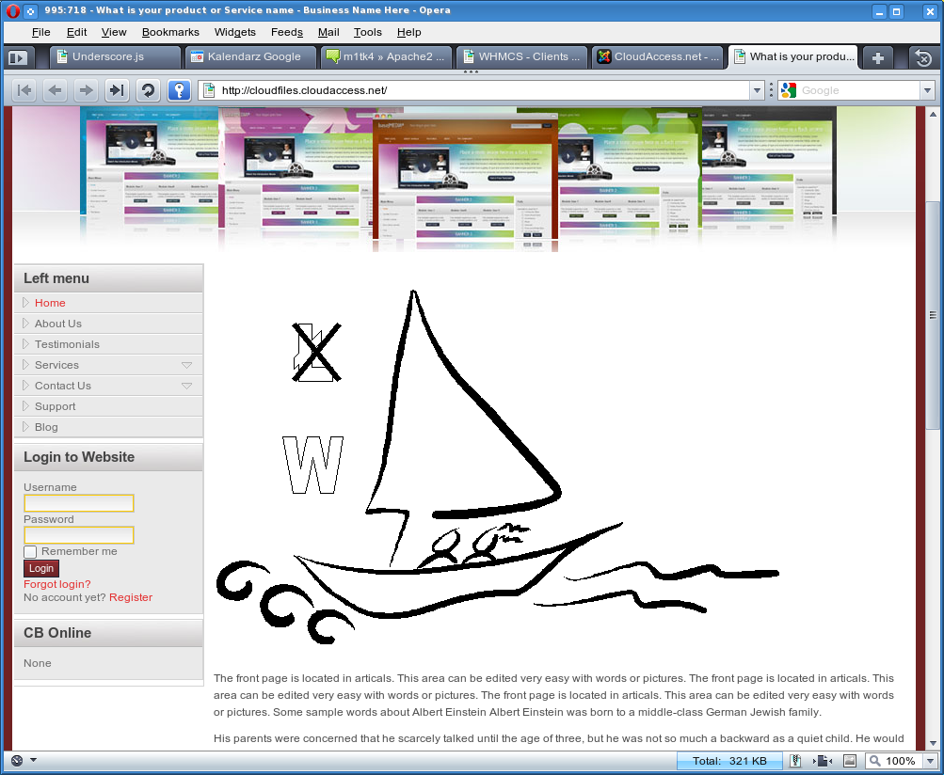
Using in articles
You should see the image you inserted in article you edited
If you're curious, check the image URL. It now points directly to S3.
After you refresh, the link should be still the same – it has been cached
After link validity period expires, you will notice that link to image will change to a new one

Slide 28
Using in articles
You can use this also to link to static files or pass flv movies as a parameter to Flash video player.
The special links are replaced by S3 links after page is rendered, so you may use them really anywhere in HTML code.

Slide 29
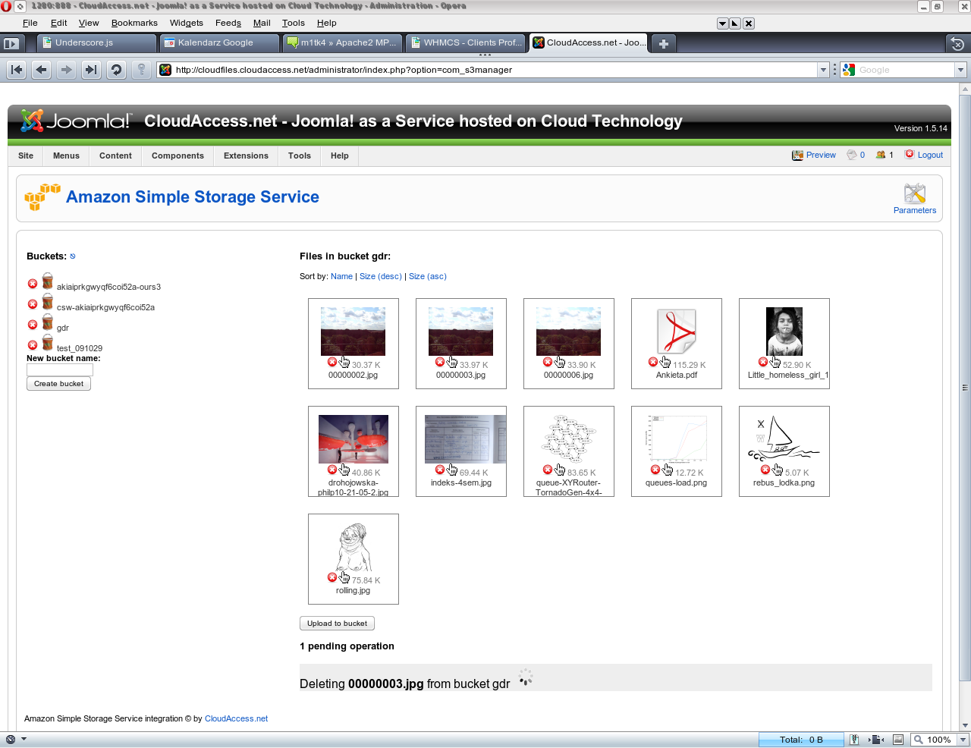
Deleting files
Click on the white cross on red background to delete a file
Delete will be added to list of pending operations

Slide 30
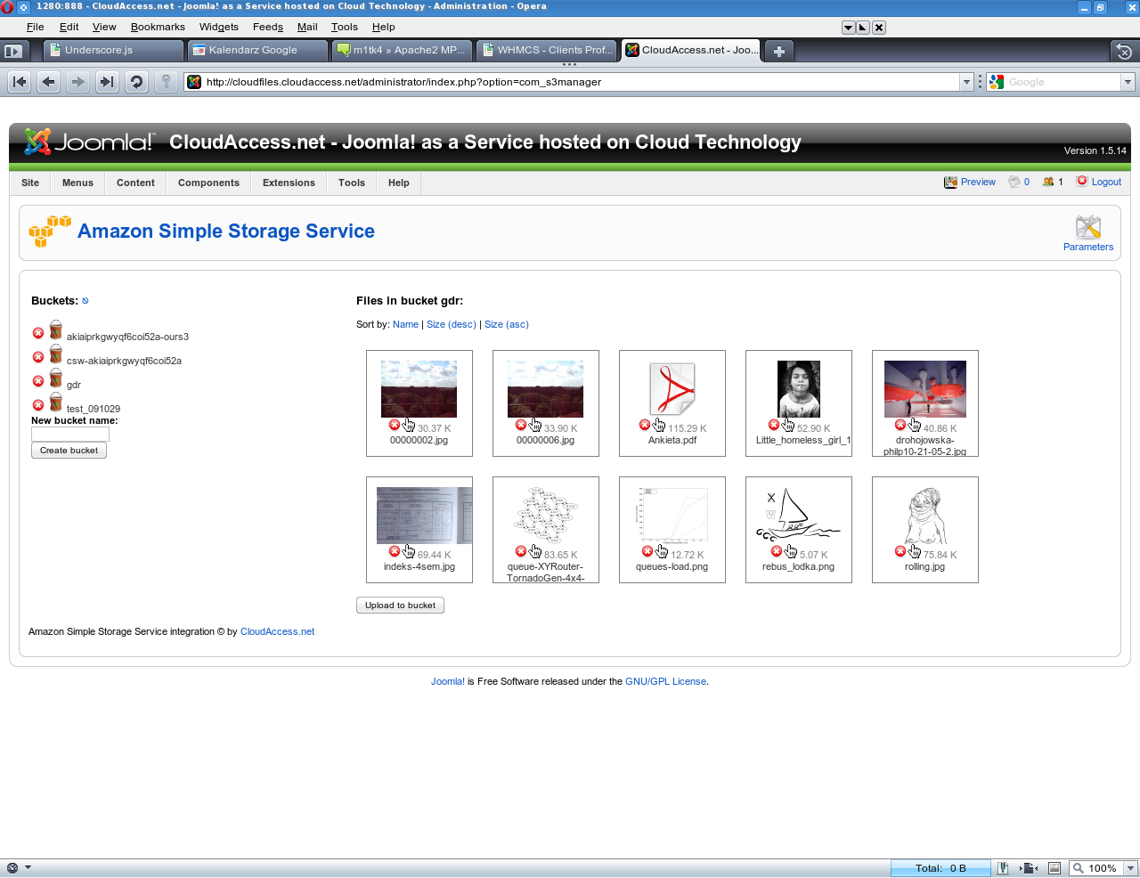
Deleting files
The list of files will refresh and file you deleted should not be there anymore

Slide 31
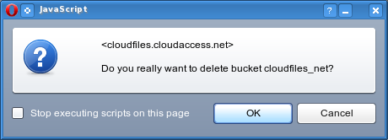
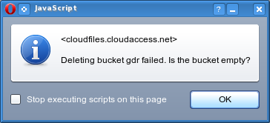
Deleting buckets
Click on the X sign next to bucket name to delete it
You will be asked to confirm your action
Bucket cannot be removed if it's not empty

Slide 32
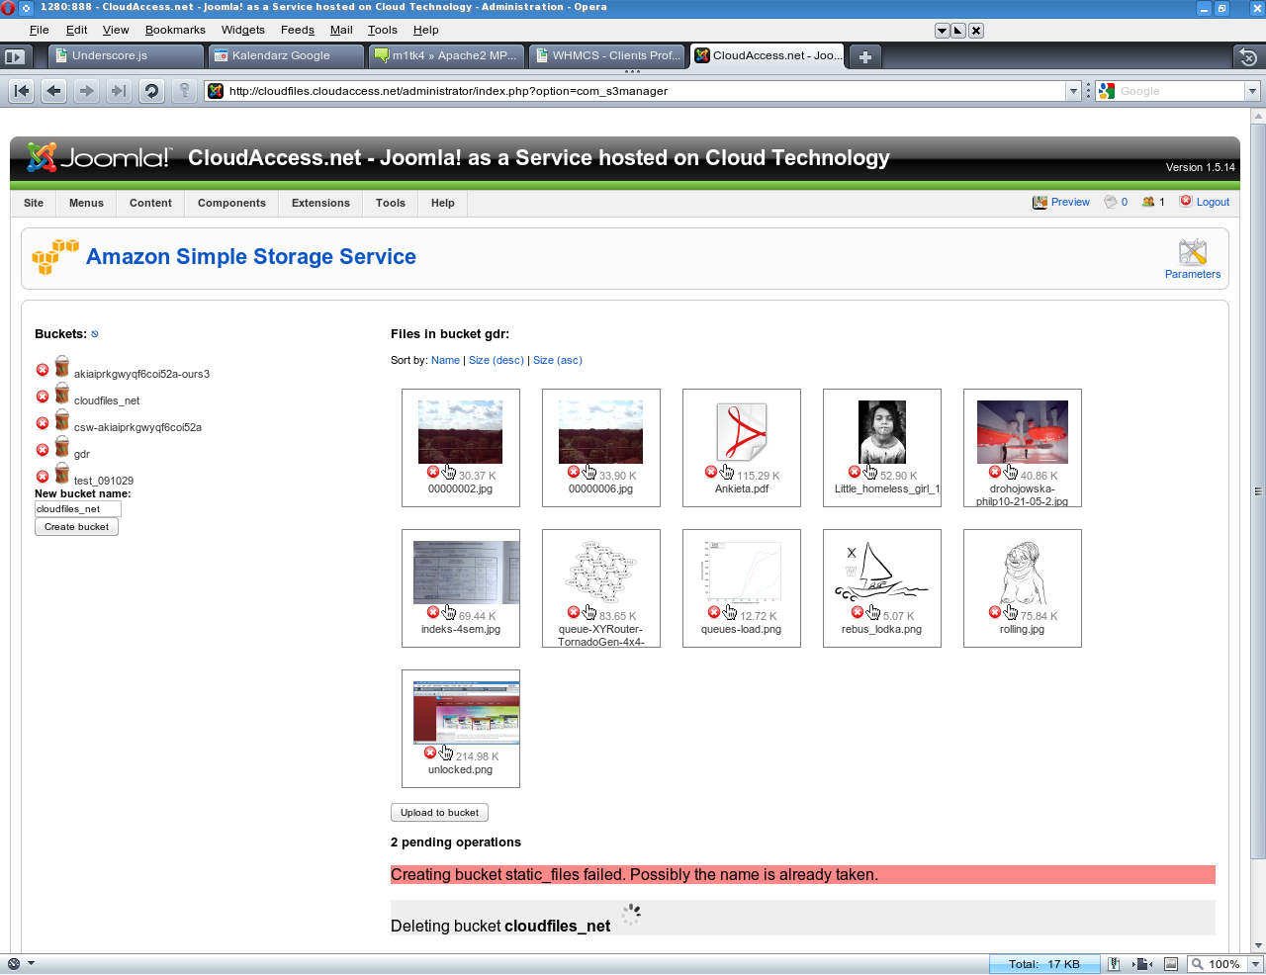
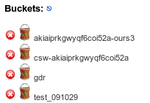
Deleting buckets
Information about deleting your bucket will appear in the queue
After a while, bucket list will refresh. Your bucket should not be there anymore.

Slide 33
Foot notes
Be sure to check our affordable Joomla! managed cloud hosting at http://cloudaccess.net/
In case of issues, our support is available at support@cloudaccess.net

