Slide 1
The Way Of JBoss Big Data
jGroups JBossCache Infinispan
Kylin Soong
Global Support Services, Red Hat
Notes:
Hello, everyone.
My name is Keishi Suzumura and I'm Technical Account Manager in Japan.
I just joined Red Hat this year and before Red Hat, I was a senior support engineer for Coherence product at BEA/Oracle and I have some technical background of the clustering area.
And, last month, I have traveled to Atlanta and took the two days JBoss Data Grids training with Clustering SEGs such as Jimmy, Dennis and Wolf.
I'm here today to talk to you about new Product ”JBoss Data Grids”. We call it something like “J, D, G” or “judge”.
As you all know JBoss Data Grids is based on the infinispan open source project.
Just now, we only provide beta version.
And GA version will be released on June 19th or so.
I am going to present JDG back ground, core architecture and functions today.
And in the next session next week, I am going to talk about some useful troublshooting tips for you.
S

Slide 2
Agenda
jGroups
JBossCache
Infinispan

Slide 3
jGroups Introduction
JGroups is a toolkit for reliable multicast communication
JGroups is a mature library, 50+ release

Slide 4
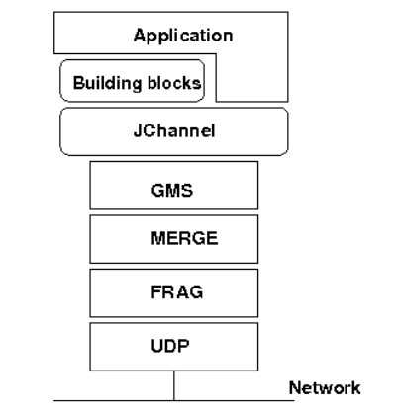
jGroups Architecture

Slide 5
jGroups Chat Demo
JChannel channel = new JChannel();
channel.setName(“node1”);
channel.setReceiver(ReceiverAdapter);
channel.connect(“ChatDemo”);
channel.send(msg);
JChannel channel = new JChannel();
channel.setName(“node2”);
channel.setReceiver(ReceiverAdapter);
channel.connect(“ChatDemo”);
channel.send(msg);
./chat.sh -n node1
./chat.sh -n node2

Slide 6
JBossCache Introduction
JBoss Cache is a tree-structured, clustered, transactional cache.
Base on jGroups
Usage
  JBoss cluster(Web, EJB, JMS, etc)
2 way to run
  Standalone
  Container

Slide 7
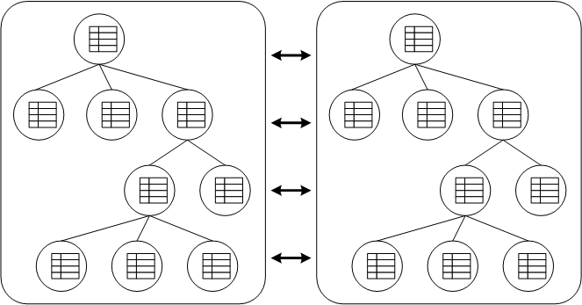
JBossCache Architecture
Node, root
Fqn

Slide 8
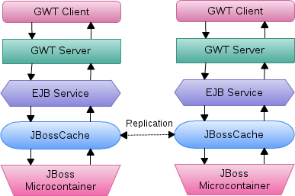
JBossCache Replication Demo
Customize JBossCache(deploy/cluster/jboss-cache-manager.sar/META-INF/jboss-cache-manager-jboss-beans.xml)
Deploy Demo to JBoss(-Djboss.service.binding.set=ports-01)
Test(http://localhost:8080/jbosscache/)

Slide 9
Infinispan Introduction
Transactional in-memory key/value NoSQL datastore
Distributed data grid platform
The 2nd generation JBossCache
JSR 107, JSR 347

Slide 10
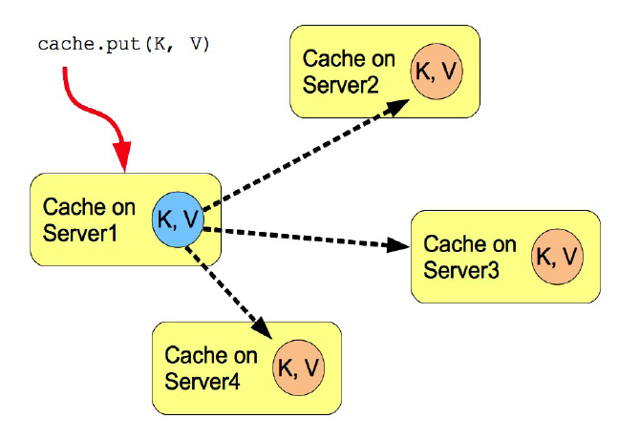
Infinispan Architecture

Slide 11
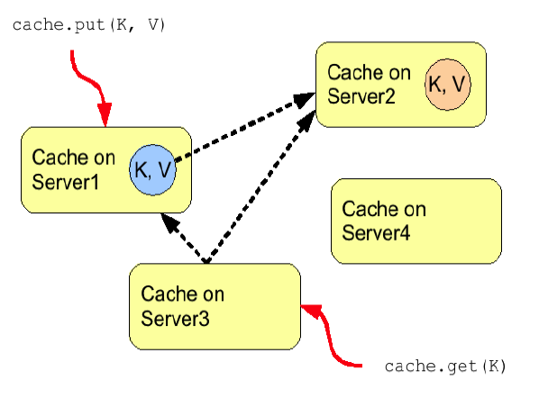
Infinispan Architecture

Slide 12
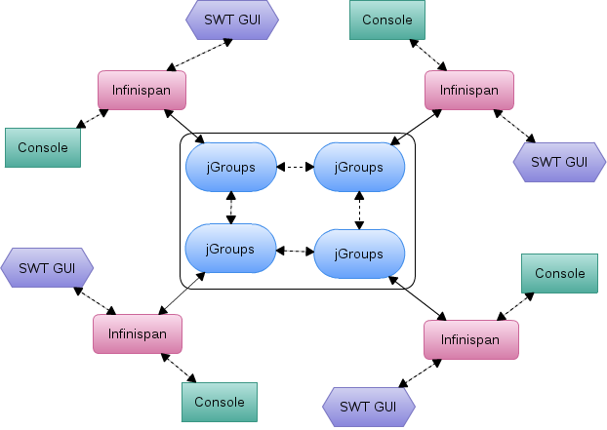
Infinispan Distribution Demo

Slide 13
Infinispan Distribution Demo
./dataGrid.sh -c infinispan-distribution.xml
./dataGrid.sh -c infinispan-distribution.xml -console

Slide 14
Thanks

