Slide 1
GIT

Slide 2
Git is the most widely used modern Version Control System (VCS). It's essential for tracking changes in source code during software development, enabling collaboration, and maintaining a history of your project.
Git is a distributed version control system. This means:
Version Control: It tracks changes to your files over time. You can see who made what changes and revert to any previous state.
Distributed: Every developer has a full copy of the entire project history (the "repository") on their own local machine. This allows you to work offline and provides redundancy.

Slide 3
SOURCE CONTROL MANAGEMENT

Slide 4
SCM is a system that records changes to a file or set of files over time

Slide 5
GIT, VCS, CVCS, DVCS

Slide 6
VCS (Version Control System)
Version control, also known as revision control or source control management (SCM), is a process that manages a collection of source code and changes
VCS is split into two main eras: Centralized (CVCS) and Distributed (DVCS)

Slide 7
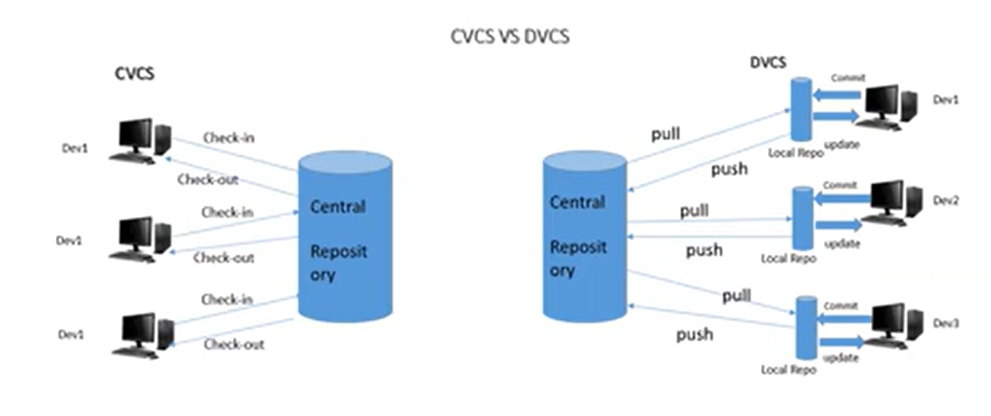

Slide 8
Centralized VCS (CVCS)
CVCS (Centralized Version Control System) This model uses a single, central server that holds the complete history and version database.
All users connect to this server to get the latest code and save their changes.
Core Concept: One central "source of truth." Developers have a "working copy" on their machine, but to see history or save snapshots, they must communicate with the central server.
Common Examples: Subversion (SVN), Perforce, CVS.
How it Works:
You checkout a working copy from the central server.
You make changes to your local files.
You commit your changes directly back to the central server.

Slide 9
Distributed VCS (DVCS)
DVCS (Distributed Version Control System) This model does not rely on a central server in the same way. Every developer clones a full copy of the entire repository, including its complete history.
Core Concept: Every clone is a full backup of the repository. There is no single point of failure.
Dominant Example: Git. Others include Mercurial and Bazaar.
How it Works:
You clone a repository from a source (e.g., GitHub). This gives you a full local repository with the entire history.
You work on your local machine: you can commit, branch, and view history completely offline.
When ready, you push your changes to a remote repository (like GitHub) or pull others' changes from it.

Slide 10
GIT FUNDAMENTALS

Slide 11
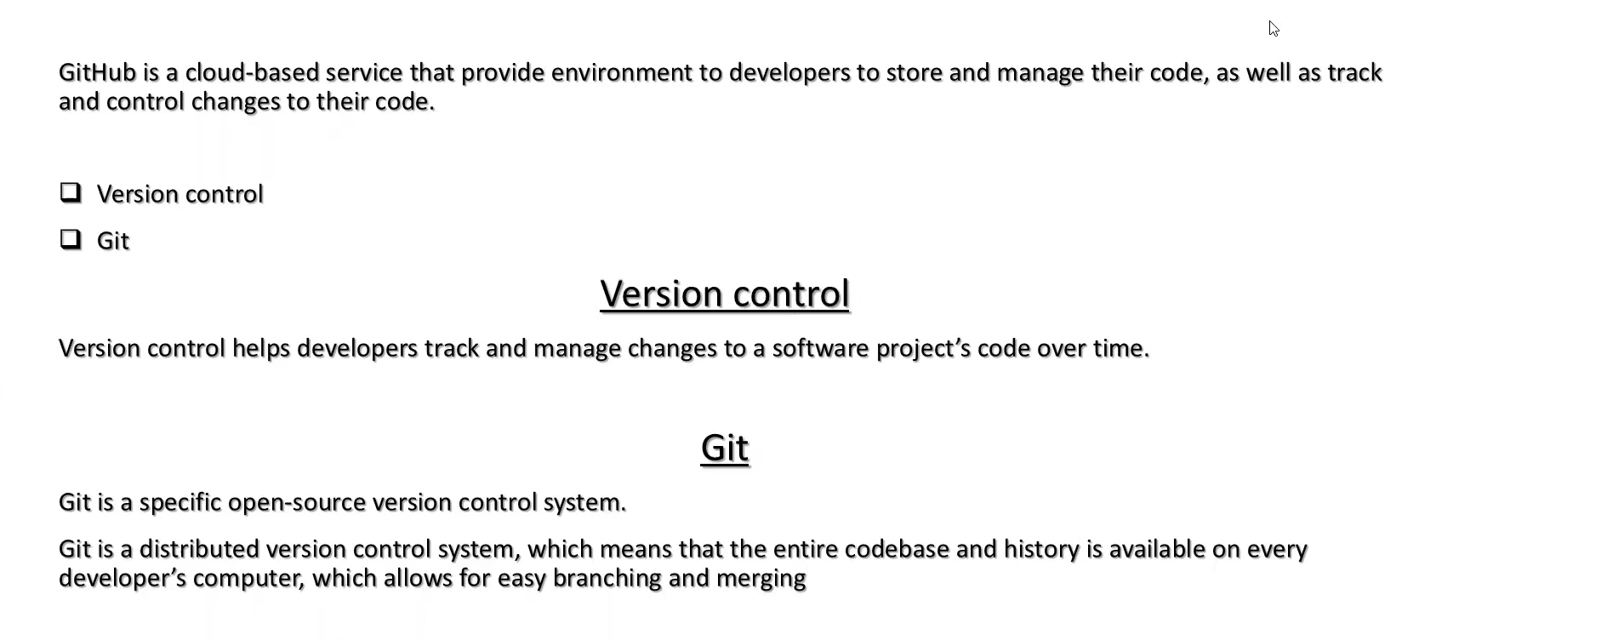

Slide 12
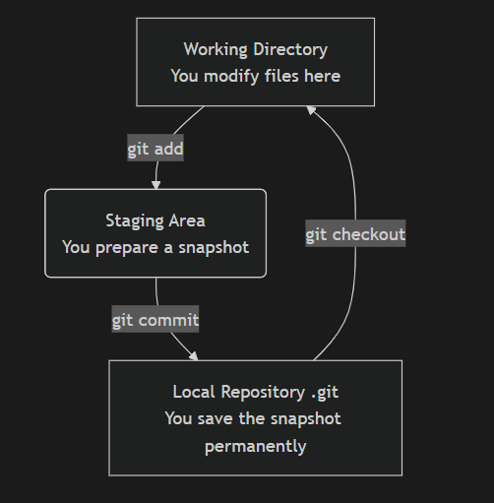
The Three States of Git
Modified (Working Directory):
You have changed the file but have not yet committed it to your database.
The changes exist only in your working folder.
Staged (Staging Area):
You have marked a modified file in its current version to go into your next commit.
The staging area is a file (also called the "index") that stores what will go into your next commit.
Committed (Repository):
The data is safely stored in your local database.
The file is snapshotted in its current state as part of the project's history.

Slide 13
Fundamental Concepts
1. Repository (Repo)
The .git folder inside your project directory. It's where Git stores all the metadata and object database for your project. It's what makes a directory a Git repository.
2. Commit
A snapshot of your project at a point in time. It's like a save point in a game. Each commit has:
A unique 40-character hash (e.g., a1b2c3d...) that identifies it.
The author and timestamp.
A commit message describing why the change was made.

Slide 14
3. Branch
A movable pointer to a specific commit. The default branch is usually called main or master.
Creating a branch is like creating a separate timeline for your work. It's cheap and fast.
You always work on a branch. Your HEAD is a pointer that indicates what branch you are currently on.
4. Remote
A shared repository hosted on the internet or network (e.g., on GitHub, GitLab). It's a common point for collaboration. The default name for a remote is origin.

Slide 15
INITIALIZING REPOSITORY

Slide 16
Initializing a repository is the first step in starting a new project with Git. It's the process of creating that all-important .git folder that turns a regular directory into a version-controlled Git repository.
There are two primary ways to initialize a Git repository, depending on whether you're starting from scratch or working with an existing project on a server like GitHub.

Slide 17
Starting a New Local Project ( git init)
1.Create your project directory:
mkdir my-new-project
cd my-new-project
2.Initialize the Git repository:
git init
This is the core command. It creates a hidden .git subdirectory where all the repository metadata (history, config, etc.) is stored.
Output: Initialized empty Git repository in /path/to/your/my-new-project/.git/
3.(Optional) Check the status:
git status
You'll see a message like "On branch main" and "No commits yet". This confirms the repo is active.

Slide 18
4. Add your files and make the first commit:
# Create your first file
echo "# My New Project" > README.md
# Stage all files in the current directory
git add .
# Commit the snapshot to the repository's history
git commit -m "Initial commit"

Slide 19
What git init Actually Does:
Creates the .git directory with subdirectories like objects, refs/heads, refs/tags.
Creates an initial HEAD file that points to the initial branch (usually main).
Sets up the basic configuration for the repository.

Slide 20
PUSHING TO A GIT REPOSITORY

Slide 21
Pushing to a Git repository is the act of uploading your local commits to a remote repository (like GitHub, GitLab, or Bitbucket).
This is how you share your work with others, back up your code, and collaborate.

Slide 22
Prerequisites for Pushing
Before you can push, you must have:
A Local Git Repository: A project folder initialized with git init or cloned with git clone.
Commits to Send: You must have made at least one commit in your local repository. Git pushes commits, not just files.
A Remote Repository Configured: A connection to a remote server. If you used git clone, this is already set up (named origin). If you used git init, you need to add it.

Slide 23
The Core Command: git push
git push <remote-name> <branch-name>
<remote-name>: The shorthand name for the remote repository. The default is origin.
<branch-name>: The name of the branch you want to push. The default in modern Git is main
git push origin main/master
This means: "Take my local main branch and its new commits, and update the main branch on the origin remote."

Slide 24
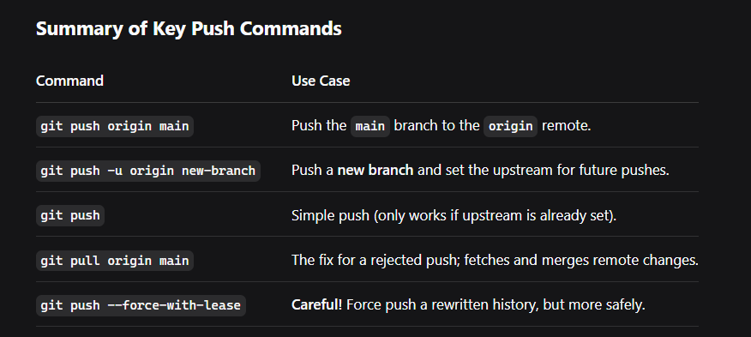

Slide 25
GIT COMMIT

Slide 26
git commit is one of the most fundamental and critical commands in Git. It's the act of creating a permanent snapshot of the changes you've staged in your repository's history.
What Does git commit Do?
When you run git commit, you are:
Taking all the changes currently in the Staging Area (Index).
Creating a new, permanent snapshot of the project in that state.
Storing that snapshot in the local Repository (the .git directory).
Creating a commit object with a unique ID (hash), your name, timestamp, and your commit message
git commit -m "Your descriptive commit message here"
The -m flag allows you to write the commit message directly in the command.

Slide 27
The Complete Workflow: Add -> Commit
# 1. Check what you've changed (optional but recommended)
git status
# 2. Stage the changes you want to commit
git add . # Stage all changes
# OR
git add specific-file.txt # Stage a specific file
# 3. Create the commit with a message
git commit -m "Add user login functionality"
# 4. Push your commit to the remote repository (to share it)
git push origin main

Slide 28
