Slide 1

Pyspark-Day1

Slide 2
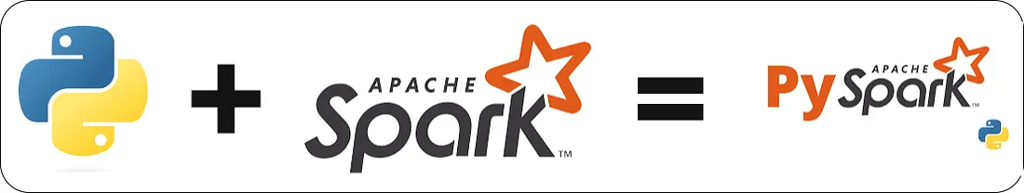
What is PySpark?
PySpark is the Python API for Apache Spark, an open-source unified analytics engine for large-scale data processing

Slide 3
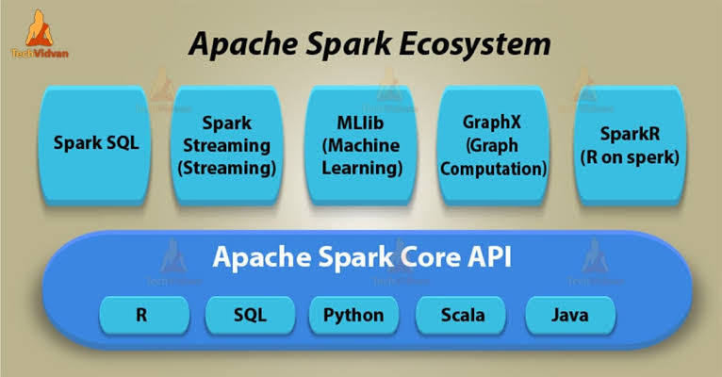
Apache Spark ecosystem
The Apache Spark ecosystem is a collection of components and libraries that support batch, streaming, SQL, graph, and machine learning workloads, all built around the Spark Core engine.

Slide 4
Spark SQL: This component is designed for working with structured data and introduces DataFrames, which provide an optimized and developer-friendly API. Users can query structured data using SQL or the DataFrame API.
Spark Streaming: This module makes it easier to build scalable and fault-tolerant streaming solutions by bringing the Spark API to stream processing. It supports both the DStreams and the newer Structured Streaming API.
MLlib: Spark's machine learning library provides scalable tools for common algorithms, including classification, regression, clustering, and recommendation. It is built on top of Spark's core and is designed to be fast.
GraphX: This is the API for performing graph and graph-parallel computations. It allows for flexible and scalable graph processing, including running common algorithms like pathfinding and clustering.
SparkR: This is the Spark package that provides the R programming language with the ability to use Spark's distributed processing capabilities. It allows R users to work with large datasets and perform operations like selection, filtering, and aggregation.

Slide 5
1. Spark Core
Foundation of the ecosystem — provides the basic functionality of Spark.
Handles:
Memory management
Task scheduling
Fault tolerance
Interaction with storage systems
Programming APIs: Scala, Python (PySpark), Java, R
RDD (Resilient Distributed Dataset): the fundamental data structure for distributed processing.

Slide 6
2. Spark SQL
Enables working with structured and semi-structured data.
Supports SQL queries, DataFrames, and Datasets.
Can integrate with data sources such as:
Hive, Parquet, ORC, JSON
Often used for ETL, data warehousing, and BI integrations.

Slide 7
3. Spark Streaming / Structured Streaming
For real-time data processing and event-driven applications.
Structured Streaming: modern API that treats streaming data as a continuous table (DataFrame-based).
Can process data from:
Kinesis.
Used for fraud detection, IoT analytics, real-time dashboards, etc.

Slide 8
4. MLlib (Machine Learning Library)
Spark’s built-in machine learning and statistical analysis library.
Includes algorithms for:
Classification, regression, clustering, recommendation, etc.
Provides utilities for:
Feature extraction, transformation, model selection, and evaluation.
Works with both DataFrames and Pipelines

Slide 9
5. GraphX
Library for graph processing and graph-parallel computations.
Allows representation of data as graphs (vertices and edges).
Provides algorithms for:
Useful for social network analysis, recommendation, and network topology.

Slide 10
6. SparkR
Provides an R interface for Spark.
Enables R users to perform distributed data analysis using DataFrames and SQL queries.

Slide 11
7. PySpark
Python API for Apache Spark.
Allows Python developers to use Spark’s features for distributed data processing and ML.
Integrates well with Pandas, NumPy, and Scikit-learn.

Slide 12
8. Delta Lake (Modern Data Lake Storage Layer)
Adds ACID transactions, schema enforcement, and time travel to data lakes.
Unifies batch and streaming pipelines on Spark.
Often used with Databricks or open-source Delta Lake.

Slide 13
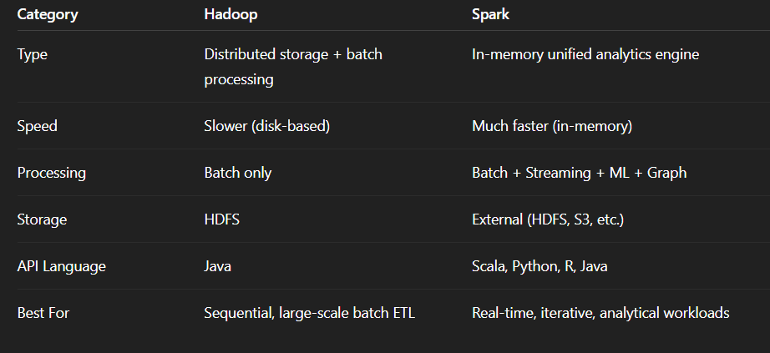
Hadoop vs Spark
✅ In Simple Terms
Hadoop = Disk-based Storage + Processing → Reliable, slower, good for big batch ETL.
Spark = In-memory Compute Engine → Fast, versatile, ideal for analytics, ML, and streaming.

Slide 14
Local vs Cluster Mode

Slide 15
Term | Description
Local Mode | Spark runs entirely on a single machine (your laptop/server) — driver and executors all in one JVM process.
Cluster Mode | Spark runs on multiple nodes (machines) — the driver and executors are distributed across the cluster.

Slide 16
Local Mode
What It Is:
Spark runs locally, using your computer’s CPU cores.
No cluster manager (like YARN, Kubernetes, or Mesos) is involved.
Ideal for testing, development, or small datasets.
spark-submit --master local[*] app.py
✅ Advantages:
Easy to set up (no cluster config).
Good for debugging or prototyping.
No need for distributed resources.

Slide 17
Cluster Mode
What It Is:
Spark runs on a distributed cluster of multiple nodes.
The workload is distributed across worker nodes.
Managed by a cluster manager (YARN, Kubernetes, Mesos, or Spark Standalone).
spark-submit \
--master spark://master-node:7077 \
--deploy-mode cluster \
app.py
on YARN:
spark-submit --master yarn --deploy-mode cluster app.py

Slide 18
Key Components in Cluster Mode
Component | Role
Driver | Coordinates the Spark job; creates DAG, schedules tasks.
Executors | Run tasks assigned by the driver; perform actual data processing.
Cluster Manager | Allocates resources and manages nodes.
Worker Nodes | Machines that host executors.

Slide 19
Local vs Cluster Mode
Feature | Local Mode | Cluster Mode
Execution | Single machine | Multiple nodes
Setup | Simple | Complex (needs cluster manager)
Scalability | Limited | Highly scalable
Speed | Limited by one system | Distributed, faster for large data
Use Case | Development, testing | Production, big data workloads
Resource Allocation | CPU cores on one machine | Managed across nodes
Example Command | --master local[*] | --master yarn / --master spark://...

Slide 20
Use Case | Recommended Mode
Testing PySpark script locally | Local Mode
Developing a Spark ML pipeline | Local Mode
Running ETL jobs on large datasets | Cluster Mode
Real-time data streaming from kinesis | Cluster Mode

