Slide 1

Databricks-Day2-Part1

Slide 2
1️⃣ Clusters
Compute resources in Databricks where you run notebooks, jobs, and queries.
Can be All-purpose clusters (interactive work)
Or Job clusters (scheduled/automated jobs)

Slide 3
2️⃣ Using Notebooks
Covers how to:
Create notebooks
Run Spark / SQL / Python / Scala code
Share notebooks
Use %sql, %python, %fs magic commands

Slide 4
3️⃣ Databricks FileStore
A special DBFS location: dbfs:/FileStore/
🔹 Why DBFS is Used?
Store input/output data
Store model files
Store temporary files
Share data between notebooks
Mount external storage (S3, ADLS) : Mounting means linking external cloud storage into DBFS so it appears like a local folder.
dbutils.fs.mount( source = "s3a://my-bucket", mount_point = "/mnt/mydata" )
Example: LISTING FILES IN FILE STORE
dbutils.fs.ls("dbfs:/FileStore/")

Slide 5
DBFS in Databricks
DBFS (Databricks File System) is a distributed file system available in Databricks. It is an abstraction layer over cloud storage like:
Amazon S3
Azure Data Lake Storage
Google Cloud Storage
DBFS allows you to store and access files in your Databricks workspace as if it were a local file system.

Slide 6
🔹 DBFS Architecture
DBFS is not actual storage — it is a layer on top of cloud storage.
Cloud Storage (S3 / ADLS / GCS)
↓
DBFS
↓
Databricks Clusters

Slide 7
🔹 DBFS Path Formats
There are 2 ways to access DBFS:
1️⃣ DBFS Path (Recommended)
dbfs:/FileStore/data.csv
2️⃣ Local Driver Path
/dbfs/FileStore/data.csv
👉 dbfs:/ is used inside Spark 👉 /dbfs/ is used in Python / shell
Location | Purpose
dbfs:/FileStore/ | Upload files manually
dbfs:/mnt/ | Mounted external storage
dbfs:/tmp/ | Temporary files
dbfs:/databricks-datasets/ | Sample datasets

Slide 8
🔹 Upload File to DBFS
Method 1: UI
Workspace → Data → Upload → Select file
Method 2: Notebook
dbutils.fs.cp("file:/local/path/data.csv", "dbfs:/FileStore/data.csv")

Slide 9
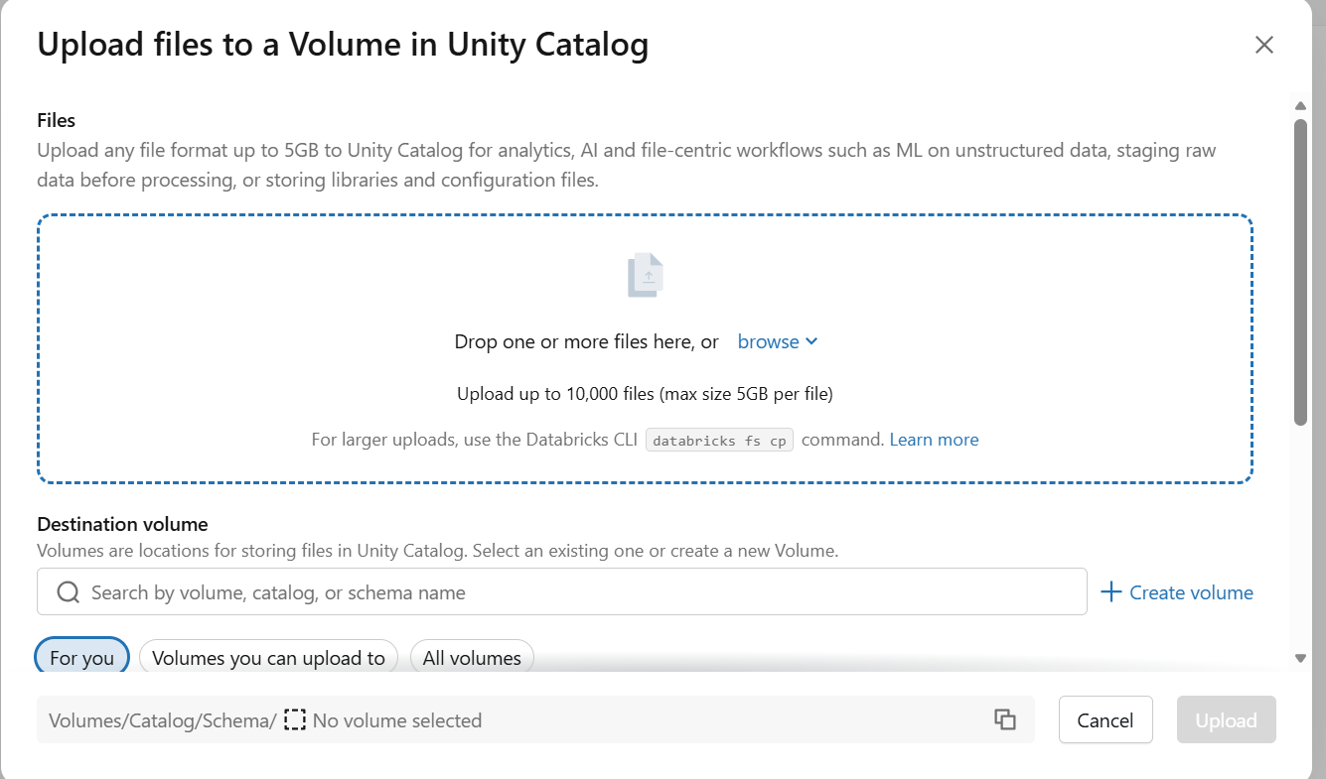
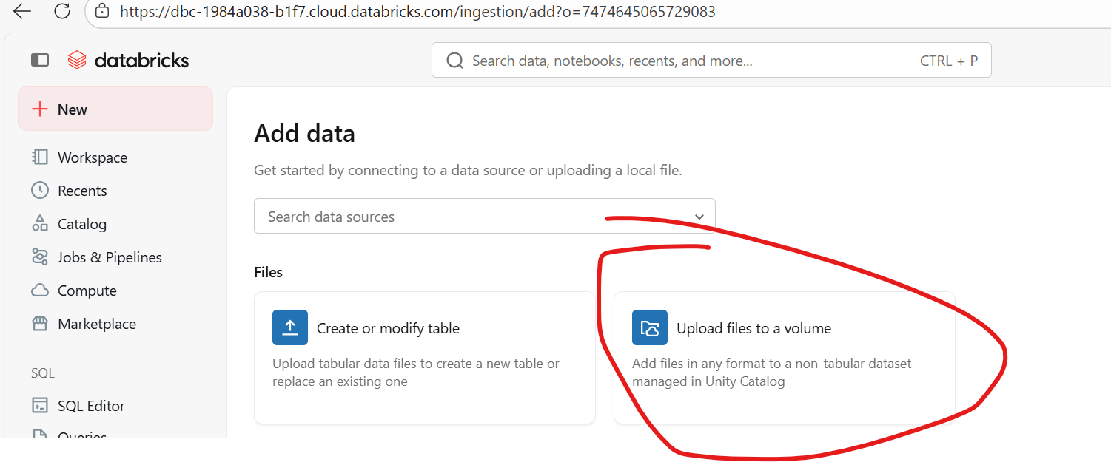
Upload file using UI

Slide 10
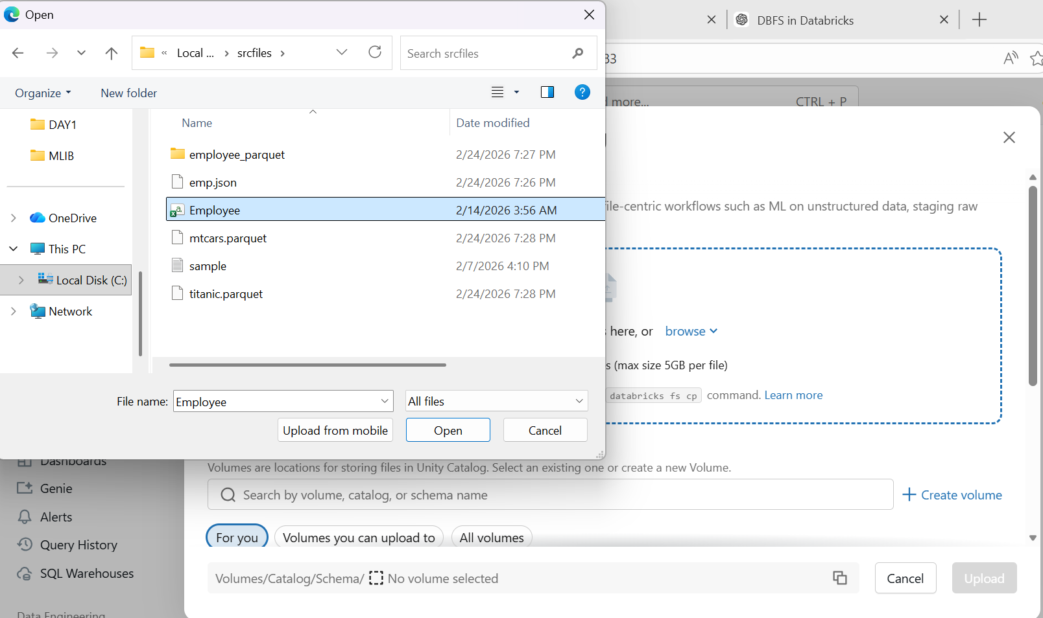
Browse to upload files

Slide 11
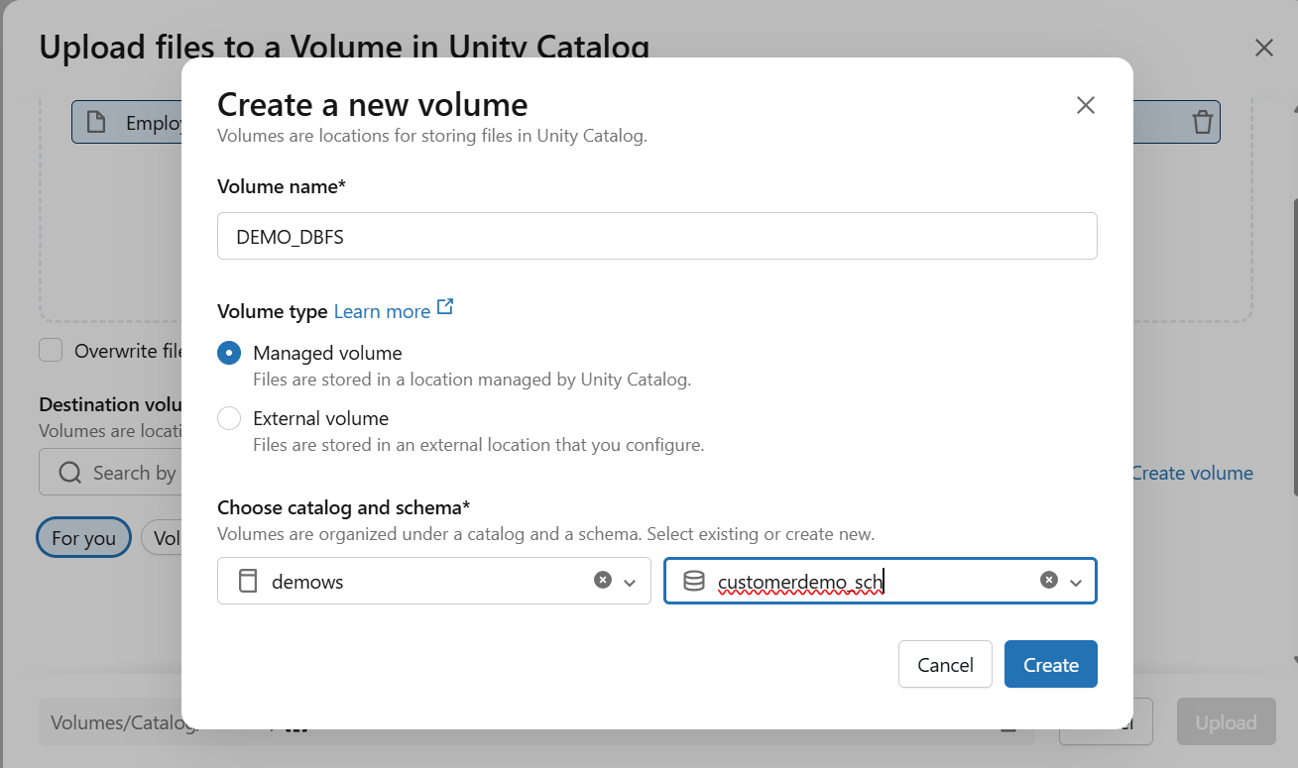
Create a Volume & Specify Catalog & Schema Name

Slide 12
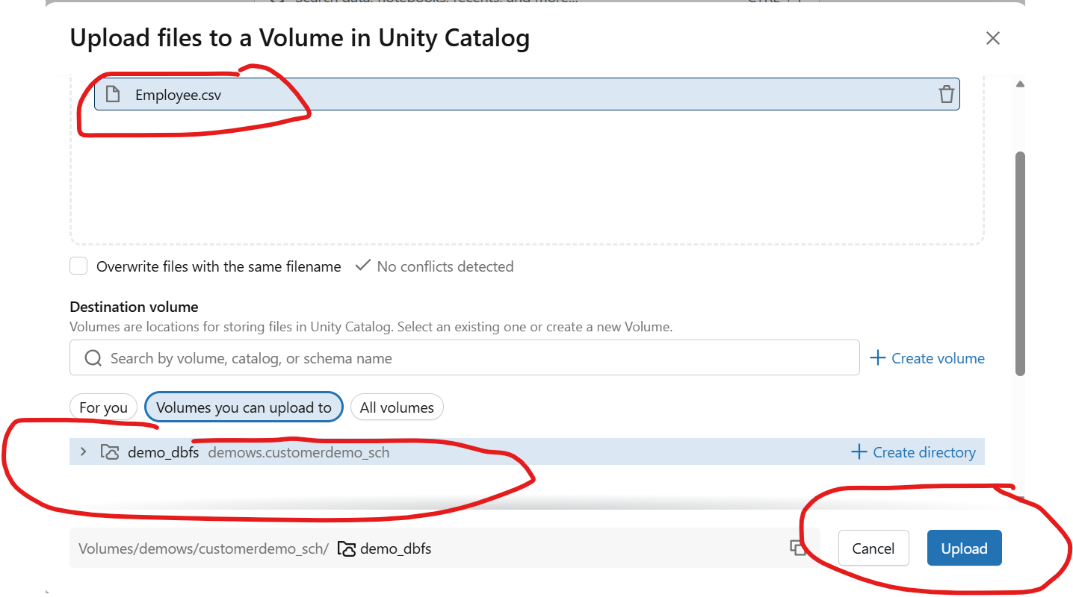

Slide 13
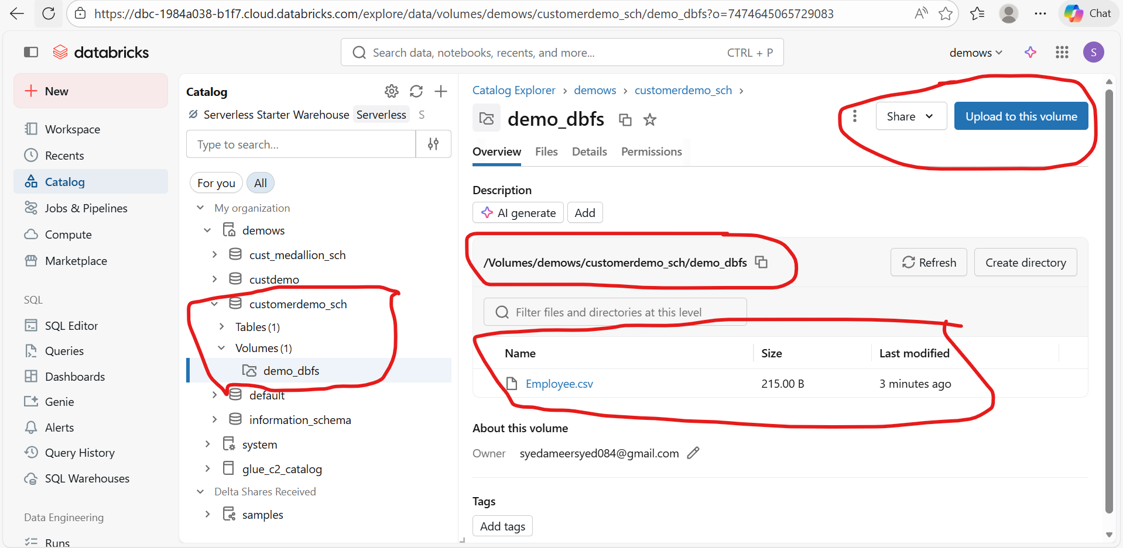

Slide 14
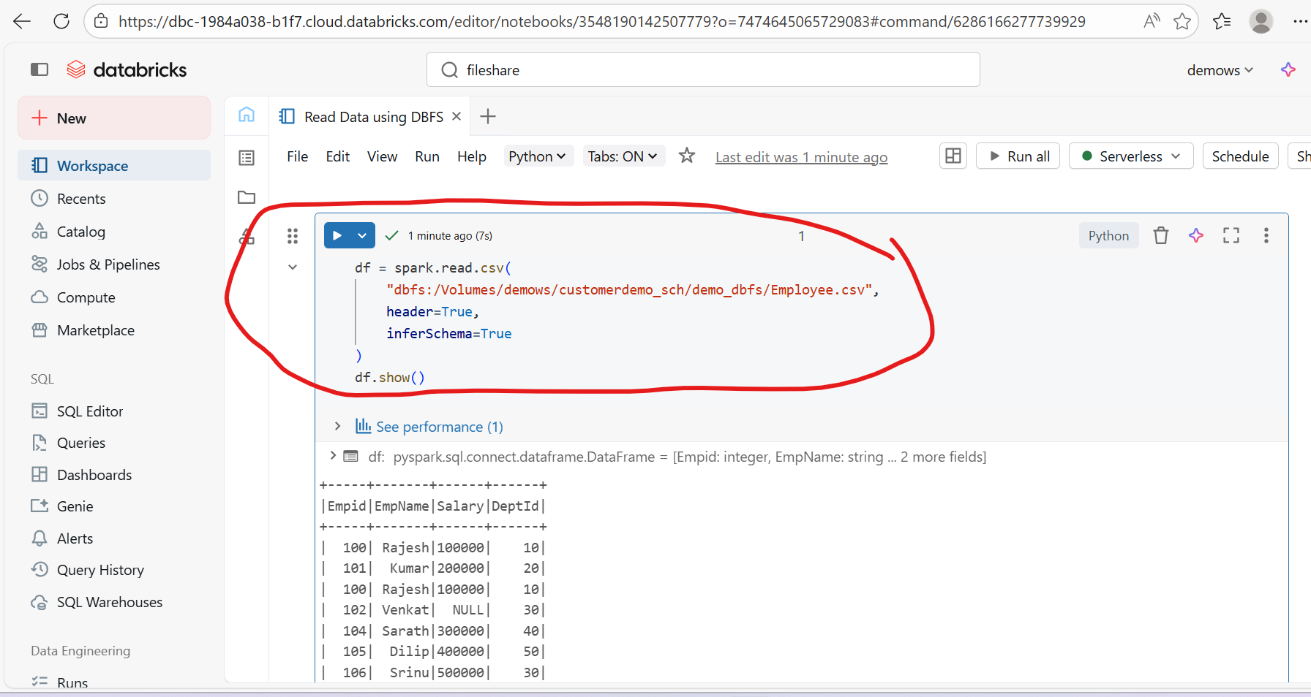

Slide 15
🔹 DBFS vs Mount
DBFS Root | Mount
Workspace storage | External cloud storage
Limited | Scalable
Not recommended for production | Recommended

Slide 16
Important (2026 Update)
Databricks now recommends:
Using Unity Catalog external locations
Avoid storing production data in DBFS root

Slide 17
🔹 Read File from DBFS
df = spark.read.csv("dbfs:/FileStore/data.csv", header=True, inferSchema=True)
df.show()
🔹 Mount S3 to DBFS (Example)
dbutils.fs.mount(
source = "s3a://my-bucket",
mount_point = "/mnt/mydata",
extra_configs = {"fs.s3a.access.key": "XXX",
"fs.s3a.secret.key": "XXX"})
Then access: dbfs:/mnt/mydata/file.csv
🔹 List Files in DBFS dbutils.fs.ls("dbfs:/FileStore/")

Slide 18
🔹 Difference Between dbfs:/ and /dbfs/
Feature | dbfs:/ | /dbfs/
Used in | Spark APIs | Driver (Python, shell)
Type | Virtual DBFS path | Local file system path
Example | spark.read.csv("dbfs:/FileStore/data.csv") | open("/dbfs/FileStore/data.csv")
Recommended | ✅ Yes | Only when needed
Use dbfs:/ inside Spark
Use /dbfs/ when accessing from Python OS or bash

Slide 19
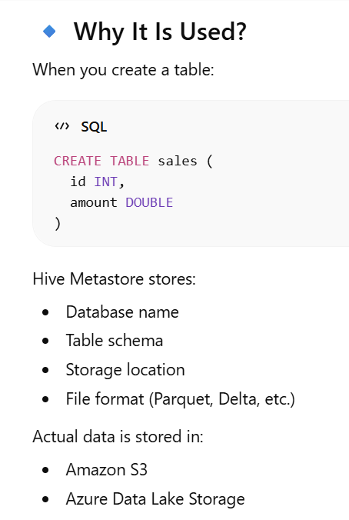
4️⃣ Hive Metastore
Legacy metadata store in Databricks used to:
Store table definitions
Manage schemas and databases
Integrate with external systems like AWS Glue
👉 It does NOT store actual data
👉 It stores only metadata about data
Example:
SHOW DATABASES; SHOW TABLES;

Slide 20
🔹 Why Hive Metastore Is Being Replaced with Unity Catalog
❌ No centralized governance ❌ No data lineage ❌ Limited security ❌ Not cross-workspace
✅ Unity Catalog provides:
Fine-grained access control
Data lineage
Cross-workspace sharing
External locations

Slide 21
5️⃣ File Types
Common formats supported in Databricks:
CSV
JSON
Parquet
ORC
Delta Lake
Avro

Slide 22
6️⃣ Databricks Security Fundamentals
Covers:
IAM roles
Access control
Workspace permissions
Data encryption
Unity Catalog

