Slide 1
MS-FABRIC

Slide 2
Introduction to Microsoft Fabric (MS Fabric)
🔷 What is Microsoft Fabric?
Microsoft Fabric is an end-to-end data & analytics platform from Microsoft that brings data engineering, data science, data warehousing, real-time analytics, and Power BI into one unified SaaS platform.
👉 One platform for the entire data lifecycle
Key Idea of Microsoft Fabric
🧠 “OneLake + One Platform + One Security + One Billing”

Slide 3
Microsoft Fabric – Architecture (End-to-End)

Slide 4
High-Level Architecture View
Microsoft Fabric is built on three core pillars:
Unified Compute + Unified Storage + Unified Experience
At the center of everything is OneLake.

Slide 5
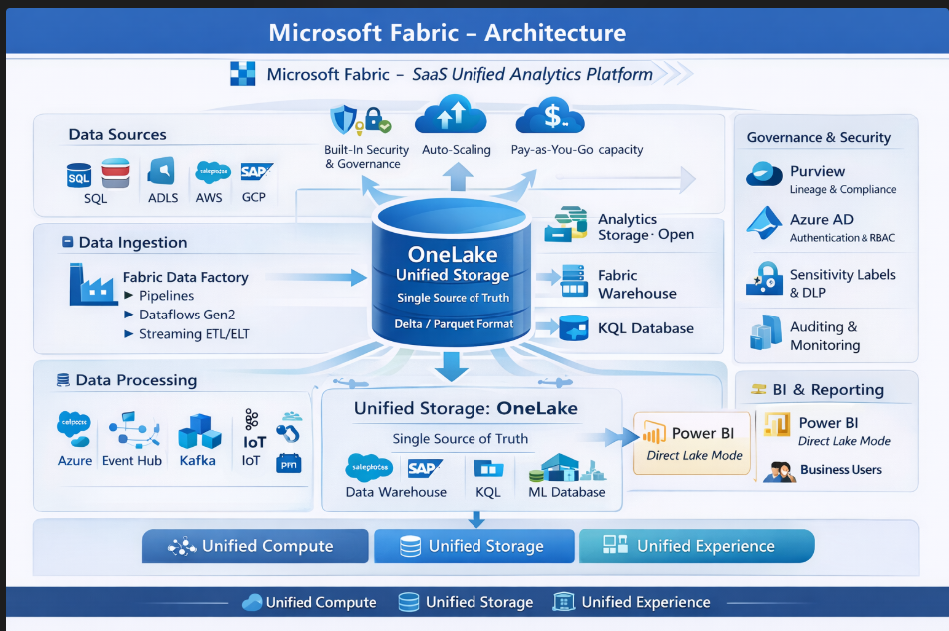

Slide 6
1. Data Sources Layer
Fabric connects to multiple enterprise and cloud sources:
Databases (SQL Server, Oracle, MySQL, PostgreSQL)
Cloud data (Azure SQL, ADLS, AWS S3, GCP)
SaaS apps (Salesforce, SAP, Dynamics)
Streaming sources (Event Hub, IoT, Kafka)
Files (CSV, JSON, Parquet)

Slide 7
2. Data Ingestion Layer – Fabric Data Factory
Fabric Data Factory (SaaS version of ADF)
Pipelines (ETL / ELT)
Copy activities
Dataflows Gen2 (low-code ingestion)
Streaming ingestion
📌 Data is ingested directly into OneLake
📌 No separate storage per service

Slide 8
3. Unified Storage Layer – OneLake (Heart of Fabric)
OneLake = OneDrive for Data
Single, logical data lake for all workloads
Stores data in open formats:
  Delta Lake
  Parquet
One copy of data – no duplication
Data is organized into:
  Lakehouses
  Warehouses
  KQL Databases
✔ Shared by all Fabric services
✔ Built-in security & governance

Slide 9
4. Data Processing & Analytics Layer
All analytics engines work on the same OneLake data.
a) Data Engineering
Apache Spark (serverless)
Notebooks (PySpark, SQL, Scala)
ELT transformations
b) Data Warehousing
Fabric Warehouse (T-SQL)
Optimized for BI & reporting
No data movement from OneLake
c) Real-Time Analytics
KQL Database
Time-series & streaming analytics
Log & event data
d) Data Science
ML notebooks
Model training & experimentation
Direct access to OneLake data

Slide 10
5. BI & Consumption Layer – Power BI
Power BI is natively embedded
Uses Direct Lake mode
  No import
  No refresh
  Reads Delta tables directly from OneLake
Ultra-fast performance
📊 Dashboards, reports, semantic models

Slide 11
6. Governance & Security Layer
Built-in, not bolt-on:
Microsoft Purview
  Data lineage
  Catalog
  Sensitivity labels
Azure AD authentication
RBAC & workspace security
Auditing & compliance

Slide 12
7. SaaS Platform Layer
Fabric is fully SaaS-managed by Microsoft:
Auto-scaling
Auto-patching
High availability
Capacity-based pricing (F-SKUs)
Single billing model for all workloads

Slide 13
Data Sources
↓
Fabric Data Factory
↓
OneLake (Single Storage – Delta/Parquet)
↓
Spark | Warehouse | KQL | ML
↓
Power BI (Direct Lake)
↓
Business Users

Slide 14
Microsoft Fabric Architecture
(Compute • Storage • Networking)

Slide 15
1️⃣ COMPUTE IN MICROSOFT FABRIC
What is Fabric Compute?
Fabric compute is fully managed, serverless, capacity-based compute provided by Microsoft.
Microsoft Fabric uses serverless, capacity-based compute shared across all analytics workloads.
You do not create VMs, clusters, or nodes
Compute Types in Fabric
All compute runs on Fabric Capacity (F SKUs)
Fabric Workload | Compute Engine
Data Engineering | Apache Spark
Data Warehouse | SQL Analytics Engine
Real-Time Analytics | KQL Engine
Data Science | Spark / Python
Power BI | VertiPaq / Analysis Services

Slide 16
2️⃣ STORAGE IN MICROSOFT FABRIC
🗄️ OneLake (Central Storage)
OneLake is a single, centralized data lake that stores all Fabric data and is shared across workloads.
OneLake is the single, unified storage layer in Fabric.
Built on Azure Data Lake Storage Gen2
Stores data in Delta / Parquet format
One copy of data
Shared across all workloads

Slide 17
3️⃣ NETWORKING IN MICROSOFT FABRIC
🌐 Fabric Networking Model
Fabric is SaaS-based, so networking is abstracted from users.
👉 No VNET, subnet, or NSG configuration needed.
🔹 How Networking Works
Microsoft-managed backbone network
Secure service-to-service communication
Encrypted data in transit (HTTPS/TLS)
Microsoft-controlled endpoints

Slide 18
4️⃣ COMPUTE + STORAGE + NETWORK FLOW
Source Systems
↓ (Secure Network)
Fabric Data Factory
↓
OneLake (Storage)
↓
Fabric Compute Engines
↓
Power BI / Consumers

Slide 19
5️⃣ COMPARISON WITH TRADITIONAL AZURE
Aspect | Traditional Azure | Microsoft Fabric
Compute | VM / Cluster-based | Serverless
Storage | Multiple ADLS | OneLake
Networking | VNETs, NSGs | Fully managed
Scaling | Manual | Automatic
Cost | Per service | Capacity-based

Slide 20
Key Architecture Benefits
✅ No infra management
✅ No data duplication
✅ One security model
✅ Faster analytics
✅ Lower cost
✅ End-to-end lineage

Slide 21
Microsoft Fabric vs Traditional Azure Data Services

Slide 22
Traditional Data Architecture
Sources
↓
Azure Data Factory
↓
ADLS Gen2
↓
Databricks / Spark
↓
Synapse SQL
↓
Power BI
❌ Multiple tools
❌ Data movement between services
❌ Complex security & governance
❌ Higher operational overhead

Slide 23
🚀 Microsoft Fabric Architecture
Sources
↓
Microsoft Fabric
↓
OneLake
↓
All Analytics Engines
↓
Power BI
✅ Single platform
✅ OneLake (single copy of data)
✅ Unified security & governance
✅ SaaS-based (less infra management)

Slide 24
Tool-by-Tool Comparison
Area | Traditional Architecture | Microsoft Fabric
Ingestion | Azure Data Factory | Fabric Data Factory
Storage | ADLS Gen2 | OneLake
Processing | Databricks / Spark | Fabric Data Engineering
SQL Analytics | Synapse SQL | Fabric Warehouse
BI | Power BI (separate) | Built-in Power BI
Security | Per-service RBAC | Unified Entra ID
Governance | Manual / Purview | Built-in + Purview
Billing | Multiple services | Single capacity

Slide 25
3️⃣ Data Movement & Duplication
❌ Traditional
Data copied between services
Multiple storage accounts
High latency
Higher storage cost
✅ Fabric
Single data copy in OneLake
Shared across all workloads
Zero data movement
Fabric = “Analyze where data lives”

Slide 26
4️⃣ Cost & Billing Model
Traditional
Pay per service
Hard to predict cost
Separate billing units
Fabric
Capacity-based pricing
Pay for compute
Predictable cost

Slide 27
5️⃣Performance & Productivity
Traditional
Longer development cycles
Tool switching
More DevOps work
Fabric
Faster development
One UI
Higher productivity

Slide 28
FABRIC WORKSPACES & LICENSING MODEL

Slide 29
🧩 Microsoft Fabric – Workspace Concepts & Hierarchy
A Workspace is a logical container used to:
Organize Fabric items
Control access & security
Manage collaboration
Apply capacity & governance
👉 Think of a workspace as a project / environment folder

Slide 30
Workspace Hierarchy
Microsoft Entra Tenant
└── Fabric Tenant
└── Capacity (F SKU)
└── Workspace
├── Lakehouse
├── Warehouse
├── Pipelines
├── Notebooks
├── Real-Time DB
├── Semantic Models
└── Power BI Reports
👉 Workspace is the core working unit in Fabric

Slide 31
Workspace Roles (Security)
Role | Permissions
Admin | Full control
Member | Create & edit
Contributor | Edit existing
Viewer | Read-only

Slide 32
Workspace Capacity Assignment
Workspaces are assigned to Fabric Capacity (F SKU)
Compute is consumed from the assigned capacity
Multiple workspaces can share one capacity
F64 Capacity
├── Workspace A
├── Workspace B

Slide 33
IN-LINE
Workspace:
A logical container in Microsoft Fabric used to organize analytics items, manage security, and assign compute capacity.
Workspace Hierarchy:
Fabric tenant → Capacity → Workspace → Items → OneLake storage.

Slide 34
Microsoft Fabric – Capacity Units & Billing
1️⃣ What is Fabric Capacity?
Fabric Capacity is the compute resource that powers all Fabric workloads
(Data Engineering, Warehouse, Real-Time Analytics, Power BI, etc.).
👉 You pay for capacity, not individual services
2️⃣ What are Capacity Units (CU)?
A Capacity Unit (CU) represents a unit of compute power in Microsoft Fabric.
Measures CPU + memory + concurrency
Shared across all Fabric workloads
Consumed when queries, pipelines, notebooks run
More CUs = More performance & concurrency

Slide 35
3️⃣ Fabric Capacity SKUs (F SKUs)
SKU | Capacity Units (CU) | Typical Use
F2 | 2 CU | Small POC
F4 | 4 CU | Dev
F8 | 8 CU | Small team
F16 | 16 CU | Medium workloads
F32 | 32 CU | Production
F64 | 64 CU | Enterprise
F128 | 128 CU | Large enterprise

Slide 36
Licensing models
There are two licensing models:
Premium Per User (PPU)
Premium Per Capacity (P-SKU)

Slide 37
Premium Per User (PPU)
🔹 What it is
License assigned to individual users
Each user pays separately
🔹 Key Features
✔️ Advanced Power BI features
✔️ Large datasets
✔️ XMLA read/write
✔️ Paginated reports
✔️ AI visuals
🔹 Limitations
❌ Content shared only with other PPU users
❌ Not suitable for large audiences
🔹 Use Case
Small teams
Individual developers
Proof of Concept (POC)

Slide 38
Premium Per Capacity (P-SKU)
🔹 What it is
Dedicated capacity for organization
Shared compute resources
🔹 Key Features
✔️ Unlimited viewers (Free users can view)
✔️ Dedicated performance
✔️ Enterprise scale
✔️ Better governance
🔹 Limitations
❌ Higher cost
❌ Requires capacity management
🔹 Use Case
Large organizations
Enterprise reporting
Wide distribution

Slide 39
Ppu vs ppc
Feature | Premium Per User (PPU) | Premium Per Capacity
Pricing model | Per user | Per capacity
Viewer license | PPU required | Free allowed
Cost | Lower | Higher
Scale | Limited | Enterprise
Performance | Shared | Dedicated
Best for | Small teams | Large orgs
Fabric workloads | ❌ No | ❌ No

Slide 40
🧩 Workspace Roles & Permissions (Microsoft Fabric)
1️⃣ What are Workspace Roles?
Workspace roles define access levels for users and groups within a workspace.
✔️ Security boundary
✔️ Collaboration control
✔️ Governance enforcement
2️⃣ Workspace Role Types
Microsoft Fabric uses 4 main workspace roles:
1. Admin
2. Member
3. Contributor
4. Viewer

Slide 41
Workspace Roles – Comparison Table
Role | Create | Edit | Delete | Manage Users | View
Admin | ✅ | ✅ | ✅ | ✅ | ✅
Member | ✅ | ✅ | ❌ | ❌ | ✅
Contributor | ❌ | ✅ | ❌ | ❌ | ✅
Viewer | ❌ | ❌ | ❌ | ❌ | ✅

Slide 42
⚙️ Microsoft Fabric – Workspace Settings & Configuration
Workspace settings control how a workspace behaves, who can do what, and how content is managed.

