Slide 1
Azure

Slide 2
Azure Global Infrastructure
1️⃣ Azure Datacenters (Foundation Level)
2️⃣ Azure Regions (Geographical Level)
3️⃣ Availability Zones (High Availability Level)
4️⃣ Region Pairs (Disaster Recovery Level)

Slide 3
1️⃣ Azure Datacenters (Foundation Level)
Datacenters are the physical buildings that contain:
  Servers
  Storage
  Networking hardware
Microsoft owns and operates these datacenters.
Each datacenter has:
  Power, cooling, physical security
  High-speed networking
📌 Key Point:
👉 Datacenters are not directly chosen by customers.

Slide 4
2️⃣ Azure Regions (Geographical Level)
An Azure Region is a geographical area that contains one or more datacenters.
Examples:
  East US
  West Europe
  Central India
  South East Asia
Characteristics of a Region:
Connected with low-latency, high-bandwidth network
Data residency and compliance apply at region level
Most Azure services are deployed per region
📌 Example:
Central India Region = Multiple Microsoft datacenters located in India

Slide 5
3️⃣ Availability Zones (High Availability Level)
Availability Zones (AZs) are physically separate datacenters within the same region.
Each AZ has:
  Independent power
  Independent cooling
  Independent networking
Typical Structure:
A region can have 3 Availability Zones
  Zone 1
  Zone 2
  Zone 3
📌 Purpose:
👉 Protect applications from datacenter-level failures
Example:
East US Region
AZ1 → Datacenter A
AZ2 → Datacenter B
AZ3 → Datacenter C
All are close enough for low latency but isolated for fault tolerance.

Slide 6
4️⃣ Region Pairs (Disaster Recovery Level)
Every Azure region has a paired region in the same geography.
Example:
  Central India ↔ South India
  East US ↔ West US
Benefits:
Platform-managed replication
Disaster recovery support
Planned maintenance happens one region at a time
📌 Used for:
👉 Business Continuity & Disaster Recovery (BCDR)

Slide 7
How All Fit Together
Azure Global Infrastructure
└── Geography (India, US, Europe)
└── Region (Central India)
└── Availability Zone 1 → Datacenter
└── Availability Zone 2 → Datacenter
└── Availability Zone 3 → Datacenter

Slide 8
Core Azure Services Overview

Slide 9
Core Azure Services
1️⃣ Azure Compute Services
2️⃣ Azure Storage Services
3️⃣ Azure Networking Services
4️⃣ Azure Database Services

Slide 10
Azure Compute Services

Slide 11
👉 Used to run applications, code, and workloads
🔹 Azure Virtual Machines (VMs)
Windows / Linux servers
Full OS control
Used for legacy apps, lift-and-shift
Example: Hosting SQL Server, app servers
🔹 Azure App Service
Platform as a Service (PaaS)
No server management
Supports .NET, Java, Python, Node.js
Example: Web apps, APIs
🔹 Azure Functions
Serverless compute
Event-driven execution
Pay per execution
Example: Data processing, triggers, automation
🔹 Azure Kubernetes Service (AKS)
Managed Kubernetes
Container orchestration
Example: Microservices architecture

Slide 12
2️⃣ Azure Storage Services

Slide 13
👉 Used to store structured & unstructured data
🔹 Blob Storage
Object storage
Hot / Cool / Archive tiers
Example: Images, videos, logs, data lake
🔹 Azure Data Lake Storage Gen2
Optimized for analytics
Hadoop compatible
Example: Big data, Snowflake, Synapse
🔹 Azure File Storage
Managed file shares
SMB & NFS
Example: Lift-and-shift file servers

Slide 14
🔹 Azure Disk Storage
Managed disks for VMs
OS disks & data disks
🔹 Azure Queue Storage
Message-based storage
Example: Async processing
🔹 Azure Table Storage
NoSQL key-value storage

Slide 15
3️⃣ Azure Networking Services

Slide 16
👉 Used to connect, secure, and route traffic
🔹 Virtual Network (VNet)
Private Azure network
IP address range, subnets
🔹 Subnets
Logical segmentation inside VNet
🔹 Network Security Group (NSG)
Inbound & outbound rules
Layer 4 security
🔹 Azure Load Balancer
Layer 4 load balancing
Example: VM traffic distribution

Slide 17
🔹 Azure Application Gateway
Layer 7 load balancing
Web Application Firewall (WAF)
🔹 Azure VPN Gateway
Site-to-Site & Point-to-Site VPN
🔹 Azure ExpressRoute
Private dedicated connectivity
On-prem ↔ Azure
🔹 Azure DNS
Domain name resolution

Slide 18
4️⃣ Azure Database Services

Slide 19
👉 Used to store structured & semi-structured data
🔹 Azure SQL Database
Fully managed relational DB
PaaS version of SQL Server
🔹 SQL Managed Instance
Near-100% SQL Server compatibility

Slide 20
🔹 Azure SQL on VM
SQL Server on Azure VM
Full control (IaaS)
🔹 Azure Cosmos DB
Globally distributed NoSQL DB
APIs:
  Core (SQL)
  MongoDB
  Cassandra
  Table
  Gremlin
🔹 Azure Database for:
MySQL
PostgreSQL
MariaDB
(Managed open-source databases)
🔹 Azure Synapse Analytics
Data warehousing + big data analytics

Slide 21
Simple Mapping
Requirement | Azure Service
Run servers | Virtual Machines
Web apps | App Service
Serverless | Azure Functions
Containers | AKS
Object storage | Blob Storage
Big data | ADLS Gen2
Networking | VNet
Security rules | NSG
Load balancing | Load Balancer / App Gateway
Relational DB | Azure SQL
NoSQL | Cosmos DB

Slide 22
🔷 Azure Service Categories: IaaS, PaaS, SaaS

Slide 23
1️⃣ IaaS – Infrastructure as a Service
What Azure Provides:
Virtualized infrastructure
Physical datacenter
Networking hardware
Storage hardware
What YOU Manage:
OS (Windows/Linux)
Patches & updates
Middleware
Runtime
Applications
Data

Slide 24
Azure IaaS Examples:
Azure Virtual Machines (VMs)
Azure Virtual Network (VNet)
Azure Load Balancer
Azure VPN Gateway
Azure Disk Storage
Use Cases:
Lift & shift migrations
Legacy applications
Full control environments
Example:
SQL Server installed on Azure VM

Slide 25
2️⃣ PaaS – Platform as a Service
👉 Azure manages infrastructure + OS
What Azure Provides:
Infrastructure
OS
Runtime
Middleware
Scaling & patching
What YOU Manage:
Application code
Data
Configurations

Slide 26
Azure PaaS Examples:
Azure App Service
Azure Functions
Azure SQL Database
Azure Cosmos DB
Azure Data Factory
Azure Databricks
Azure Synapse Analytics
Use Cases:
Cloud-native apps
Faster development
Reduced ops overhead
Example:
Web app hosted on Azure App Service

Slide 27
3️⃣ SaaS – Software as a Service
👉 Azure manages everything
What Azure Provides:
Infrastructure
OS
Application
Security
Updates
What YOU Manage:
User access
Data usage
Configuration

Slide 28
Azure SaaS Examples:
Microsoft 365 (Office 365)
Outlook
Teams
OneDrive
Dynamics 365
Power BI
Use Cases:
Business applications
Collaboration tools
Analytics & reporting
Example:
Using Microsoft Teams for meetings

Slide 29
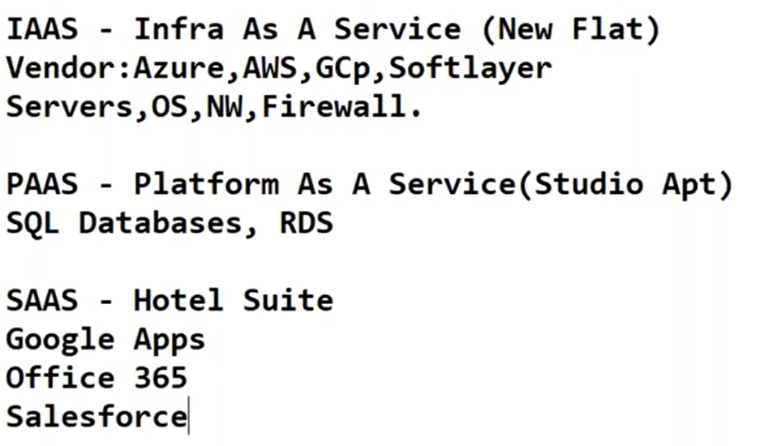

Slide 30
🔁 Shared Responsibility Model (Simple Table)
Layer | IaaS | PaaS | SaaS
Application | You | You | Azure
Data | You | You | Azure
Runtime | You | Azure | Azure
Middleware | You | Azure | Azure
OS | You | Azure | Azure
Infrastructure | Azure | Azure | Azure

Slide 31
🔷 Azure Pricing Models & Cost Management
1. Pay-As-You-Go
2. Reserved Instances (RI)
3. Spot Pricing (Azure Spot VMs)
4. Azure Hybrid Benefit
5. Free Tier & Free Services

Slide 32
1. Pay-As-You-Go
👉 Pay only for what you use.
No upfront cost
Charged per second/minute/hour (service dependent)
Example:
VM running for 10 hours → billed only for 10 hours
📌 Best for:
POCs
Short-term workloads
Startups

Slide 33
2. Reserved Instances (RI)
👉 Commit for 1 year or 3 years to save cost.
Up to 72% cheaper than Pay-As-You-Go
Available for:
  Virtual Machines
  SQL Database
  Cosmos DB
  App Service
Best for:
Long-running production workloads

Slide 34
3. Spot Pricing (Azure Spot VMs)
Use unused Azure capacity at very low cost.
Up to 90% discount
Can be evicted anytime
📌 Best for:
Batch jobs
Dev/Test
Non-critical workloads

Slide 35
4. Azure Hybrid Benefit
👉 Use your existing on-prem licenses.
Windows Server
SQL Server
Benefit:
Reduce VM & SQL costs significantly

Slide 36
5. Free Tier & Free Services
Azure Free Account:
₹200 credit (limited time)
Always-free services:
Azure Functions (limited)
Blob Storage (limited)
Azure App Service (basic)

Slide 37
Azure Tour

Slide 38
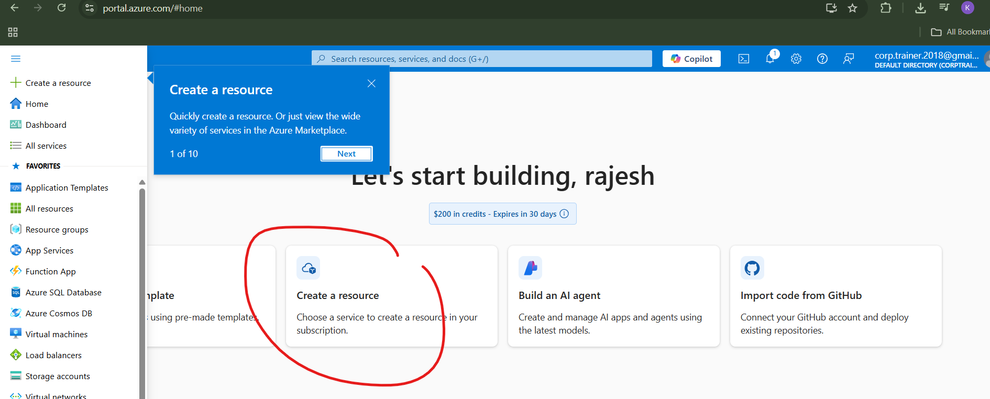
Create a resource

Slide 39
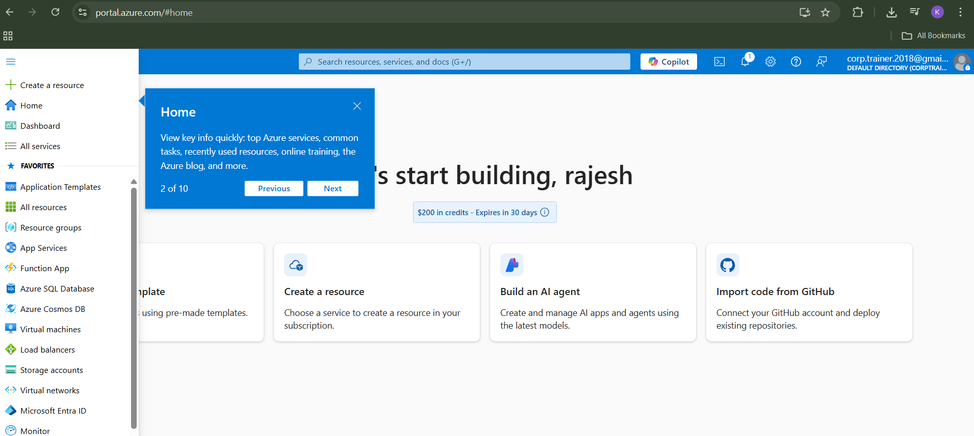
Home

Slide 40
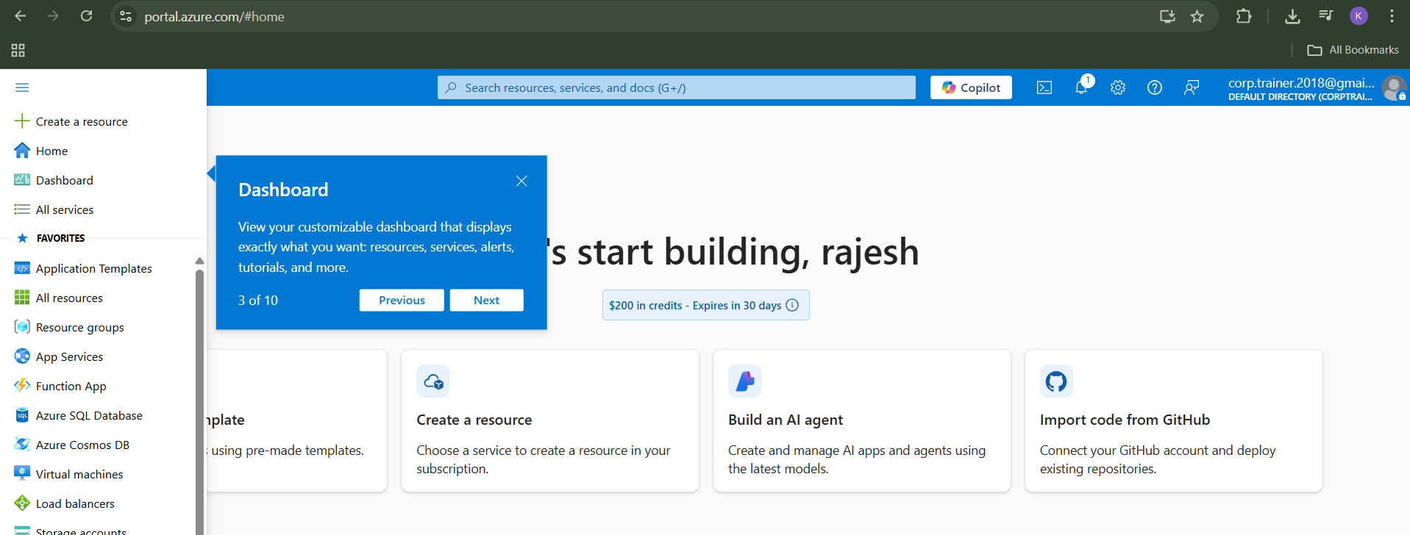
Dashboard

Slide 41
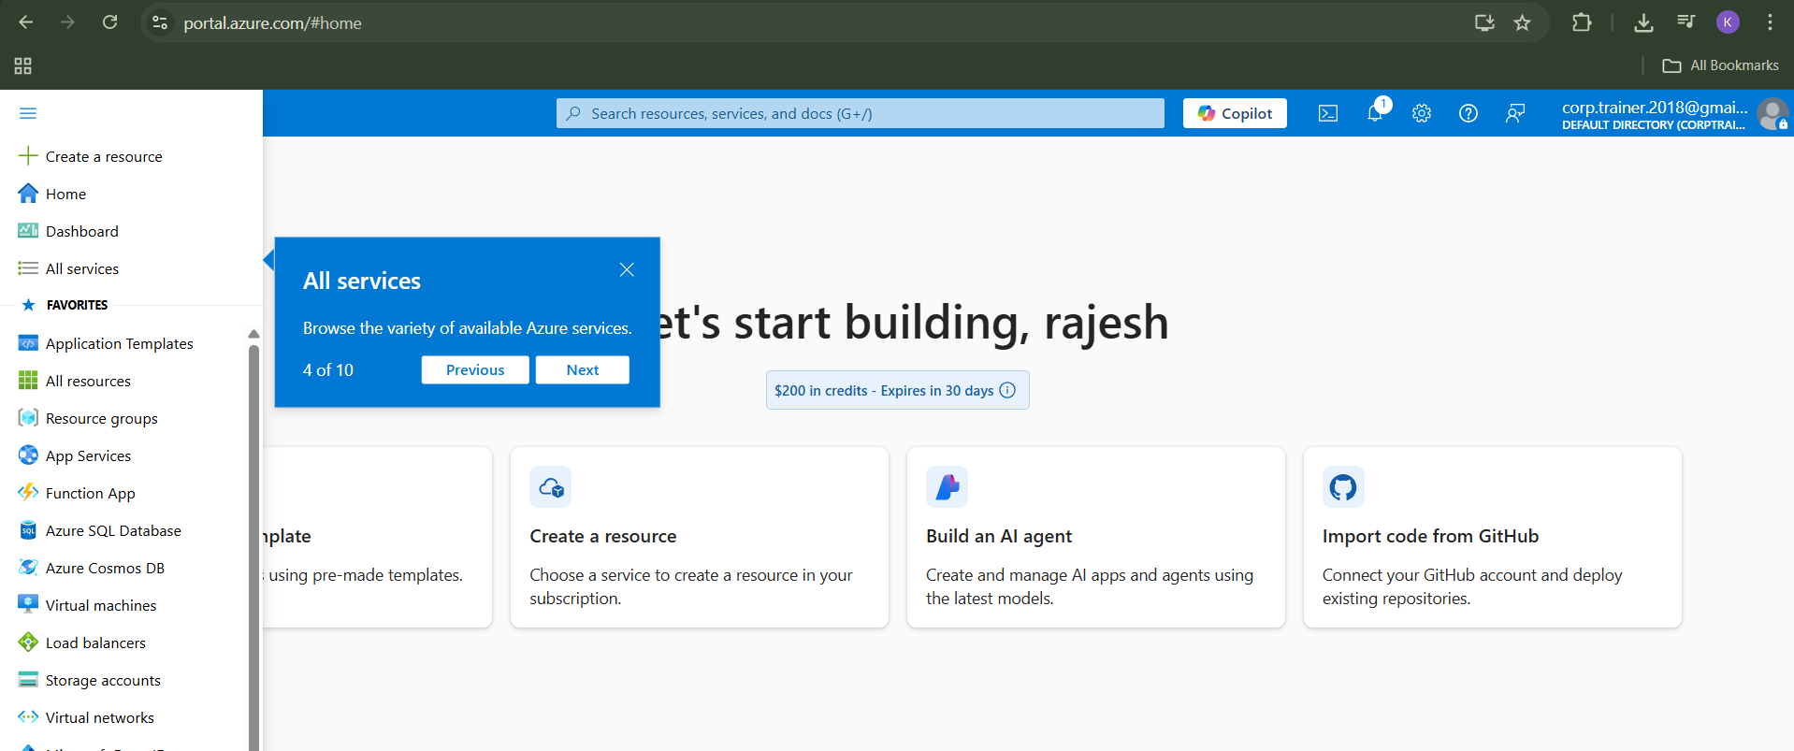
All Services

Slide 42
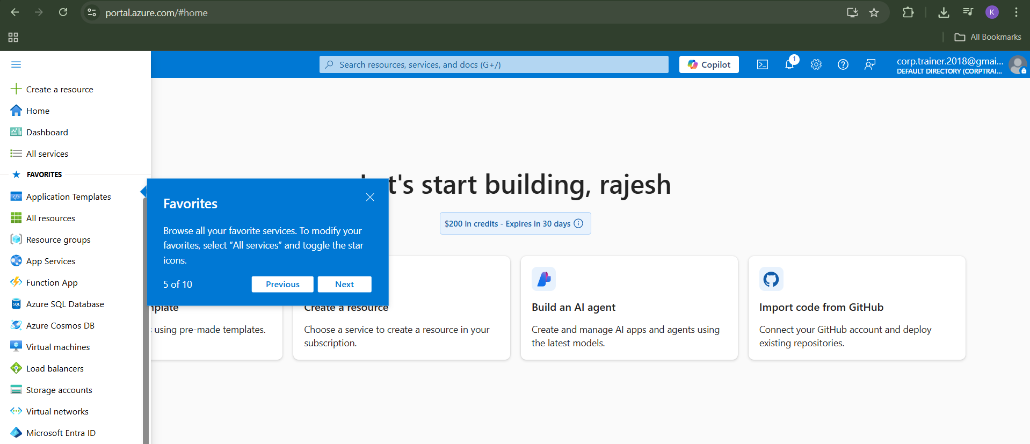
Fav

Slide 43
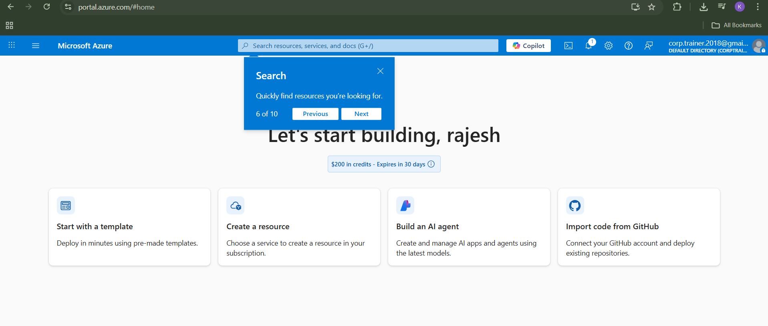
search

Slide 44
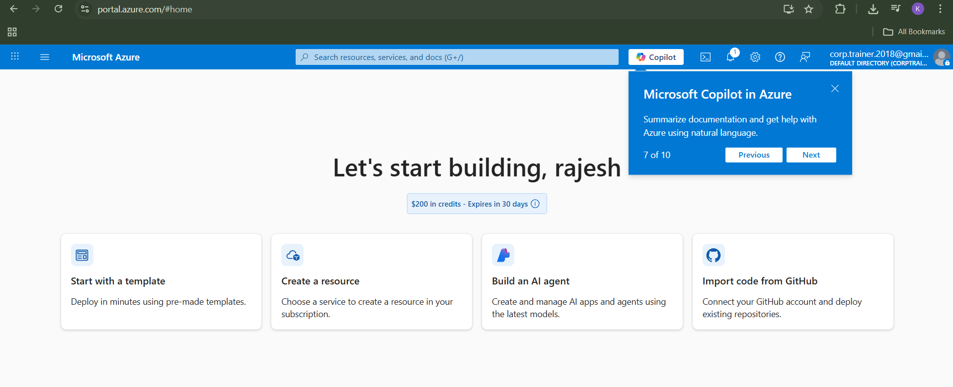
copilot

Slide 45
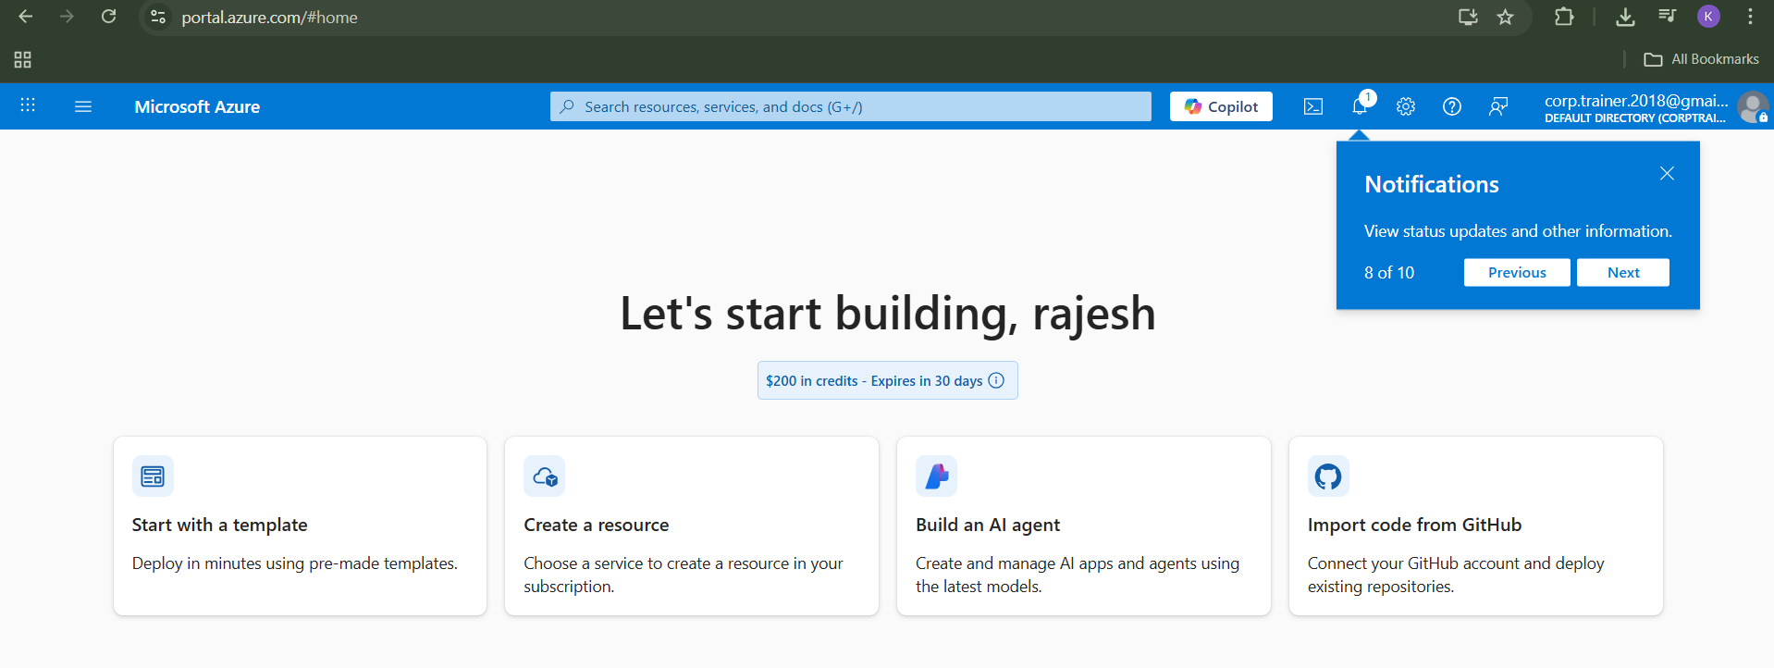
notifications

Slide 46
🔷 Azure Resource Manager (ARM)

Slide 47
1️⃣ What is Azure Resource Manager?
Azure Resource Manager (ARM) is the management layer of Azure that enables you to create, update, manage, and delete Azure resources in a consistent, secure, and repeatable way.
In simple words:
👉 ARM is the control plane of Azure

Slide 48
2️⃣ Why ARM is Needed?
Before ARM:
Resources were managed individually
No consistency
No grouping
No lifecycle management
With ARM:
Unified management
Infrastructure as Code (IaC)
Role-based access
Cost and governance control

Slide 49
ARM & SUBSCRIPTIONS

Slide 50
3️⃣ Core Concepts of ARM
🔹 1. Resource
Any Azure service instance
Example: VM, Storage Account, VNet
🔹 2. Resource Group
Logical container for resources
Resources share:
  Same lifecycle
  Same permissions
Can contain resources from different regions
📌 Best Practice:
Delete Resource Group → All resources deleted
🔹 3. Subscription
Billing boundary
Access control boundary
Contains multiple resource groups
🔹 4. Management Group
Top-level container
Used to manage multiple subscriptions
📌 Used in enterprises

Slide 51
4️⃣ ARM Architecture (Hierarchy)
Management Group
└── Subscription
└── Resource Group
└── Resources

Slide 52
1️⃣ Management Group (Top Level)
👉 Used to manage multiple subscriptions together
Key Points:
Highest scope in Azure
Used mainly in large enterprises
Apply policies & RBAC across subscriptions
Example:
Management Group: Corp-IT
  Applies security policies to all subscriptions
📌 Use case:
Enforce company-wide rules (allowed regions, security baseline)

Slide 53
2️⃣ Subscription (Billing & Access Boundary)
👉 Logical container for billing and access control
Key Points:
Billing unit in Azure
Contains multiple resource groups
Access controlled via RBAC
Example:
Subscription: Prod-Subscription
Subscription: Dev-Subscription
📌 Use case:
Separate Dev / Test / Prod environments

Slide 54
Subscrption types
Free Subscription (Azure Free Account)
Pay-As-You-Go Subscription
Enterprise Agreement (EA)
Student Subscription (Azure for Students)

Slide 55
3️⃣ Resource Group (Logical Grouping)
👉 Logical container for related resources
Key Points:
Resources share:
  Lifecycle
  Permissions
Can contain resources from different regions
Delete RG → All resources deleted
Example:
Resource Group: rg-snowflake-prod
  ADLS
  Azure VM
  Key Vault
📌 Use case:
Application-level management

Slide 56
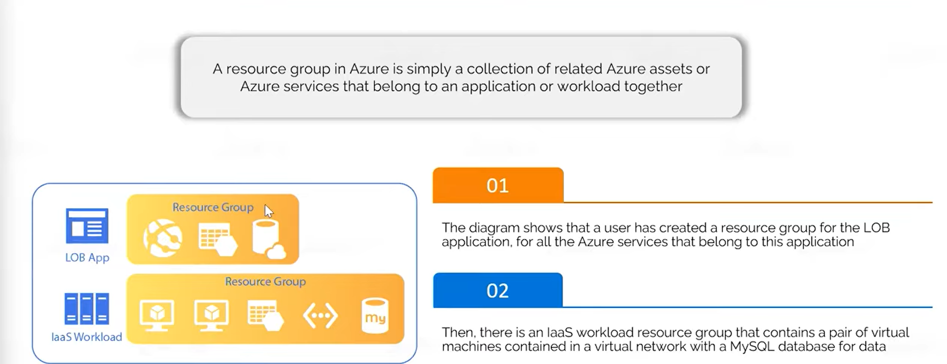

Slide 57
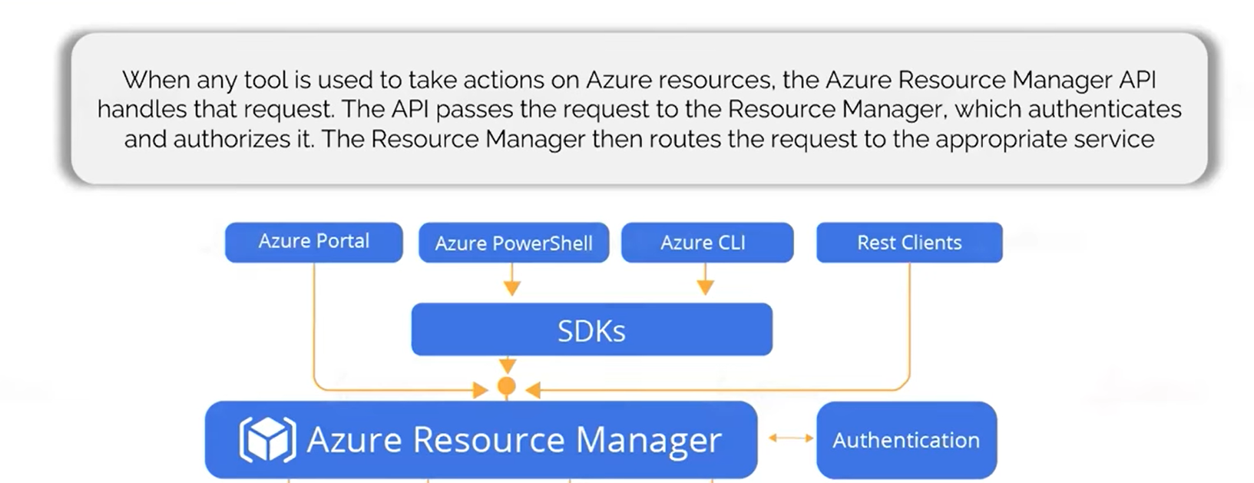

Slide 58
4️⃣ Resources (Actual Azure Services)
👉 Individual Azure services you create
Examples:
Virtual Machine
Storage Account
VNet
Azure SQL Database
Key Vault
📌 Use case:
Actual workload execution

Slide 59
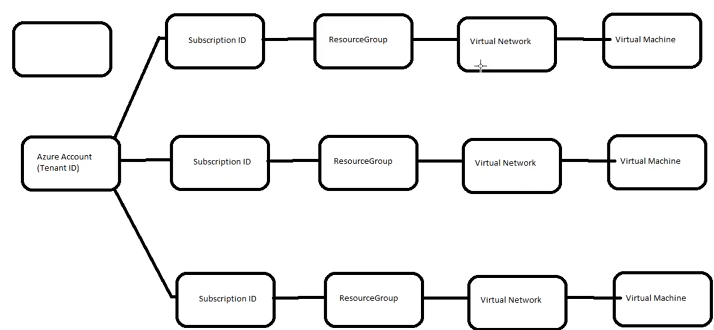

Slide 60
ARM
Azure resource management is about how you structure, control, secure, and manage Azure resources at scale using ARM.
1️⃣ Azure Resource Organization Hierarchy
Management Group
└── Subscription
└── Resource Group
└── Resources

Slide 61
ARM and organization
Management Groups (Enterprise Organization)
Subscriptions (Billing & Isolation)
Resource Groups (Lifecycle Management)
Resources (Actual Services)
Access Control (RBAC)
Tagging Strategy (VERY Important)
Azure Policy (Governance)

Slide 62
Tagging Strategy
A tagging strategy is a standardized approach to applying key–value metadata (tags) to Azure resources, resource groups, or subscriptions so that they can be organized, tracked, governed, and billed properly.
In simple terms:
👉 Tags help you identify who owns a resource, why it exists, and how much it costs.
What Are Azure Tags?
Key–Value pairs
Applied at:
Management Group
Subscription
Resource Group
Resource level
Inherited from higher levels (mostly from RG)

Slide 63
Common Tags:
Environment = Prod
Project = DataPlatform
Owner = AnalyticsTeam
CostCenter = FIN001
Used for:
Cost allocation
Reporting
Automation

Slide 64
Azure Policy (Governance)
👉 Enforce rules & standards
Examples:
Allow only approved regions
Restrict VM sizes
Enforce tagging
Applied at:
Management Group
Subscription
Resource Group

Slide 65
Azure Active Directory (Entra ID) Integration

Slide 66
1️⃣ What is Azure AD Integration?
Azure AD integration means connecting applications, users, devices, and services with Microsoft Entra ID for:
Authentication (who you are)
Authorization (what you can access)
Identity management
Single Sign-On (SSO)
👉 Azure AD = Identity & Access Management (IAM) service

Slide 67
2️⃣ Why Azure AD Integration is Needed
Centralized user management
Single Sign-On (SSO)
Secure access to Azure & SaaS apps
Role-based access control (RBAC)
Compliance & security

Slide 68
3️⃣ Core Components of Azure AD
🔹 Users
Cloud-only users
Synced users (from on-prem AD)
🔹 Groups
Security groups
Microsoft 365 groups
Used for:
  RBAC
  App access
  License assignment

Slide 69
🔹 Roles
Built-in roles (Global Admin, Reader, Contributor)
Custom roles
🔹 Applications
Enterprise applications (SaaS apps)
App registrations (custom apps)
🔹 Devices
Azure AD Joined
Hybrid Azure AD Joined

