Slide 1
MySQL

Slide 2
🧩 What is RDBMS?
RDBMS (Relational Database Management System) is a type of database management system that stores data in tables (relations) made up of rows and columns. It uses SQL (Structured Query Language) to manage and manipulate the data.
⚙️ Key Features of RDBMS
Data stored in tables – structured in rows and columns
Relationships – links between tables using keys (Primary and Foreign keys)
SQL support – data managed through queries
Data integrity – ensures accuracy and consistency
ACID properties – ensures reliable transactions
Atomicity → all or nothing
Consistency → keeps data valid
Isolation → transactions don’t affect each other
Durability → data remains after system crash

Slide 3
🧠 Advantages of RDBMS
✅ Easy to use and manage ✅ Avoids data redundancy (no duplicate data) ✅ Enforces relationships between tables ✅ Ensures data security and integrity ✅ Supports multi-user access
🏢 Popular RDBMS Software
MySQL
PostgreSQL
Oracle Database
Microsoft SQL Server
SQLite
IBM Db2

Slide 4
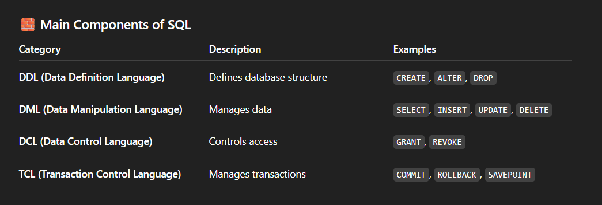
What is SQL
SQL (Structured Query Language) is a standard programming language used to manage and interact with relational databases.
It allows you to store, retrieve, update, and delete data in a structured way using simple English-like commands.

Slide 5
What is a Database?
A database is an organized collection of data that can be easily accessed, managed, and updated. It stores information in a structured way so that computers and users can quickly find and use it.
A database is like a digital filing cabinet — it keeps data in an organized form so you can quickly store, search, and retrieve information.
📘 Example:
Imagine a school database that stores information about:
Students (Name, Roll Number, Class)
Teachers (Name, Subject)
Courses (Course Code, Duration)
All this data is stored in tables within a single database.

Slide 6
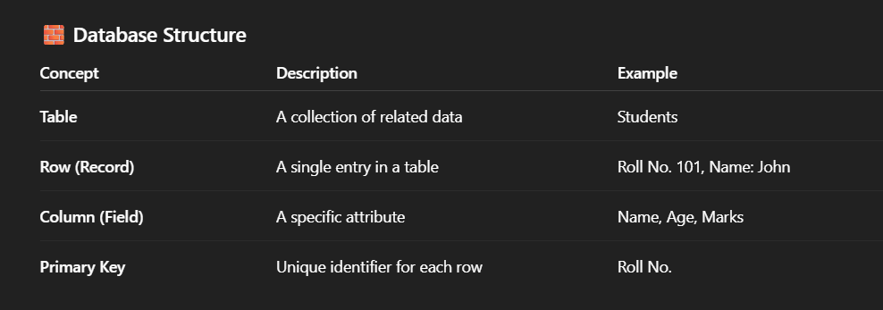
-- Create a new database
CREATE DATABASE school;
-- Use that database
USE school;
-- Create a table inside it
CREATE TABLE students (
roll_no INT PRIMARY KEY,
name VARCHAR(50),
class VARCHAR(10),
marks INT
);

Slide 7
🧩 What is a Schema in a Database?
A Schema is the logical structure of a database — it defines how data is organized, what tables exist, what columns they have, and how those tables are related to each other.
Schema as a blueprint or plan for your database.
Just like a blueprint of a building shows rooms, doors, and connections — a database schema shows tables, columns, and relationships.

Slide 8
🧱 Schema Components
A schema typically includes:
Tables – structures that store data
Columns (Fields) – attributes of each table
Constraints – rules like Primary Key, Foreign Key, Not Null, etc.
Relationships – links between tables (e.g., Employee → Department)
Views, Indexes, Procedures – logical or performance elements

Slide 9
🗃️ Types of Schemas
Type | Description
Physical Schema | How data is stored on disk
Logical Schema | How data is logically organized (tables, columns, relationships)
User Schema | Individual user’s view or subset of the database

Slide 10
MySQL SQL Data Types

Slide 11
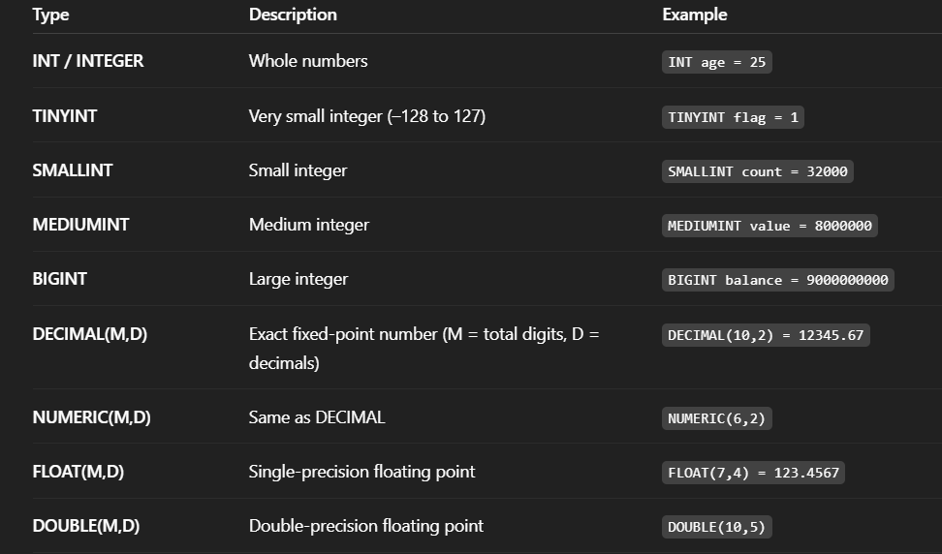
1. Numeric Data Types

Slide 12
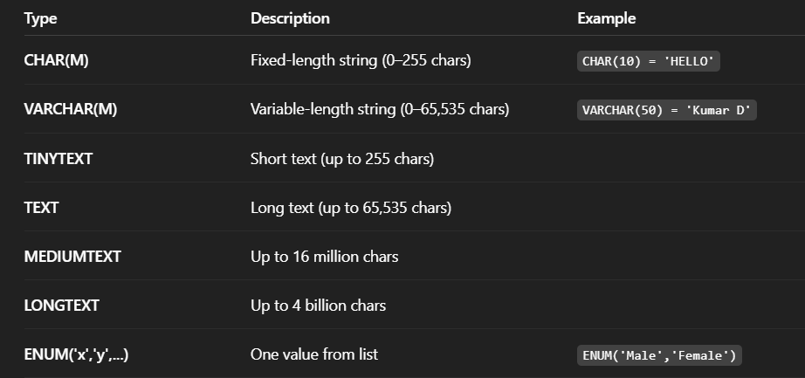
2. String (Character) Data Types

Slide 13
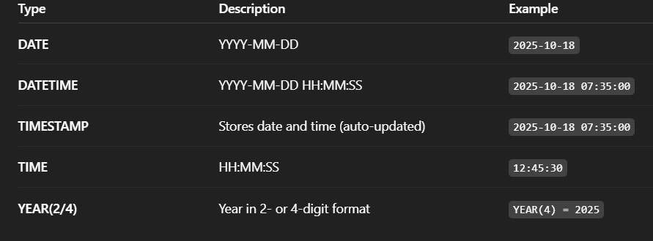
🕒 3. Date and Time Data Types

Slide 14
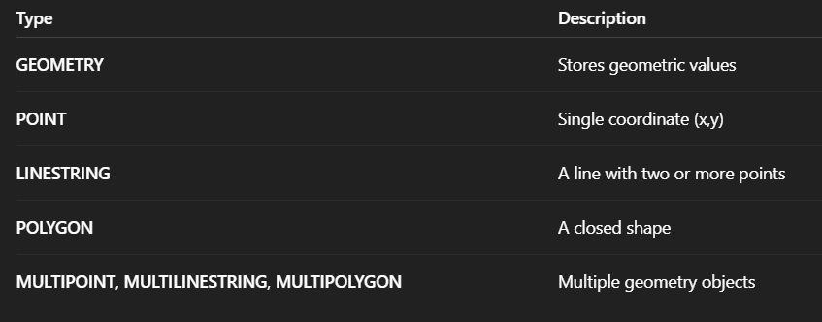
💾 4. Spatial (Geometric) Data Types

Slide 15
Example Table Creation in MySQL
CREATE TABLE employees (
emp_id INT PRIMARY KEY,
name VARCHAR(50),
salary DECIMAL(10,2),
join_date DATE,
active BOOLEAN,
skills SET('Python','SQL','AI')
);

Slide 16
DATA MODELLING AND ERD

Slide 17
🧠 What is Data Modelling?
Data Modelling is the process of designing the structure of a database — how data will be stored, related, and accessed. It’s like planning a blueprint before building the actual database.
Data modelling helps you organize data logically — defining what entities (things) exist, what attributes (details) they have, and how they relate to each other.

Slide 18
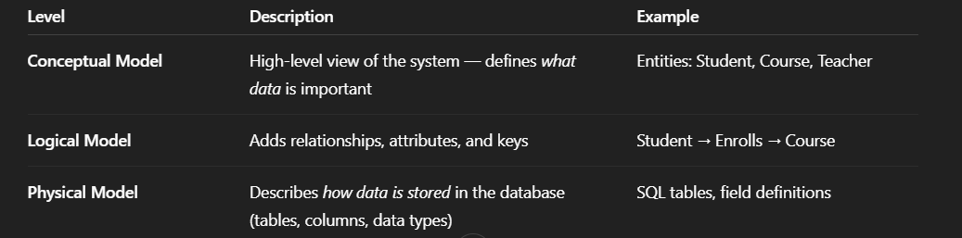
🧩 Levels of Data Models

Slide 19
🏷️ What is an ERD (Entity Relationship Diagram)?
An ERD (Entity Relationship Diagram) is a visual representation of the data model — it shows:
Entities (tables)
Attributes (columns)
Relationships (links between tables)

Slide 20
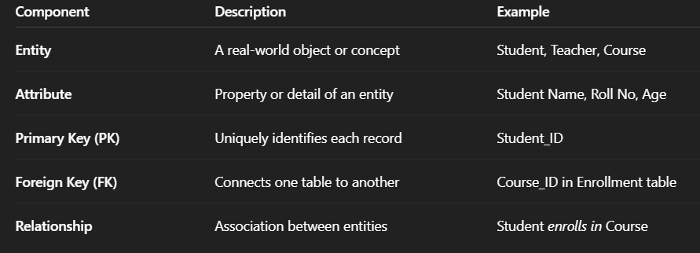
📘 Key Components of ERD

Slide 21
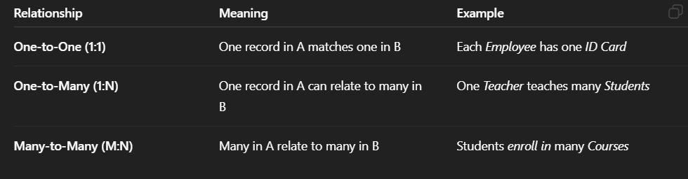
🔗 Types of Relationships

Slide 22
🧭 Example ERD: School Database
Entities:
Student
Student_ID (PK)
Name
Age
Class
Course
Course_ID (PK)
Course_Name
Duration
Enrollment
Enrollment_ID (PK)
Student_ID (FK)
Course_ID (FK)
Enrollment_Date

Slide 23
🧩 Relationships:
A Student can enroll in many Courses
A Course can have many Students → This is a Many-to-Many relationship, implemented using the Enrollment table.

Slide 24
🧩 Sublanguages of SQL
SQL (Structured Query Language) is not a single command language — it’s divided into sub-languages, each designed for a specific purpose in managing data and databases.

Slide 25
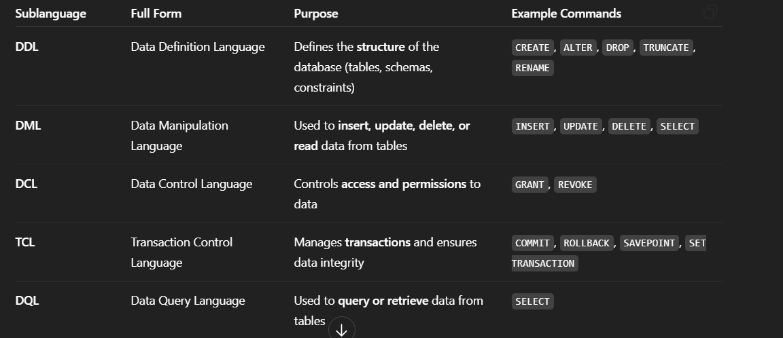
🧠 Main SQL Sublanguages

Slide 26
1️⃣ DDL – Data Definition Language
Defines and manages database objects (tables, schemas, indexes and many more).
CREATE TABLE employees (
emp_id INT PRIMARY KEY,
name VARCHAR(50),
salary DECIMAL(10,2)
);
ALTER TABLE employees ADD COLUMN department VARCHAR(30);
DROP TABLE employees;

Slide 27
2️⃣ DML – Data Manipulation Language
Used for handling data within tables.
INSERT INTO employees VALUES (101, 'John', 50000, 'HR');
UPDATE employees SET salary = 55000 WHERE emp_id = 101;
DELETE FROM employees WHERE emp_id = 101;

Slide 28
3️⃣ DQL – Data Query Language
Used to fetch or retrieve data.
SELECT name, salary FROM employees WHERE department = 'HR';

Slide 29
4️⃣ DCL – Data Control Language
Manages user permissions and access control.
GRANT SELECT, UPDATE ON employees TO user1;
REVOKE UPDATE ON employees FROM user1;

Slide 30
5️⃣ TCL – Transaction Control Language
Ensures that database transactions are consistent and reliable.
START TRANSACTION;
UPDATE employees SET salary = 60000 WHERE emp_id = 102;
COMMIT; -- Saves changes
-- or
ROLLBACK; -- Undoes changes

Slide 31
SQL Queries

Slide 32
💡 What Are SQL Queries?
A query in SQL is a request or command used to interact with the database — to retrieve, insert, update, or delete data.
👉 Simply put:
A query tells the database what you want it to do with the data.

Slide 33
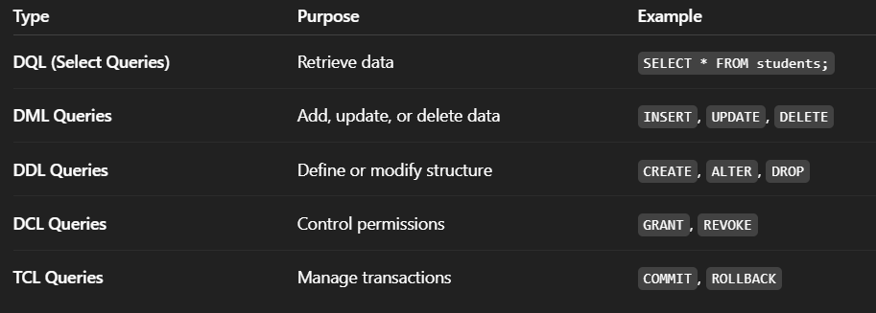
🧩 Types of SQL Queries

Slide 34
Example: Complete Query Flow
CREATE TABLE employees (
id INT PRIMARY KEY,
name VARCHAR(50),
department VARCHAR(30),
salary DECIMAL(10,2)
);
INSERT INTO employees VALUES (1, 'Alice', 'HR', 50000);
INSERT INTO employees VALUES (2, 'Bob', 'IT', 60000);
SELECT name, salary FROM employees WHERE department = 'IT';
UPDATE employees SET salary = 65000 WHERE id = 2;
DELETE FROM employees WHERE id = 1;

Slide 35
✅ f) SELF JOIN
Table joined with itself — useful for hierarchical data.
Example: Find employees who earn more than another employee.
SELECT e1.name AS Employee, e2.name AS Lower_Paid_Employee
FROM employees e1
JOIN employees e2
ON e1.salary > e2.salary;

Slide 36
Join Type | Diagram | Meaning
INNER JOIN | 🎯 (A ∩ B) | Common records
LEFT JOIN | ⬅️ (All A + match B) | Keep all left
RIGHT JOIN | ➡️ (All B + match A) | Keep all right
FULL JOIN | 🔄 (A ∪ B) | All records
CROSS JOIN | ✖️ | All combinations

Slide 37
Joins with WHERE vs ON
-- Using ON (preferred)
SELECT * FROM employees e
LEFT JOIN departments d
ON e.dept_id = d.dept_id AND d.location = 'Delhi';
-- Using WHERE (filters after join)
SELECT * FROM employees e
LEFT JOIN departments d
ON e.dept_id = d.dept_id
WHERE d.location = 'Delhi’;
💡 The first keeps unmatched employees (with NULLs), the second filters them out, acting like an INNER JOIN.

Slide 38
SUMMARY
Join | Returns | Use Case
INNER JOIN | Only matches | Common data
LEFT JOIN | All left + matches | Show all employees
RIGHT JOIN | All right + matches | Show all departments
FULL JOIN | All records | Merge results
CROSS JOIN | All combinations | Matrix or pair analysis
SELF JOIN | Join table to itself | Hierarchies, comparisons

