Slide 1
Micro-Partitions-Snowflake

Slide 2
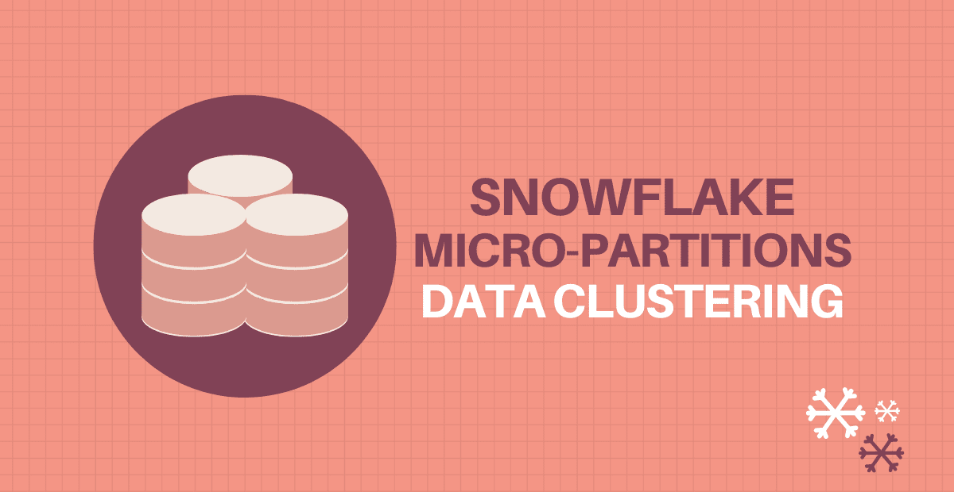

Slide 3
Traditional databases allows partitioning of large tables where the data in table divided into segments, called partitions, that make it easier to manage and query your data.
This is referred to as static partitioning which requires you to include a partitioning clause in the CREATE TABLE statement to create a partitioned table.
The Snowflake Data Platform, as opposed to a traditional data warehouse, uses a unique and distinctive method of partitioning called Micro-partitioning that offers all the benefits of static partitioning without the known drawbacks and offers extra substantial advantages.

Slide 4
Micro-Partitions
Snowflake stores all table data automatically divided into encrypted compressed files which are referred to as Micro-partitions.
Micro-partitions are immutable files i.e. cannot be modified once created and stores data in columnar format.
Every new data arrival creates a new micro-partition. Each micro-partition contains between 50 MB and 500 MB of uncompressed data.
Micro-partitioning is automatically performed on all Snowflake tables. The order in which the data is put or loaded is used to transparently partition the tables.

Slide 5
Snowflake also stores metadata about all rows stored in a micro-partition.
The metadata information includes
The range of values for each of the columns in the micro-partition.
The number of distinct values.
Additional properties used for both optimization and efficient query processing.

Slide 6
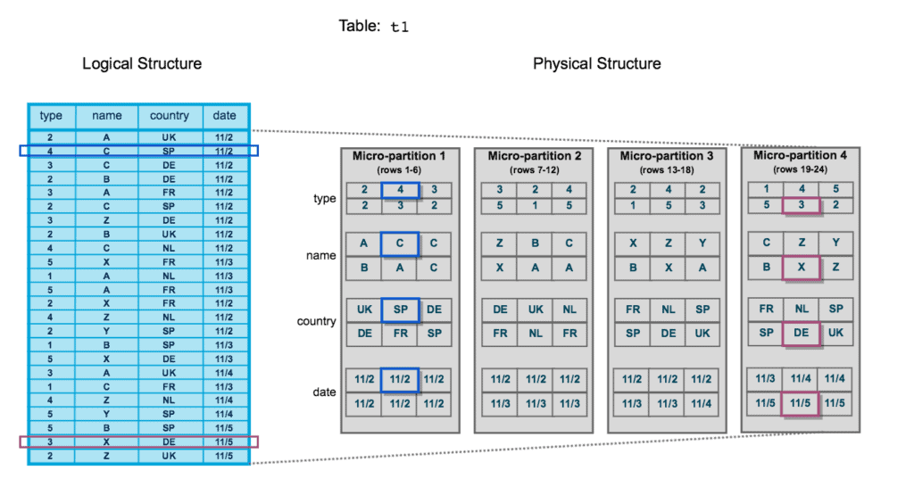
organization of data into micro-partitions

Slide 7
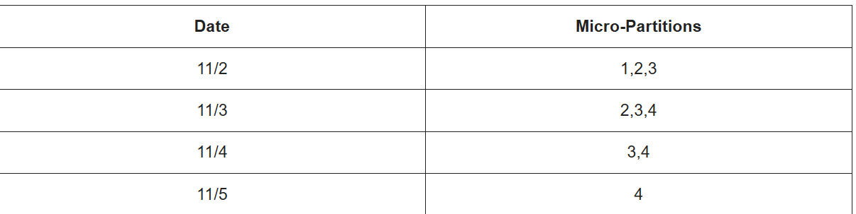
Logical Structure. There are 24 rows of data and 4 columns – type, name, country, and date.
Physical Structure. Here, there are four distinct micro-partitions that each hold six rows of data. Data of rows 1 through 6 are contained in the first micro-partition and so on.
retrieve records that belong to date ‘11/2’
SELECT type, country FROM MY_TABLE WHERE Date = '11/2’ ;
When you execute this query in Snowflake, only those micro-partitions are scanned which satisfies the filter condition. Once the micro-partitions to be scanned are identified, a portion of the micro-partitions is scanned that contain the data for the columns in the select query so that an entire partition is not scanned

Slide 8
What is Data Clustering?
Clustering is a technique used to organize data storage to better accommodate anticipated queries. The key objective is to increase query performance while lowering the amount of system resources needed to run queries.
Snowflake supports explicitly selecting the columns on which a table is clustered, giving you additional control over the clustering process. These columns are known as Clustering keys, and they allow Snowflake to maintain the clustering in accordance with the chosen columns while also allowing you to recluster on demand.

Slide 9
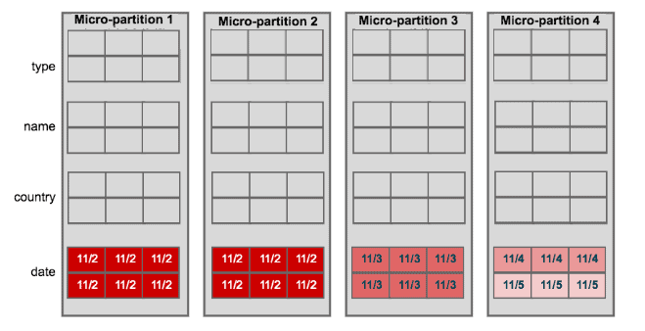
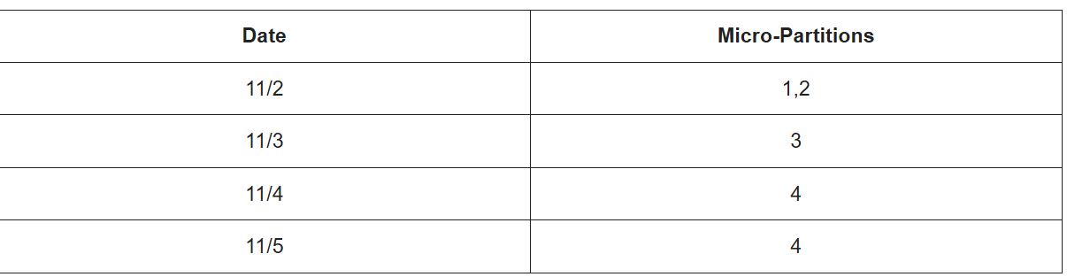
how clustering the table on date column would have distributed data into micro-partitions
Notes:
table on date columns reduced the number of micro-partitions to be scanned

Slide 10
create Clustered Tables in Snowflake
CREATE TABLE MY_TABLE
(type NUMBER ,
name VARCHAR(50) ,
country VARCHAR(50) ,
date DATE ) CLUSTER BY (date) ;
ALTER TABLE MY_TABLE CLUSTER BY (date) ;
ALTER TABLE MY_TABLE CLUSTER BY (date, type) ;
ALTER TABLE MY_TABLE CLUSTER BY (YEAR(date), SUBSTRING(country,1,2)) ;

Slide 11
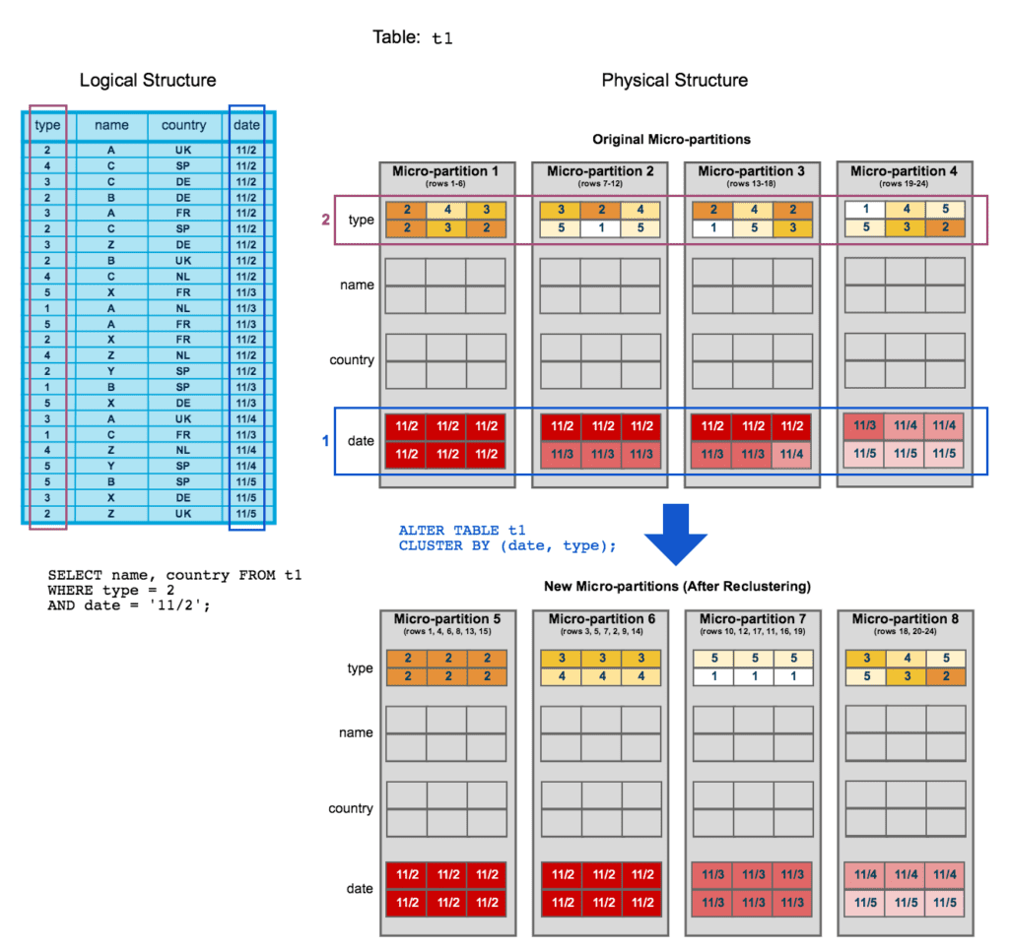

Slide 12
Automatic Clustering
Automatic Clustering is the Snowflake service that seamlessly and continually manages all reclustering, as needed, of clustered tables.
Note that Automatic Clustering consumes Snowflake credits, but does not require you to provide a virtual warehouse.
Instead, Snowflake internally manages and achieves efficient resource utilization for reclustering the tables.
To suspend Automatic Clustering for a table, use the ALTER TABLE command with a SUSPEND RECLUSTER clause.
To suspend Automatic Clustering for a table, use the ALTER TABLE command with a SUSPEND RECLUSTER clause
ALTER TABLE my_table SUSPEND RECLUSTER ;
To resume Automatic Clustering for a clustered table, use the ALTER TABLE command with a RESUME RECLUSTER clause
ALTER TABLE my_table RESUME RECLUSTER ;
Verify if Automatic Clustering is enable for a table using SHOW TABLES command.
SHOW TABLES LIKE 'my_table';

Slide 13
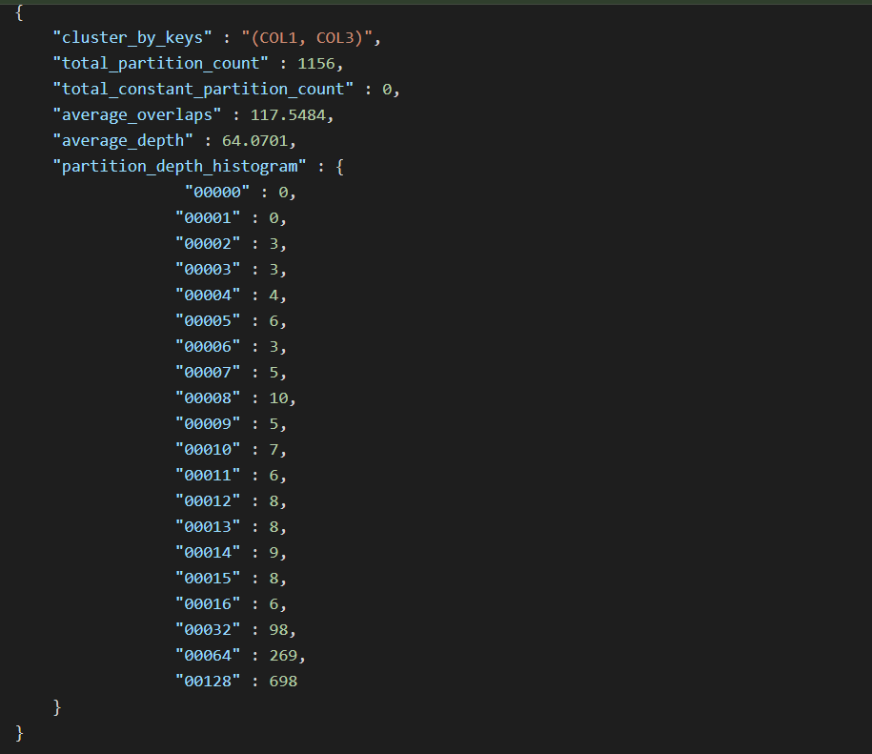
Clustering Information
SELECT SYSTEM$CLUSTERING_INFORMATION('my_table', '(date, type)');

Slide 14
How data physically stored
Data in Snowflake is physically stored in micro-partitions, which are small, compressed, and immutable storage units containing columnar data.
Each micro-partition is automatically created and contains between 50 and 500 MB of uncompressed data, with Snowflake managing the underlying physical storage in cloud object storage like Amazon S3.

Slide 15
Micro-partitions: When you load data, Snowflake automatically divides it into micro-partitions, which are the fundamental units of storage.
Columnar format: Data within each micro-partition is organized in a columnar fashion, meaning each column's data is stored together. This is different from traditional row-based storage and is optimized for analytic queries that often only need to scan specific columns.
Automatic compression and optimization: Snowflake automatically determines the most efficient compression algorithm for the data in each micro-partition. The data is compressed, making the actual physical size of a micro-partition smaller than its uncompressed size.
Cloud object storage: The physical storage for these micro-partitions resides in cloud object storage (like Amazon S3, Azure Blob Storage, or Google Cloud Storage) and is managed entirely by Snowflake.
Metadata: Snowflake maintains a system catalog that stores metadata for each micro-partition. This includes the min/max values for each column, the number of distinct values, and other properties, which enables efficient query processing.

Slide 16
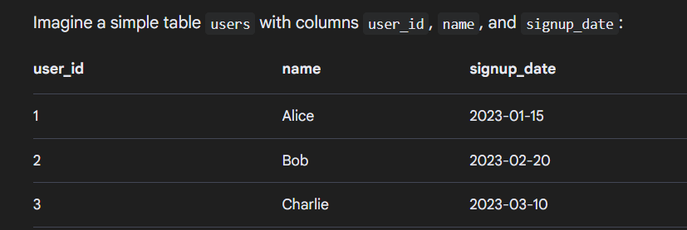
Example

Slide 17
Data Loading: When this data is loaded into a Snowflake table, it is automatically partitioned. Let’s say the first three rows are grouped into one micro-partition.
Columnar Storage: The data isn't stored as a full row "1, Alice, 2023-01-15" in one location. Instead, the user_id values are stored together, the name values are stored together, and the signup_date values are stored together within that micro-partition.
Metadata: Snowflake would record metadata for this micro-partition, such as:
  user_id: Min value = 1, Max value = 3
  name: Min value = "Alice", Max value = "Charlie"
  signup_date: Min value = 2023-01-15, Max value = 2023-03-10
Query Example: If you run a query like SELECT name FROM users WHERE user_id = 2;, Snowflake uses the metadata to find the specific micro-partitions that contain user_id values between 1 and 3. It then only needs to read the name column from those partitions, rather than scanning all columns for all rows, which is much more efficient.

Slide 18
Clustering Works at Storage Level
Layer | Description
Storage Layer | Data is stored in micro-partitions (compressed columnar format). Each partition holds metadata for pruning.
Metadata Layer | Keeps clustering statistics (min/max values per partition).
Query Engine (Optimizer) | Uses metadata to skip partitions during query execution — this is called partition pruning.

Slide 19
Clustering at the Storage Level in Snowflake
1. Storage in Snowflake → Micro-Partitions
At the lowest level, Snowflake stores table data in small, immutable units called micro-partitions.
Each micro-partition:
Is about 16 MB compressed (50–500 MB uncompressed).
Stores data for multiple columns (columnar storage).
Contains metadata describing each column’s value range and statistics.
Example metadata stored per micro-partition:
Metadata Type | Example
Min & Max value per column | region: min='APAC', max='EMEA'
Count of NULLs | order_date: 0 nulls
Number of rows | 10,000
File location & partition ID | Unique internal references

Slide 20
2. Physical Clustering — How Data is Organized
When Snowflake loads data into a table:
It divides the data into micro-partitions automatically.
Each micro-partition stores contiguous ranges of column values, based on the load order or clustering key (if defined).
📘 In essence:
Clustering is the physical ordering of how values of certain columns are distributed across micro-partitions.

Slide 21
Internals of Storage-Level Clustering
Stage | Description
Data Ingestion | Data is written into new micro-partitions, either ordered by load or by clustering key.
Storage Metadata | Min/max values per column are recorded and stored in Snowflake’s metadata service.
Optimizer | During queries, Snowflake checks the metadata to determine which partitions to read.
Reclustering | When necessary, Snowflake automatically reorders data in the background to maintain clustering.

