Slide 1
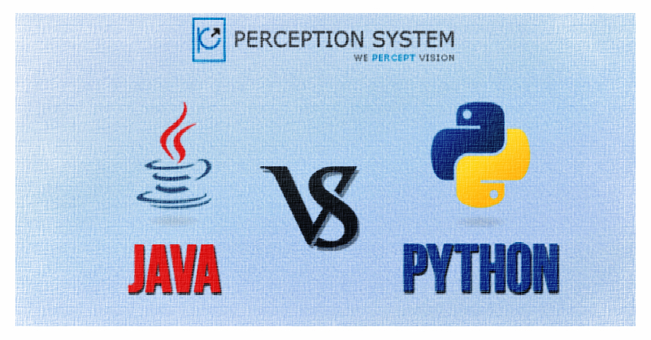

Slide 2



“Python is more creative than Java, isn’t it? It would be dangerous to claim that Java is not as productive as Python due to many factors. Java is statically typed while Python is dynamically. We have seen huge debate between dynamic typing and static typing among many programming languages.”

Slide 3
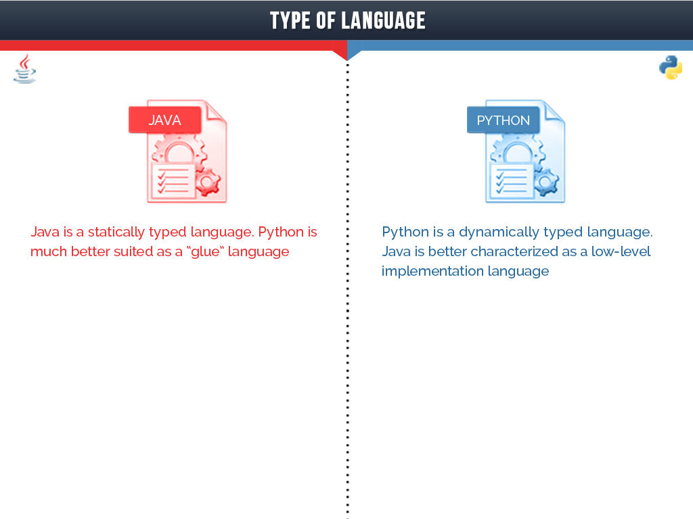

Slide 4
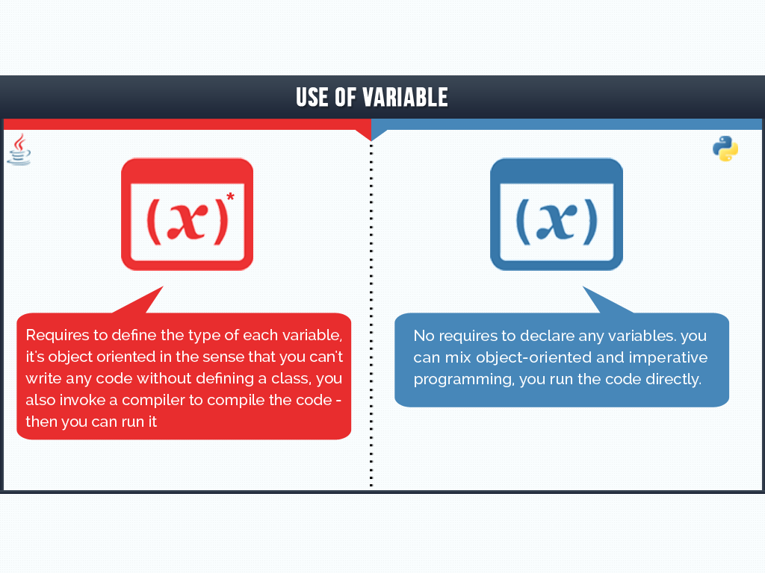

Slide 5
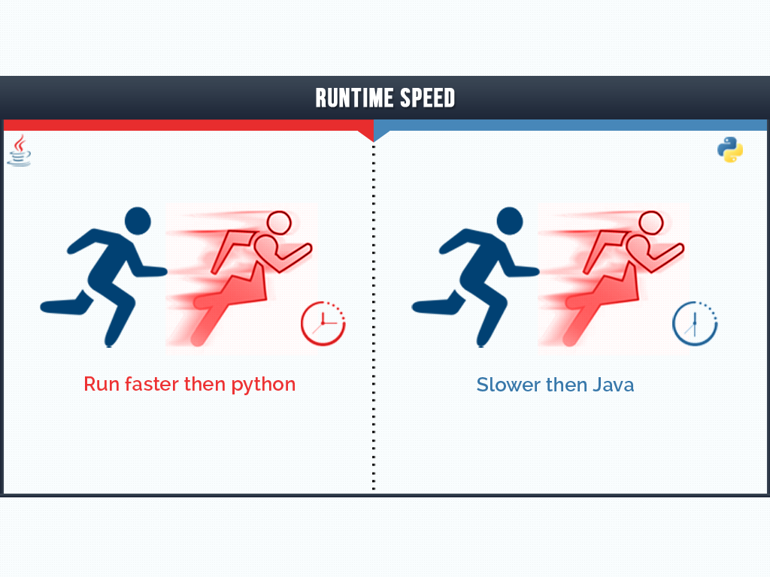

Slide 6
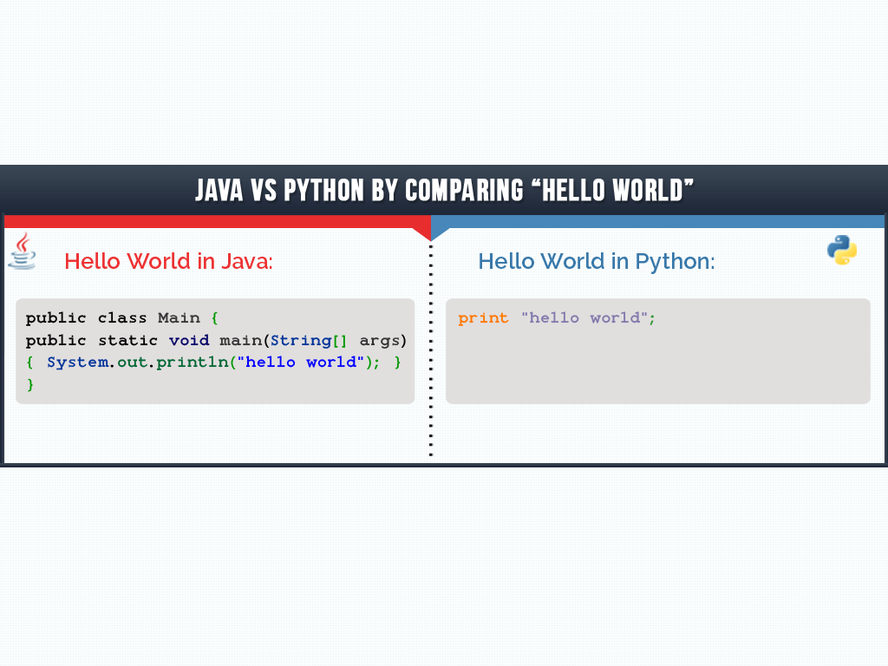

Slide 7
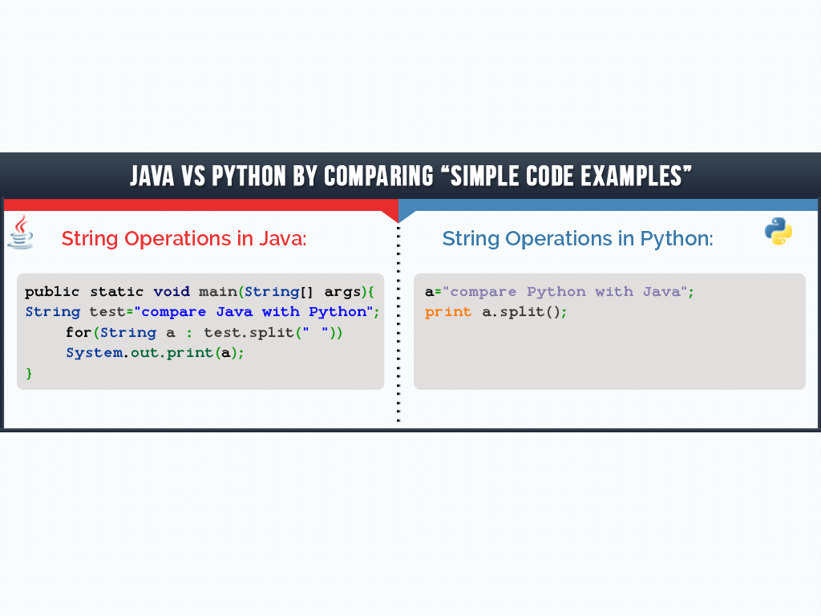

Slide 8
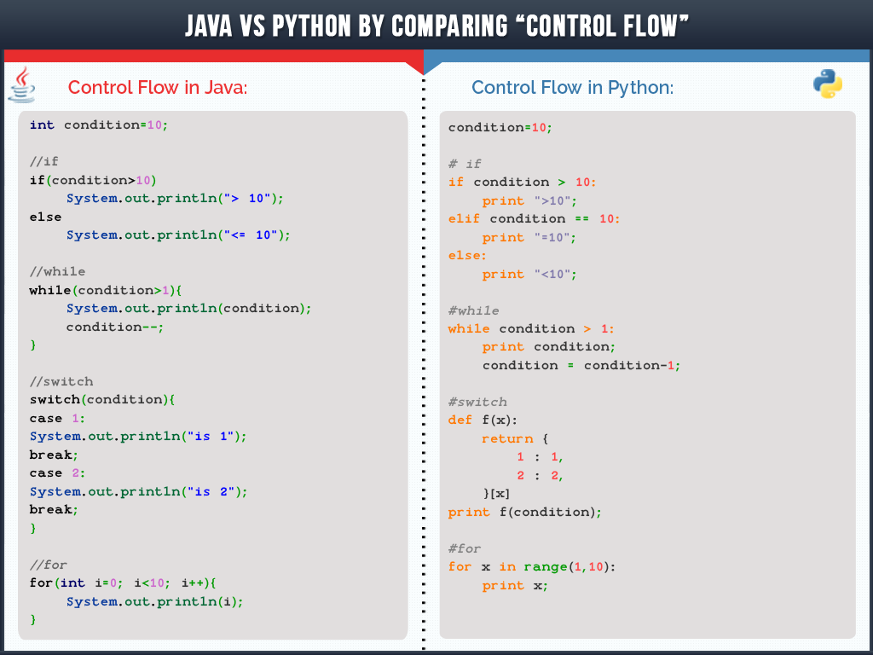

Slide 9
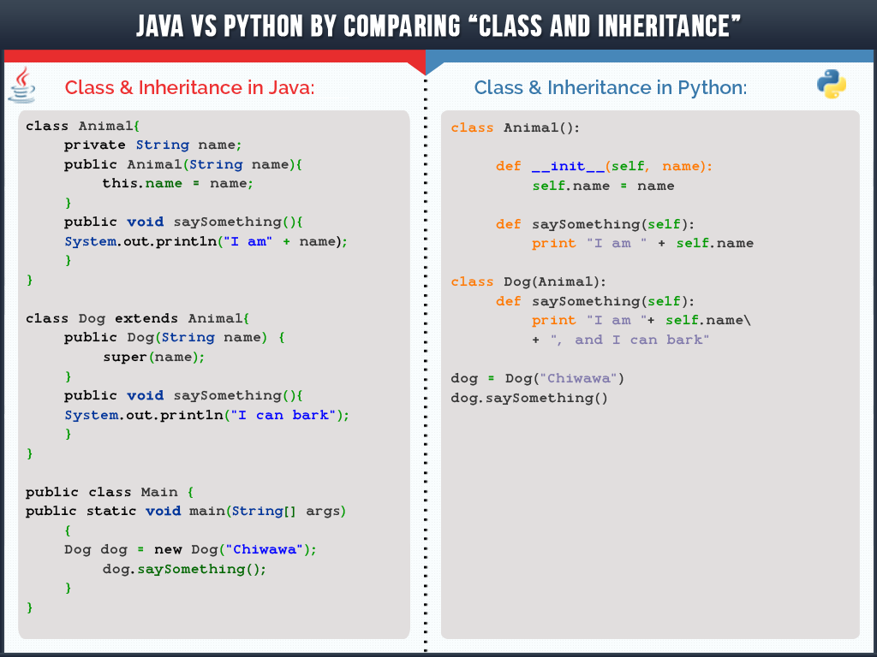

Slide 10
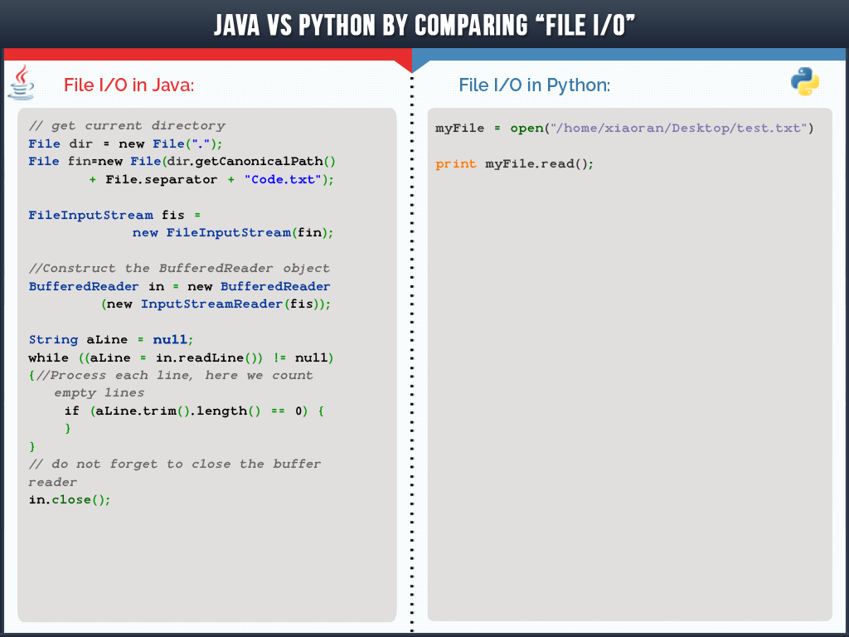

Slide 11
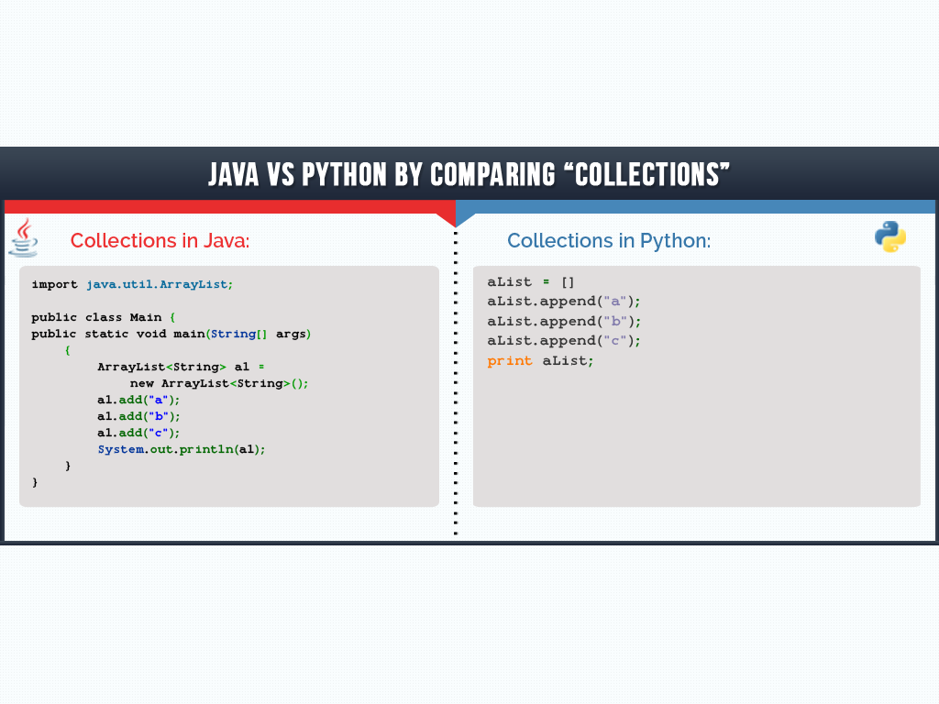

Slide 12
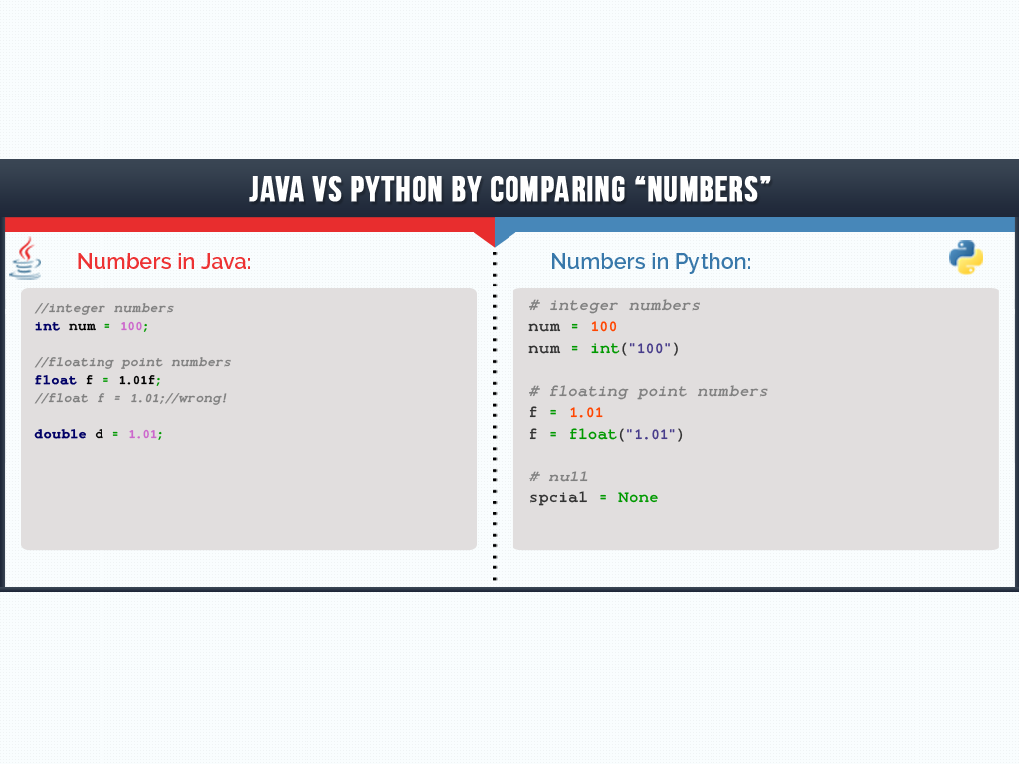

Slide 13
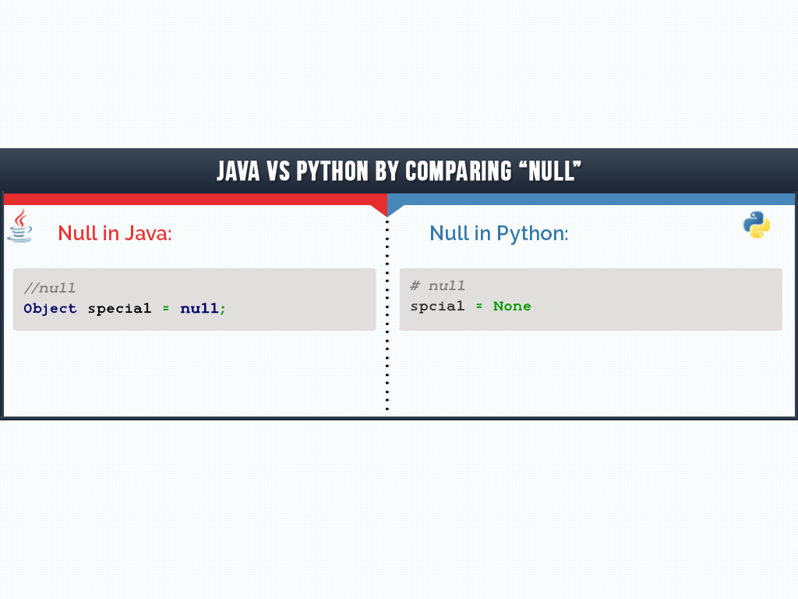

Slide 14
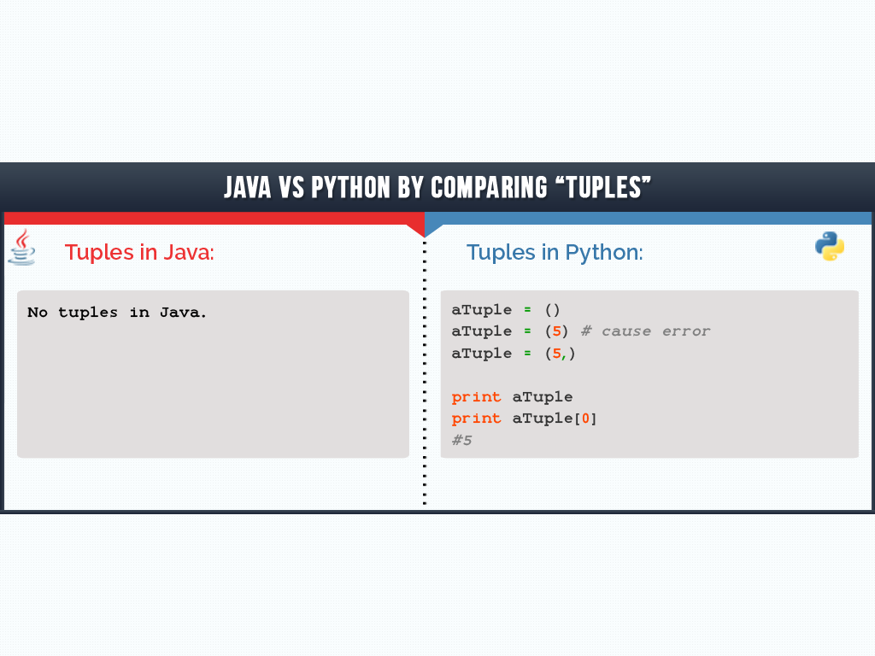

Slide 15
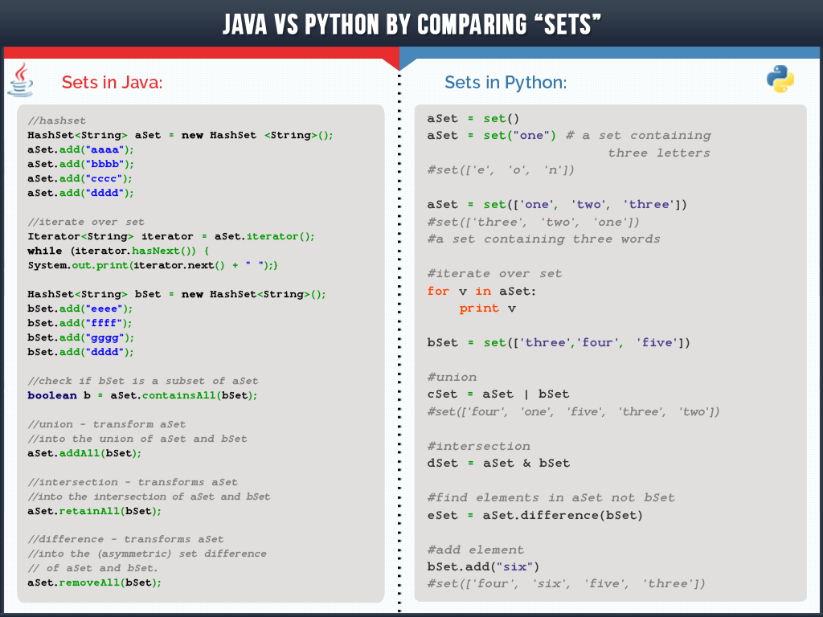

Slide 16
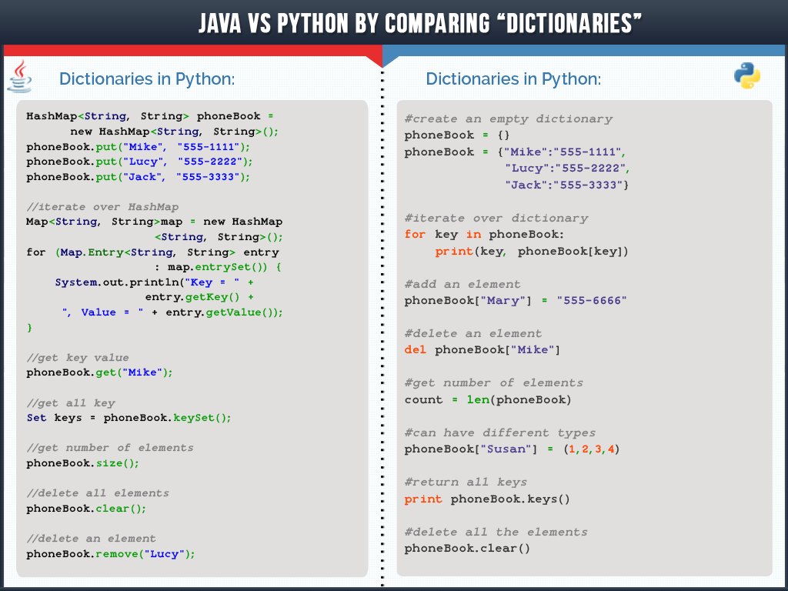

Slide 17

PERCEPTION SYSTEM PVT LTD
2nd Floor, Samudra Annexe,
Off C.G.Road, Navrangpura,
Ahmedabad-380009
Gujarat, INDIA
Telephone : +91-79-26561837 | +91-79-40074331
Mail : info@perceptionsystem.com
Website : www.perceptionsystem.com
Are looking for expert Java developer ?
Send your

