Slide 1
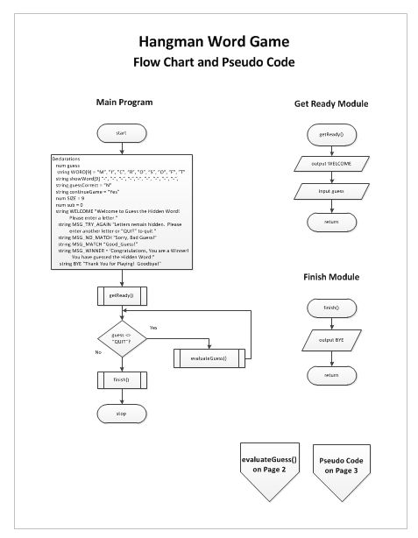

Slide 2
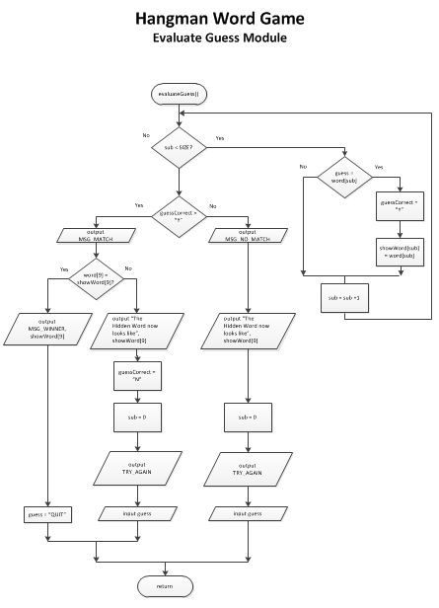

Slide 3
Hangman Program Pseudo Code
START
Declarations
num guess
string WORD[9] = “M”, ”I”, ”C”, “R”, ”O”, ”S”, ”O”, ”F”, ”T”
string showWord[9] “-“, “-“, “-“, “-“,“-“, “-“, “-“, “-“, “-“,
string guessCorrect = “N”
string continueGame = “Yes”
num SIZE = 9
num sub = 0
string WELCOME “Welcome to Guess the Hidden Word!
Please enter a letter.”
string MSG_TRY_AGAIN “Letters remain hidden. Please
enter another letter or “QUIT” to quit."
string MSG_NO_MATCH “Sorry, Bad Guess!”
string MSG_MATCH “Good_Guess!”
string MSG_WINNER = ‘Congratulations, You are a Winner!
You have guessed the Hidden Word:”
string BYE “Thank You for Playing! Goodbye!"
getReady()
while guess <> "QUIT"
evaluateGuess()
endwhile
finish()
STOP
getReady()
output WELCOME
input guess
return
evaluateGuess()
while sub < SIZE
if guess = word[sub] then
guessCorrect = "Y"
showWord[sub] = word[sub]
endif
sub = sub + 1
endwhile
if guessCorrect = "Y" then
output MSG_Match
if word[9] = showWord[9] then
output MSG_Winner, showWord[9]
guess = "QUIT"
else
output “The Hidden Word now looks like”, showWord[9]
guessCorrect = "N"
sub = 0
output TRY_AGAIN
input guess
endif
else
output MSG_NO_MATCH
output “The Hidden Word now looks like”, showWord[9]
sub = 0
output TRY_AGAIN
input guess
return
finish()
output BYE
return

