Slide 1
Test Stations/Robot
Proposal For Simple Development
Stations/Robot For FRC Training

Slide 2
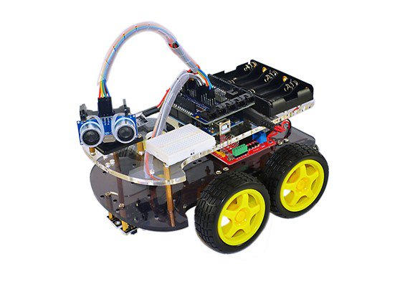
Overview
Targeted Need
Provide a training apparatus for students that will help develop robot building skills.
This platform should be modular and simple to build and support.
Each subsystem should have the same footprint and be stackable to form a simple robot.

Slide 3
CPU/Power Subsystem
Components
RoboRio
Radio
PDP
Voltage Regulator Module
Signal Light
Main Breaker
Battery

Slide 4
Drive Subsystem
Components – designed to be the base of a small robot
Four Talon SRX
Four Small Motors
Four Wheels
Four Encoders
IMU

Slide 5
Vision Subsystem
Components – contain all types for analysis
Raspberry Pi
Axis Ethernet Camera
Microsoft Life Cam
Jetson CPU

Slide 6
Drive Station
Components – Separate from current DS
Two USB Joysticks
USB Hub
Custom Secondary Controller
Game controller
Drive Computer – This should be the students own laptop.

Slide 7
Future Subsystems
Each of the following can be designed to be a stackable module as needed.
Pneumatics Subsystem
PID Subsystem – various PID experiments
Misc Controls Subsystem, servos actuators etc
Shooter Subsystem
Arm Subsystem

Slide 8
Summary
The above describes my ideas for a training and development platform and I welcome any input others may have. I see this as a tool to provide hands on training for the team as well as a method of future design development. The intention is to keep this platform out of the competition critical path and provide a tool to allow students to experiment with the freedom to fail without fear. In addition this robot should be underpowered and light weight. Reduced power makes experimentation with auto modes and PID safe as well as more instructive. Using larger motors creates situations where larger loads and forces are needed to demonstrate effect thus increasing safety hazards.

Slide 9
Schedule
For the near future I see a simple four wheeled robot containing the CPU and drive subsystems only. Initially subsystems can be built from wood or polycarbonate. Later if we wish we can incorporate more complex designs like the WCD. The next step would be to add the vision subsystem. I realize the previous years robots are available but in the near future they should be used for THOR improvements like auto modes. This solution is meant to provide a non-critical path for rookie development.

