Slide 1

Introduction to Apache Hive

Slide 2
Apache Hive is a Data Warehousing tool built on top of Hadoop and is used for data analysis.
Hive is targeted towards users who are comfortable with SQL.
It is similar to SQL and called HiveQL, used for managing and querying structured data.
This language also allows traditional map/reduce programmers to plug in their custom mappers and reducers.
The popular feature of Hive is that there is no need to learn Java.
Hive, an open source date warehousing framework based on Hadoop, was developed by the Data Infrastructure Team at Facebook.

Slide 3
Hive is also one of the technologies that are being used to address the requirements at Facebook.
Hive is very popular with all the users internally at Facebook and is being used to run thousands of jobs on the cluster with hundreds of users, for a wide variety of applications.
Hive-Hadoop cluster at Facebook stores more than 2PB of raw data and regularly loads 15 TB of data on a daily basis.

Slide 4
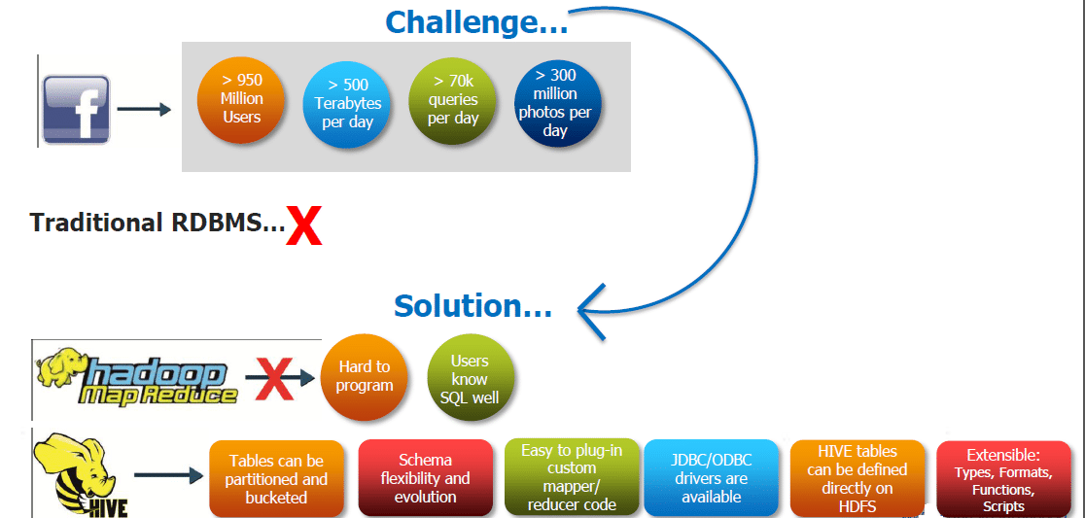

Slide 5
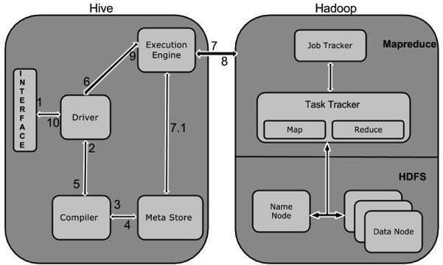
Hive Architecture:

Slide 6
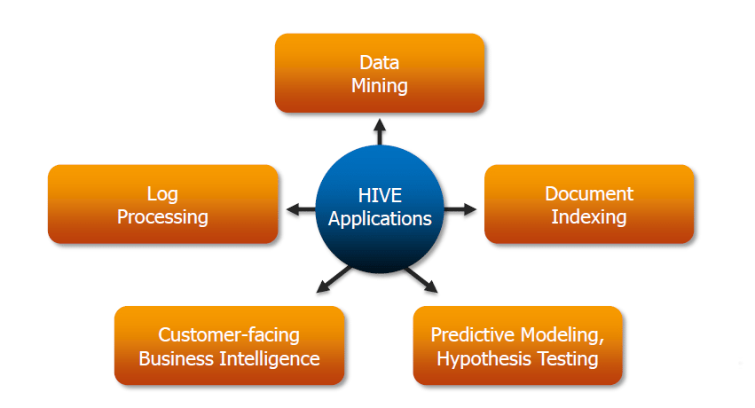
Where to Use Hive

Slide 7
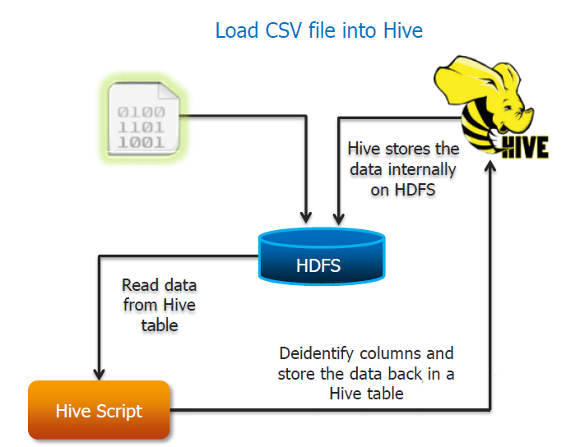
Role of Hive in real time applications

Slide 8
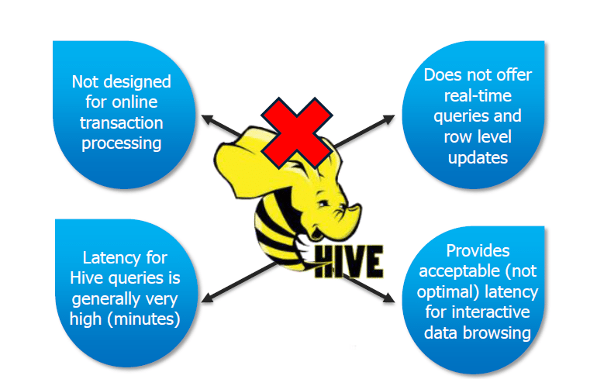
Limitations of Hive:

Slide 9
SQL
SQL stands for Structured Query Language.
SQL is a language which helps us to work with the databases. Database does not understand English or any other language.
Just as to create software, we use Java or C#, in a similar way to work with databases, we use SQL.
SQL is the standard language of Database and is also pronounced as Sequel by many people
SQL itself is a declarative language.
SQL deals with structured data and is for RDBMS that is a relational database management
SQL support schema for data storage
We use SQL when we need frequent modification in records. SQL is used for better performance
Data Modelling using Entities and Relationships

Slide 10
HiveQL
Hive’s SQL language is known as HiveQL, it is a combination of SQL-92, Oracle’s SQL language, and MySQL.
HiveQL provides some improved features from the previous version of SQL standards, like analytics function from SQL 2003.
Some Hive’s’ extension like multitable inserts, TRANSFORM, MAP and REDUCE.
Data Modelling using Entities and Relationships

Slide 11
Hive Data Types
Hive data types are categorized in numeric types, string types, misc types, and complex types.
Integer Types Decimal Type
Type | Size | Range
TINYINT | 1-byte signed integer | -128 to 127
SMALLINT | 2-byte signed integer | 32,768 to 32,767
INT | 4-byte signed integer | 2,147,483,648 to 2,147,483,647
BIGINT | 8-byte signed integer | -9,223,372,036,854,775,808 to 9,223,372,036,854,775,807
Type | Size | Range
FLOAT | 4-byte | Single precision floating point number
DOUBLE | 8-byte | Double precision floating point number
Data Modelling using Entities and Relationships

Slide 12
Date/Time Types
TIMESTAMP
It supports traditional UNIX timestamp with optional nanosecond precision.
As Integer numeric type, it is interpreted as UNIX timestamp in seconds.
As Floating point numeric type, it is interpreted as UNIX timestamp in seconds with decimal precision.
As string, it follows java.sql.Timestamp format "YYYY-MM-DD HH:MM:SS.fffffffff" (9 decimal place precision)
DATES
The Date value is used to specify a particular year, month and day, in the form YYYY--MM--DD. However, it didn't provide the time of the day. The range of Date type lies between 0000--01--01 to 9999--12--31.
Data Modelling using Entities and Relationships

Slide 13
String Types
STRING
The string is a sequence of characters. It values can be enclosed within single quotes (') or double quotes (").
Varchar
The varchar is a variable length type whose range lies between 1 and 65535, which specifies that the maximum number of characters allowed in the character string.
CHAR
The char is a fixed-length type whose maximum length is fixed at 255.
Data Modelling using Entities and Relationships

Slide 14
Complex Type
Type | Size | Range
Struct | It is similar to C struct or an object where fields are accessed using the "dot" notation. | struct('James','Roy')
Map | It contains the key-value tuples where the fields are accessed using array notation. | map('first','James','last','Roy')
Array | It is a collection of similar type of values that indexable using zero-based integers. | array('James','Roy')
Data Modelling using Entities and Relationships

Slide 15
Hive DDL Commands
Hive DDL commands are the statements used for defining and changing the structure of a table or database in Hive. It is used to build or modify the tables and other objects in the database.
DDL Command | Use With
CREATE | Database, Table
SHOW | Databases, Tables, Table Properties, Partitions, Functions, Index
DESCRIBE | Database, Table, view
USE | Database
DROP | Database, Table
ALTER | Database, Table
TRUNCATE | Table
Data Modelling using Entities and Relationships

Slide 16
Hive DML Commands
Hive DML (Data Manipulation Language) commands are used to insert, update, retrieve, and delete data from the Hive table once the table and database schema has been defined using Hive DDL commands.
The various Hive DML commands are:
LOAD
SELECT
INSERT
DELETE
UPDATE
EXPORT
IMPORT
Data Modelling using Entities and Relationships

Slide 17
Hive Sort by vs order by
Hive supports SORT BY which sorts the data per reducer. The difference between "order by" and "sort by" is that the former guarantees total order in the output while the latter only guarantees ordering of the rows within a reducer. If there are more than one reducer, "sort by" may give partially ordered final results.
Data Modelling using Entities and Relationships

Slide 18
Hive Joining tables
The HiveQL Join clause is used to combine the data of two or more tables based on a related column between them. The various type of HiveQL joins are: -
Inner Join
Left Outer Join
Right Outer Join
Full Outer Join
Data Modelling using Entities and Relationships

Slide 19
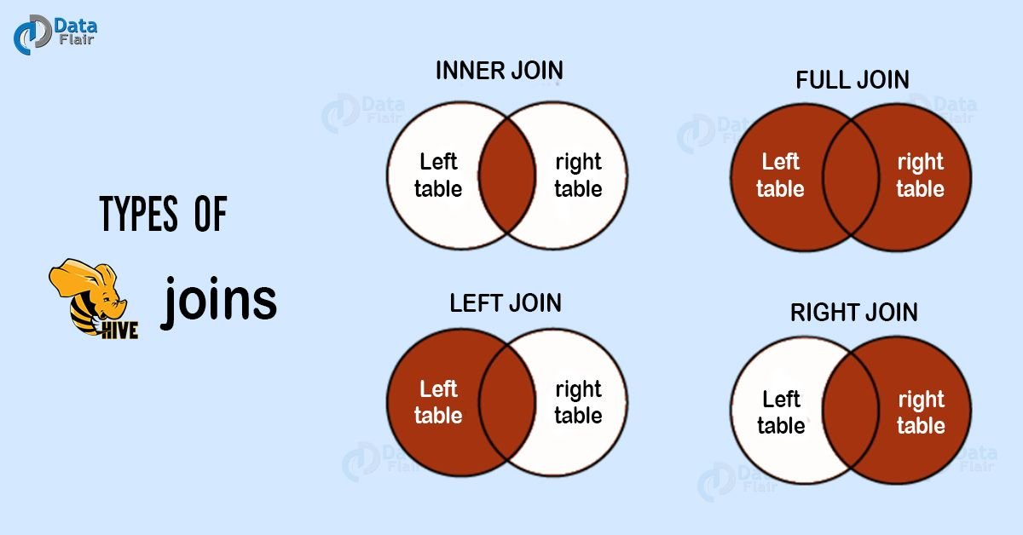
Data Modelling using Entities and Relationships

Slide 20
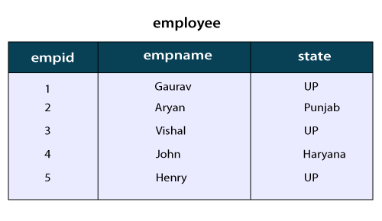
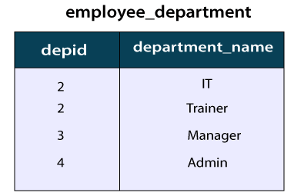
Here, we are going to execute the join clauses on the records of the following table:
Data Modelling using Entities and Relationships

Slide 21
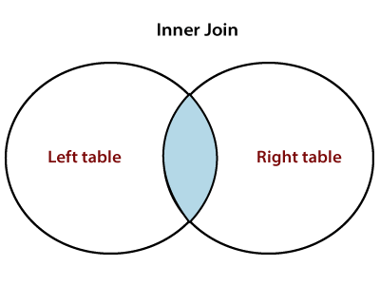
inner Join in HiveQL
The HiveQL inner join is used to return the rows of multiple tables where the join condition satisfies. In other words, the join criteria find the match records in every table being joined.
Example of Inner Join in Hive
In this example, we take two table employee and employee_department. The primary key (empid) of employee table represents the foreign key (depid) of employee_department table. Let's perform the inner join operation by using the following steps: -
Select the database in which we want to create a table.
select e1.empname, e2.department_name from employee e1 join employee_department e2 on e1.empid= e2.depid;
Data Modelling using Entities and Relationships

Slide 22
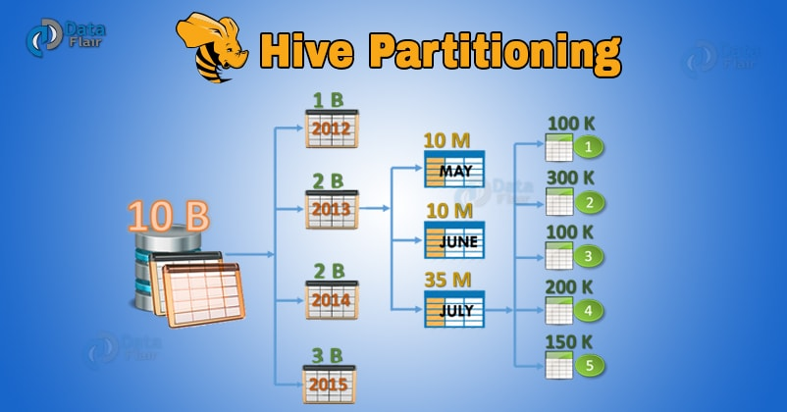
What are the Hive Partitions?
Apache Hive organizes tables into partitions. Partitioning is a way of dividing a table into related parts based on the values of particular columns like date, city, and department.
Each table in the hive can have one or more partition keys to identify a particular partition. Using partition it is easy to do queries on slices of the data.

Slide 23
Why is Partitioning Important?
In the current century, we know that the huge amount of data which is in the range of petabytes is getting stored in HDFS. So due to this, it becomes very difficult for Hadoop users to query this huge amount of data.
The Hive was introduced to lower down this burden of data querying. Apache Hive converts the SQL queries into MapReduce jobs and then submits it to the Hadoop cluster. When we submit a SQL query, Hive read the entire data-set.
So, it becomes inefficient to run MapReduce jobs over a large table. Thus this is resolved by creating partitions in tables. Apache Hive makes this job of implementing partitions very easy by creating partitions by its automatic partition scheme at the time of table creation.
In Partitioning method, all the table data is divided into multiple partitions. Each partition corresponds to a specific value(s) of partition column(s). It is kept as a sub-record inside the table’s record present in the HDFS.
Therefore on querying a particular table, appropriate partition of the table is queried which contains the query value. Thus this decreases the I/O time required by the query. Hence increases the performance speed.

Slide 24
How to Create Partitions in Hive?
To create data partitioning in Hive following command is used-
CREATE TABLE table_name (column1 data_type, column2 data_type) PARTITIONED BY (partition1 data_type, partition2 data_type,….);

Slide 25
Hive Data Partitioning Example
Now let’s understand data partitioning in Hive with an example. Consider a table named Tab1. The table contains client detail like id, name, dept, and yoj( year of joining).
Suppose we need to retrieve the details of all the clients who joined in 2012. Then, the query searches the whole table for the required information. But if we partition the client data with the year and store it in a separate file, this will reduce the query processing time. The below example will help us to learn how to partition a file and its data-

Slide 26
The file name says file1 contains client data table:
[php]tab1/clientdata/file1
id, name, dept, yoj
1, sunny, SC, 2009
2, animesh, HR, 2009
3, sumeer, SC, 2010
4, sarthak, TP, 2010[/php]
Now, let us partition above data into two files using years
[php]tab1/clientdata/2009/file2
1, sunny, SC, 2009
2, animesh, HR, 2009
tab1/clientdata/2010/file3
3, sumeer, SC, 2010
4, sarthak, TP, 2010

Slide 27
Now when we are retrieving the data from the table, only the data of the specified partition will be queried. Creating a partitioned table is as follows:
CREATE TABLE table_tab1 (id INT, name STRING, dept STRING, yoj INT) PARTITIONED BY (year STRING);
LOAD DATA LOCAL INPATH tab1’/clientdata/2009/file2’OVERWRITE INTO TABLE studentTab PARTITION (year=’2009′);
LOAD DATA LOCAL INPATH tab1’/clientdata/2010/file3’OVERWRITE INTO TABLE studentTab PARTITION (year=’2010′);[/php]

Slide 28
Hive Static Partitioning
Types of Hive Partitioning :
Static Partitioning
Dynamic Partitioning
Insert input data files individually into a partition table is Static Partition.
Usually when loading files (big files) into Hive tables static partitions are preferred.
Static Partition saves your time in loading data compared to dynamic partition.
You “statically” add a partition in the table and move the file into the partition of the table.
We can alter the partition in the static partition.
You can get the partition column value from the filename, day of date etc without reading the whole big file.
If you want to use the Static partition in the hive you should set property set hive.mapred.mode = strict This property set by default in hive-site.xml
Static partition is in Strict Mode.
You should use where clause to use limit in the static partition.
You can perform Static partition on Hive Manage table or external table.

Slide 29
Hive Dynamic Partitioning
Single insert to partition table is known as a dynamic partition.
Usually, dynamic partition loads the data from the non-partitioned table.
Dynamic Partition takes more time in loading data compared to static partition.
When you have large data stored in a table then the Dynamic partition is suitable.
If you want to partition a number of columns but you don’t know how many columns then also dynamic partition is suitable.
Dynamic partition there is no required where clause to use limit.
we can’t perform alter on the Dynamic partition.
You can perform dynamic partition on hive external table and managed table.
If you want to use the Dynamic partition in the hive then the mode is in non-strict mode.
Here are Hive dynamic partition properties you should allow

Slide 30
Hive Partitioning – Advantages and Disadvantages
a) Hive Partitioning Advantages
Partitioning in Hive distributes execution load horizontally.
In partition faster execution of queries with the low volume of data takes place. For example, search population from Vatican City returns very fast instead of searching entire world population.

Slide 31
b) Hive Partitioning Disadvantages
There is the possibility of too many small partition creations- too many directories.
Partition is effective for low volume data. But there some queries like group by on high volume of data take a long time to execute. For example, grouping population of China will take a long time as compared to a grouping of the population in Vatican City.

Slide 32
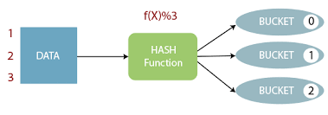
Bucketing in Hive
What is Bucketing in Hive
Basically, for decomposing table data sets into more manageable parts, Apache Hive offers another technique. That technique is what we call Bucketing in Hive.

Slide 33
Why Bucketing?
Basically, the concept of Hive Partitioning provides a way of segregating hive table data into multiple files/directories. However, it only gives effective results in few scenarios. Such as:
– When there is the limited number of partitions.
– Or, while partitions are of comparatively equal size.

Slide 34
Although, it is not possible in all scenarios. For example when are partitioning our tables based geographic locations like country. Hence, some bigger countries will have large partitions (ex: 4-5 countries itself contributing 70-80% of total data).
While small countries data will create small partitions (remaining all countries in the world may contribute to just 20-30 % of total data). Hence, at that time Partitioning will not be ideal.
Then, to solve that problem of over partitioning, Hive offers Bucketing concept. It is another effective technique for decomposing table data sets into more manageable parts.

Slide 35
Features of Bucketing in Hive
Basically, this concept is based on hashing function on the bucketed column. Along with mod (by the total number of buckets).
i. Where the hash_function depends on the type of the bucketing column.
ii. However, the Records with the same bucketed column will always be stored in the same bucket.
iii. Moreover, to divide the table into buckets we use CLUSTERED BY clause.
iv. Generally, in the table directory, each bucket is just a file, and Bucket numbering is 1-based.
v. Along with Partitioning on Hive tables bucketing can be done and even without partitioning.
vi. Moreover, Bucketed tables will create almost equally distributed data file parts.

Slide 36
Advantages of Bucketing in Hive
i. On comparing with non-bucketed tables, Bucketed tables offer the efficient sampling.
ii. Map-side joins will be faster on bucketed tables than non-bucketed tables, as the data files are equal sized parts.
iii. Here also bucketed tables offer faster query responses than non-bucketed tables as compared to Similar to partitioning.
iv. This concept offers the flexibility to keep the records in each bucket to be sorted by one or more columns.
v. Since the join of each bucket becomes an efficient merge-sort, this makes map-side joins even more efficient.
Limitations of Bucketing in Hive
i. However, it doesn’t ensure that the table is properly populated.
ii. So, we need to handle Data Loading into buckets by our-self.

Slide 37
Example Use Case for Bucketing in Hive
To understand the remaining features of Hive Bucketing let’s see an example Use case, by creating buckets for the sample user records file for testing in this post
first_name,last_name, address, country, city, state, post,phone1,phone2, email, web Rebbecca, Didio, 171 E 24th St, AU, Leith, TA, 7315, 03-8174-9123, 0458-665-290, rebbecca.didio@didio.com.au,http://www.brandtjonathanfesq.com.au
Hence, let’s create the table partitioned by country and bucketed by state and sorted in ascending order of cities.

Slide 38
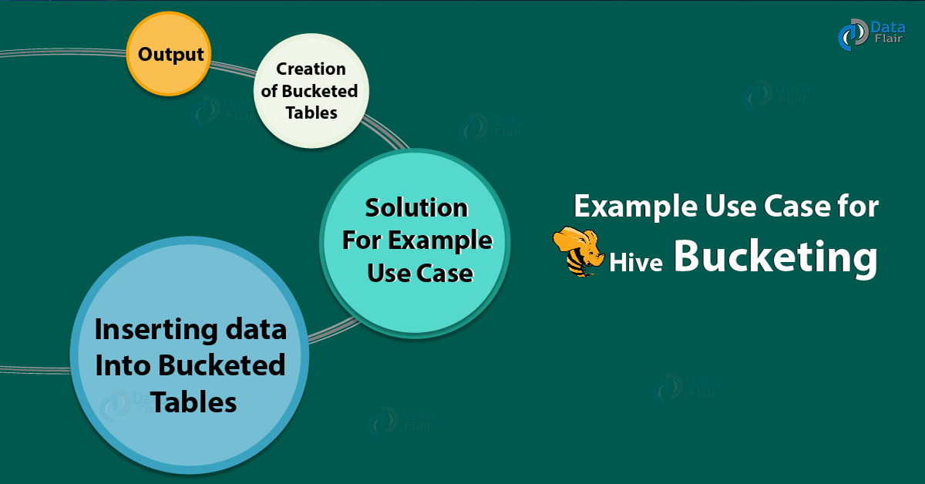

Slide 39
Creation of Bucketed Tables
However, with the help of CLUSTERED BY clause and optional SORTED BY clause in CREATE TABLE statement we can create bucketed tables. Moreover, we can create a bucketed_user table with above-given requirement with the help of the below HiveQL.

Slide 40
CREATE TABLE bucketed_user(
firstname VARCHAR(64),
lastname VARCHAR(64),
address STRING,
city VARCHAR(64),
state VARCHAR(64),
post STRING,
phone1 VARCHAR(64),
phone2 STRING,
email STRING,
web STRING
)
COMMENT ‘A bucketed sorted user table’
PARTITIONED BY (country VARCHAR(64))
CLUSTERED BY (state) SORTED BY (city) INTO 32 BUCKETS
STORED AS SEQUENCEFILE;

Slide 41
CREATE TABLE bucketed_user(
firstname VARCHAR(64),
lastname VARCHAR(64),
address STRING,
city VARCHAR(64),
state VARCHAR(64),
post STRING,
phone1 VARCHAR(64),
phone2 STRING,
email STRING,
web STRING
)
COMMENT 'A bucketed sorted user table'
PARTITIONED BY (country VARCHAR(64))
CLUSTERED BY (state) SORTED BY (city) INTO 32 BUCKETS
STORED AS SEQUENCEFILE;
As shown in code for state and city columns Bucketed columns are included in the table definition, Unlike partitioned columns. Especially, which are not included in table columns definition.

Slide 42
Inserting data Into Bucketed Tables
However, we can not directly load bucketed tables with LOAD DATA (LOCAL) INPATH command, similar to partitioned tables. Instead to populate the bucketed tables we need to use INSERT OVERWRITE TABLE … SELECT …FROM clause from another table.
Hence, we will create one temporary table in hive with all the columns in input file from that table we will copy into our target bucketed table for this.
i. However, in partitioning the property hive.enforce.bucketing = true is similar to hive.exec.dynamic.partition=true property. So, we can enable dynamic bucketing while loading data into hive table By setting this property.
ii. Moreover, it will automatically set the number of reduce tasks to be equal to the number of buckets mentioned in the table definition (for example 32 in our case). Further, it automatically selects the clustered by column from table definition.
iii. Also, we have to manually convey the same information to Hive that, number of reduce tasks to be run (for example in our case, by using set mapred.reduce.tasks=32) and CLUSTER BY (state) and SORT BY (city) clause in the above INSERT …Statement at the end since we do not set this property in Hive Session.

