Slide 1

Pitch deck
WE HELP BUSINESSES GROW AND NURTURE A CONSUMER-FIRST MINDSET.
Mirjam Nilsson

Slide 2

About us
WE HELP BUSINESSES GROW AND NURTURE A CONSUMER-FIRST MINDSET.
At Contoso, we’re disrupting the online retail landscape by finding new ways to engage with customers from across the globe. By closing the loop between the customer and online retail stores, we help businesses grow and nurture a consumer-first mindset.

Slide 3
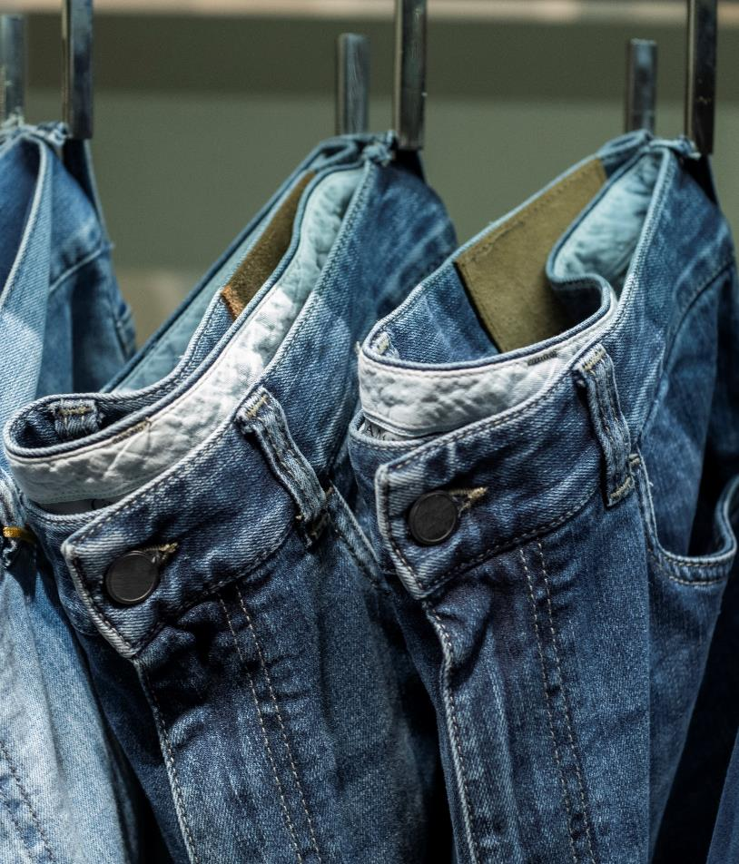
Problem
Market gap
Online shopping continues to be consumer driven, but we're seeing a lapse of availability in the market for small business online shopping experience
Customers
69% of American customers now shop online
Financials
The average American spends an average of $1,804 per order
Costs
Loss of sales from not offering more customizable apps and websites for the small business owner

Slide 4




Solution
Close the gap
Target audience
Cost savings
Easy to use
Our product makes online shopping more available to small business owners, and no other product on the market offers the same benefits
Gen Z (18-25 years old)
Reduce expenses for adding products to third-party retail websites
A simple product that gives customers the information they need to order online and ship to their location

Slide 5

Product overview
Unique
Tested
Only product specifically dedicated to the small retail businesses market
Conducted testing with young entrepreneurs in the area
First to market
Authentic
First beautifully designed product that's both stylish and functional
Designed with the help and input of online retail experts in the field

Slide 6

Product benefits
1.
Simple and efficient to use
2.
Areas for community connections
3.
Online store and market swap

Slide 7
Company overview
WE HELP BUSINESSES GROW AND NURTURE A CONSUMER-FIRST MINDSET.

Slide 8



Business model
Research
Abstract
Design
We based our research on market trends and social media trends
We believe people need better tools for online shopping that cater to small business owners
Minimalist design and easy to use

Slide 9


Market overview
$3B
Opportunity to build
Fully inclusive market
Total addressable market
$2B
Freedom to invent
Selectively inclusive market
Serviceable available market
$1B
Few competitors
Specifically targeted market
Serviceable obtainable market

Slide 10
Market comparison
$3
Billion
$2
Billion
$1
Billion
Opportunity to build
Addressable market
Freedom to invent
Serviceable market
Few competitors
Obtainable market

Slide 11
Our competition
Competitors
Company A
Product is more expensive
Contoso
Companies B & C
Product is expensive and inconvenient to use
Our product is priced below that of other online marketplace companies
Simple and easy to use, compared to the complex websites and apps of our competitors
Affordability is the main draw for our consumers to our product
Companies D & E
Product is affordable, but inconvenient to use

Slide 12
Our competition
Convenient
Contoso Ltd.
Competitor A
Affordable
Expensive
Competitor B
Competitor E
Competitor D
Competitor C
Inconvenient

Slide 13
Growth strategy
How we’ll scale in the future
January
February
March
April
May
June
Roll out product to local retail stores in the region to help establish the product
Release the product to the general public and monitor press and regional market trends
July
August
September
October
November
December
Gather feedback from the retail community to expand availability of the product

Slide 14
Two-year action plan
Draft blueprints
Gather feedback
Deliver to client
20XX
Jan
Feb
Mar
Apr
May
Jun
Jul
Aug
Sep
Oct
Nov
Dec
20XX
Jan
Feb
Mar
Apr
May
Jun
Jul
Aug
Sep
Oct
Nov
Dec
Run focus groups
Test design
Launch design

Slide 15
Financials
 | Year 1 | Year 2 | Year 3
Income
Users | 50,000 | 400,000 | 1,600,000
Sales | 500,000 | 4,000,000 | 16,000,000
Average price per sale | 75 | 80 | 90
Revenue @ 15% | 5,625,000 | 48,000,000 | 216,000,000
Gross profit | 5,625,000 | 48,000,000 | 216,000,000
Expenses
Sales & marketing | 5,062,500 | 38,400,000 | 151,200,000 | 70%
Customer service | 1,687,500 | 9,600,000 | 21,600,000 | 10%
Product development | 562,500 | 2,400,000 | 10,800,000 | 5%
Research | 281,250 | 2,400,000 | 4,320,000 | 2%
Total expenses | 7,593,750 | 52,800,000 | 187,920,000

Slide 16




Meet the team
Takuma Hayashi​
Mirjam Nilsson​
Flora Berggren​
Rajesh Santoshi​
President
Chief Executive Officer
Chief Operations Officer
VP Marketing

Slide 17








Meet the full team
Takuma Hayashi
Flora Berggren​
Graham Barnes
Elizabeth Moore
President
Chief Operations Officer
VP Product
Product Designer
Mirjam Nilsson​
Rajesh Santoshi​
Rowan Murphy
Robin Kline
Chief Executive Officer
VP Marketing
SEO Strategist
Content Developer

Slide 18

Summary
WE HELP BUSINESSES GROW AND NURTURE A CONSUMER-FIRST MINDSET.
At Contoso, we believe in giving 110%. By finding new ways to engage with customers from across the globe, we’re disrupting the online shopping landscape and fostering a consumer-first mindset. We thrive because of our market knowledge and a great team behind our product. As our CEO says, "Efficiencies will come from proactively transforming how we do business."

Slide 19

Thank you
WE HELP BUSINESSES GROW AND NURTURE A CONSUMER-FIRST MINDSET.
Mirjam Nilsson​
206-555-0146
mirjam@contoso.com
www.contoso.com

