Slide 1

Pitch Deck 2026
Neighborhood Bites
Founder & CEO
Redefining Urban Dining
Fresh.
Bringing Gourmet Street Food to Your Doorstep.

Slide 2

01
Limited Culinary Diversity
High-density residential areas often lack diverse, high-quality dining options within walking distance, forcing residents to settle for generic fast food.
The Challenge
The "Food Desert" in Busy Residential Hubs
02
The Convenience Gap
Remote workers and busy commuters struggle to find fresh, healthy meals without long drives or expensive, slow delivery services.
03
Erosion of Community
Traditional dining lacks a personal connection to the local neighborhood, missing opportunities for social interaction and community building.

Slide 3

The Solution
Hyperlocal Dining: The Future of Urban Food
Hyperlocal Focus
Sustainability
Community Integration
A rotating food truck model that integrates deeply with local communities, offering menus tailored to the specific tastes and demographics of each neighborhood.
Commitment to zero-waste with 100% compostable packaging and electric-powered kitchen equipment, minimizing our environmental footprint.
Beyond food, we serve as a neighborhood hub, fostering social interaction through local events and neighborhood-specific engagement.

Slide 4
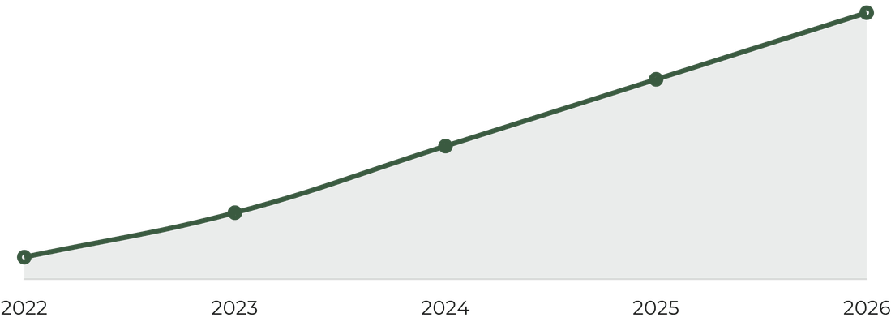
Market Analysis
Target Audience
Primarily Gen Z and Millennials who prioritize sustainability, local sourcing, and unique culinary experiences. This demographic represents 40% of total food spending.
A $4.2 Billion Market Opportunity
$4.2B
Trend Alignment
Capitalizing on the "15-minute city" urban planning trend, where residents expect high-quality services and dining within a short walk from their homes.
Projected Market Size by 2026
Growth Potential
The mobile food service industry is projected to grow at a 6.5% CAGR through 2026, driven by the demand for convenience and artisanal quality.

Slide 5

Diversified Revenue Streams
Revenue & Tech
Daily street sales (60%), private catering (25%), and community events (15%) ensure a stable and scalable income model.
The "Neighborhood Bites" Business Model
"Bites Pass" Subscription
A recurring revenue model offering regular customers exclusive discounts, priority ordering, and neighborhood-specific perks.
Proprietary Tech Integration
Our custom app features real-time truck tracking, pre-ordering, and AI-driven demand forecasting to optimize operations.

Slide 6



The Local Hero
The Menu
Grass-fed beef burger topped with artisanal aged cheddar, caramelized onions, and house-made aioli on a brioche bun.
Globally Inspired, Locally Sourced
Urban Garden Bowl
Roasted seasonal vegetables, quinoa, and local microgreens drizzled with a wild ramp pesto dressing.
Our culinary philosophy is simple: 70% of our ingredients are sourced from farms within a 50-mile radius, ensuring peak freshness and supporting the local economy.
Seasonal Rotation
Our menu evolves every 90 days to celebrate the harvest of the season, bringing new global flavors to your neighborhood.
New Menu Every Quarter

Slide 7



Social-First Discovery
Real-time location updates and "Menu Polls" where residents vote on next week's specials, driving high engagement and anticipation.
Growth Strategy
Strategic Marketing & Community Engagement
"Community Points" Loyalty
Points earned for every purchase are redeemable for free meals or can be donated to local neighborhood charities, fostering brand affinity.
Hyperlocal Partnerships
Collaborations with local breweries and neighborhood associations for "Block Party" events, embedding our brand into the local social fabric.

Slide 8

Fleet Management
Centralized "Cloud Kitchen" for all prep work, ensuring culinary consistency and quality control across the entire fleet of trucks.
The Engine
Operational Excellence & Scalability
Logistics & AI
AI-driven route optimization to maximize foot traffic, minimize fuel consumption, and adapt to real-time neighborhood demand patterns.
Modular Scalability
Standardized truck designs and operational playbooks allow for rapid expansion into new urban hubs with minimal overhead.

Slide 9
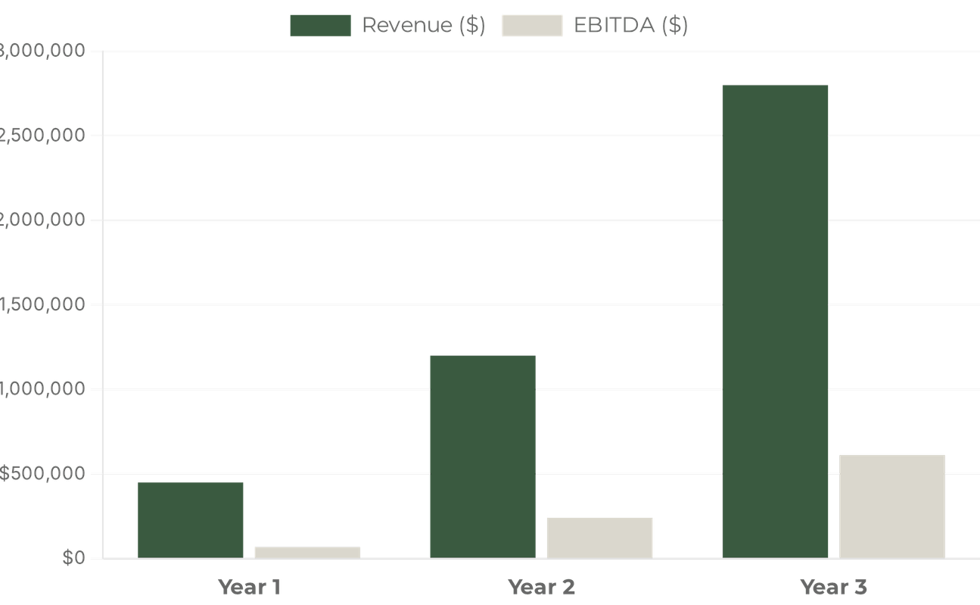
The Numbers
Financial Projections: Path to Profitability
$450K
Year 1 Revenue Per Truck
Month 14
Projected Breakeven Point
$612K
Year 3 Target EBITDA

Slide 10




Leadership
The Visionary Team Behind the Wheel
Founder & CEO
Head of Operations
Executive Chef
Alex Johnson
Sarah Chen
Marcus Thorne
10+ years in culinary management and tech startups. Former operations lead at a national food delivery platform with a passion for sustainable urban dining.
Expert in logistics and supply chain management. Specialized in fleet optimization and sustainable sourcing for high-growth hospitality groups.
Award-winning chef with a background in Michelin-starred kitchens. Dedicated to bringing farm-to-table excellence to the street food scene.

Slide 11

The Ask
Use of Funds
Investment Opportunity: Fueling Our Growth
Equipment & Trucks
50%
Marketing & Launch
30%
Working Capital
20%
$500,000
Exit Strategy
Our goal is to achieve a 5-truck fleet within 3 years, positioning Neighborhood Bites for acquisition by a major hospitality group or a nationwide franchise expansion.
Seed Funding Round

Slide 12




Contact Us
hello@neighborhoodbites.com
Join the Neighborhood Revolution
www.neighborhoodbites.com
@NeighborhoodBites
Local.
Let's redefine how communities eat.

