Slide 1
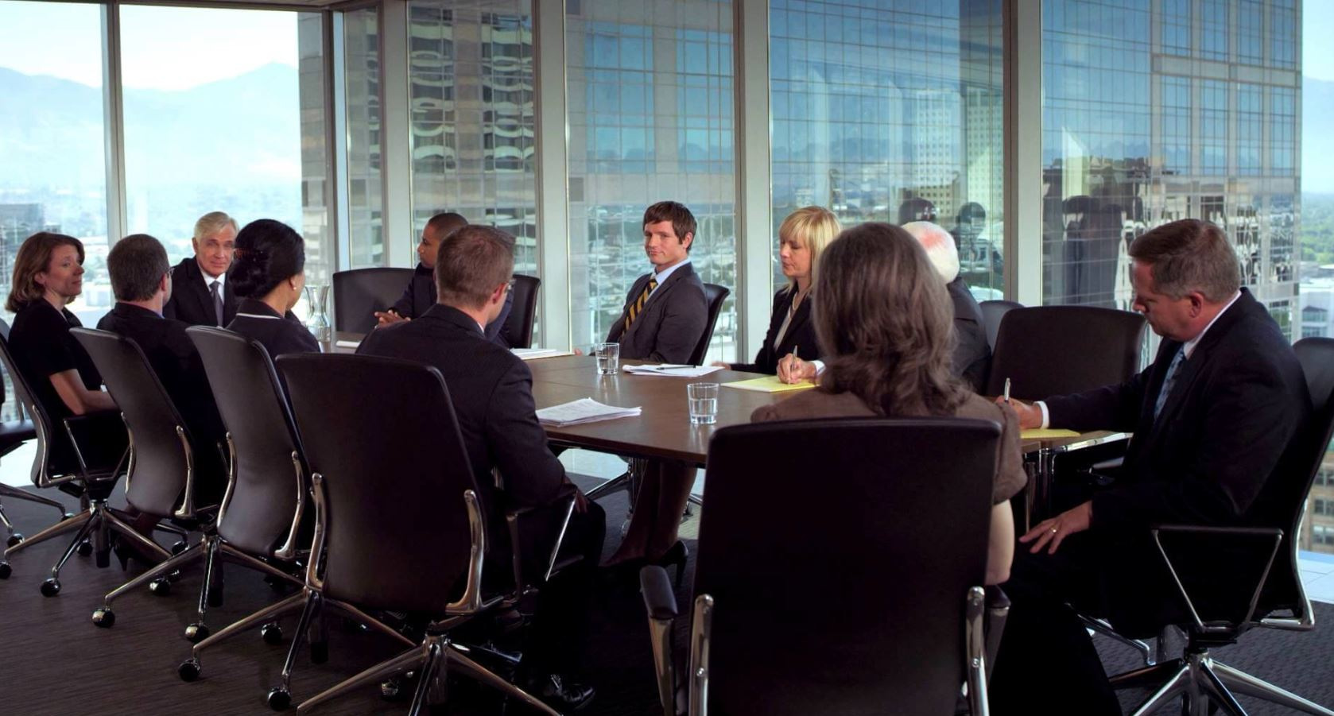
PRESENTATION TEMPLATES
Stories worth telling…
WWW.POWERSLIDES.COM
Notes:
There is a background placeholder in this slide.
To change the images :
Right Click and Select Format Background -> Select FILL -> Picture Or Texture Fill -> Select File...

Slide 2


EXECUTIVE PROJECT STATUS REPORT
PROJECT STATUS
SCOPE | SCHEDULE | COST | RISKS | QUALITY
To upgrade 50 feeders all across the states | The 19 weeks completion period might be exceeded due to funds unavailability | Project cost has been exceeded | Regulatory approval has been granted. Risk is under control | The very high standard that has been set by the management is being deviated from
Off Track
Require Attention
On Track
SPRINT DELIVERABLES
Headline | Start | End | Status | Owner
Mapping | 19 January 2022 | 27 January 2023 | Complete | Wale
Site Visit | 2 February 2022 | 10 February 2023 | Delay | Mark
Pre-Project Report | 15 February 2023 | 19 February 2024 | Complete | Sham
Project Commencement | 1 March 2023 | 19 August 2024 | In progress | Project Team
POWERSLIDES WWW.POWERSLIDES.COM
1

Slide 3
EXECUTIVE PROJECT STATUS REPORT
PROJECT NAME
Development of food ordering mobile app
PROJECT MANAGER | PERIOD COVER | DATE | PROJECTED DATE
Matthew Dave | Sprint 1 | 19 August 2022 | 19 September 2024
Design mobile app screen prototypes
Milestone 3
Project Initiation
Current timeline position
Milestone 1
Milestone 2
Project Start Date
Project End Date
1 June 2022
1 July 2024
Key Issues | Status | Owner | Description
Mobile App Scalability | OPEN | Matthew Rice | Mobile Apps Fails Test
User interface | CLOSE | Lan Ben | Upgrade of the UI
Dummy text removal | CLOSE | Jane Liz | Replace dummy text
POWERSLIDES WWW.POWERSLIDES.COM
2

Slide 4


EXECUTIVE PROJECT STATUS REPORT
75%
RATE
$8,789
$9,212
$3,810
$8,918
Project 1
Project 2
Project 3
Project 4
1
2
3
All the projects are within 75% done
Construction of new annex
Implementation of CRM 2.0
Renovation of the convenience room at HQ
Scholarship for university students
PROJECT TIMELINE
PROJECT TIMELINE
PROJECT TIMELINE
Project 1 has a timeline of 37 weeks
Project 2 has a timeline of 5 weeks
Project 3 has a timeline of 7 weeks
Scope
Time
Quality
Cost
POWERSLIDES WWW.POWERSLIDES.COM
3

Slide 5
EXECUTIVE PROJECT STATUS REPORT
PROJECT TIMELINE
07
Wrap Up
04
Construction
03
Painting
02
Water pipeline
06
Final Inspection
01
Excavation
05
Indoor set up
JAN
FEB
MAR
APR
MAY
JUN
JUL
AUG
SEP
OCT
NOV
DEC
POWERSLIDES WWW.POWERSLIDES.COM
4

Slide 6


EXECUTIVE PROJECT STATUS REPORT
Project Status Here
 | Jan | Feb | Mar | Apr | May
Project Alpha
Project November
Project India
Project Sierra
PROJECT TIMELINE
Level of completion for each quarter during the project
POWERSLIDES WWW.POWERSLIDES.COM
5

Slide 7
THANK YOU
Do you a need bespoke presentation design service? We can custom create your slides from scratch. Contact us today.
WWW.POWERSLIDES.COM
Notes:
There is a background placeholder in this slide.
To change the images :
Right Click and Select Format Background -> Select FILL -> Picture Or Texture Fill -> Select File...

