Slide 1
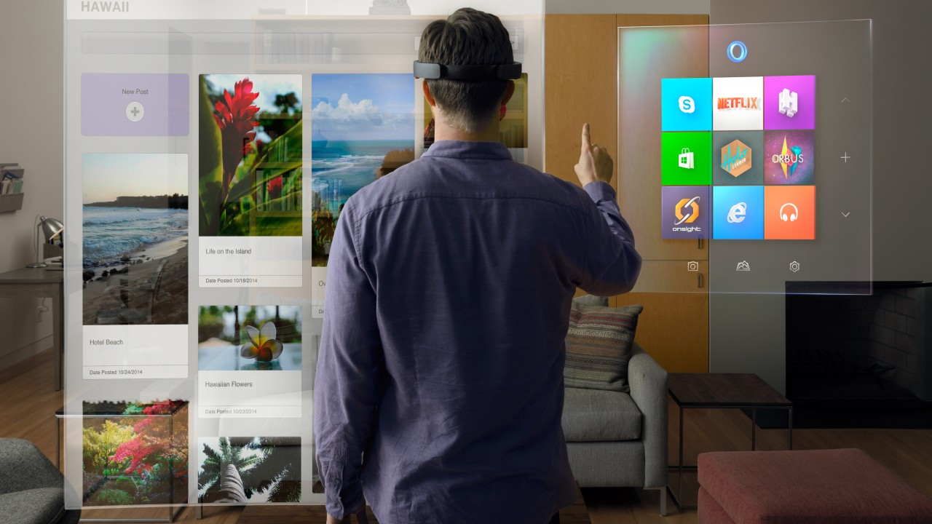
PRESENTATION TEMPLATES
Stories worth telling…
WWW.POWERSLIDES.COM
Notes:
There is a background placeholder in this slide.
To change the images :
Right Click and Select Format Background -> Select FILL -> Picture Or Texture Fill -> Select File...

Slide 2
THEORY OF CHANGE
Input
Material
Human
Finance
Information
Assumptions
Sand Invitation
Output
Possession like these sweet mornings of spring which I enjoy with my whole heart. I am alone,
Activities
Aid selection appropriate to context
Do no harm principles followed
Sensitization of non-beneficiary groups
SHORT/MEDIUM TERM OUTCOMES
ShelterBox response is accurate
Monitoring
Coordination
Community engagement
Logistics
Protection from weather & environmental extremes
Increased personal safety & security possessions
Increased protection from water & vector borne diseases
Reduced household displacement
Households are intact
Knowledge & skills to utilize the provided materials
Reduced stress & anxiety
Contribution to IMPACT LEVEL CHANGES
Long-term Outcome
Improved psychological health & wellbeing
Improved access to & retention in education
Reduced morbidity & mortality
Secure of tenure
Improved access to basic services
POWERSLIDES WWW.POWERLIDES.COM
1

Slide 3
THEORY OF CHANGE
START
Information
What do others think?
It begins with an idea
I like it!
I share that dream too!
How will it impact our people
How will it impact our planet
Has this been addressed before?
TIME TO MAKE IT OUR OWN
What am I learning?
How will it make our community prosperous
This is really different
Teamwork!
Let’s get together!!
Join us!!!
Let’s take time to do this right
Now let’s get to work!
Time to Pause
RESULT
This is a lot of work
…but the work is powerful personally, and for our community
What have I learned and what might we need to change?
THE COMMUNITY IS STRONGER
POWERSLIDES WWW.POWERLIDES.COM
2

Slide 4







THEORY OF CHANGE
PROBLEM
YOUTH CONTEXT
KEY STRATEGY AREAS
OUTCOMES
Significant numbers of young people from East Palo Alto and the Belle Haven neighbourhood of Menlo Park are at-risk of not completing high school due to low grades, poor attendances, disciplinary/ behavioural issues and credit deficiency.
Short-Term
Youth Assets
Academics
Behaviors
Families
Coordination
Relationship Building
Holistic Supports
Intermediate
Partnerships
01
02
Peer Networks
Students earn a GED or High School Diploma
Students complete collage or vocational training
Framed by Key Assumptions
Sufficient Resources
A clear system to identify, refer, and enroll youth
Students actively participate and adults keep records
Clear roles, structures, and processes
School
Long-Term
Students find long-term & sustainable employment at a liveable wage.
Community
POWERSLIDES WWW.POWERLIDES.COM
3

Slide 5
THEORY OF CHANGE
SHORT-TERM OUTCOMES
MEDIUM-TERM OUTCOMES
Stakeholders increasingly invest in and/or reward improved practices and responsible sourcing for aluminum.
Sustainability and human rights principles are increasingly embedded in aluminum production, use and recycling.
Aluminum continues to improve its sustainability credentials.
OUR LONG-TERM GOALS
ASI membership is inclusive
Increasing uptake of certification by diverse businesses
Relevant, practical and consistent assurance
Continual improvement among certified entitles
Enhanced ability to leverage existing certifications
Reduced climate change impact
Enhanced waste management of upstream processing residues
Enhanced biodiversity management
Practices that implement business’ responsibility to respect human rights
Increased material stewardship by all actors in the aluminium value chain
ASI is recognised as a valuable initiative
Society makes effective use of aluminium
POWERSLIDES WWW.POWERLIDES.COM
4

Slide 6
THEORY OF CHANGE
Enabling Condition and Values
By 2025
Relationships and Collaboration
Education and Capacity Building
Shared Data and Mapping
Resource Integration
Disruption and Innovation
Adaptive Leadership
Economics of Change
We expect to deliver on our goals of the following:
75%
Increase in access to affordable nutritious food
Our Project
40%
Our projects are divided into 3 phases
New circular economy businesses and collaborations
Nutritious Foods
Circular Jobs & Business
60%
Increase in media circulation
Waste as a Resource
POWERSLIDES WWW.POWERLIDES.COM
5

Slide 7
THEORY OF CHANGE
Define Desired Impact
01
01
02
Review, evaluate, revise, learn
Problem Analysis
List & cluster required outcomes
Present Theory of Change
02
06
03
Turn it into a narrative
Arrange outcomes in a logical order
Select Outcome
03
05
04
Results Chain
04
Validate it
Identity feedback loops
Select Output
POWERSLIDES WWW.POWERLIDES.COM
6

Slide 8
THEORY OF CHANGE
STRATEGIC PLANNING
THE EFFECTS
Inputs
Activities
Outputs
Outcomes
Impact
All financial and non-financial inputs which are required for projects (BIG’s grant, other funding, volunteer time)
Activities might include; engagement and outreach; advice and guidance; placements and ILMs
Focus on clear measurable outputs which may include; numbers supported, numbers of employers engaged
Numbers into sustained employment or self-employment.
Numbers of regular volunteers
Focus here is on the ‘net change’, what would have happened without Talent Match
POWERSLIDES WWW.POWERLIDES.COM
7

Slide 9
THEORY OF CHANGE
Input
Learning
Output
Short Term Changes
Young Enterprise’s network of volunteers engages
Young people are given access to relevant business materials
Induction events are held with newly registered companies and team members
Young people take part in the company programme business led learning activities
Sustained and continuous learning activities addressing employability barriers helps in defining career choices
Volunteers and center leads engaging with the enterprise education learning model
Learning
Individual development in key employability competences
Personal capacities development
Improved learning and understanding of employees’ expectations with respect to attitude and aptitude to work
Enhancing awareness on
Getting started
Business planning
Running the business
Competition participation
Company closure
Attitude
Skills
Aspirations
Motivations
Opinions
Strength & weaknesses
Long Term Changes
Medium Term Changes
Conditions
Power Within
Power To
Action
Power within
Actions taken lead to enhanced professional and emotional capabilities
Young people’s employability and career potential is increased, leading to a greater array of career and personal choices
Young people improve their capacity to make informed decisions using their practical learning and experience
Acquired learning leads to improved or enhanced
Young people act upon employability competencies gained and learning to increase their chances of engaging with work and making a smooth transition between the education system and world of work
Social
Economic
Education
Career
Employment
Behavior
Attitudes
Applying knowledge
Emotional capabilities
POWERSLIDES WWW.POWERLIDES.COM
8

Slide 10

THANK YOU
Do you a need bespoke presentation design service? We can custom create your slides from scratch. Contact us today.
WWW.POWERSLIDES.COM
Notes:
There is a background placeholder in this slide.
To change the images :
Right Click and Select Format Background -> Select FILL -> Picture Or Texture Fill -> Select File...

