Slide 1
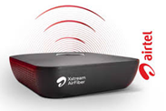
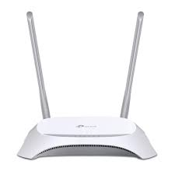



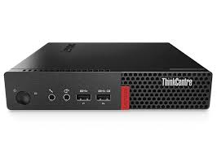
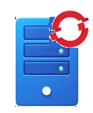
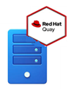







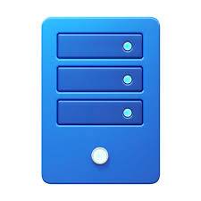





192.168.1.0/24
192.168.0.0/24
Mirror
Registry
Mirror
Registry2
SNO2-ZTP
SNO-ZTP
i5-8^{8h}Gen/32GB
192.168.0.150
192.168.0.110/24
192.168.0.149
192.168.0.111
192.168.0.160/24
i5-6thGen/24GB
i5-8^{8h}Gen/32GB
192.168.0.159/24
8000
8000
192.168.0.161/24
Sushy
Tool
Sushy
Tool
Virtual Redfish BMC
Virtual Redfish BMC
GITHUB: http://192.168.0.159:3000/cloudcafe/homelab
SNO-ACM: https://console-openshift-console.apps.sno-acm.pkar.tech
SNO-ZTP: https://console-openshift-console.apps.sno-ztp.pkar.tech
SNO2-ACM: https://console-openshift-console.apps.sno2-ztp.pkar.tech
MR: https://mirror-registry.pkar.tech:8443
MR2: https://mirror-registry2.pkar.tech:8443
pkar.tech
192.168.0.135
SNO-ACM
Web Server
RHACM

Slide 2




192.168.0.135
SNO-ACM
RHACM
192.168.0.160
Mirror
Registry
Mirror
Registry2
SNO2-ZTP
SNO-ZTP
192.168.0.150
192.168.0.111
192.168.0.110
192.168.0.149
8000
8000
Sushy
Tool
Sushy
Tool
192.168.0.159
Virtual Redfish BMC
Virtual Redfish BMC
192.168.0.161

Slide 3

ZTP (Zero Touch Provisioning) Workflow
HUB Cluster
Bare Metal
> AI Creates Discovery ISO
SNO
> BMO boots BM via BMC
Minimal ISO download from ACM
RootFS image pulled from http srv
OCM
OCM Import Cluster
Klusterlet
Discovery Agents starts
SYNC
> AI Discovery Agents report
Apply Policies
AddOns
> Installation Starts
Assisted
Installer
Creates
Discovery
ISO
HIVE reports to OCM
> OCP Installed
OCP Installed
> HIVE reports to OCM
HIVE
BOOT
> OCM Import Cluster
< Discovery Agents report AI
Installation Starts
> Discovery Agents collect HW & NW info from AI
> OCM apply policies
Discovery
Agent
> OCP SNO Cluster Ready
Bare Metal
Operator
BMC
BMC – Baseboard Management Controller BM - Bare Metal AI- Assisted Installer BMO - Bare Metal Operator OCM – Open Cluster Management

Slide 4




