Slide 1

App

Slide 2
App
App Server
Runtime
Libraries
OS Kernel

Slide 3
App
App
App
App Server
App Server
App Server
Runtime
Runtime
Runtime
Libraries
Libraries
Libraries
OS Kernel
OS Kernel
OS Kernel
DEV
TEST
PROD

Slide 4
War File
Spring Boot
Boxfuse
App
App
App
App Server
App Server
App Server
JVM
JVM
JVM
Libraries
Libraries
Libraries
OS Kernel
OS Kernel
OS Kernel

Slide 5

TomEE War File
Boxfuse Image
Instance
Instance
App
App
Instance
TomEE
TomEE
JVM
JVM
Libraries
Libraries
OS Kernel
OS Kernel

Slide 6
https
tcp
Elastic IP
Application Load Balancer
Classic Elastic Load Balancer
https
https
https
tcp
tcp
tcp
Auto-Scaling Group
Auto-Scaling Group
Auto-Scaling Group
Instance
Instance
Instance
Instance
Instance
Instance
Instance
Instance
Instance
Instance
Instance
single-instance
load-balanced-https
load-balanced
worker
one-off

Slide 7
https
Application Load Balancer
https
https
https
Auto-Scaling Group
Instance
Instance
Instance
load-balanced-https

Slide 8

https
Elastic Load Balancer
https
https
https
Auto-Scaling Group
Instance
Instance
Instance
load-balanced

Slide 9
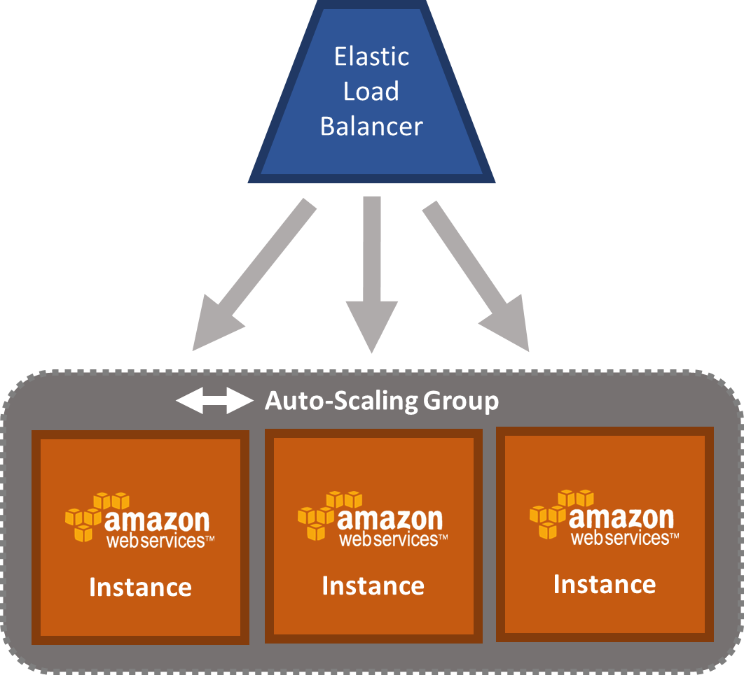
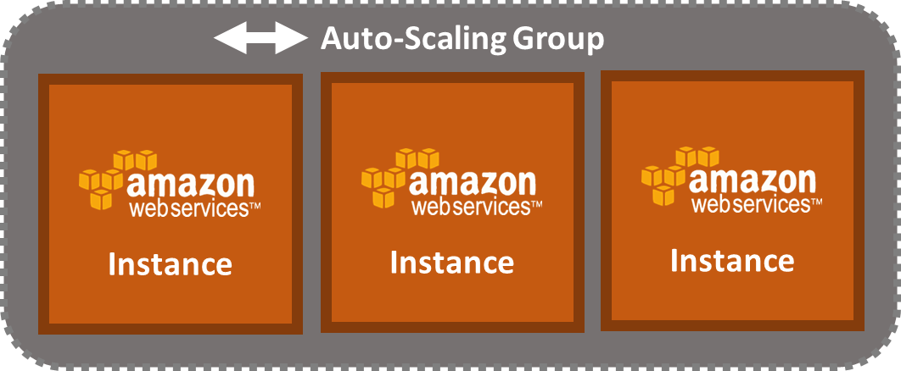
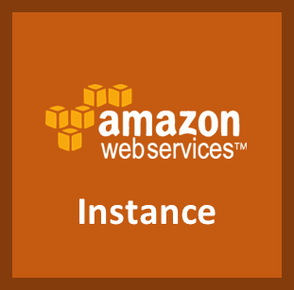
Load-balanced App with Eureka Client & Ribbon
discover
Worker App A with Eureka Client
Worker App B with Eureka Client
register
register
register
register
register
register
Eureka Server

Slide 10
Producer
put
Auto-Scaling Group
Queue

Instance
get
get
get
Worker App

Slide 11



Runtime stack comparison - smaller is better
Docker Container
App
TomEE
Engine
Boxfuse Instance
Base OS
Libraries
OS Kernel

Slide 12

Instance
App
run -ports.http=80 -ports.admin=8081
HTTP
80/TCP
ADMIN
8081/TCP
Internet
Your Workstation

Slide 13
Instance
App
run -ports.http=80 -ports.admin=8081:@
HTTP
80/TCP
ADMIN
8081/TCP
Internet
Your Workstation

Slide 14
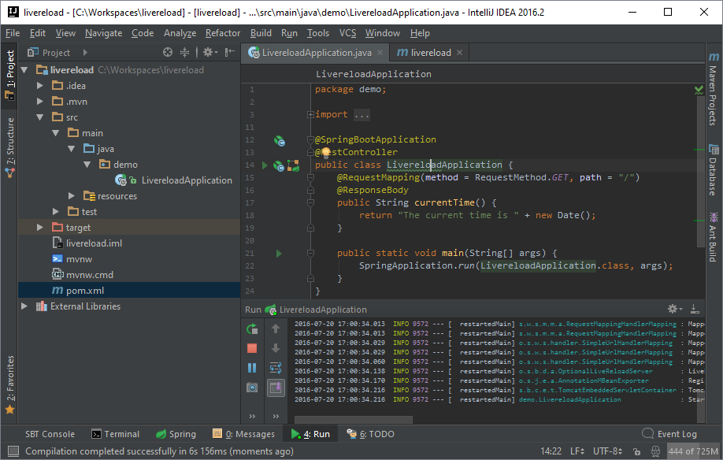
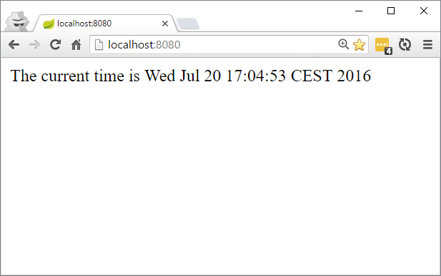

live reload
manual reload
RemoteApplication and LiveReload server in IDE
Spring Boot app with DevTools jar on
Browser

Slide 15
live reload
manual reload
RemoteApplication and LiveReload server in IDE
Spring Boot app with DevTools jar on
Browser

Slide 17
App
App Server
Machine Image
Runtime
Libraries
OS Kernel

Slide 18
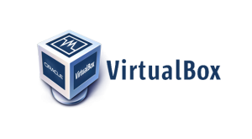




Boxfuse Component Inventory
Play App
Dist Zip
Boxfuse Bootable App
minimal Linux-based Image (100x smaller)
generated on-the-fly (<10 secs provisioning)
contains only App, JVM & Linux kernel
secure (smallest attack surface)
boots directly on VirtualBox & AWS

Slide 19

Linux x64
tar.gz
Boxfuse Minimal Image

Slide 20


Boxfuse Component Inventory
Boxfuse Bootable App
minimal Linux-based Image (100x smaller)
generated on-the-fly (<10 secs provisioning)
contains only App, JVM & Linux kernel
secure (smallest attack surface)
boots directly on VirtualBox & AWS
Play App
Dist Zip

Slide 21



Boxfuse Component Inventory
Boxfuse Minimal Image
minimal Linux-based Image (100x smaller)
generated on-the-fly (<10 secs provisioning)
contains only App, JVM & Linux kernel
secure (smallest attack surface)
boots directly on VirtualBox & AWS
Grails 3.x
Executable Jar

Slide 22
Machine Image
Machine Image
Machine Image
DEV
TEST
PROD

Slide 23


Boxfuse Component Inventory
Bootable App
App

Slide 24


Boxfuse Component Inventory
Bootable App
App
Boxfuse Image Generation
5 Seconds

Slide 25
Machine Image
Bootable App
Legacy OS
Multiple GBs
Boxfuse Secure Micro OS
Few MBs

Slide 26
Machine Image
with
Legacy OS
Boxfuse Micro OS
100x smaller
<10 secs provisioning
secure (smallest attack surface)

Slide 27
Bootable App

Slide 28
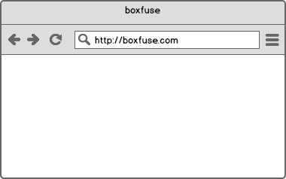

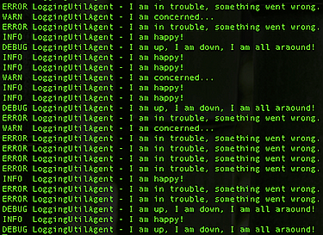
ls -vault
destroy
create
App
App
Image
AMI
convert
inventory
rm -vault
Image
run -env=...
Component
push
Component
ps / info
ls
pull
cfg / scale


Instance
open


Boxfuse
Inventory
Image
Boxfuse
Vault
fuse
open -db

run
kill
Payload
logs
rm
Instance
Image

Slide 29
cfg
Instance
Elastic Load Balancer
V1
Instance
V1
Instance
V1
Instance
V2
Instance
info
Instance

Slide 30
dev
test
prod
Instance
Instance
Instance
Instance
Instance
Instance

Slide 31




Instance
Dev VM
Instance
Dev VM


Elastic Load Balancer
Dev Environment with PostgreSQL
Dev Environment with MySQL
Auto-Scaling Group
Instance
Instance
Instance


RDS
Database per Service pattern

Slide 32
myuser/myapp:123 instance
JVM
CloudWatch Logs
App
Logback
Cloudwatch Logs Appender
LogGroup boxfuse/prod
LogStream myuser/myapp
STDOUT
Cloudwatch Logs Agent
STDERR

Slide 33
Instance
Dev VM
Instance
RDS
Instance
RDS


Test & Prod Environments with PostgreSQL
Test & Prod Environments with MySQL
Instance

RDS

Slide 34


pull image
Private Vault
Boxfuse
FastAMI Instance
launch
create
AMI
Your AWS account

Slide 35
ls
Component
Image
Image
Component


Boxfuse
Inventory
Image
fuse

Payload
rm

Image
create
App
Boxfuse Vault
destroy
App

Slide 36
Component
Component
Component
Component




Boxfuse
Inventory
Image
Instance
Boxfuse
Inventory
Image
(live)
Instance
(live)
fuse
fuse -live
Payload
Payload
Directory
Regular Image & Instance
Live Image & Instance

Slide 37


convert
Image
Instance
Boxfuse Vault
run
kill
Instance
ps
Instance
Instance
AMI
Instance
Instance
Instance
App
create
AMI
launch
instances

Slide 38
AMI
other
tools
Instance
Instance
Instance
App
convert
Instance
open
open -db

Instance
logs
Instance
Instance
scale
Instance

Slide 39

Image


push
Image

Boxfuse Vault
pull
Boxfuse Vault


deploy
Boxfuse Vault

Slide 40


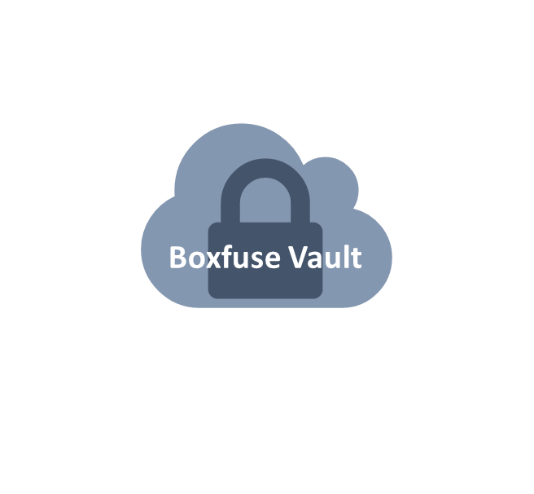


Image
Minimal
Secure
Portable

Slide 41

Image
package
pre-integration-test
integration-test
post-integration-test
deploy

Slide 42






Slide 43

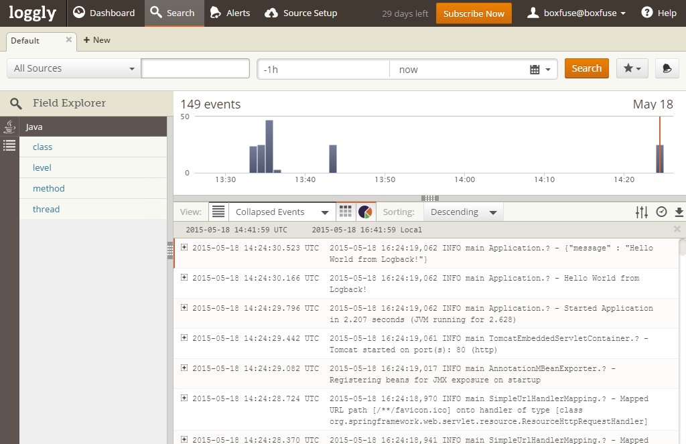

Instance Boot logs
Instance
Application logs
Boxfuse Image
15 MB
3 secs provisioning
only App, Node.js & Linux kernel
secure
boots directly on VirtualBox & AWS

Slide 44

Boxfuse Image
7 MB
< 1 sec provisioning
only app ELF64 binary & Linux kernel
secure
boots directly on VirtualBox & AWS

Slide 45
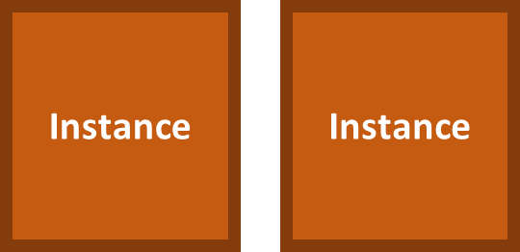
scale up
Instance
Instance
Instance
Instance
Instance
scale in
scale out
Instance
Instance
scale down

Slide 46
central package repository
Instance 1
Package A
1.0
Package A
1.0
Package B
2.5
provision
Package B
2.5
Package A
1.1
Package B
2.6
Instance 2
provision
Package A
1.1
time
Package B
2.6.1
Package B
2.6.1
Package B
2.7
Package A
1.2
Instance 3
provision
Package A
1.2
Package B
2.8
Package B
2.8

Slide 47
central package repository
Instance 1
create
image
Image 1
launch
instance
Package A
1.0
Package A
1.0
Package A
1.0
Package B
2.5
Package B
2.5
Package B
2.5
Package A
1.1
launch
instance
Package B
2.6
Instance 2
Package A
1.0
time
Package B
2.6.1
Package B
2.5
Package B
2.7
Package A
1.2
Package B
2.8

Slide 48
central package repository
Instance 1
create
image
Image 1
launch
instance
Package A
1.0
Package A
1.0
Package A
1.0
Package B
2.5
Package B
2.5
Package B
2.5
Package A
1.1
launch
instance
Package B
2.6
Instance 2
Package A
1.0
time
Package B
2.6.1
Package B
2.5
Package B
2.7
Package A
1.2
Instance 2
update
Instance 2
Package B
2.8
Package A
1.2
Package B
2.8

Slide 49
SSH

Slide 50

central package repository
Instance 1
create
image
Image 1
launch
instance
Package A
1.0
Package A
1.0
Package A
1.0
Package B
2.5
Package B
2.5
Package B
2.5
Package A
1.1
launch
instance
Package B
2.6
Instance 2
Package A
1.0
time
Package B
2.6.1
Package B
2.5
Package B
2.7
Package A
1.2
Image 2
create
image
launch
instance
Instance 3
Package A
1.2
Package A
1.2
Package B
2.8
Package B
2.8
Package B
2.8

Slide 51






