Slide 1
Polymorphic Graph Classifier
Preliminary Theoretical and Practical Underpinnings
Alexander Bikeyev
2025-05-24

Slide 2
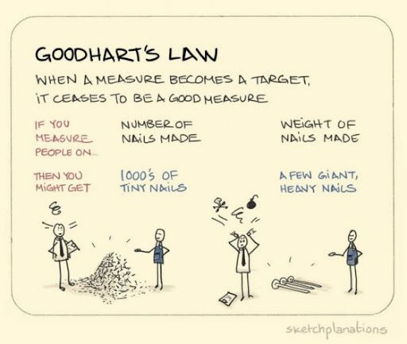
theory
benchmarks

Slide 3
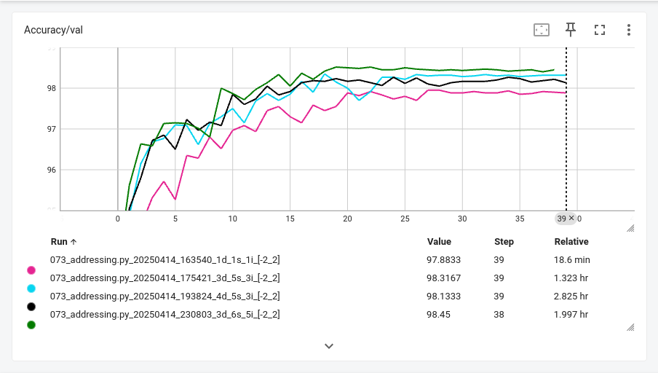
Origins

Slide 4
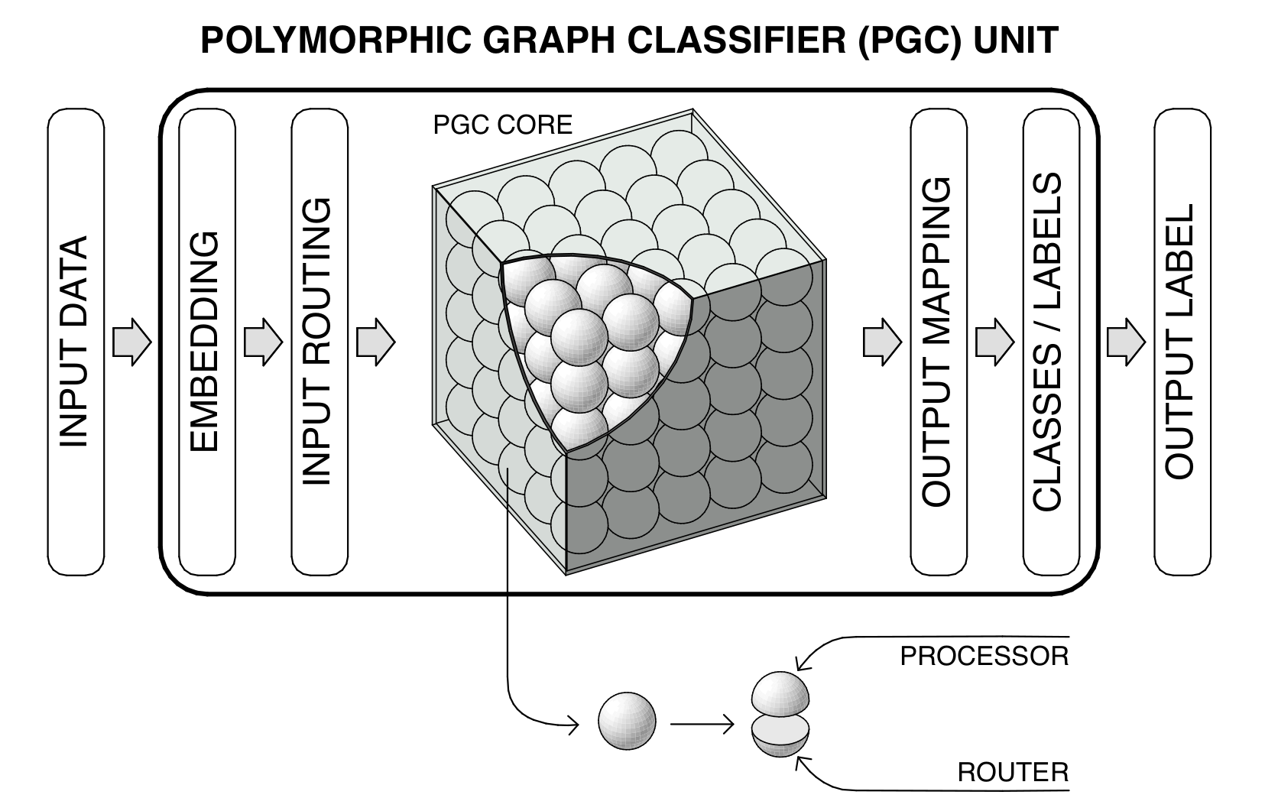

Slide 5
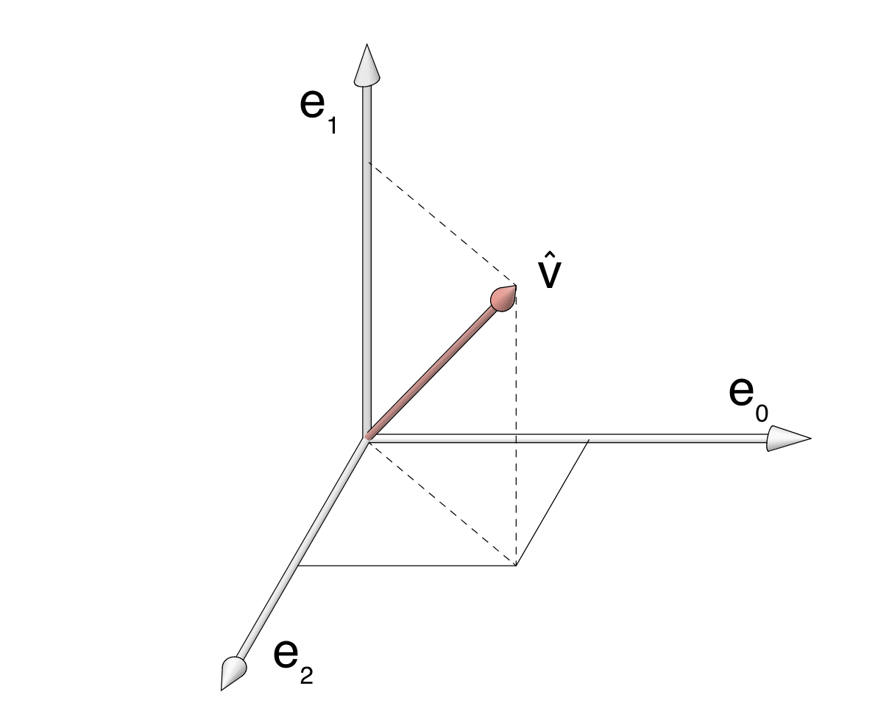

Slide 6
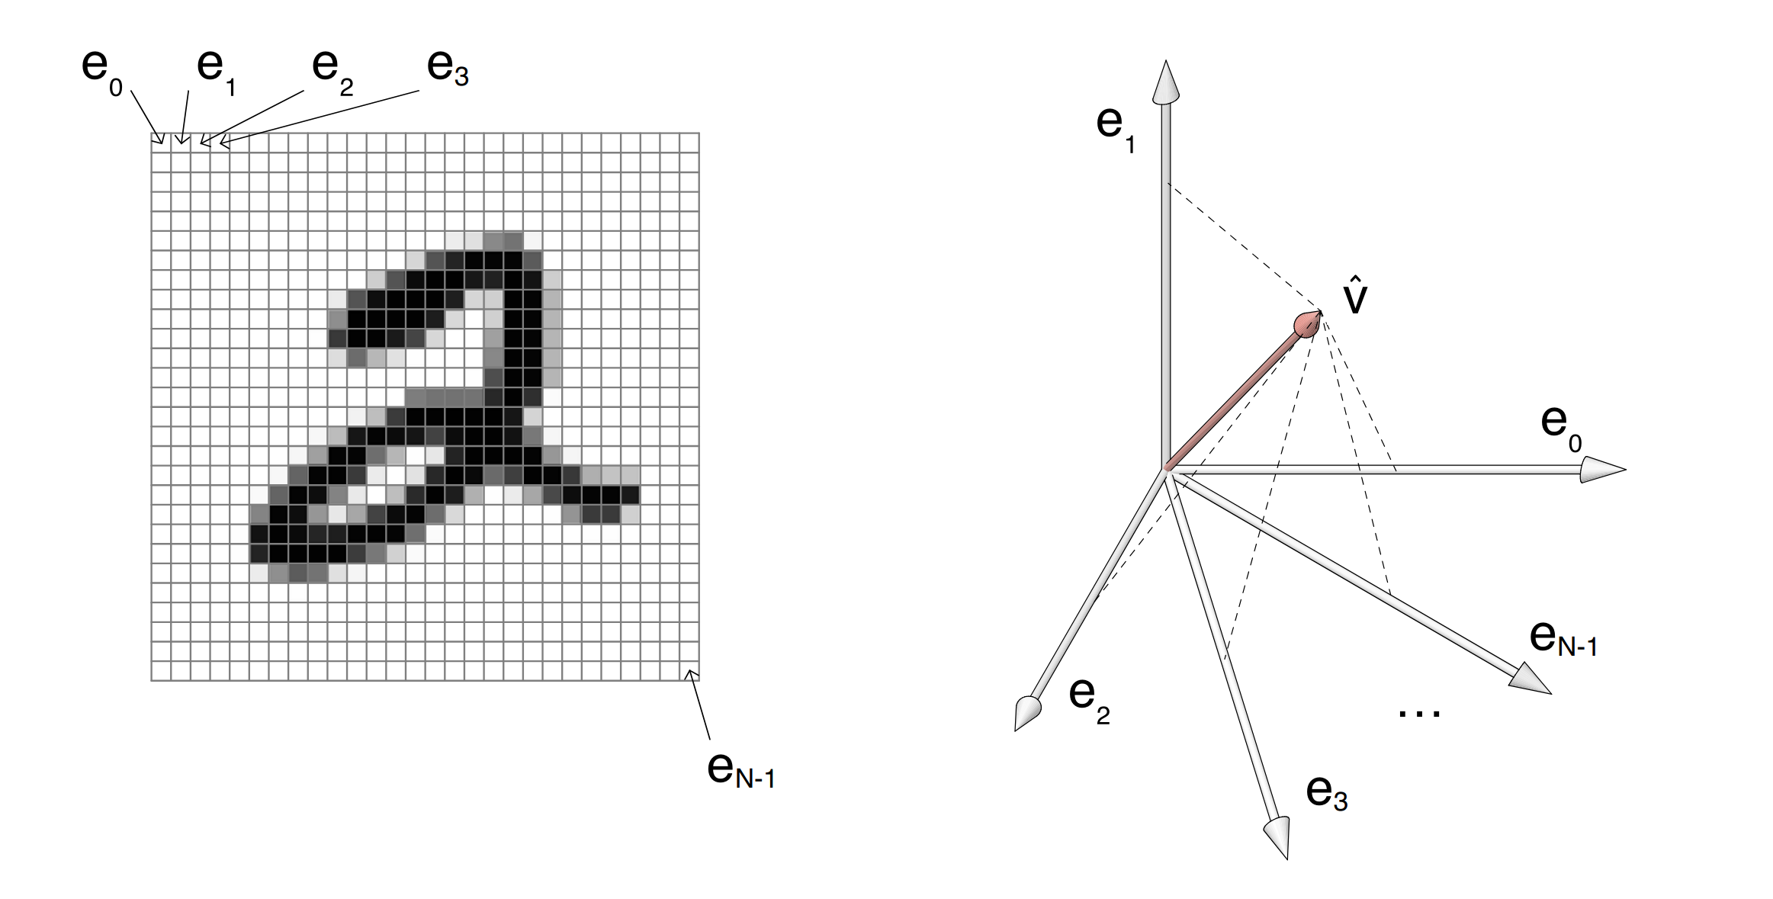

Slide 7
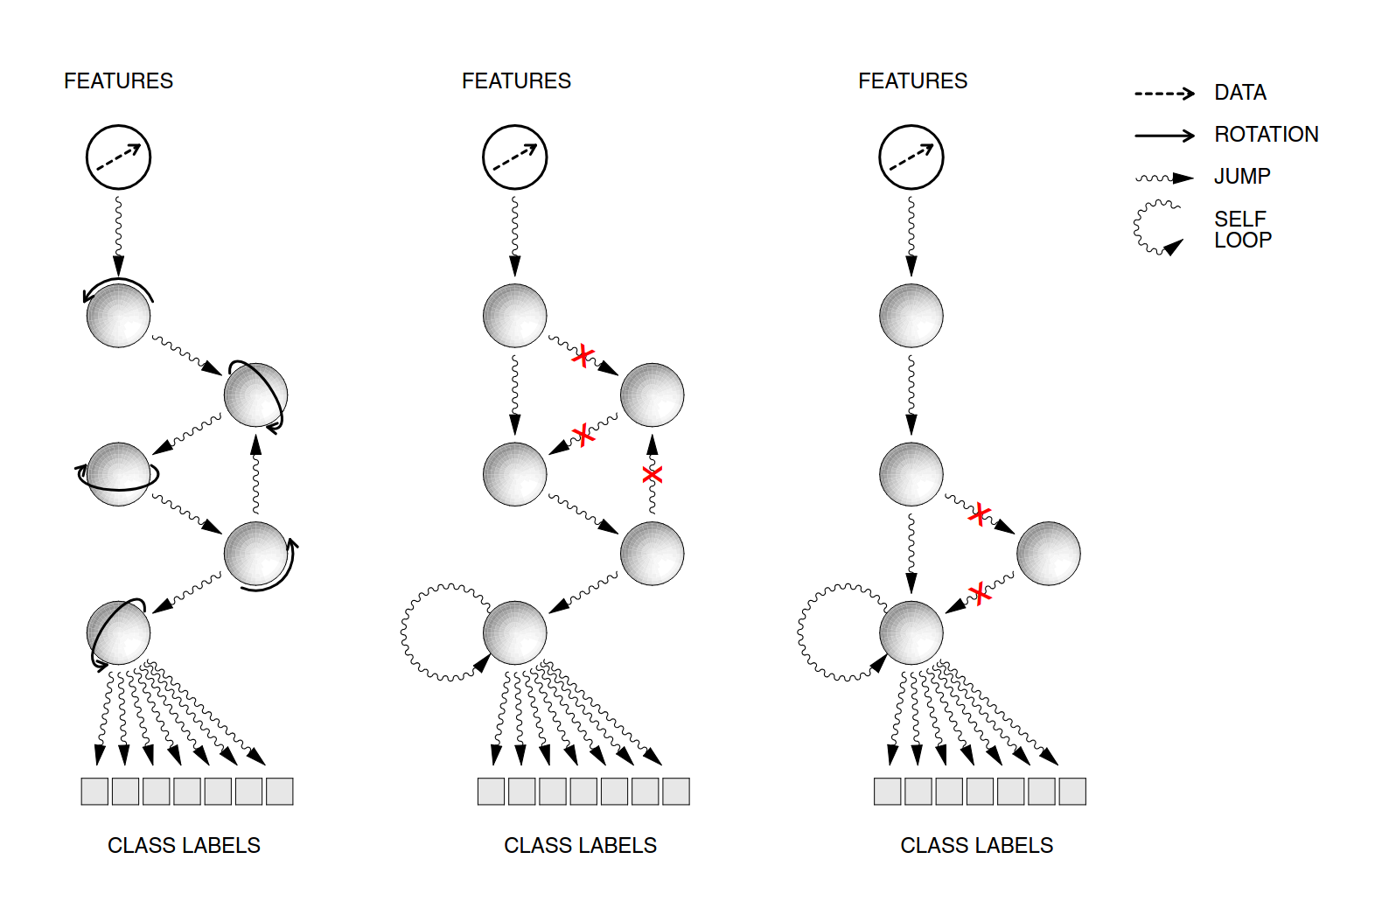

Slide 8
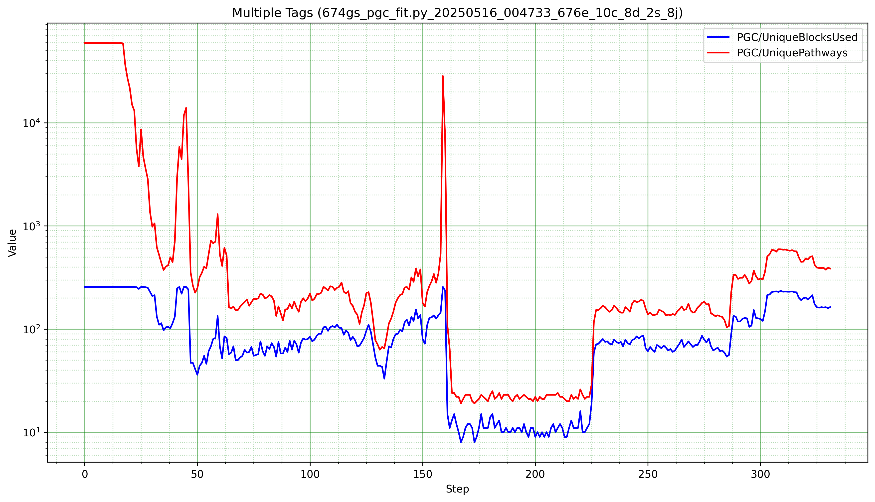
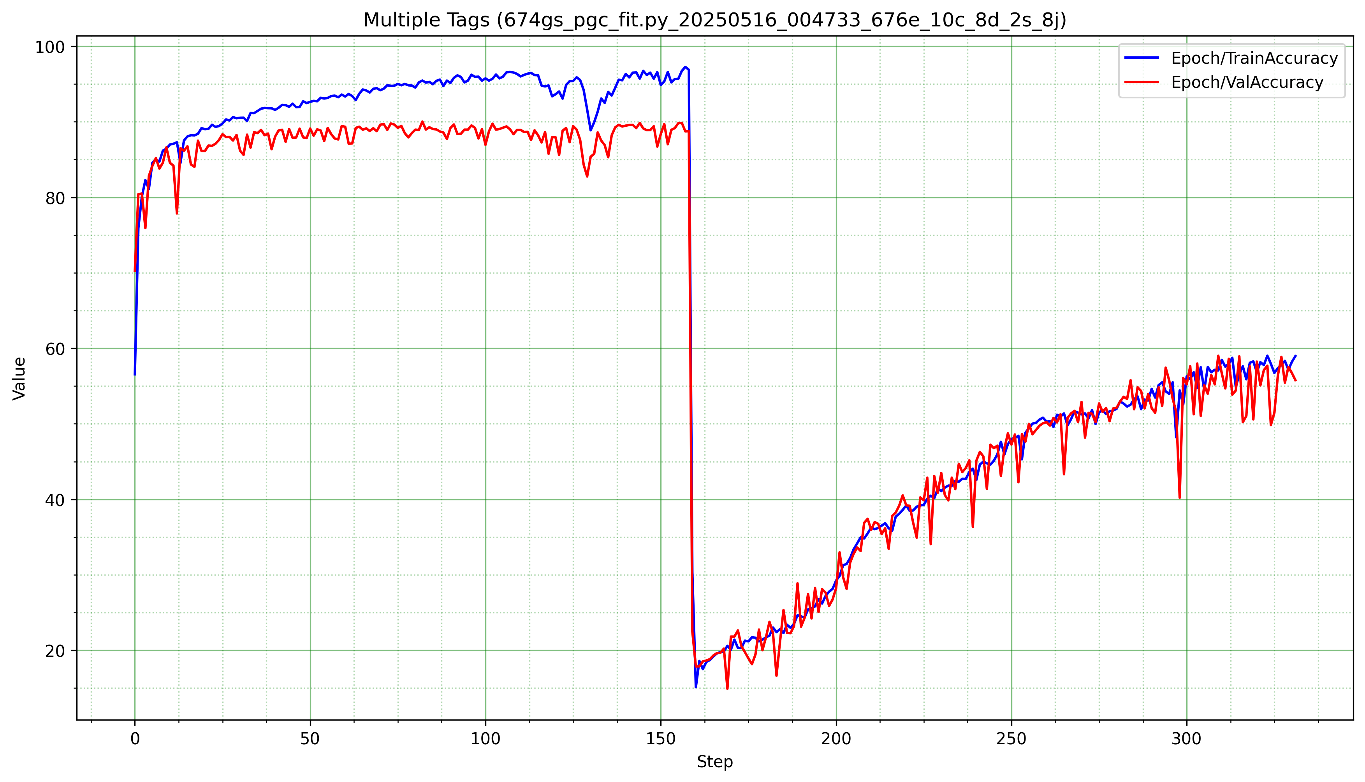
MNIST FASHION – PGC SMALL
ResNet Collapse

Slide 9
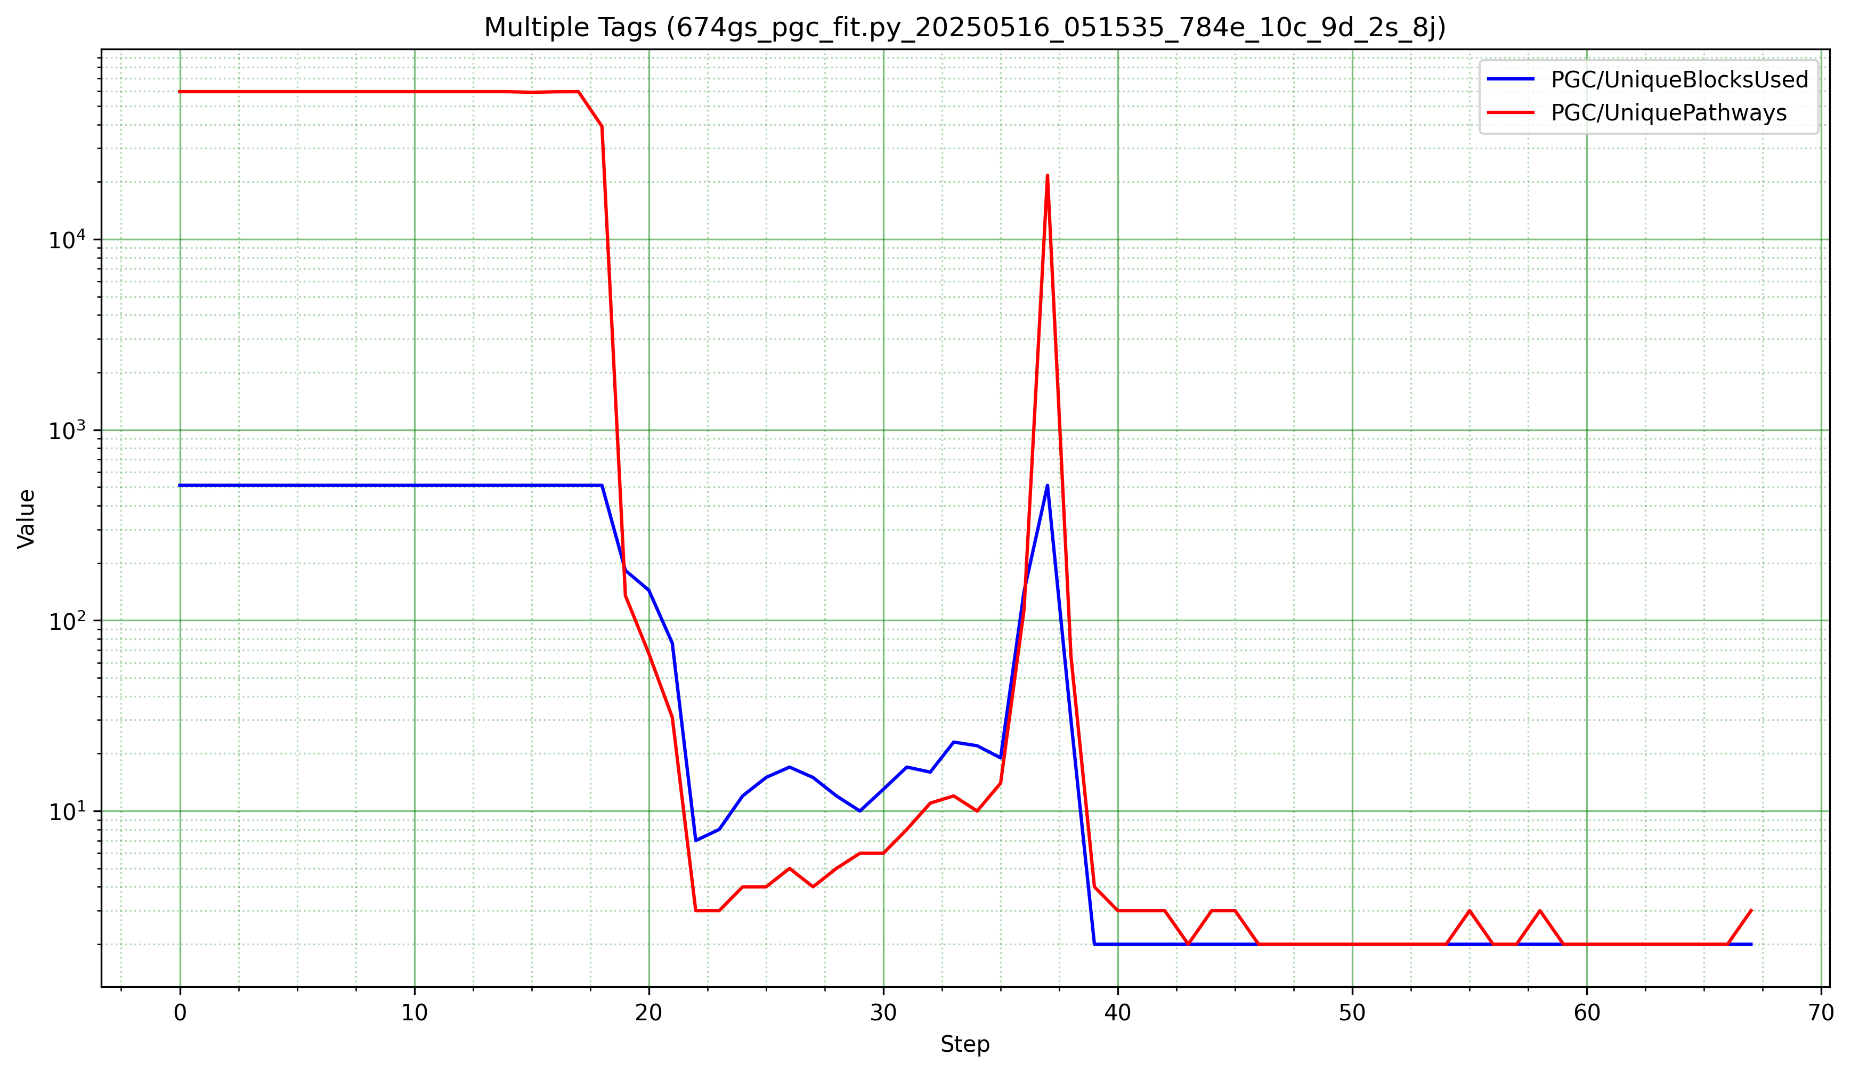
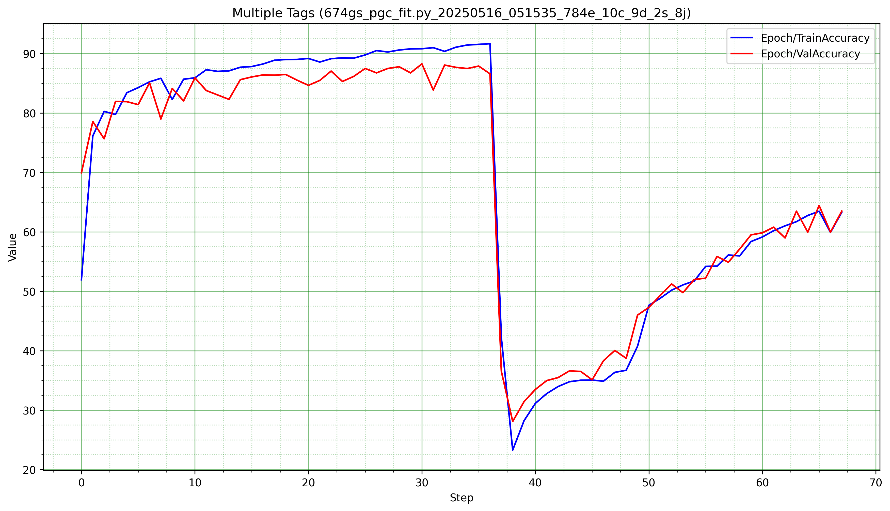
MNIST FASHION – PGC LARGE
ResNet Collapse

Slide 10
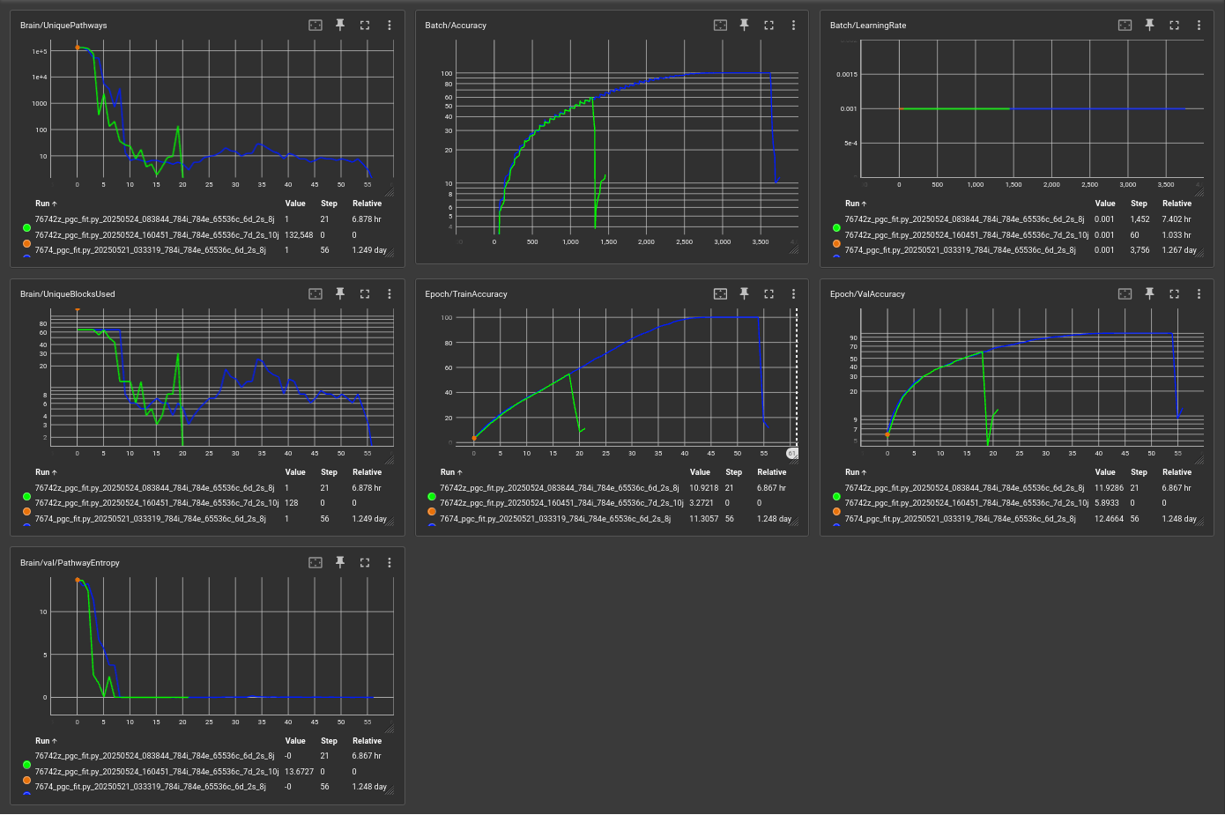
ResNet Collapse
Go Rin No Sho

Slide 11
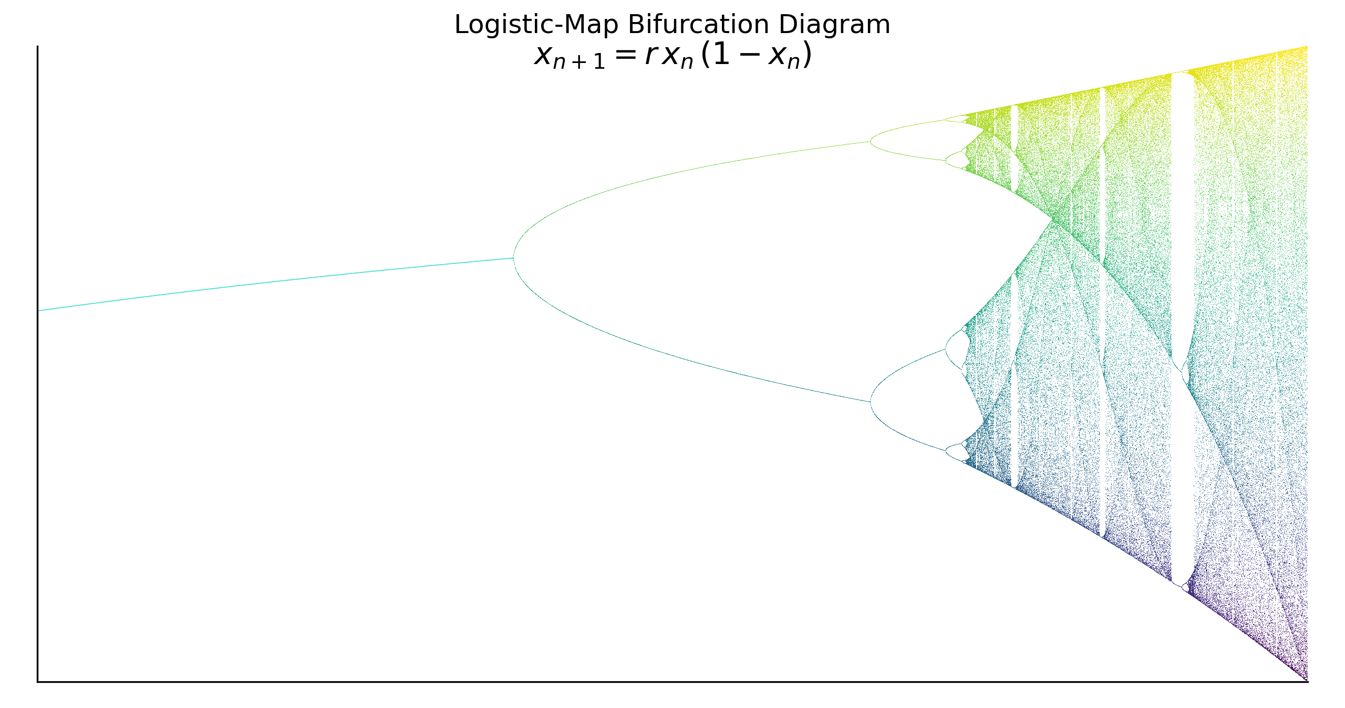

Slide 13
This work is licensed under a Creative Commons Attribution-ShareAlike 3.0 Unported License.
It makes use of the works of Mateus Machado Luna.

