Slide 1

Infrastructure as Code
Build your cloud infrastructure with Azure Bicep

Slide 2





About Christoph
Guy from Magdeburg, Germany
Cloud Architect & Senior Consultant @SoftwareOne
Web Developer -> SharePoint Consultant -> Cloud Consultant
Specialized in Azure Networking, IaC & Governance
To be found on Twitter 𝕏 as: @CloudChristoph
Sometimes blogs: christoph.vollmann.co

Slide 3
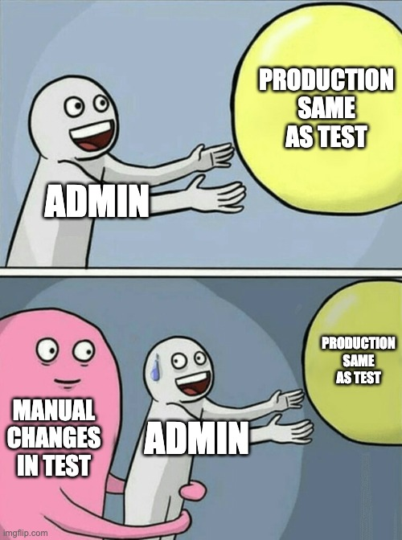
Agenda
What is Infrastructure as Code (IaC) Introducing Azure Bicep & Benefits Get started with Azure Bicep Parameterization & Modularization Source Control & Pipelines Best practices for Azure Bicep
Notes:
- Was ist Infrastructure as Code (IaC): Eine kurze Einführung in das Konzept von Infrastructure as Code und warum es wichtig ist.
- Einführung in Azure Bicep und dessen Vorteile: Was ist Azure Bicep, was sind Vorteile und Features die Azure Bicep bietet und wie kann ich starten.
- Erste Schritte mit Azure Bicep: Eine Demonstration, wie man ein einfaches Bicep-Projekt einrichtet und Komponenten implementiert.
- Parametrisierung: Wie rolle ich Komponenten standardisiert und mehrfach in meiner Umgebung aus.
- Best Practices für Azure Bicep: Praktische Tipps und Tricks für die Arbeit mit Bicep.
- Fragen und Antworten

Slide 4
What is Infrastructure as Code?
Infrastructure resource provisioning process
similar to the deployment of software
Possible resources:
Virtual machines, virtual networks, web applications, databases, permissions, policies, etc.
Can be combined with software deployment
Essential for DevOps

Slide 5
Benefits of Infrastructure as Code?
Repeatable Deployments
Reusable Components
Uniform Environments
Documented Changes
Recoverability
Increased efficiency

Slide 6
Imperative vs. Declarative

Slide 7

What is Azure Bicep?
Domain Specific Language (DSL) for declarative provisioning of Azure resources
Released: August 2020
Goals: Simplify template creation with clear syntax, type safety and module support
Automatic dependencies and orders
Free, open-source, platform-independent, Microsoft-supported
Alternatives: Terraform, Pulumi

Slide 8
Bicep Tooling
Visual Studio Code
Azure Bicep Extension
Bicep Binaries
PowerShell + Az Module or Azure CLI
Git Repositories
Pipelines

Slide 9

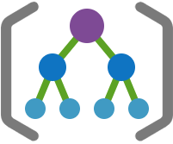



Structure in Azure
Azure AD / Tenant
Management Groups
Subscriptions
Resource Groups
Resources

Slide 10

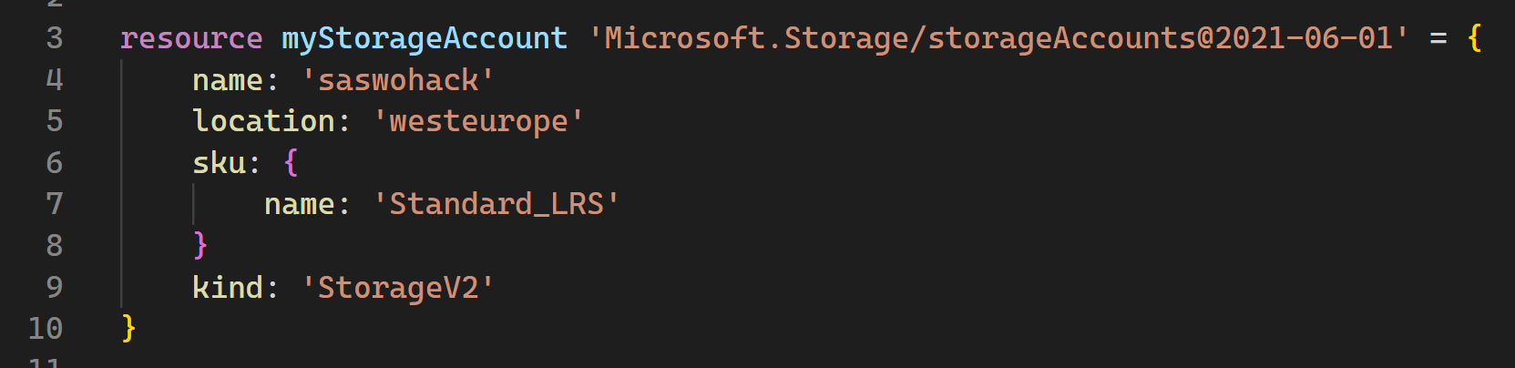
Bicep Resource

Slide 11
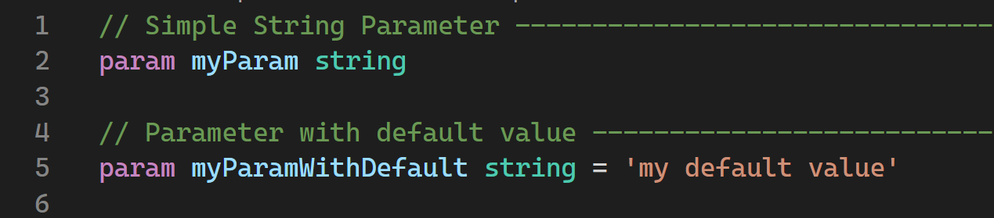
Parameters and variables

Slide 12
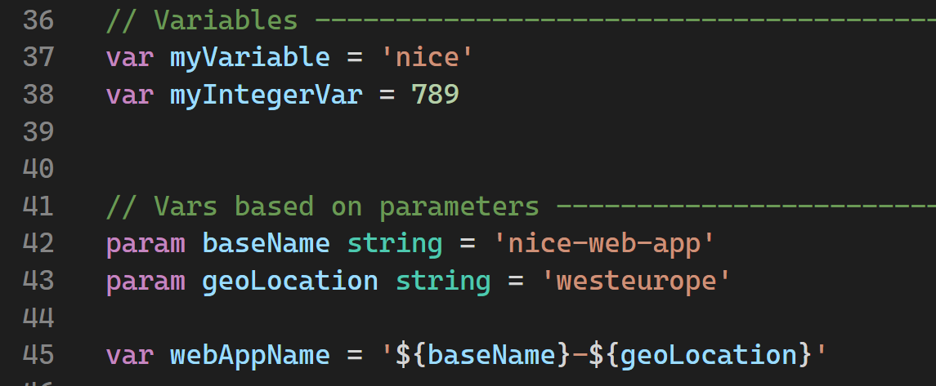

Slide 13
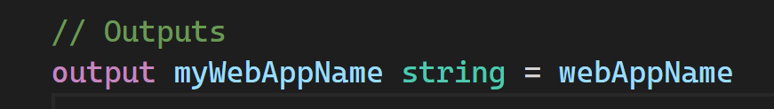
Outputs

Slide 14
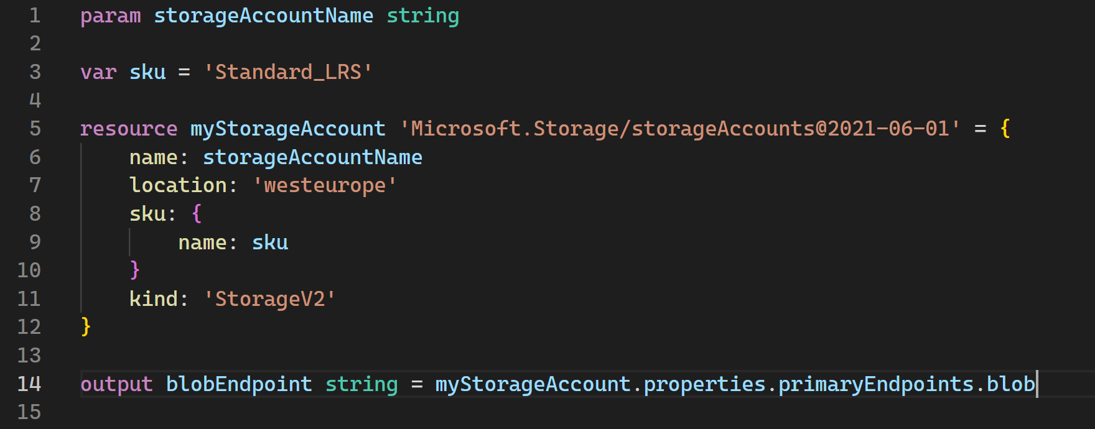
References

Slide 15
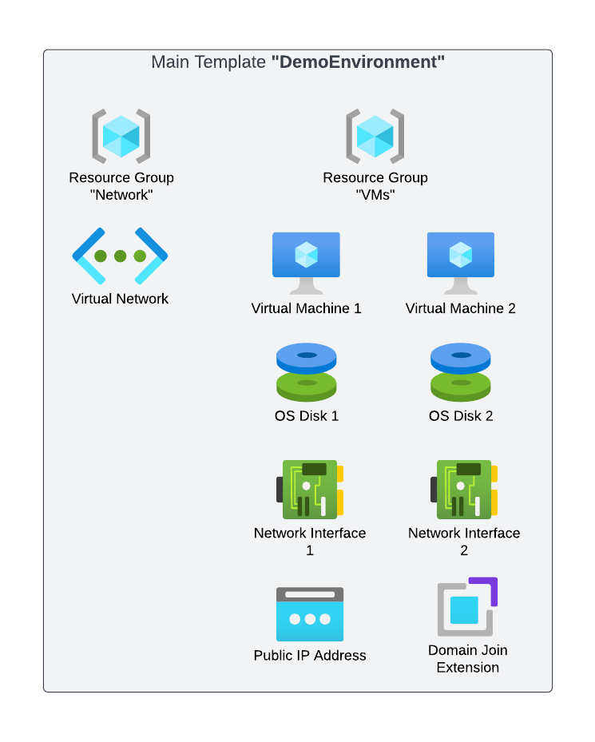
Module

Slide 16
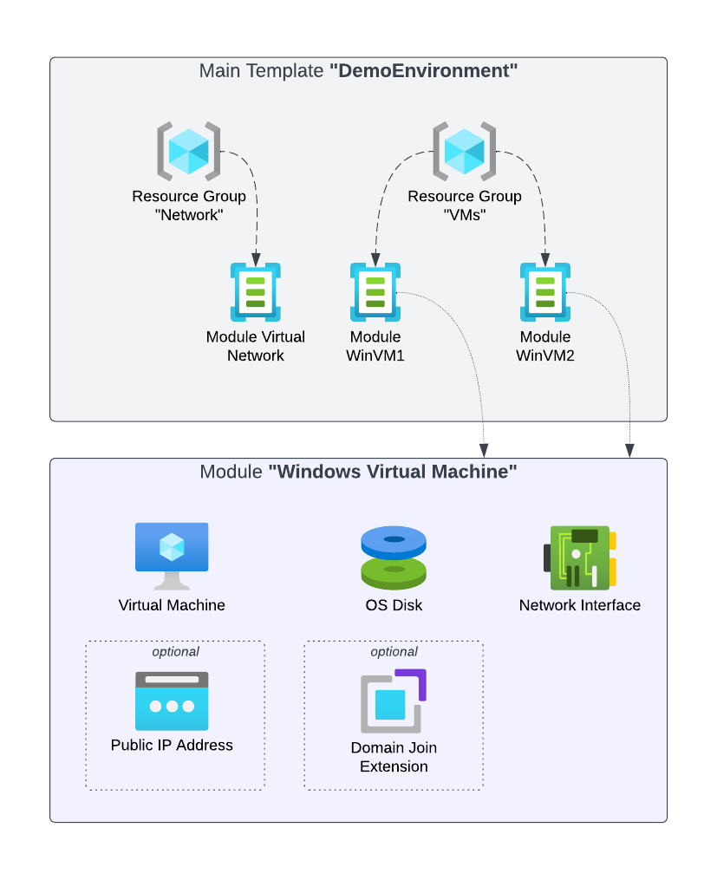
Module

Slide 17
Functions, conditions, loops, dependencies

Slide 18
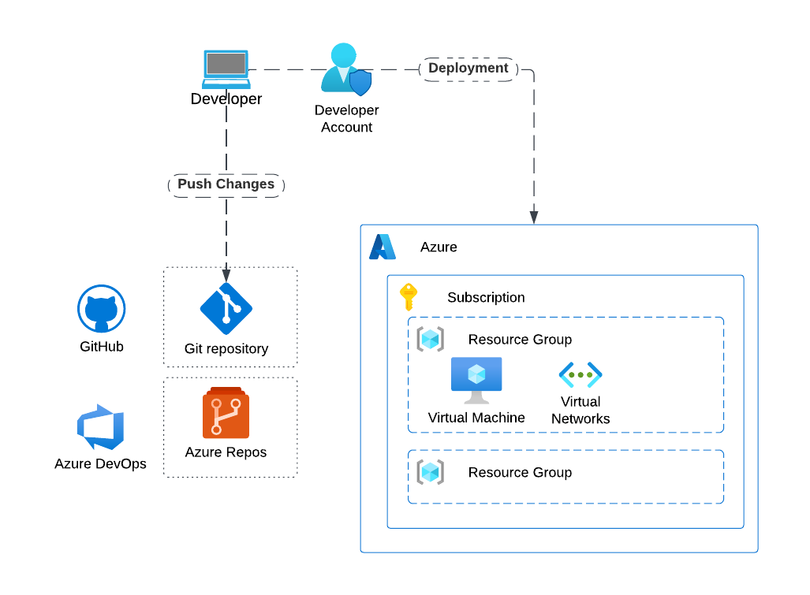
Source Control

Slide 19
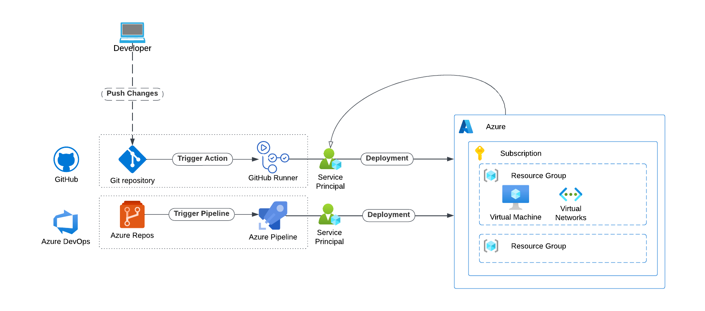
Source Control & Pipelines

Slide 20
Tips and Tricks
What-if Deployments
T-Shirt Sizes for Resources Not defining all possible parameters Naming: Use variables Secrets belong in a Key Vault Organize modules by resource namespace No "Premature Optimization" (YAGNI)

Slide 21

Thank you!
Wanna connect?
Twitter / 𝕏 : @CloudChristoph
Bluesky: @cloudchristoph.bsky.social
Find me on LinkedIn: Christoph Vollmann
On the web: christoph.vollmann.co

