Slide 1
SELF LEARNING
SELF LEARNING VIDEOS

Slide 2
START
Welcome to Self-Learning Video
I am Kunal Saxena and am back with one more video.
Learning - Problem
Today We are going to LEARN new thing

Slide 3
PROBLEM / LEARNING
Automation Framework Design.
Github Location: https://github.com/cloudclaritie/FrameworkDesign

Slide 4
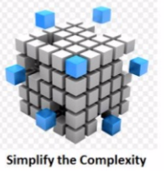
THEORY
Creating automation suite is different than implementing an automation framework for your product
Good Framework Designing means your task are independent.
Coding of cases is kept separate and handling logging and reporting is implemented separately.

Slide 5
Types of Automation Framework
Custom Framework
Keyword Driven Framework
Data Driven Framework
Linear Framework
Modular Framework
Hybrid Framework

Slide 6

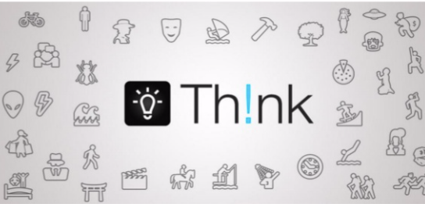

Framework Design Considerations
1. Type of Framework
2. Data Management
6. Reporting
7. Logging
3. Integration of tools and scripts
4. Configuration Parameters
5. Generic Modules

Slide 7
Points to consider
Easy to learn and easy to execute
Easy to add new Features / Product.
Easy to increase / decrease number of cases in regression.
Easy to maintain Input data for different products.
Good Logging for each test case.
Reporting to Stakeholder at each milestone.
Scaling of your automation suite.
Easy to Increase / decrease number of system.
Can plugin script to check performance stats and Accuracy Stats
Dynamically setup, automation environment in new machine
Proper documentation of Automation Suite

Slide 8
THANK YOU
--KUNAL SAXENA
Github Location: https://github.com/cloudclaritie/FrameworkDesign

Slide 9
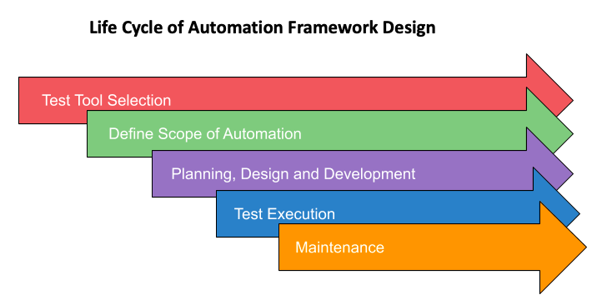
LifeCycle ....

Slide 10
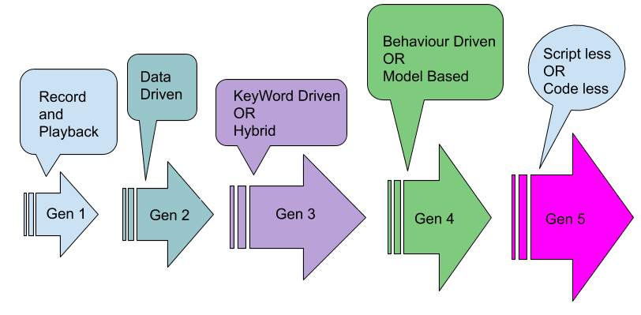
Generations of Automation

