Slide 1
SELF LEARNING
SELF LEARNING VIDEOS

Slide 2
START
Welcome to Self-Learning Video
I am Kunal Saxena and I am back with one more video.
Learning - Problem
Today We are going to LEARN about DevOps

Slide 3
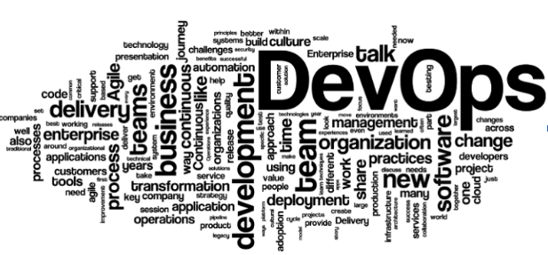
DevOps

Slide 4
LEARNING
DevOps:
DevOps is a culture, movement or practice that emphasizes the collaboration and communication between Development and Operations. It aims at establishing a culture and environment where building, testing, and releasing software, can happen rapidly, frequently, and more reliably.
DevOps is about identifying friction and resolving it.
DevOps is about using tool to reduce complexity
DevOps is about collaboration
DevOps is about automating task

Slide 5
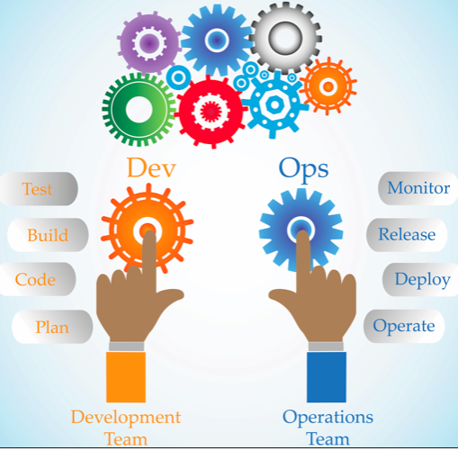
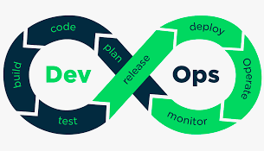
Theory
Step 1: Plan
Get Requirement, Plan your task using some tool
Step 2: Code
Use source code management tool for version control and repository
Step 3: Build
Software you will use to build your code ...
Step 4: Test
Tool you will use to conduct various test. Unit, Integeraton, System Functional, Load
Step 5: Release
Manage Release of software for deployment. Save it in artifacts repository
Step 6: Deploy
Deploy your software on single or multiple server using some deployment tool
Step 7: Operate
Manage deployment and configuration
Step 8: Monitor
continous monitoring of all applications, servers and network

Slide 6
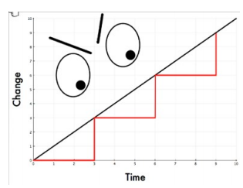
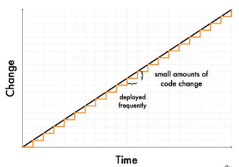
Release Frequently
Frequent release will give fast feedback to the development team, which in turns helps in better quality of the product.
6 months for 1 release having 100 changes
1 week for 1 release having 10 changes

Slide 7
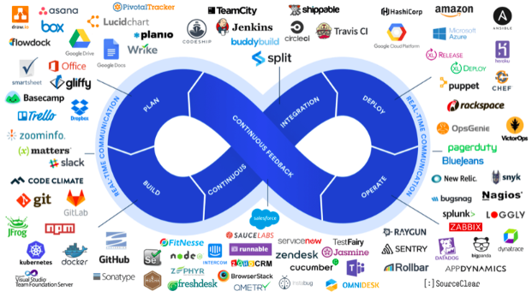
Tools in DevOps

Slide 8
































List of Few Tools for DevOps
Code
Build
Test
Release
Deploy
Monitor

Slide 9
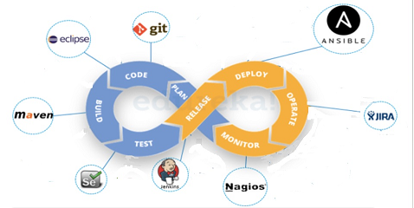
Example of DevOps Tools
We are working on GUI based java project, having 10 servers on staging and 10 servers on production.
Use tool for versioning and saving code.
Monitor your production server continously to give feedback back to development team .

Slide 10
What is DevOps
DevOps is …
… learning to work in small batches
… creating fast feedback loops
… enabling cross-functional collaboration
… continually working to remove waste and make things better
… keep automating redundant task to pace up the process of deployment
… Implement different tools at different stage to ease complexity

Slide 11
Finally … Who is DevOps Engineer?
DevOps Engineer is …
⇒ Person who is aware of source code management tool e.g git / bitbucket
⇒ Aware of Cloud Service Provider e.g AWS / Azure / Google Cloud
⇒ Knowledge continuous testing tools e.g Selenium / pytest
⇒ Hands-on continuous integration tool e.g Jenkins / Bamboo
⇒ Knowledge of Orchestration tool e.g Ansible / Chef / puppet / Juju
⇒ Knowledge of software containerization e.g. docker OR kubernetes
⇒ Must know Logging and Monitoring tools e.g. Splunk, Nagios

Slide 12
Future Plan
This is the introduction of DevOps and Tools we can use for Devops
Going Forward, I will share hands-on session with different tools of DevOps.
Stay Tuned with my Channel
Thank you

Slide 13
THANK YOU
--KUNAL SAXENA
Github Location: https://github.com/cloudclaritie/DevOps

Slide 14
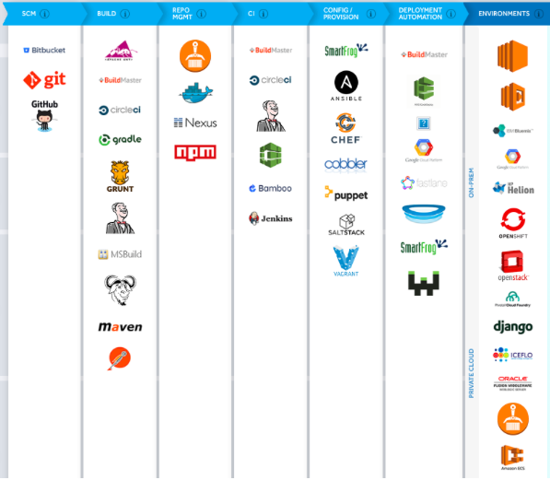
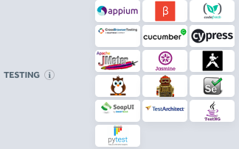
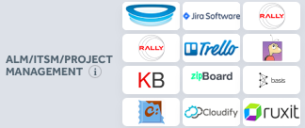



Tools in DevOps

