Slide 1
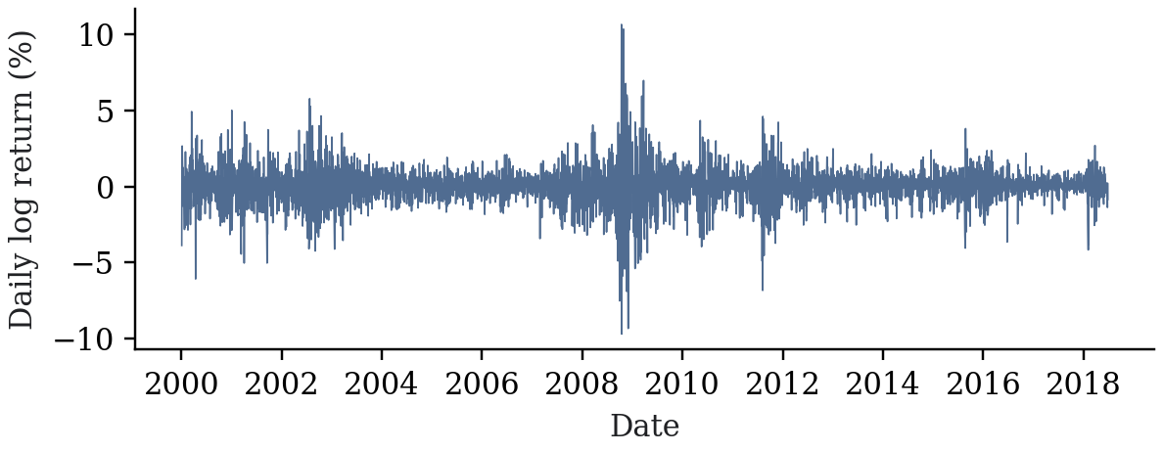
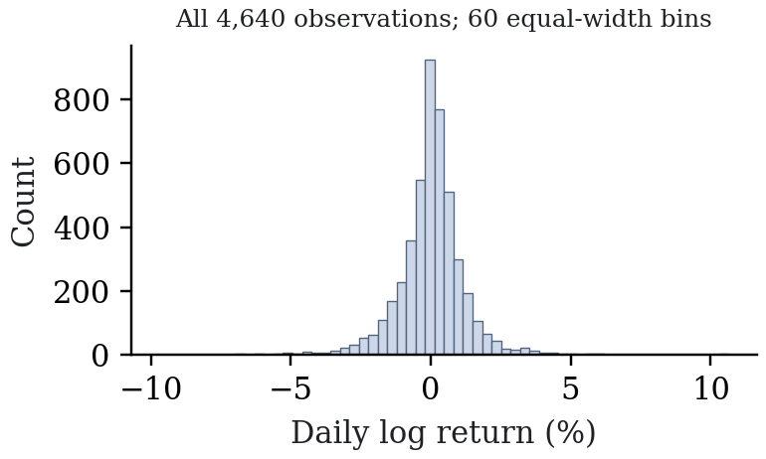
One-day SPY quantile forecasting
(a) Observed data
(b) Empirical return distribution
(c) Chronological estimation
Forecast target: day t
Training
Validation
t
Past observations only; roll forward one day
(d) Implemented model families and shared evaluation
Statistical baselines
Ordinary / weighted / KDE HS
GARCH-t · GJR-GARCH-t
SPY snapshot
4,640 trading observations
log_ret · rv5 · bv
Shared target dates
Coverage /
independence
Pinball loss
Fit diagnostics
Three ordered quantiles
q₀.₀₁,t ≤ q₀.₀₅,t ≤ q₀.₁₀,t
GARCH anchor → C2
Neural quantile models
MLP · C2 anchored correction
PatchTST-inspired Transformer
Data: 2000-01-04–2018-06-27 · horizon: one trading day · α ∈ {0.01, 0.05, 0.10}

Slide 2
Conservative GARCH-anchored neural correction (C2)
(a) Observed feature vector
(b) Dense correction network
One-step GARCH-t anchor
Lagged returns and
rolling statistics
10 features
Raw correction gθ(x)
3 outputs
Lagged rv5 and bv
4 features
GARCH quantiles + σ
4 features
18
64
32
3
s · softplus(gθ(x))
s = 1; nonnegative
Subtract from
GARCH quantiles
18 → 64 → 32 → 3
18 inputs; training-only standardization
ReLU · dropout 0.1 after first hidden layer
Circles represent dense layers; widths are exact
Sort across α
Final return quantiles
q̂^{C2}_{α,t} = sort_{α} [ q̂^{GARCH}_{α,t} − s · softplus(g_{θ}(x))_{α} ]
Training: mean pinball loss over α = 0.01, 0.05, 0.10; chronological early stopping
Implemented project model; inherited regularization was selected after inspecting historical test results

Slide 3
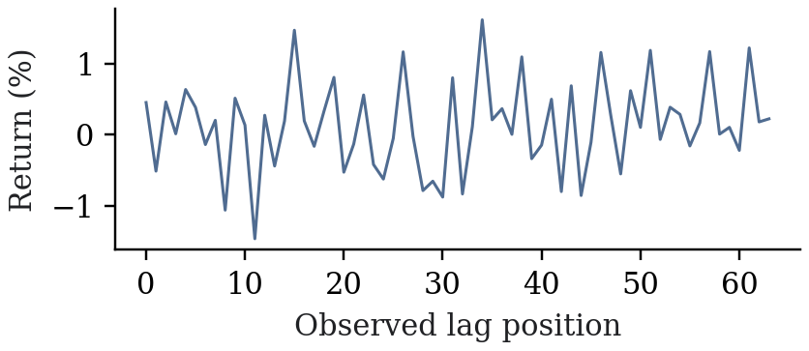
Patch-based Transformer for one-day return quantiles
Project-specific adaptation inspired by PatchTST (Nie et al., ICLR 2023)
(a) Input: 64 observed log returns
Reversible per-window
normalization
(no learnable affine)
Patch tokenization
length 16 · stride 8
7 overlapping patches
Linear projection
+ learned position
7 tokens · width 32
Transformer encoder
2 layers · 4 heads
FFN 64 · dropout 0.1
One return channel; no future data
q₀.₀₁,t, q₀.₀₅,t, q₀.₁₀,t
Inverse normalization
+ quantile sorting
Flatten 7 × 32
Linear 224 → 3
(b) Native patch representation
(c) Quantile objective and chronological validation
Patch overlap is structural;
no fabricated activations shown
L(θ) = mean_{α,t} ρ_{α}(r_{t} − q̂_{α,t}); ρ_{α}(u) = max(αu, (α − 1)u)
20-epoch cap · Adam 0.001 · batch 64 · 20% trailing validation · refit every 20 days
Univariate quantile adaptation; distinct from the original long-horizon point-forecasting model

Slide 4
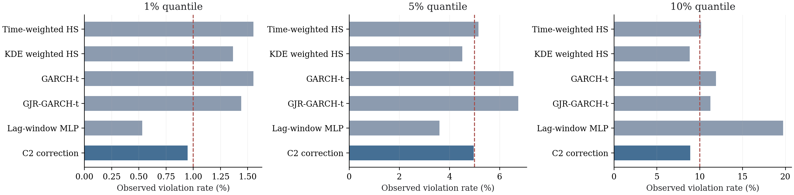
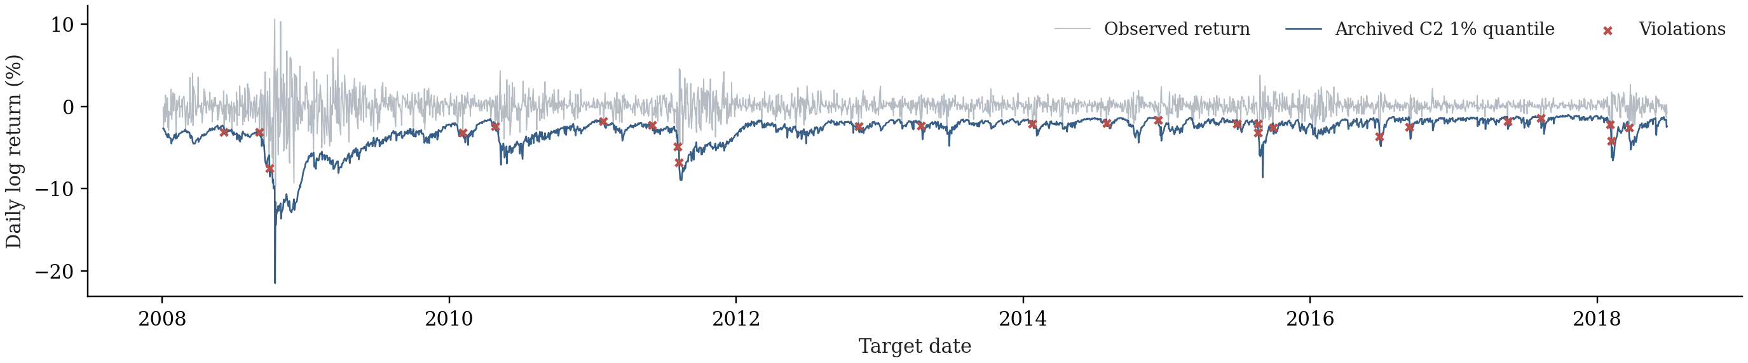
Archived forecasts on common target dates
(a) Observed violation rates; dashed lines mark nominal probabilities
(b) C2 1% quantile and all observed returns on the same 2,640 dates
2008-01-03–2018-06-27 · exact archived CSVs · exploratory evidence; no superiority claim

