Slide 1
Stream data processing on resource constrained devices
Presented by Alireza Nazari

Slide 2
Introduction
With the ever increasing amount of data that needs to be collected from IoT data sources, it becomes more and more expensive to simply stream all the data to a cloud-side data processing platform
Depending on specific scenarios, it may be beneficial to (pre-)process the data as close to its source as possible.
there are limitations on how powerful computing resources are available near the data sources.
The goal of this presentation is to evaluate existing solutions for streaming data processing which allow performing part of the data processing nearer to the source
give an overview of their usability, advantages and disadvantages and analyse their effectiveness in comparison to more classical stream data processing frameworks such as Apache Spark or Storm.

Slide 3
Introduction(cont’d)
Automated IoT devices lead the improvement of factory operational efficiency.
They helped to reduce operational time and personnel expenses, and helped to increase operational accuracy.
Their jobs include prediction of operation failure and anomaly detection to avert factory downtime.
If stream data, which is generated by machines in the factory, can be processed faster than before, the downtime could be shorter and prediction could be made earlier.
To make stream data processing time shorter, performing it close to the machine could be a good approach.

Slide 4
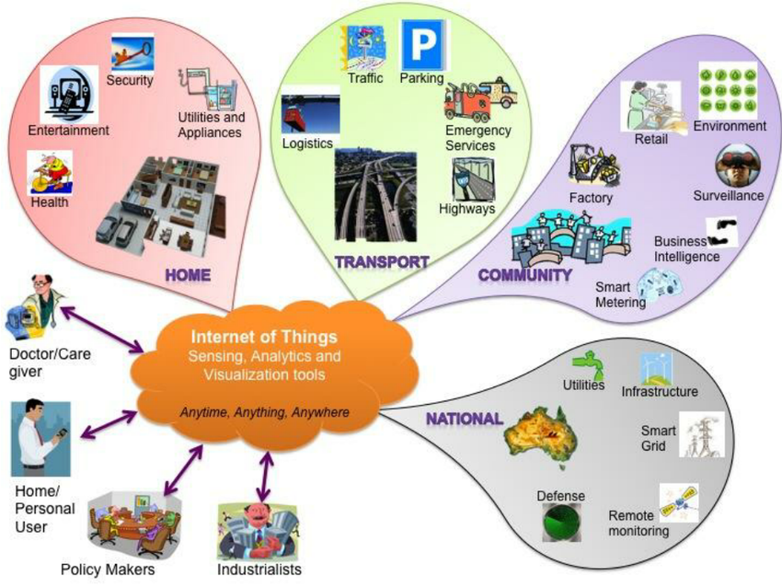

Slide 5
Introduction(cont’d)
If an IoT device is smart enough to process data, it can obtain meaningful information by processing data by itself.
We can also use another machine to collect data from small sensors, and process the data to make decision.
We address this type of data processing which is performed at the machines as “Edge Computing”. “Edge” originally meant the edge of the network.
If data processing can be performed without being transmitted to the cloud or another storage, it would be done faster.
“Edge” devices usually have lower hardware capacity than “Server”,

Slide 6
Introduction(cont’d)
We wanted to know which data processing engine can be used for edge devices.
We selected three representative engines: Apache Flink, Apache Storm and Apache Spark streaming.
We installed them on the Raspberry Pi 3 and evaluated their latencies and throughputs.
The conclusion is that Apache Flink and Apache Spark Streaming showed competing results in all tests while Apache Storm showed worse performance than the others.
It required more memory resources to execute its basic components, and this caused its long warming up time to perform our simple algorithms.

Slide 7
Introduction(cont’d)
IoT application, such as self- driving of autonomous vehicle, human-machine collaborations on smart factory, might require very short response time to control the device and avoid the dangerous situation.
Devices that generate data are increasing exponentially, all the data could not be processed nor stored because it is treated as useless unless being processed at the time it has produced.
The analysis using the cloud could not guarantee the real-time data processing because it depends on network status and amount of data in its storage.

Slide 8
Introduction(cont’d)
To process the data produced by machines in real-time, such devices on the edge of the network which are attached and connected closely to those machines are being recognized as the most proper place
Data generated by things and machines could be processed at the point where data is produced.
Therefore, data processing engines for edge system should be able to process data in real-time and to be installed in resource constrained devices.

Slide 9
Related Work
In the industrial domain, reducing the Operating Expenses, OPEX, is the main goal.
In order to achieve this goal, several approaches such as reducing abnormal behavior counts of machines and predicting the life-time of tools are being proposed and used in the machines.
However, those approaches require the real-time data processing capabilities, and the cloud system is not recognized as the proper place to meet this requirement.
Since, the Yahoo! carried out the previous benchmark task based on the system with high performance capability such as cloud system, it is required to check whether Yahoo!’s benchmark result is still valid on the edge devices with constrained hardware capabilities in general

Slide 10
Data proccessing algorithm
Two Data Mining algorithms, “Linear Regression” and “Näıve Bayes” have been selected, with which could be used for detecting abnormal behaviors of the machines or predicting the life-time of tools being used in the machine for our experiment.
For this experimental system, we use the trained model.
The “Algorithm” component of the overall design already have the trained model, and perform the algorithm logic with input stream data and produce the result.

Slide 11
Experiment Environment
Machines in the factory to travel through the multiple network routers which leads to increment of delay time until the actual action to be taken.
Therefore, those actions should be triggered on the edge of the network which is close enough to the target machine.
There are various of type of Edge device with the various hardware capabilities to assist specific type of machines or a specific process consisted of various machines.
However, the hardware capabilities of the Edge device is much more constrained comparing to that of the cloud computing environment because most of them are for specific purpose in general.
To consider such practical environment, we decided to use the Raspberry PI 3 as the Edge device for our experiment; Raspberry PI 3 consists of ARM Quad-Core CPU and 1GB RAM.

Slide 12
Experiment Environment (cont’d)
In the figure, “Sender” creates a TCP channel and prepares for generating the stream data to send.
”Job” is a set of components which process the data that we have implemented for the benchmark.
When Job is registered on to each open-sources successfully, it attempts to connect to the Sender through the TCP channel and receives the stream data from it.
After receiving the data, it processes the data and delivers the result to the “Receiver”.
In case of factory, Sender is a machine, mostly, which is being used in manufacturing process.

Slide 13
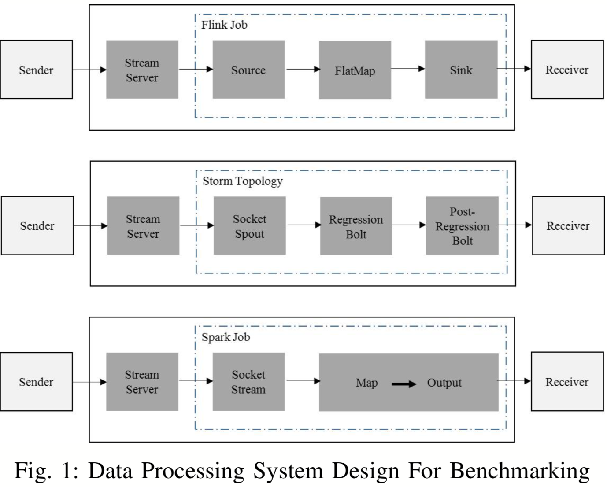

Slide 14
Performance evaluation (cont’d)
When simulating this scenario on the Raspberry Pi 3, we found that the average processing time for executing the “Linear Regression Model” in the data processing Job took less than 1ms.
Most of time for finalizing the data processing was consumed by reading received-data and processing-result delivery in the data processing engine(open-sources).
Total time consumed by Storm for processing all the delivered data was relatively bigger than that of others. This was expected result because of its architecture.
The prominent difference was found in case of real-time data streaming circumstance such as receiving one message per 1 ms or 10 ms.

Slide 15
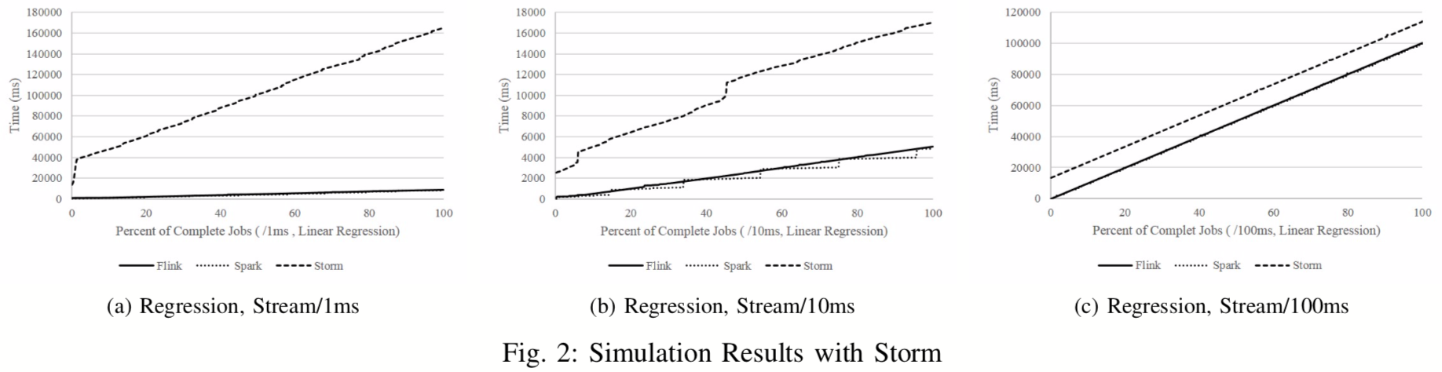

Slide 16
Performance evaluation (cont’d)
The results of data processing for all the received data with Spark Streaming and Flink were almost identical.
At some instances, Spark Streaming showed even better performance comparing to that of Flink.
The stair-like result of the Spark Streaming came from its data processing mechanism which is batch processing. Therefore, Spark-stream module loads all the received stream data until its size reaches to a certain size, and deliver such set of stream data, which is called as micro batch, to the data processing logic.
Therefore, the performance result of Spark Streaming is competing on since it has additional task before actual data processing task.
The result from this scenario shows that Storm would not be a good choice for stream data processing on the Edge System.
We excluded Storm and focused on benchmark the performance on two stream data processing engines, Spark Streaming and Flink.

Slide 17
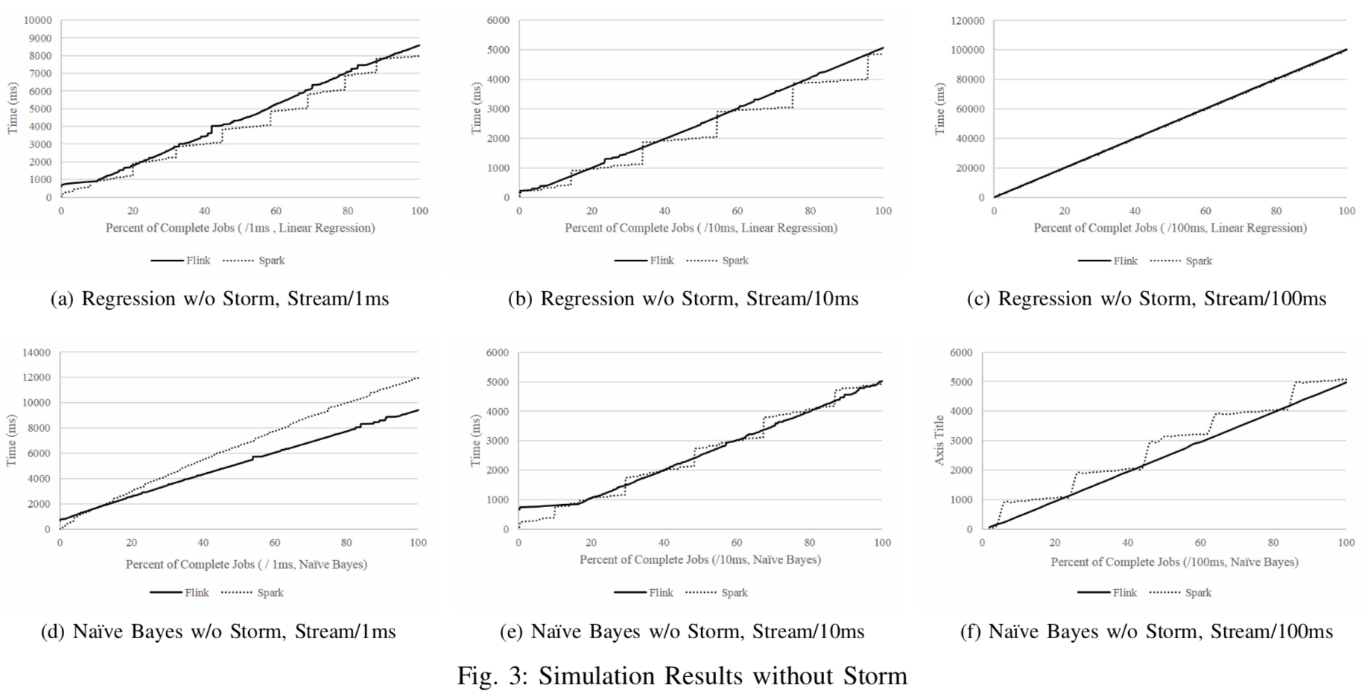

Slide 18
Performance evaluation (cont’d)
the average data processing time for executing the Na ̈ıve Bayes Model took 8ms.
And this difference influences the result of data processing performance.
The result from Flink which shows the better performance compared with that of Spark Streaming came from its data processing mechanism.
Flink separates the logic inside the job and executes them separately, therefore, the stream data reader could read the next stream data earlier than Spark Streaming does.
Even though Spark Streming showed competitive result when receiving stream data per 10 ms and 100ms, Flink would be the best choice for real-time stream data processing task, since receiving stream data in every 1ms could be general case in industrial domain.

Slide 19
Performance evaluation (cont’d)
To check whether such situation could be resolved by using the “Parallel Data Processing” capability supported by open sources, we divided a Job into 5/10 processes and distributed the stream data to them.
Spark’s performance got better when using parallel processing.

Slide 20
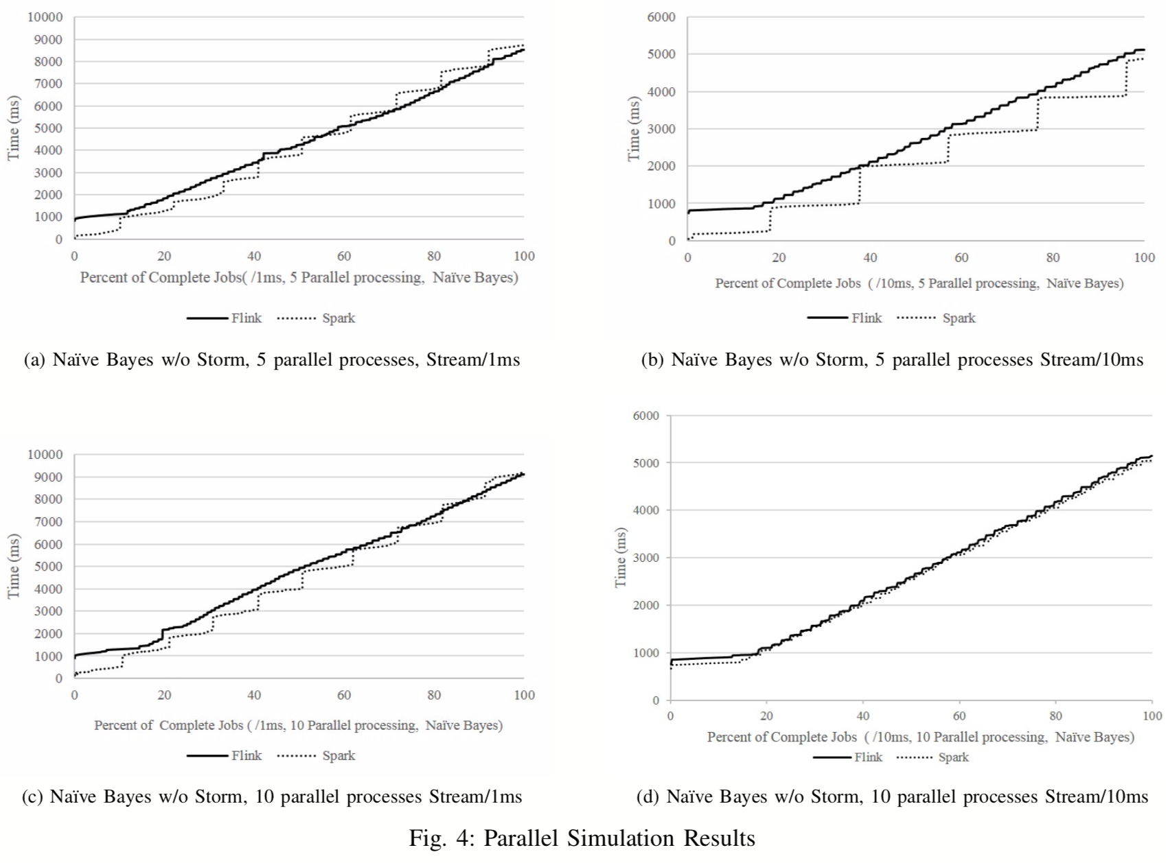

Slide 21
conclusion
According to the evaluation results of this experiment, Storm may not be appropriate stream data processing engine for resource constrained Edge device.
As mentioned in section II, Storm’s basic modules consume most of memory resource of Raspberry Pi 3 so that there is no enough memory left to perform the task.
Spark Streaming, by the way, showed competing performance through parallel processing and also executed one of our algorithms, linear regression, faster than Flink does. Fig. 3a and Fig. 3b proves that.
However, it’s hard to think up a general use-case with using parallel processing functionality for edge device which have constrained hardware capabilities.
Flink showed high performance in all experiments, leaving the performance in parallel processing aside. Overall, Spark and Flink turned out to be appropriate data processing engines for our target Edge system while Storm was busily engaged in running multiple tasks.
As a future work, we are planning to extend our experiment with Spark and Flink which includes utilizing the practical algorithms that we adapted in our factory with distributed functionality enabled on Raspberry Pi 3.

Slide 22
references
H. Lee, J. Oh, K. Kim and H. Yeon, "A data streaming performance evaluation using resource constrained edge device," 2017 International Conference on Information and Communication Technology Convergence (ICTC), Jeju, 2017, pp. 628-633. doi: 10.1109/ICTC.2017.8191055
W. Shi, J. Cao, Q. Zhang, Y. Li and L. Xu, "Edge Computing: Vision and Challenges," in IEEE Internet of Things Journal, vol. 3, no. 5, pp. 637-646, Oct. 2016. doi: 10.1109/JIOT.2016.2579198

Slide 23
Thank you for your attention

