Slide 1
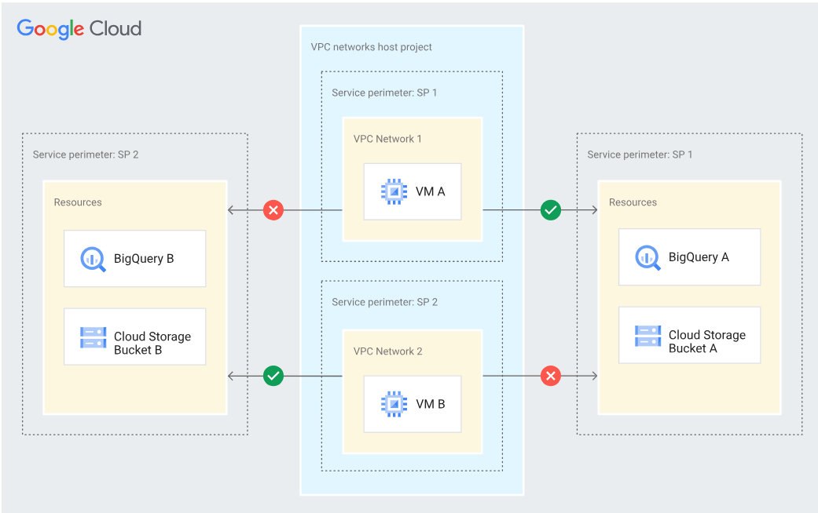
VPC Service Controls With Shared VPC
You can create separate perimeters for each of the VPC networks in your host project instead of creating a single perimeter for the entire host project.
For example, if your host project contains separate VPC networks for development, test, and production environments, you can create separate perimeters for the development, test, and production networks.
You can also allow access from a VPC network that is not inside your perimeter to resources inside your perimeter by specifying an ingress rule.

Slide 2
Rules for including VPC networks in service perimeters
If the host project is not protected by a perimeter, you can add VPC networks in the host project to separate perimeters under the same access policy.
VPC networks in the same host project must exist under the same access policy.
You can add VPC networks and their host project to the same perimeter.
VPC networks and their host project must not exist in different perimeters.
You cannot add a VPC network to multiple perimeters.
You cannot use VPC networks in a perimeter bridge.
If a VPC network's parent project is in a perimeter bridge, you cannot add the VPC network to a perimeter.

